Slide 1
Extended Range Forecast Experiment Verification
CONUS forecasts created 24 October

Slide 2
500 mb Geopotential Height | 500Z

Slide 3
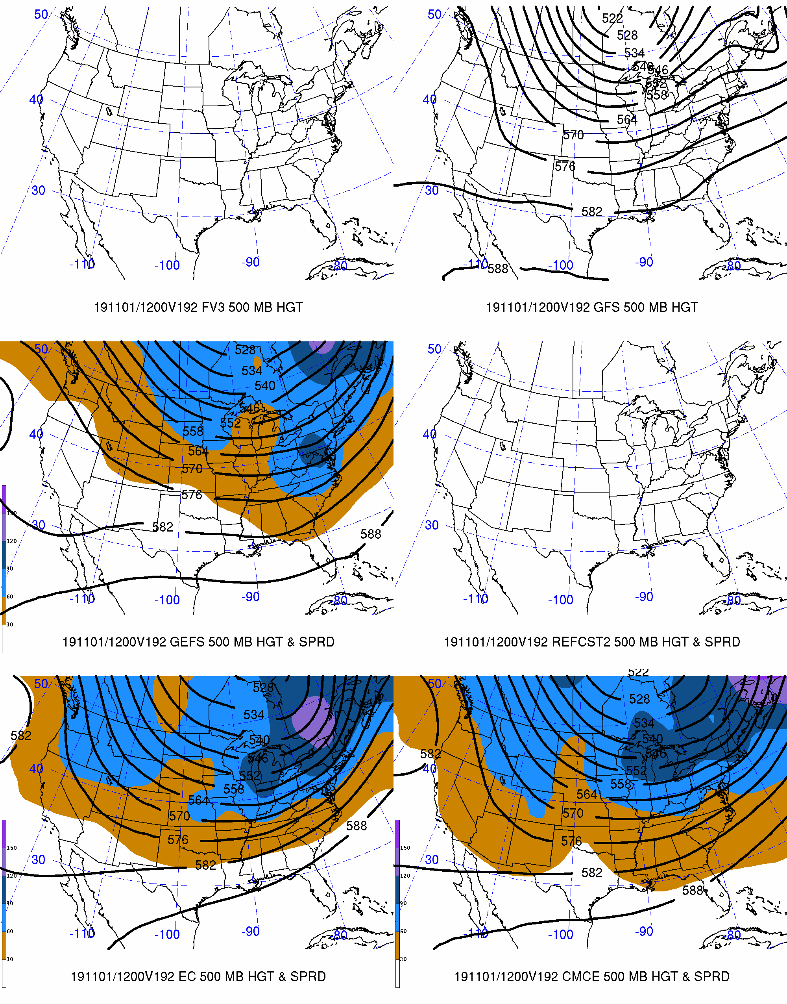
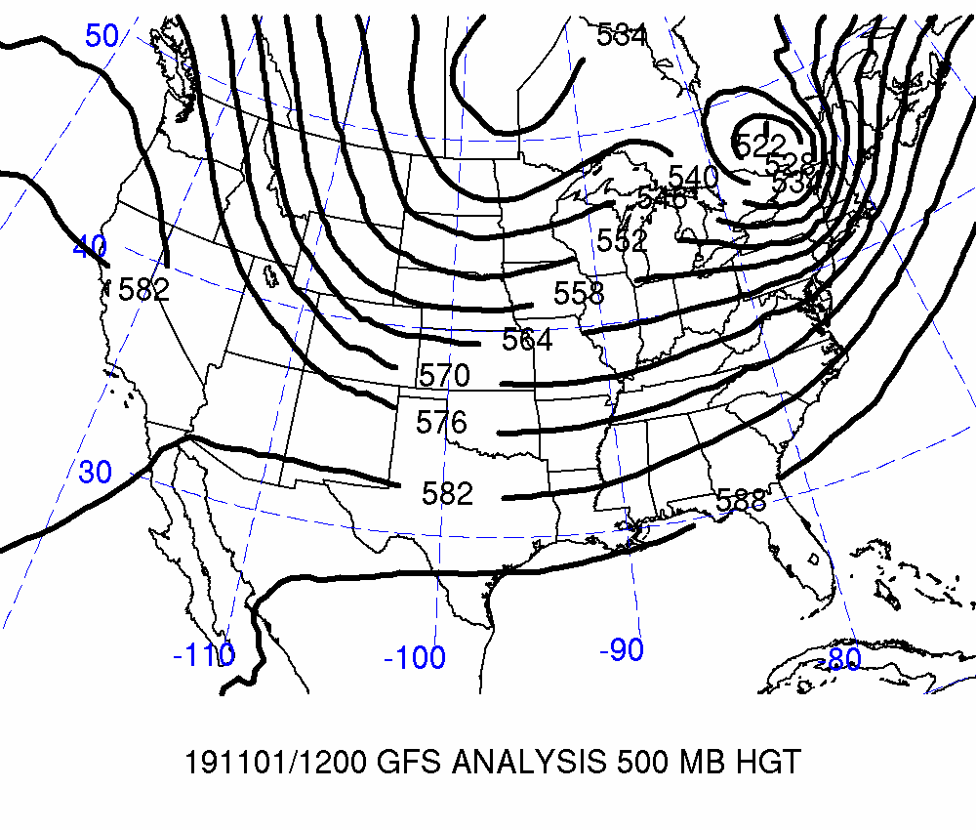
Day 8: Valid 2019-11-01 12Z
FCSTR Blend Weights (%)
TMAX / TMIN / QPF
FV3: 0% / 0% / 0%
GFS: 0% / 0% / 0%
GEFS: 0% / 0% / 0%
REFCST2: 0% / 0% / 0%
EC CTRL: 0% / 0% / 0%
ECENS: 0% / 0% / 0%
CMCE: 0% / 0% / 0%

Slide 4
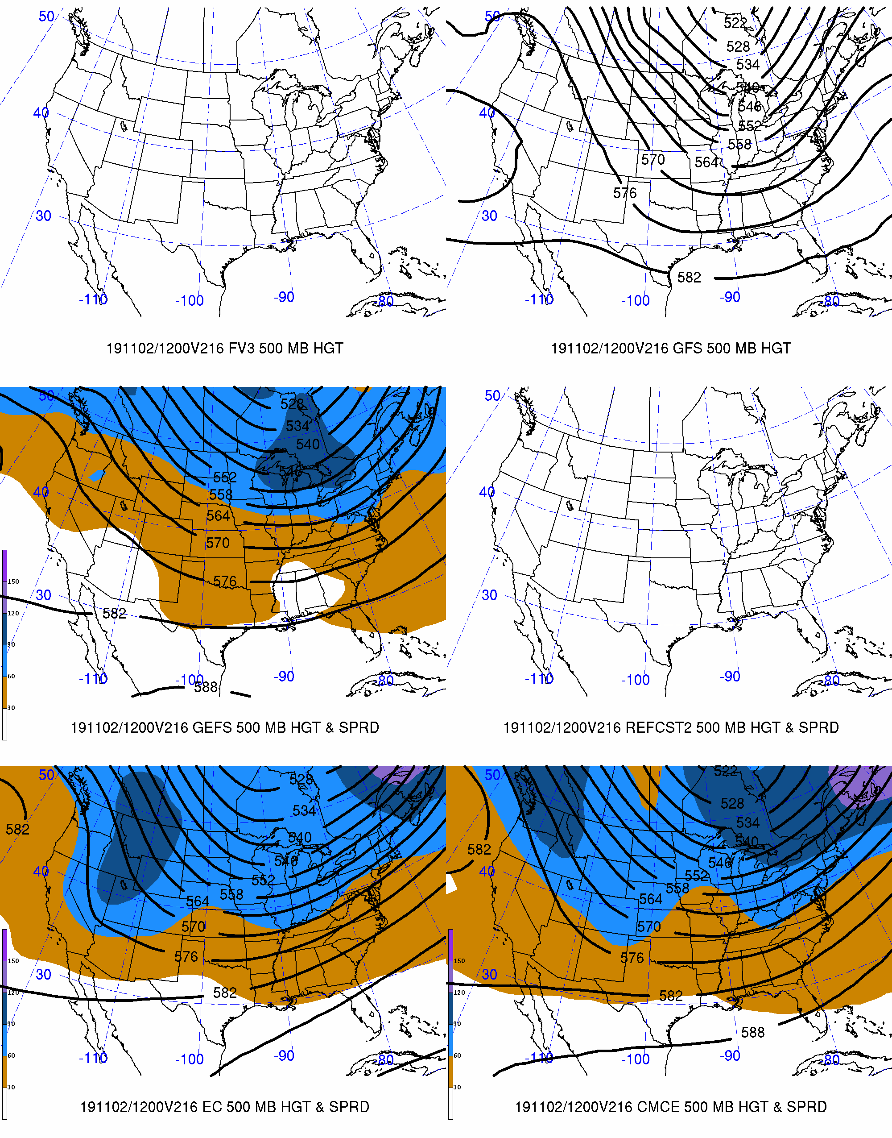
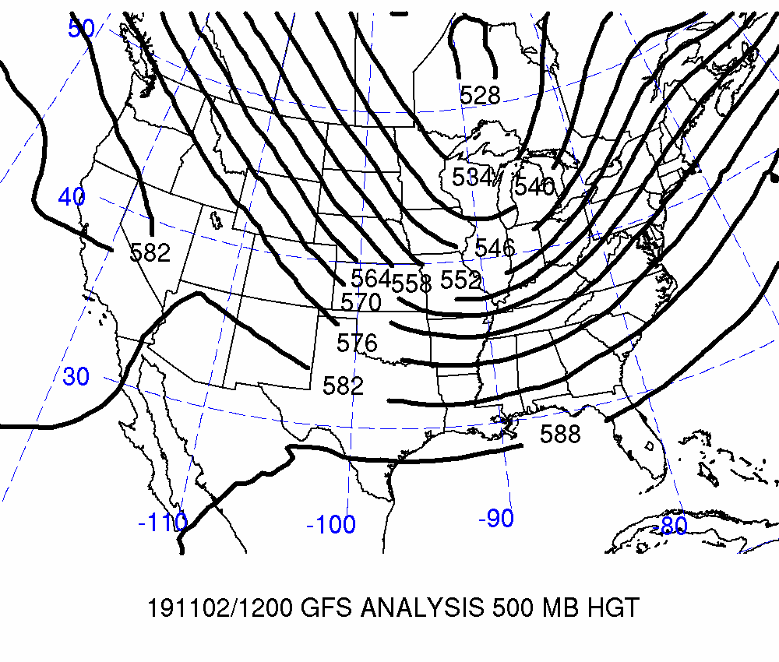
Day 9: Valid 2019-11-02 12Z
FCSTR Blend Weights (%)
TMAX / TMIN / QPF
FV3: 0% / 0% / 0%
GFS: 0% / 0% / 0%
GEFS: 0% / 0% / 0%
REFCST2: 0% / 0% / 0%
EC CTRL: 0% / 0% / 0%
ECENS: 0% / 0% / 0%
CMCE: 0% / 0% / 0%

Slide 5
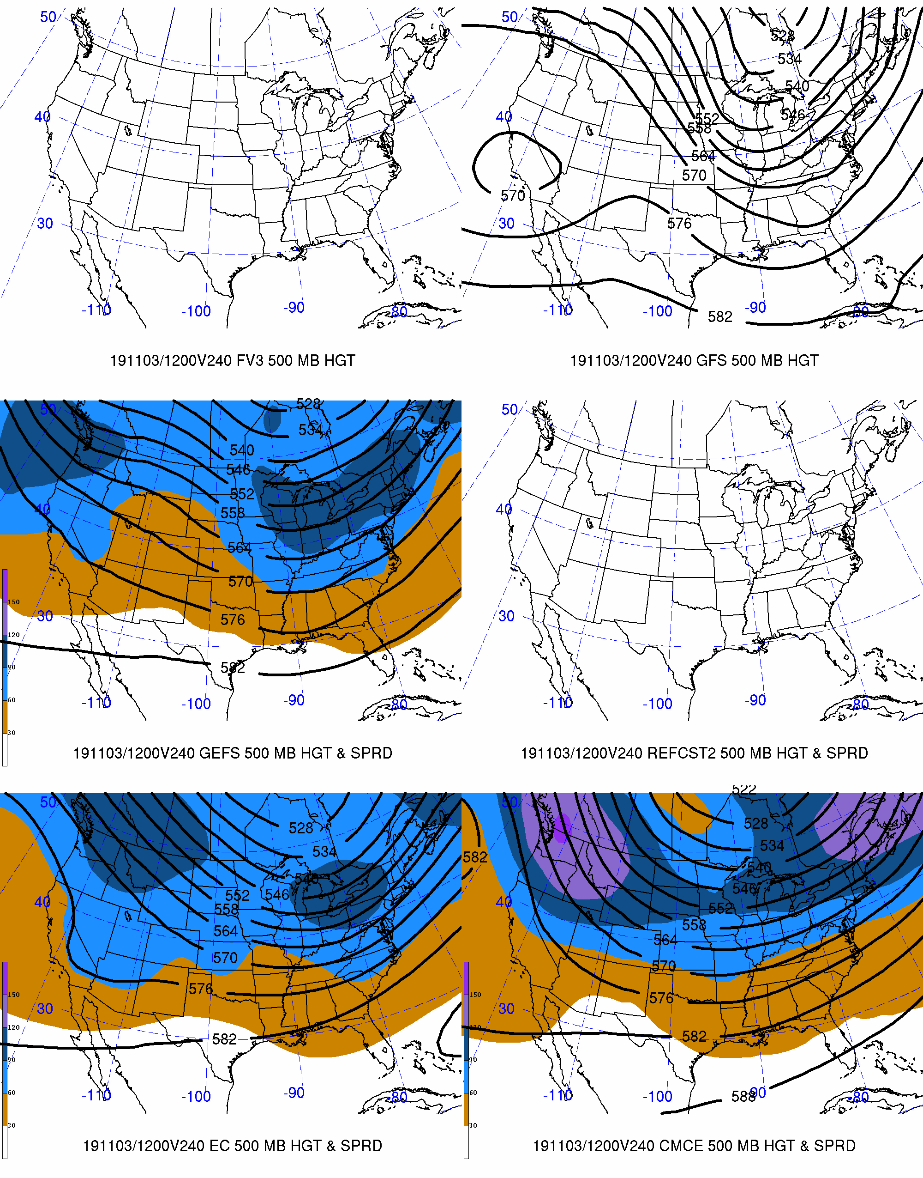
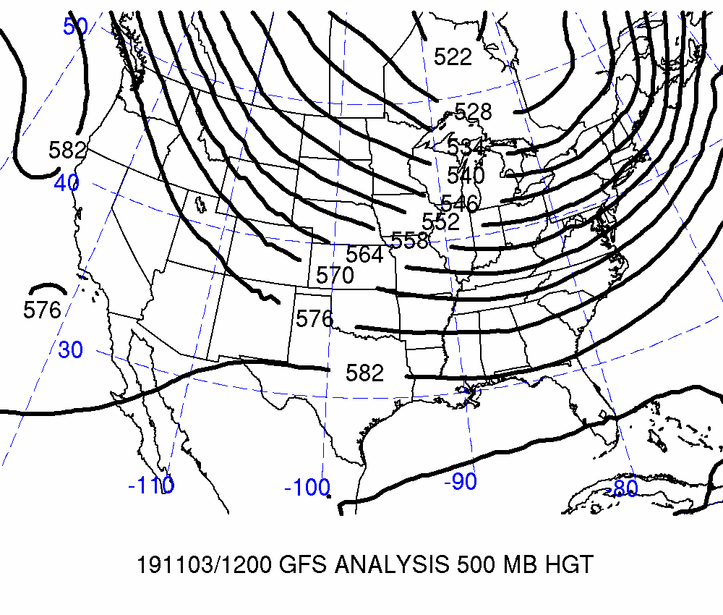
Day 10: Valid 2019-11-03 12Z
FCSTR Blend Weights (%)
TMAX / TMIN / QPF
FV3: 0% / 0% / 0%
GFS: 0% / 0% / 0%
GEFS: 0% / 0% / 0%
REFCST2: 0% / 0% / 0%
EC CTRL: 0% / 0% / 0%
ECENS: 0% / 0% / 0%
CMCE: 0% / 0% / 0%

Slide 6
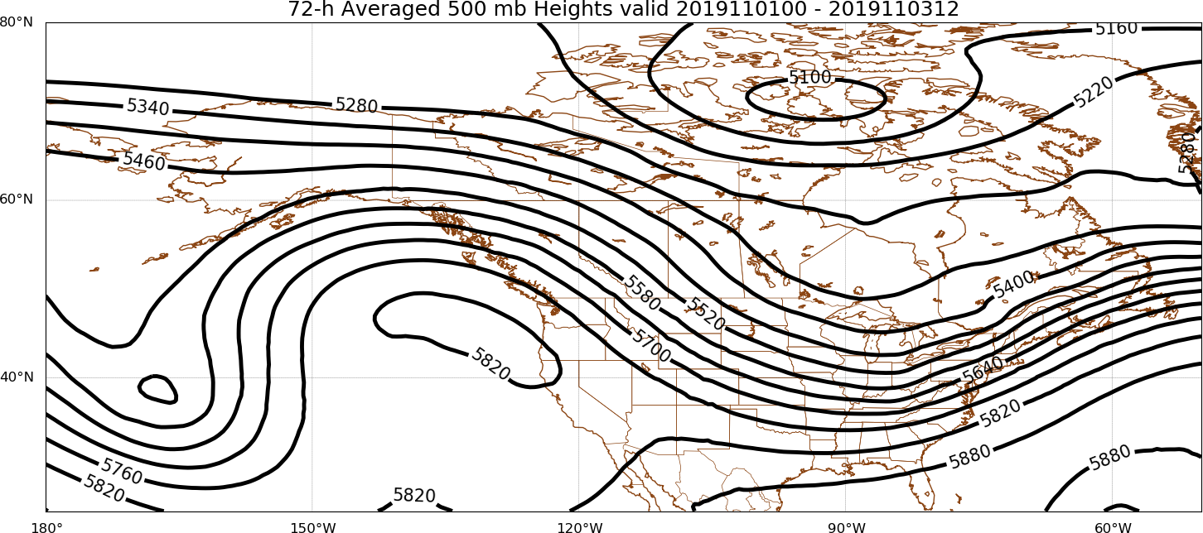
Days 8–10
FCSTR Blend Weights (%): TMAX / TMIN / QPF
EOF1P: 0% / 0% / 0%
EOF1N: 0% / 0% / 0%
EOFMN: 100% / 100% / 100%
GFS Analysis
EOF2P: 0% / 0% / 0%
EOF2N: 0% / 0% / 0%

Slide 7
Maximum Temperature | TMAX

Slide 8
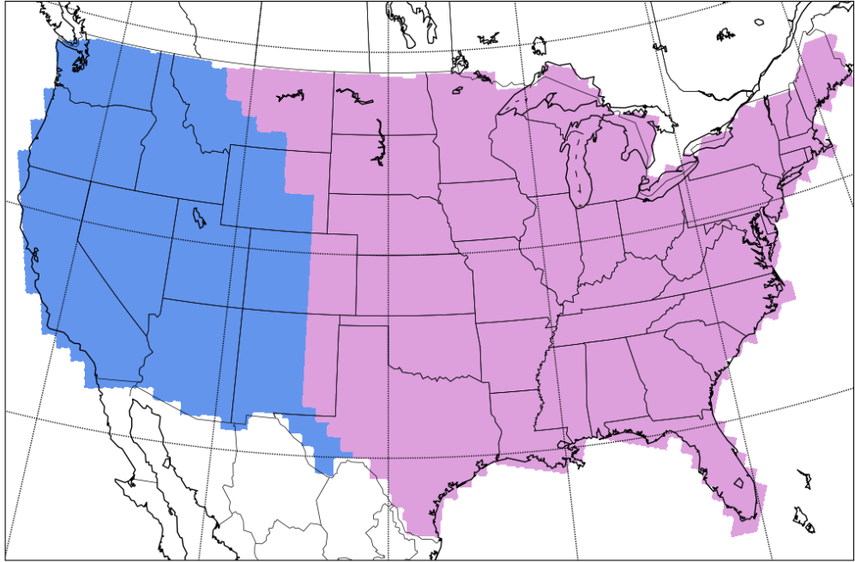
Separation of Western & Eastern CONUS
West
East
West
East

Slide 9
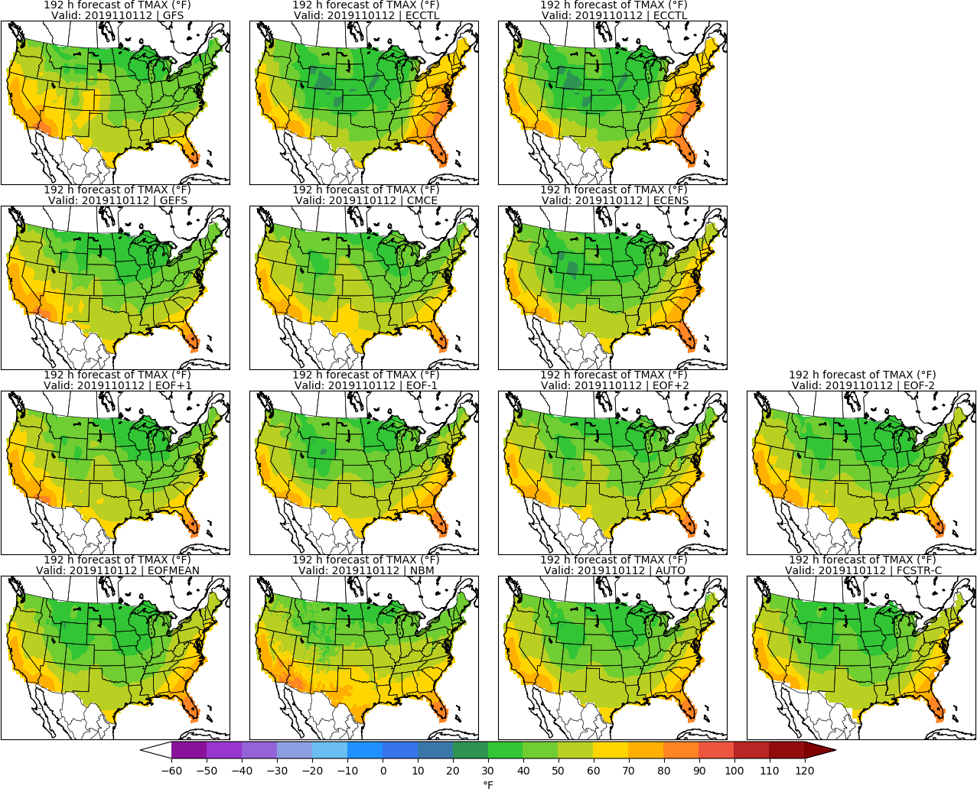
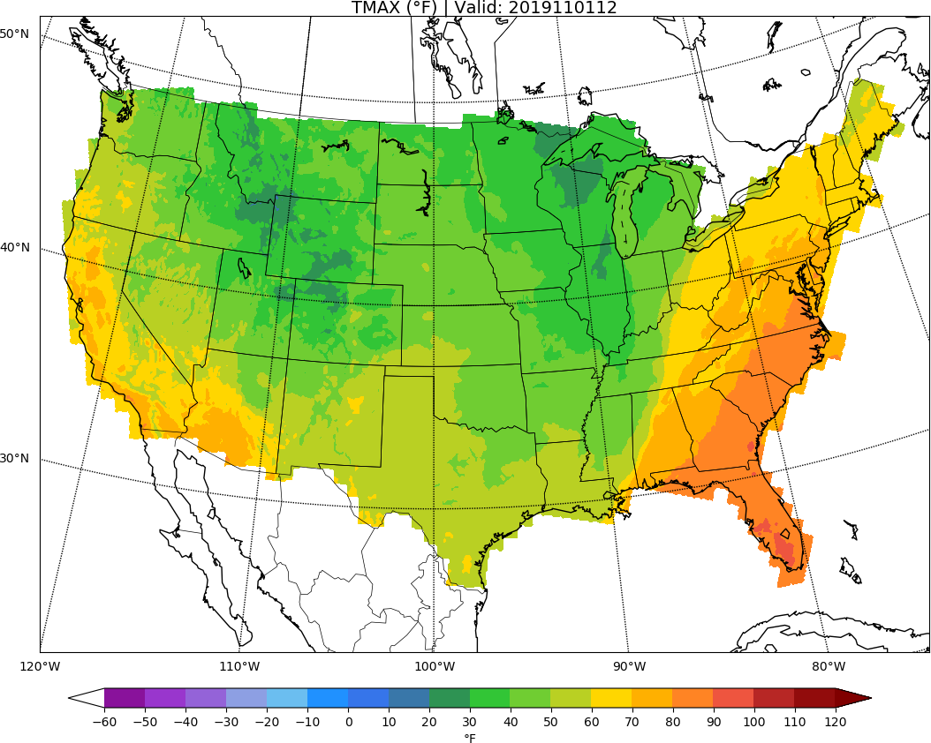
MISSING
ECCTL
Day 8: TMAX
URMA

Slide 10
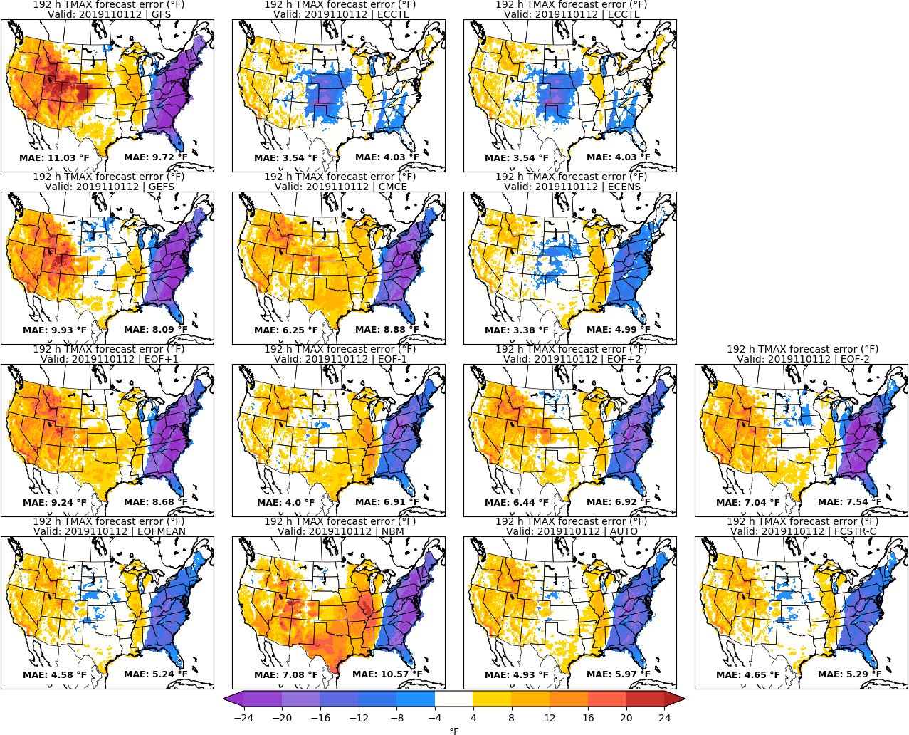
MISSING
ECCTL
Day 8: TMAX
URMA

Slide 11
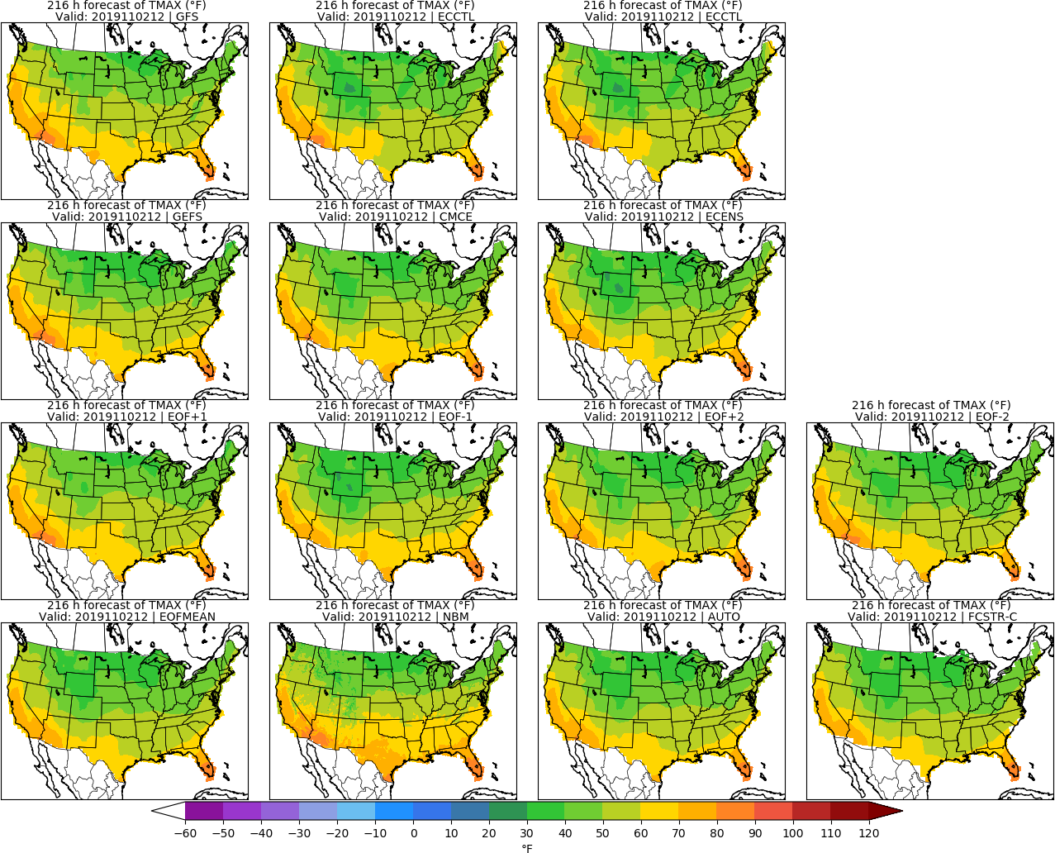
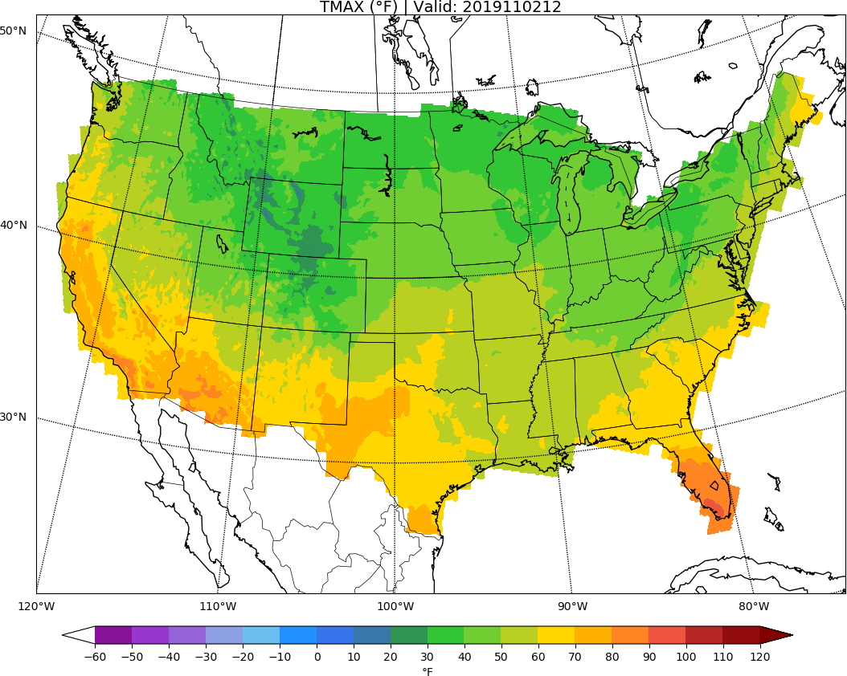
MISSING
ECCTL
Day 9: TMAX
URMA

Slide 12
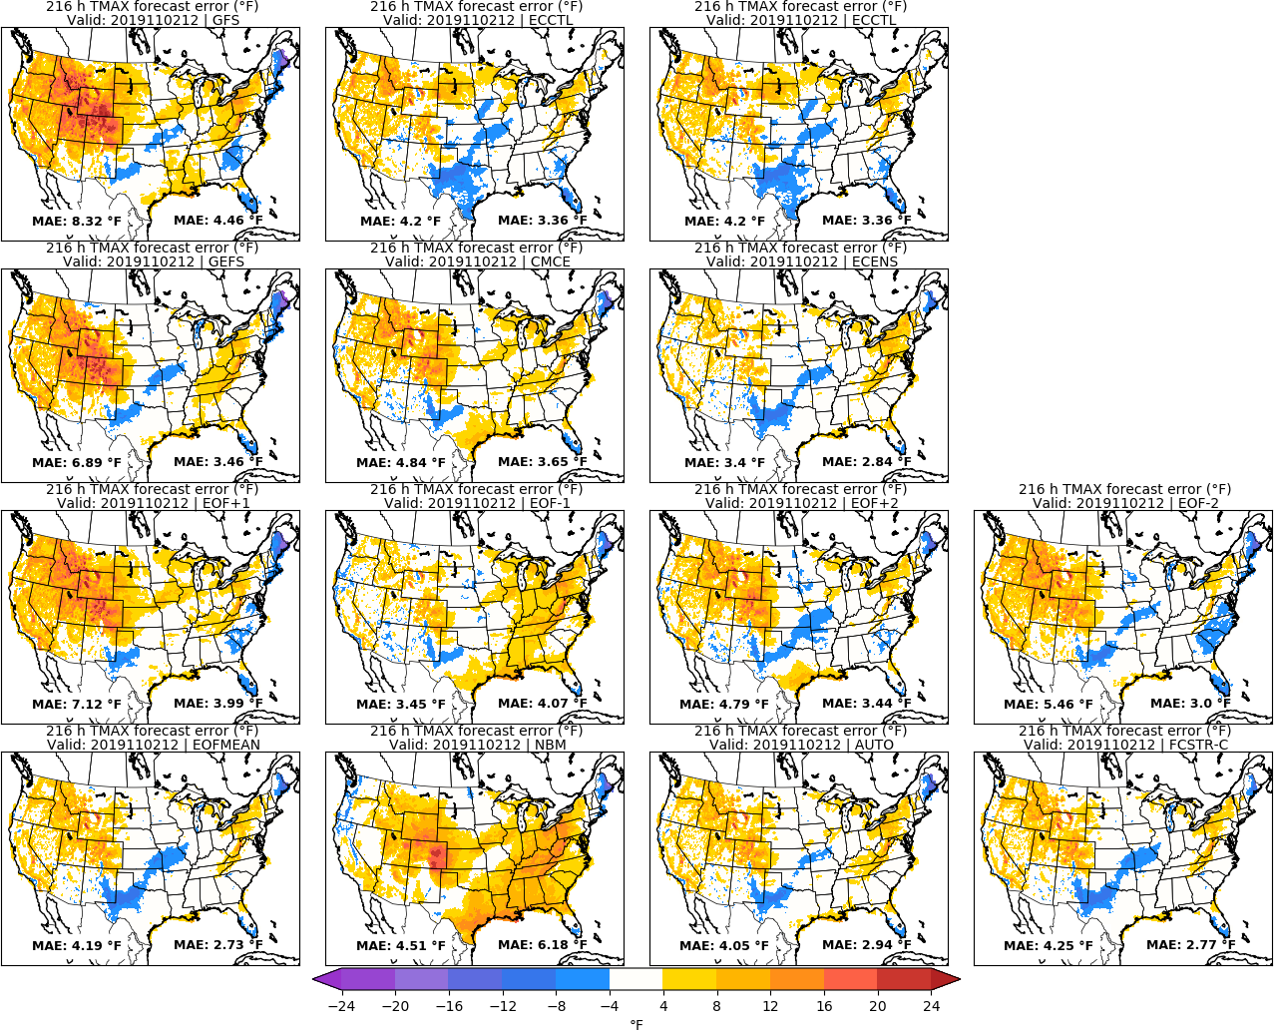
MISSING
ECCTL
Day 9: TMAX
URMA

Slide 13
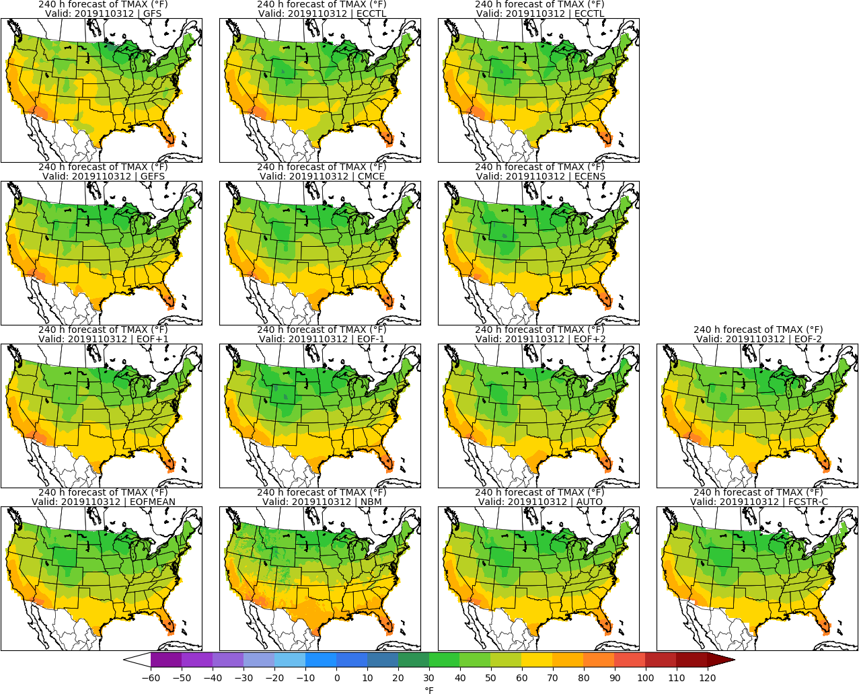
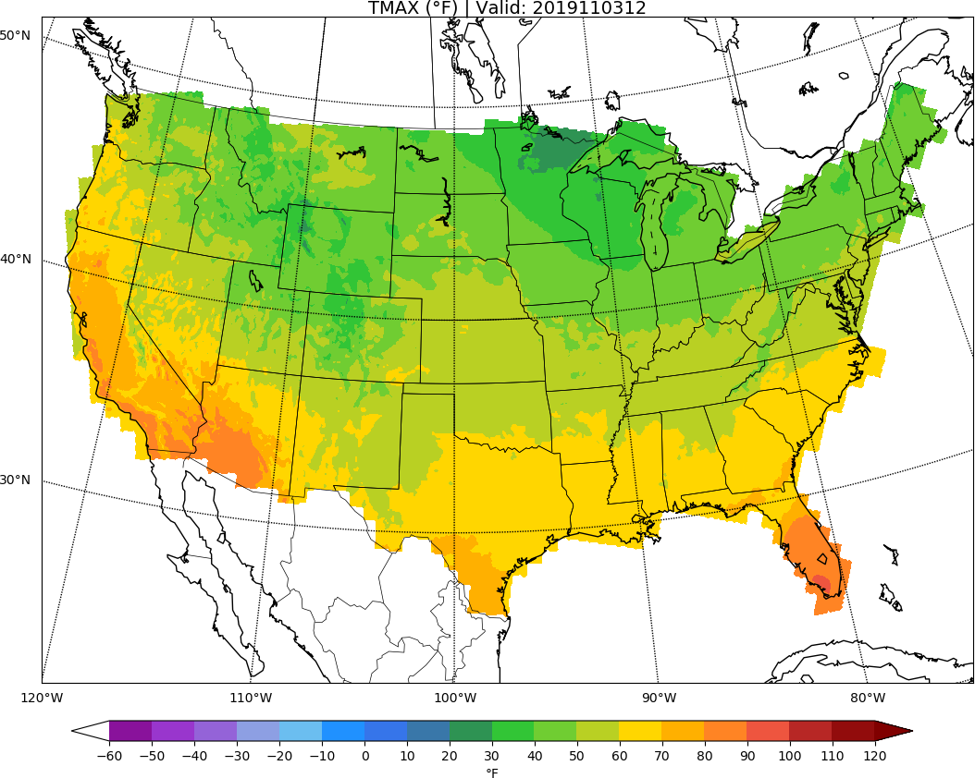
MISSING
ECCTL
Day 10: TMAX
URMA

Slide 14
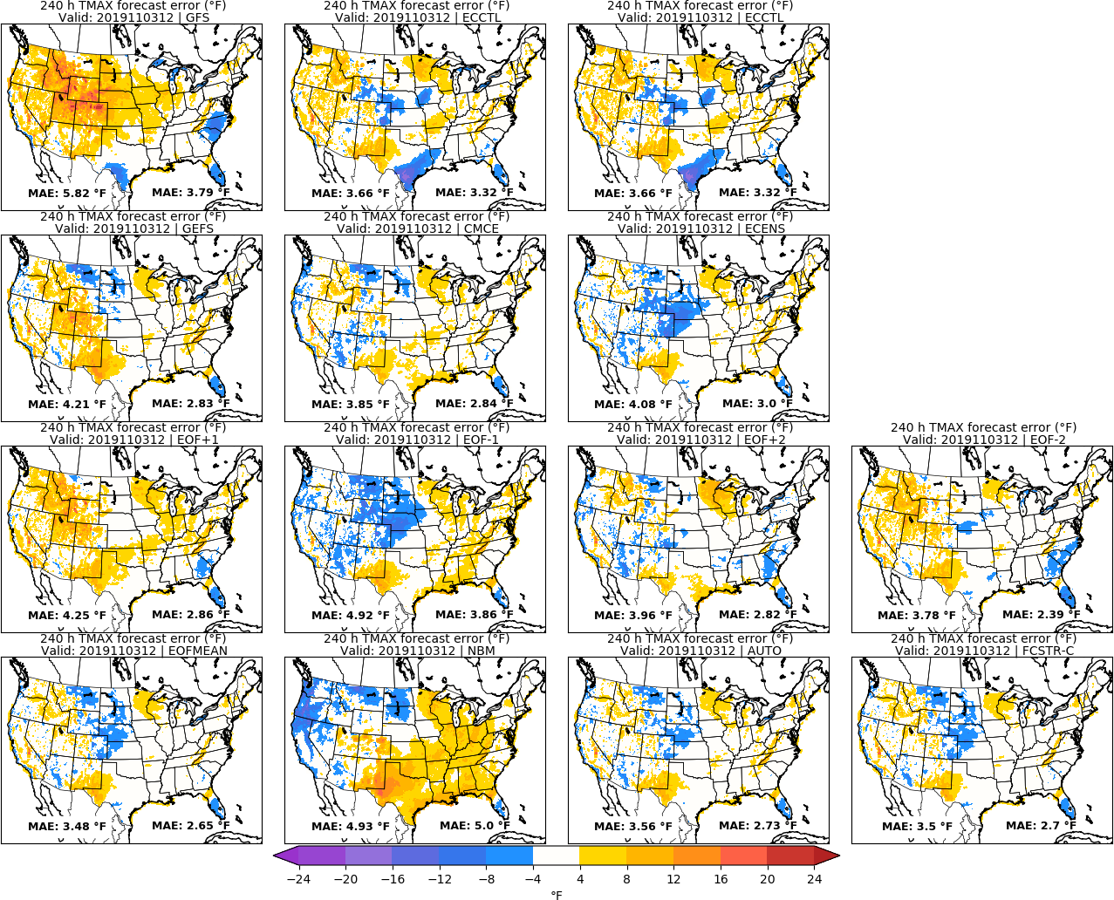
MISSING
ECCTL
Day 10: TMAX
URMA

Slide 15
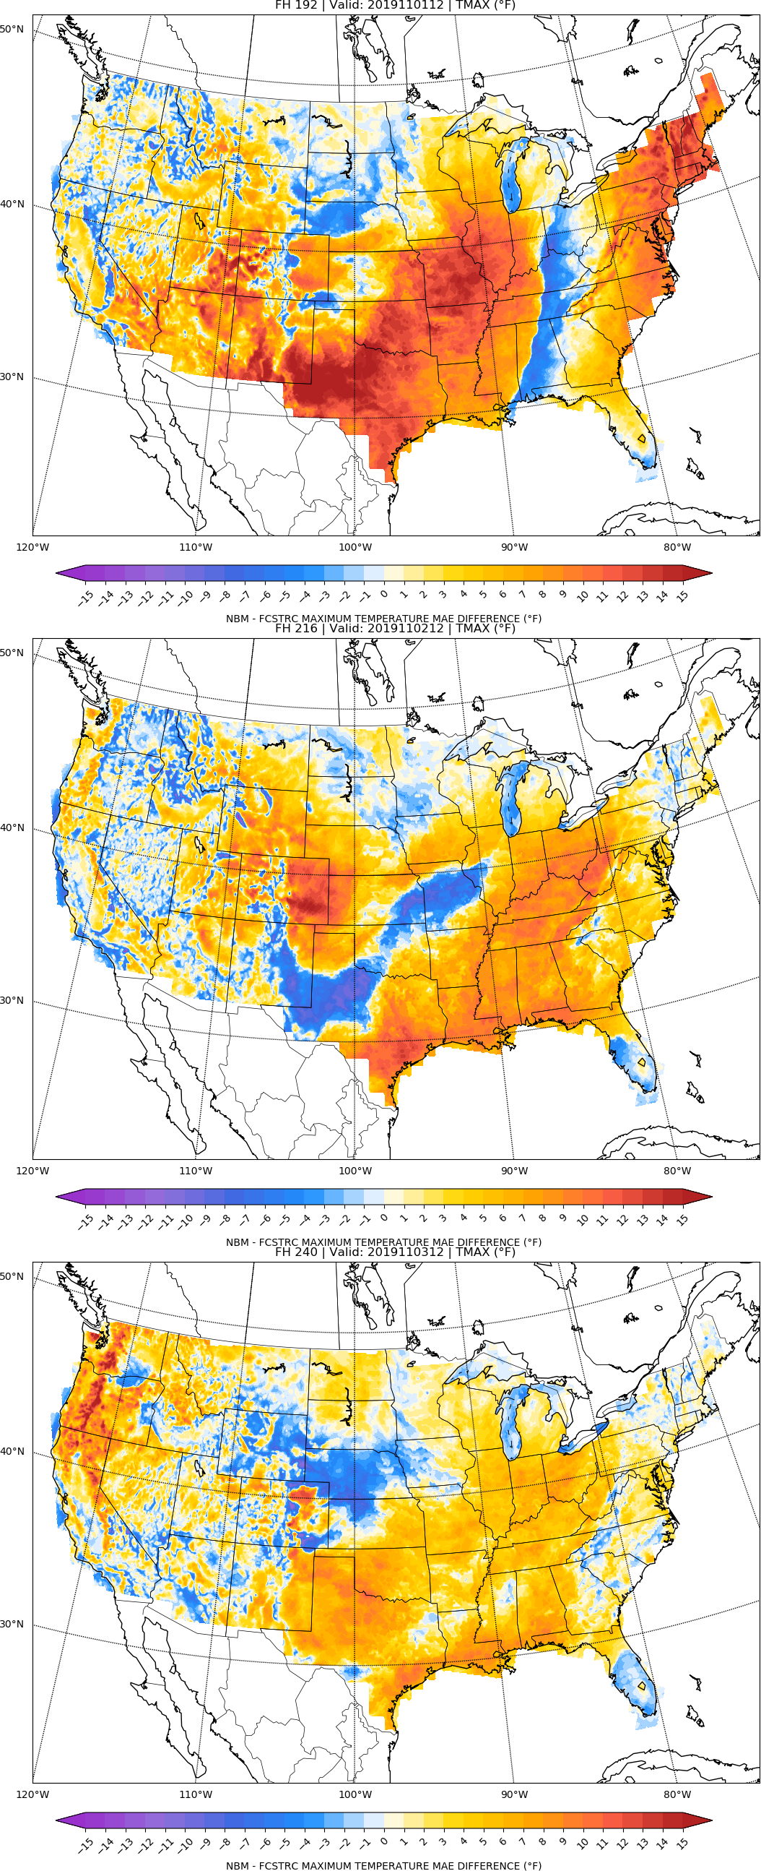
NBM vs FCSTR-C
Blend Comparison
Day 8
MAE_{NBM} – MAE_{FCSTRC} } > 0 is FCSTRC
improvement
over NBM
Day 9
FCSTRC Worse
FCSTRC Better
Day 10

Slide 16
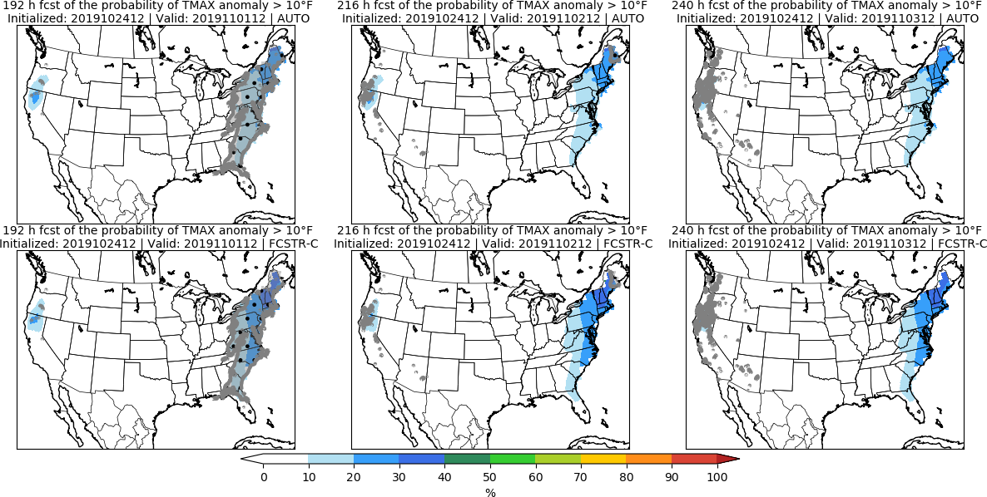
Day 8 Day 9 Day 10

Slide 17
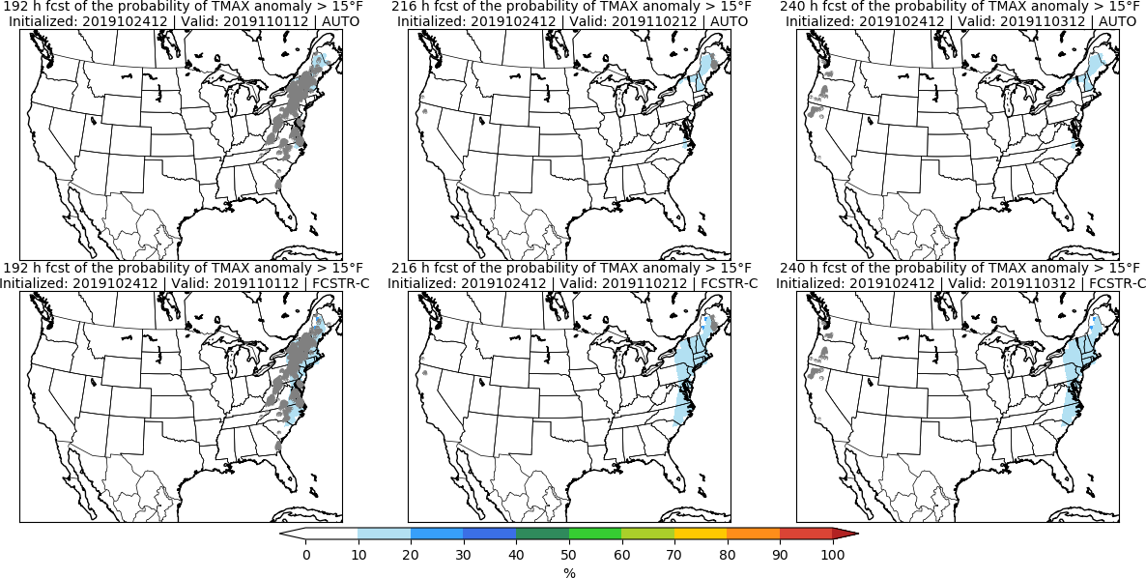
Day 8 Day 9 Day 10

Slide 18
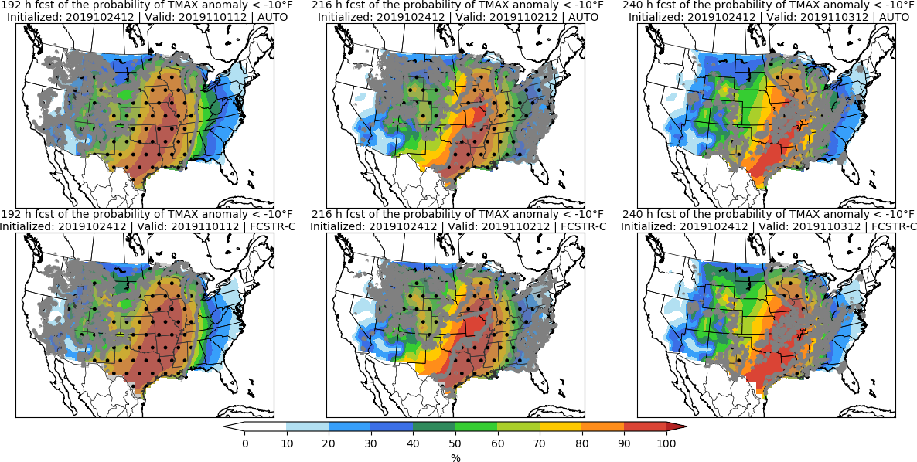
Day 8 Day 9 Day 10

Slide 19
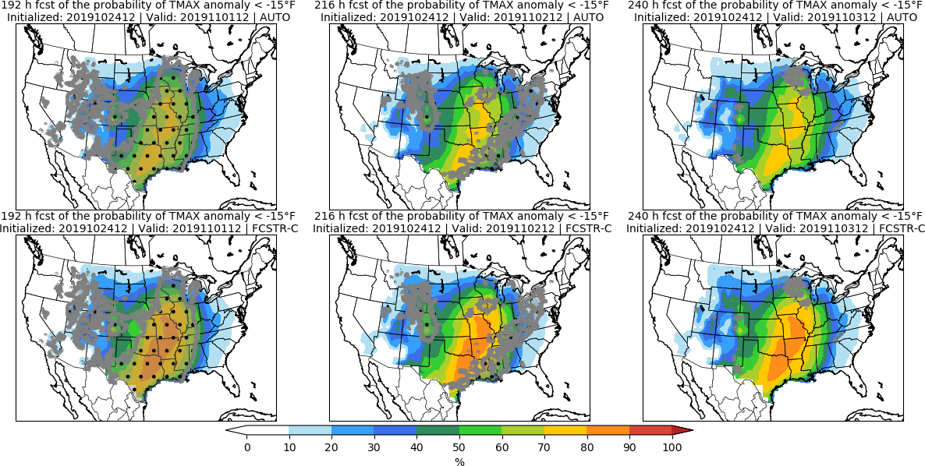
Day 8 Day 9 Day 10

Slide 20
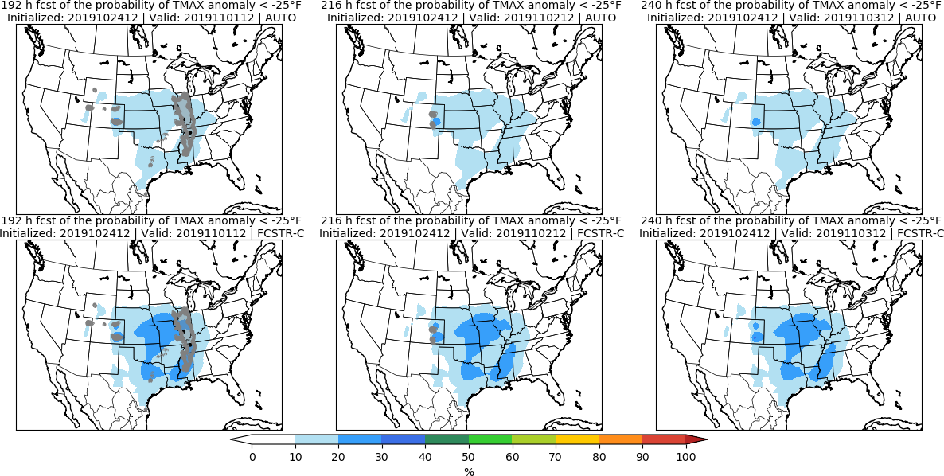
Day 8 Day 9 Day 10

Slide 21
Minimum Temperature | TMIN

Slide 22
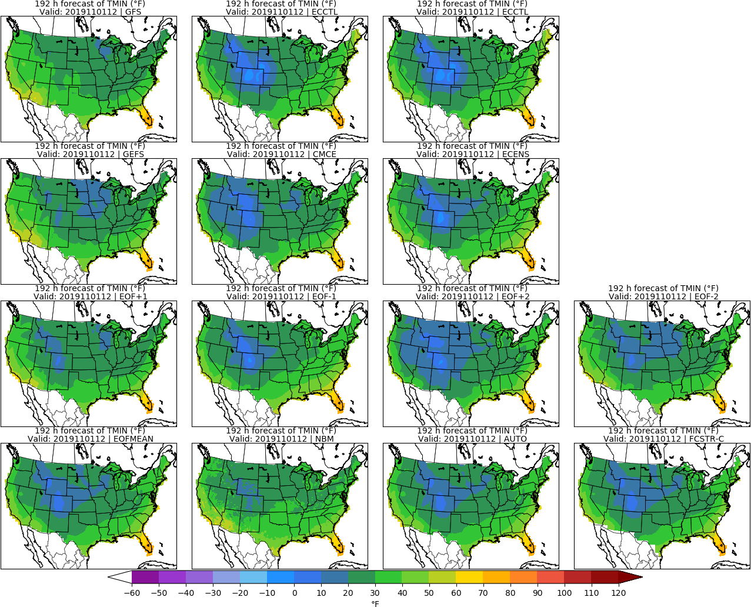
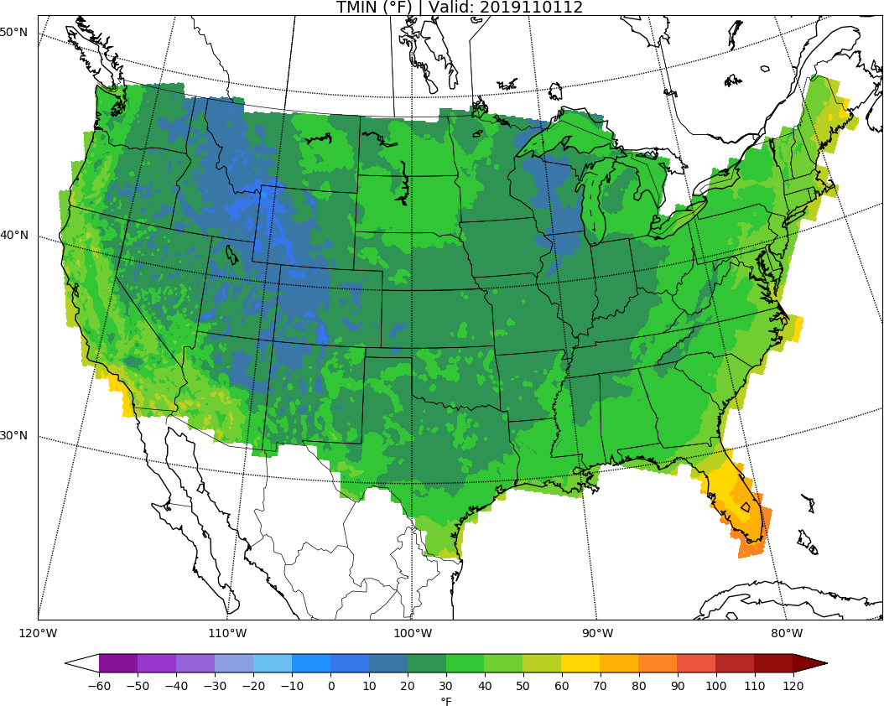
MISSING
ECCTL
Day 8: TMIN
URMA

Slide 23
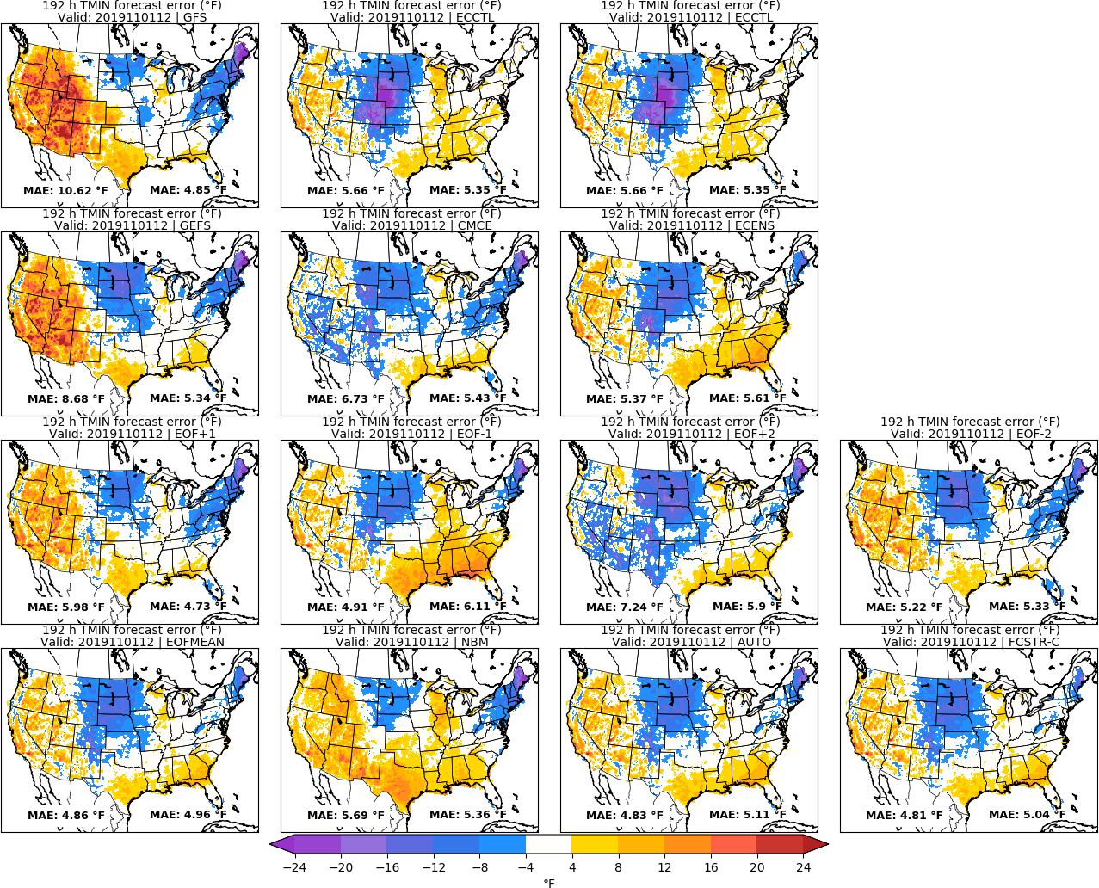
MISSING
ECCTL
Day 8: TMIN
URMA

Slide 24
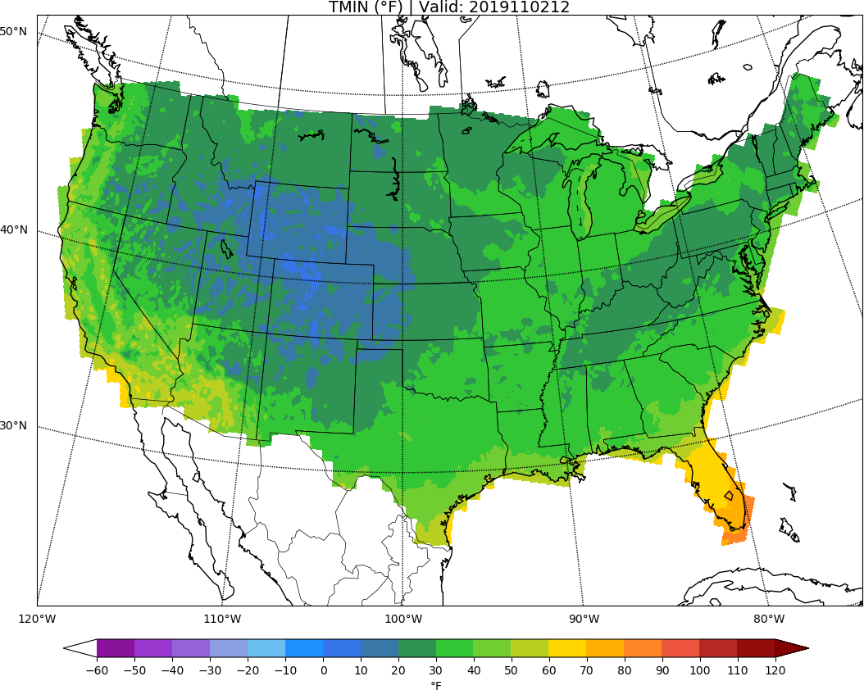
MISSING
ECCTL
Day 9: TMIN
URMA

Slide 25
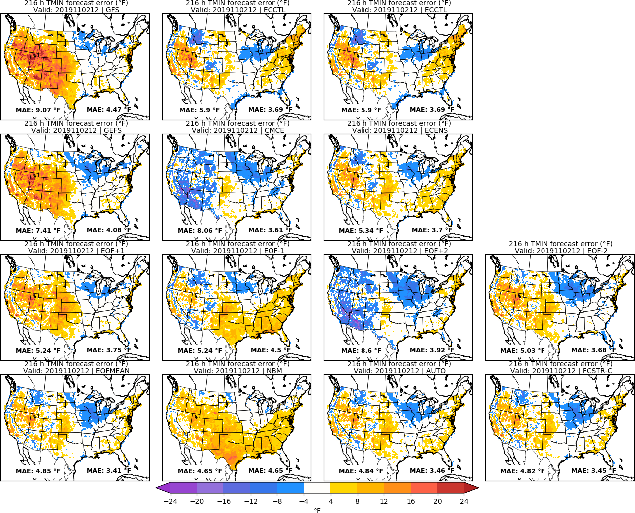
MISSING
ECCTL
Day 9: TMIN
URMA

Slide 26
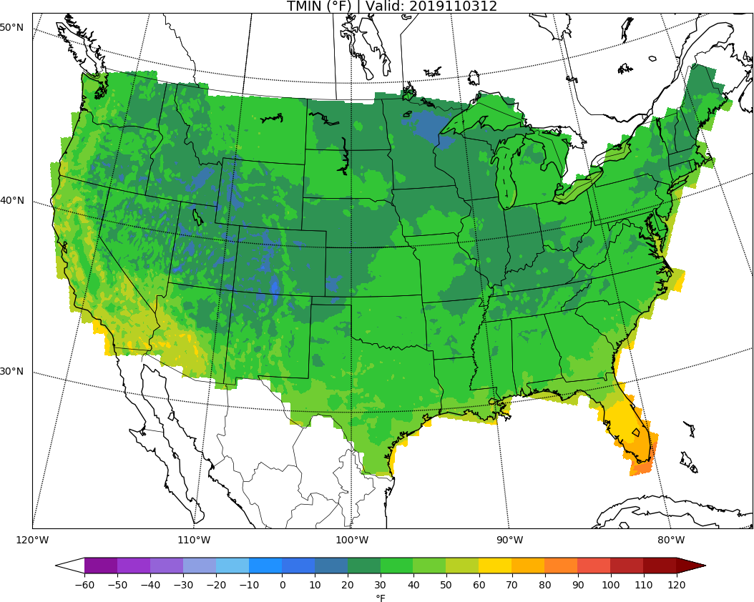
MISSING
ECCTL
Day 10: TMIN
URMA

Slide 27
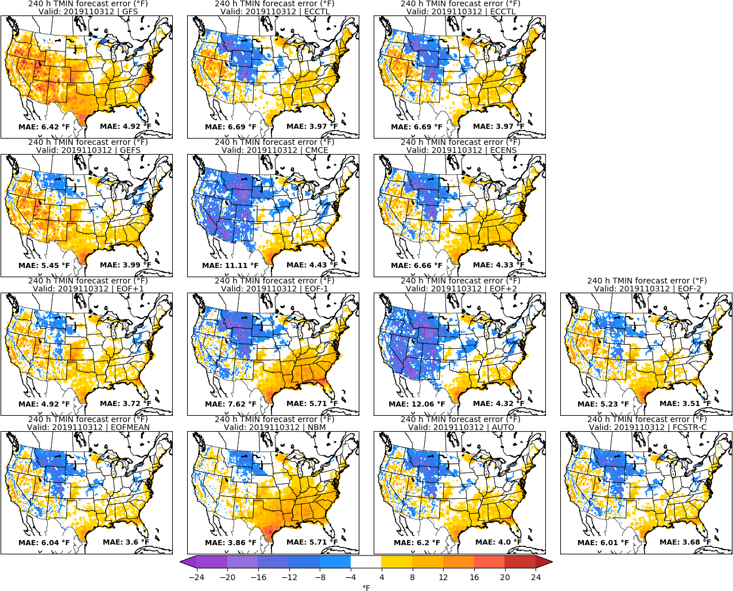
MISSING
ECCTL
Day 10: TMIN
URMA

Slide 28
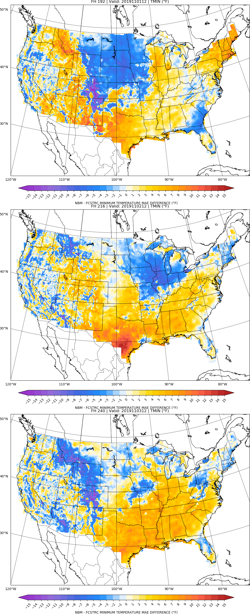
NBM vs FCSTR-C
Blend Comparison
Day 8
MAE_{NBM} – MAE_{FCSTRC} } > 0 is FCSTRC
improvement
over NBM
Day 9
FCSTRC Worse
FCSTRC Better
Day 10

Slide 29
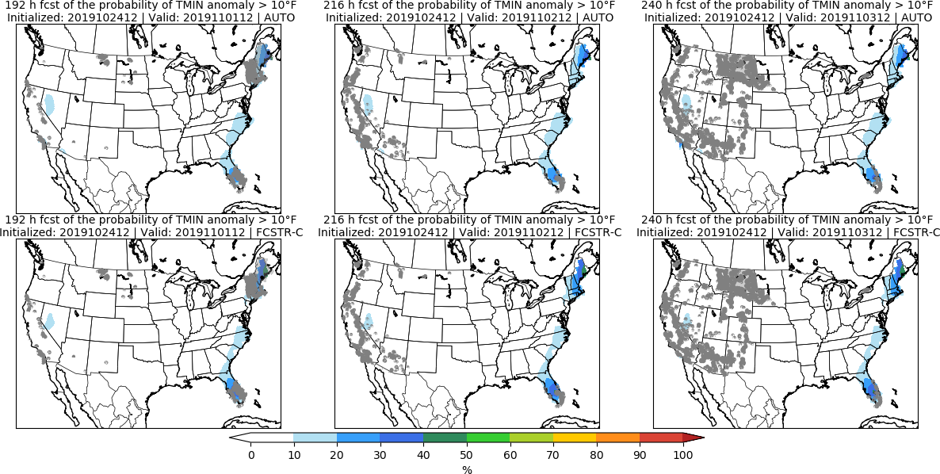
Day 8 Day 9 Day 10

Slide 30
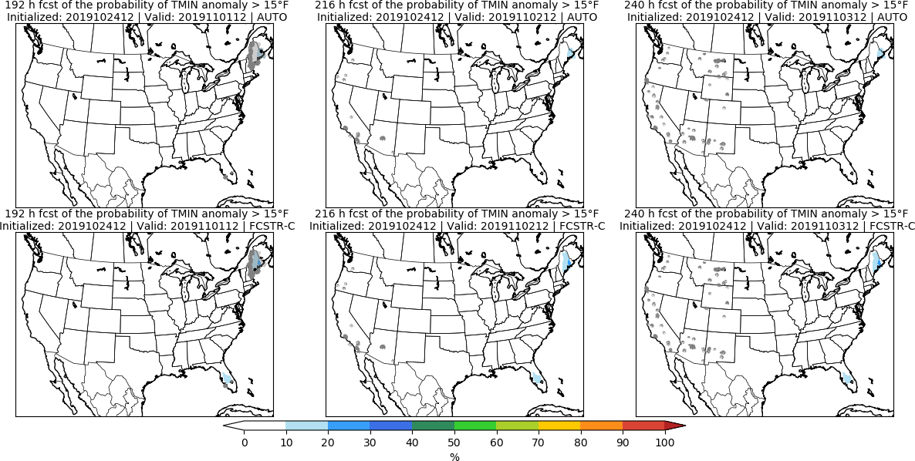
Day 8 Day 9 Day 10

Slide 31
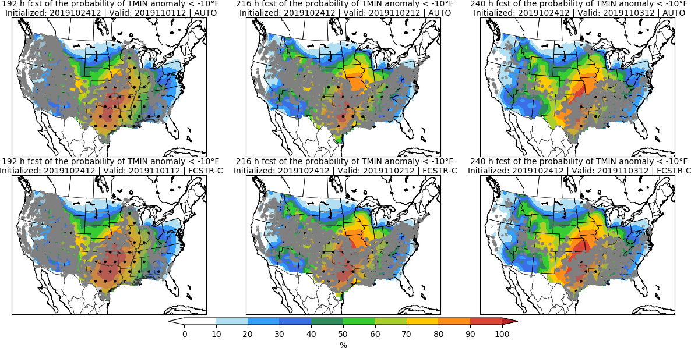
Day 8 Day 9 Day 10

Slide 32
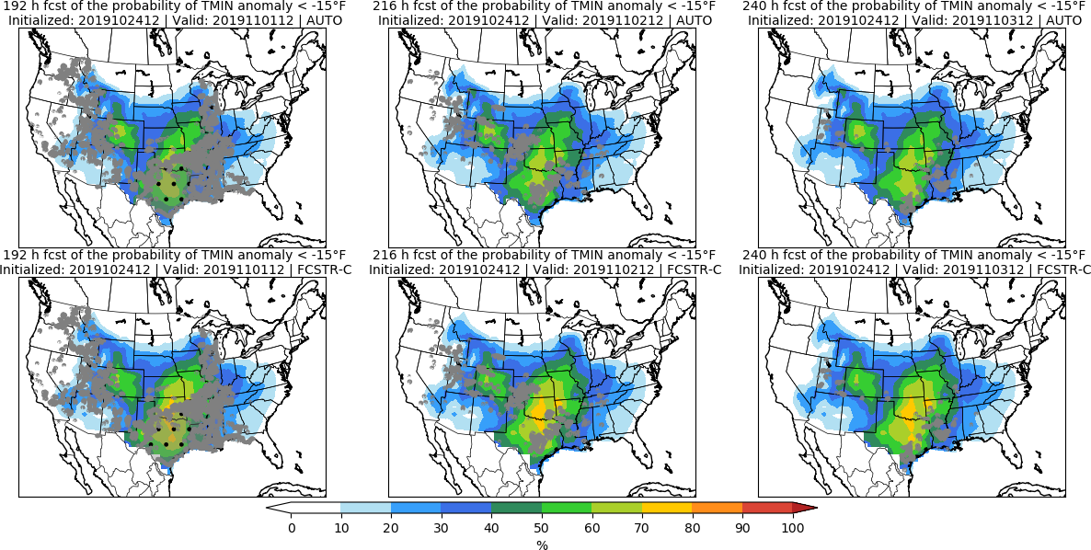
Day 8 Day 9 Day 10

Slide 33
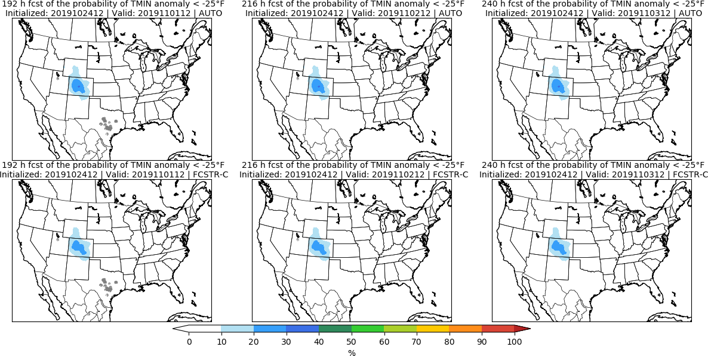
Day 8 Day 9 Day 10

Slide 34
Accumulated Precipitation | APCP

Slide 35
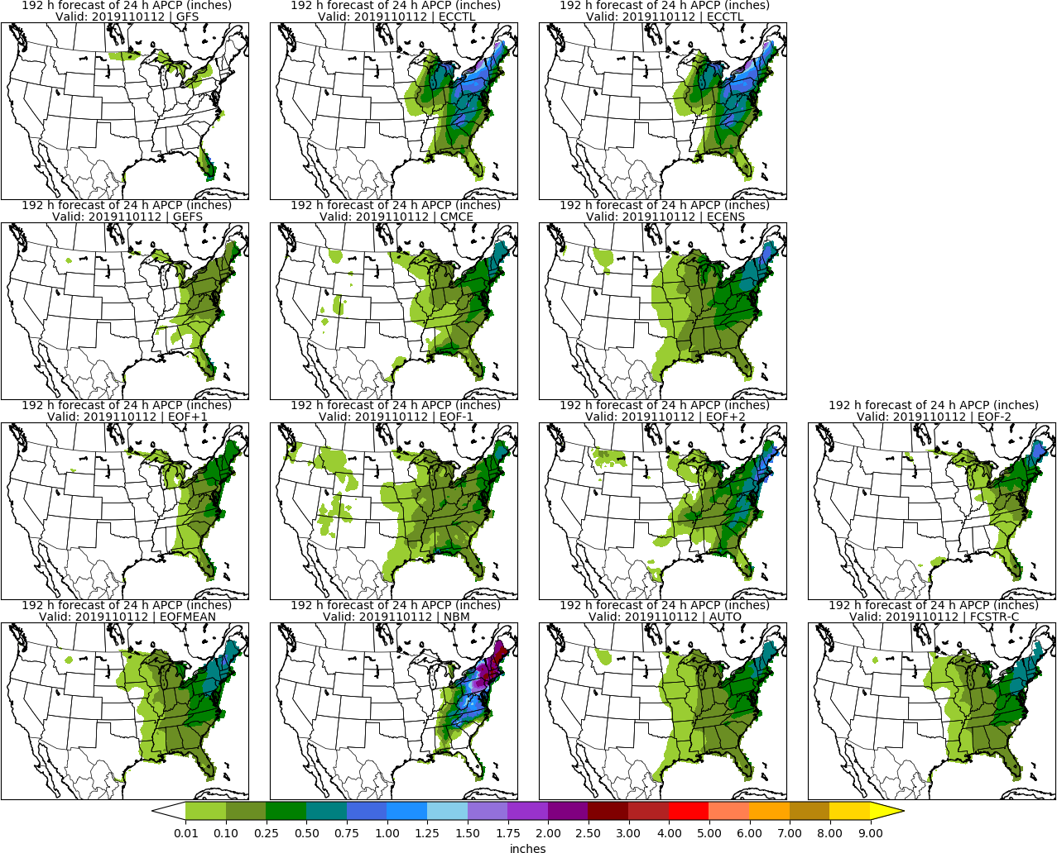
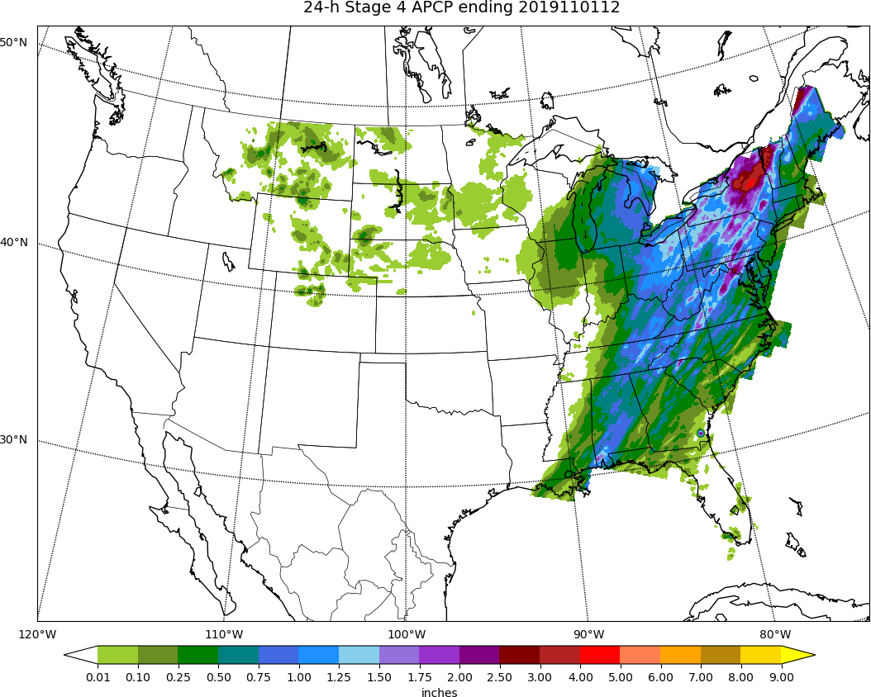
MISSING
ECCTL
Day 8: APCP
STAGE 4

Slide 36
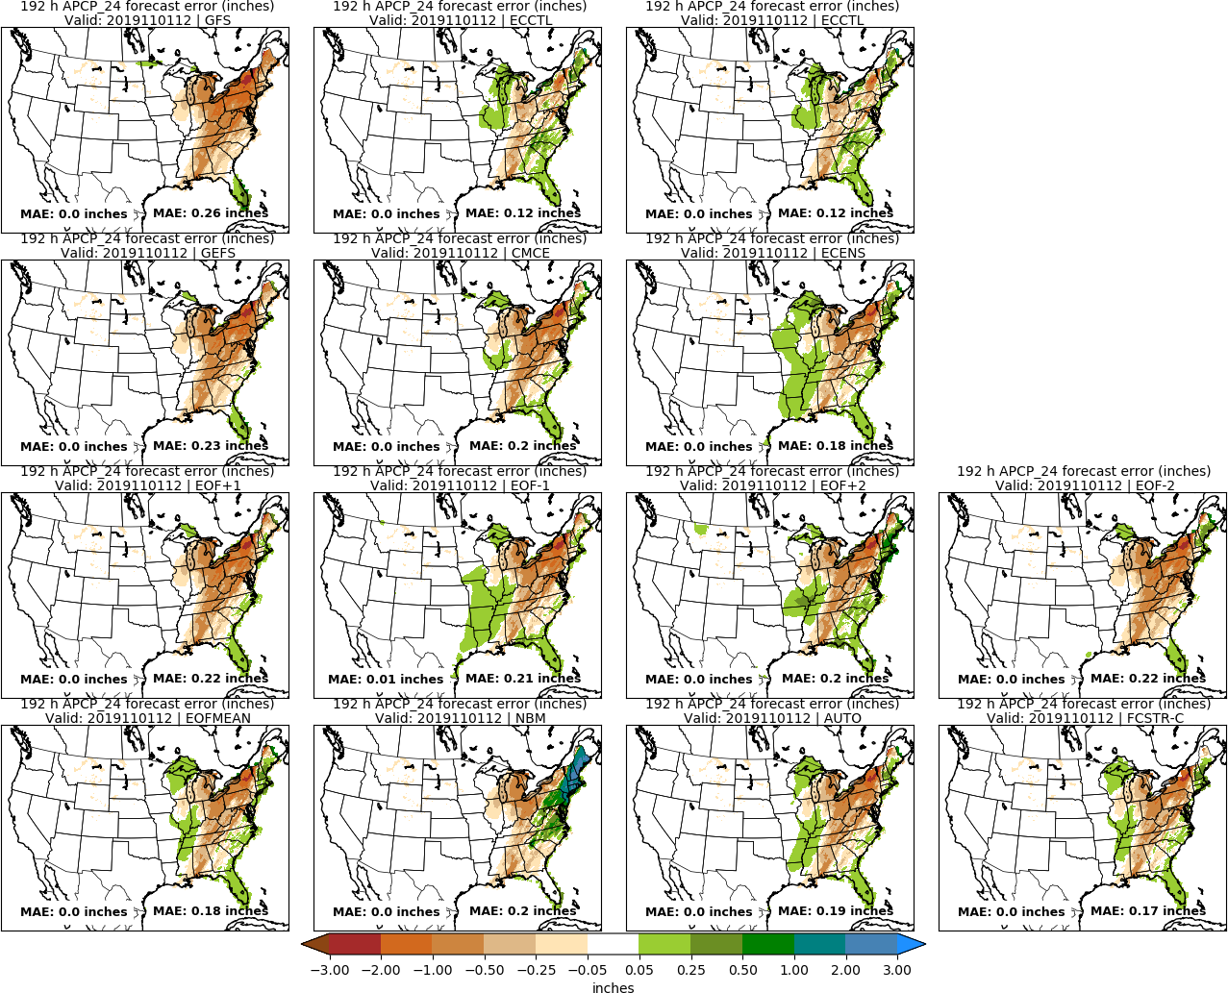
MISSING
ECCTL
Day 8: APCP
STAGE 4

Slide 37
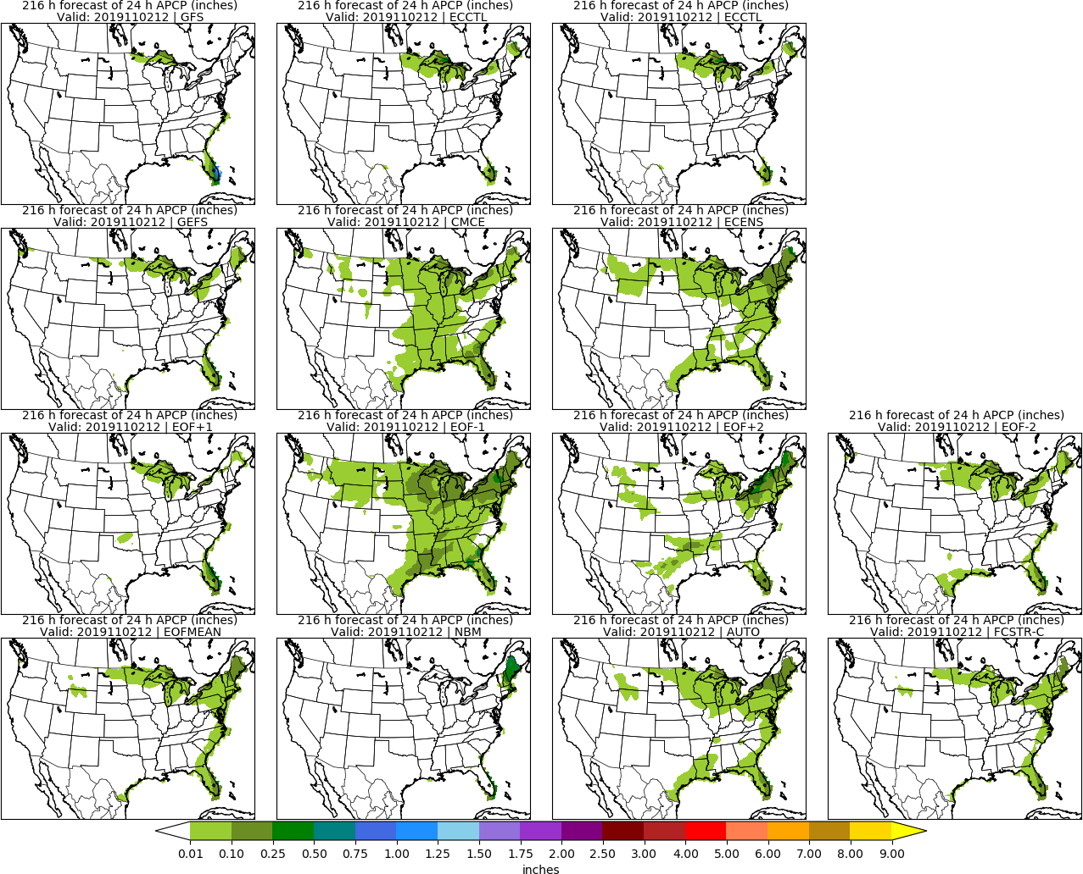
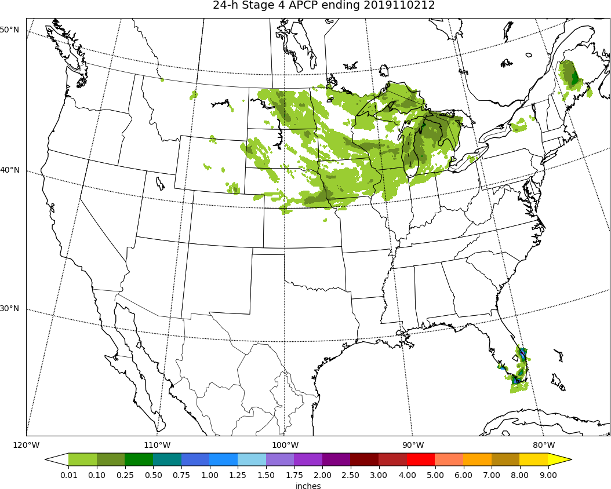
MISSING
ECCTL
Day 9: APCP
STAGE 4

Slide 38
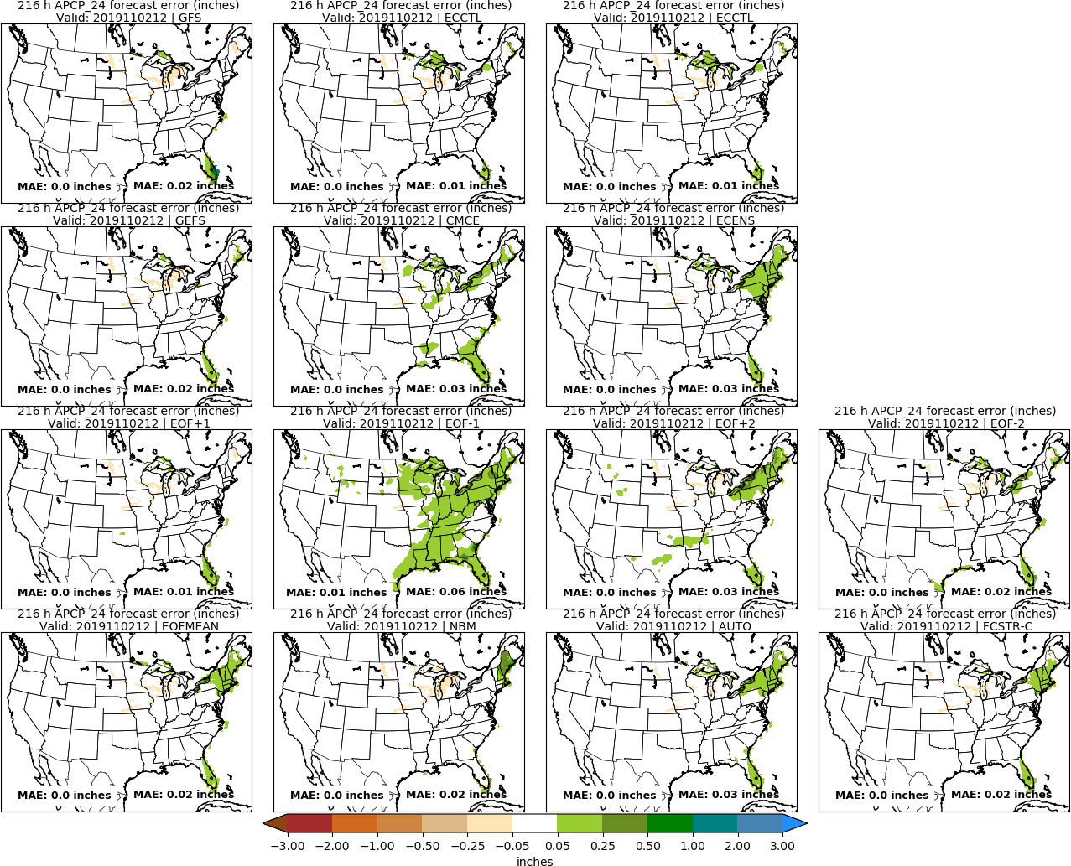
MISSING
ECCTL
Day 9: APCP
STAGE 4

Slide 39
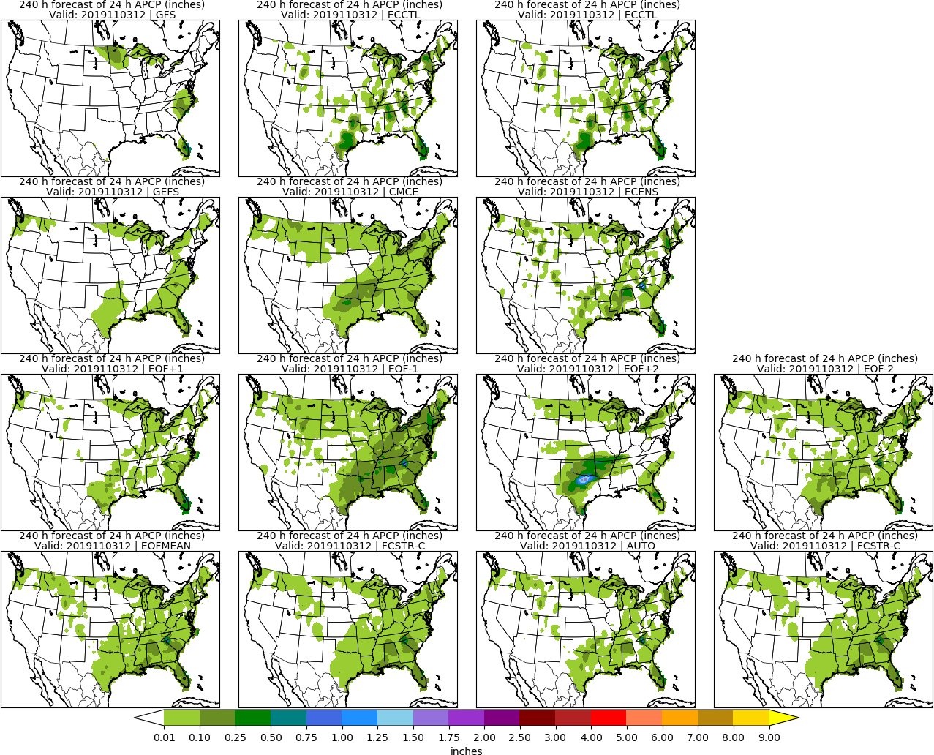
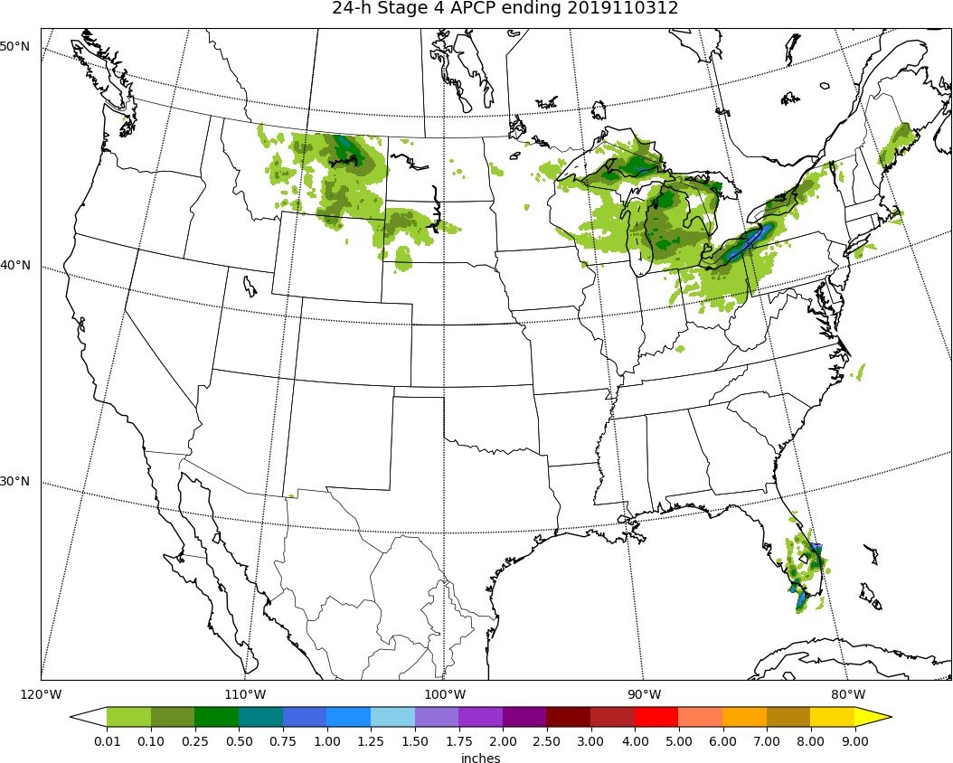
MISSING
ECCTL
Day 10: APCP
STAGE 4

Slide 40
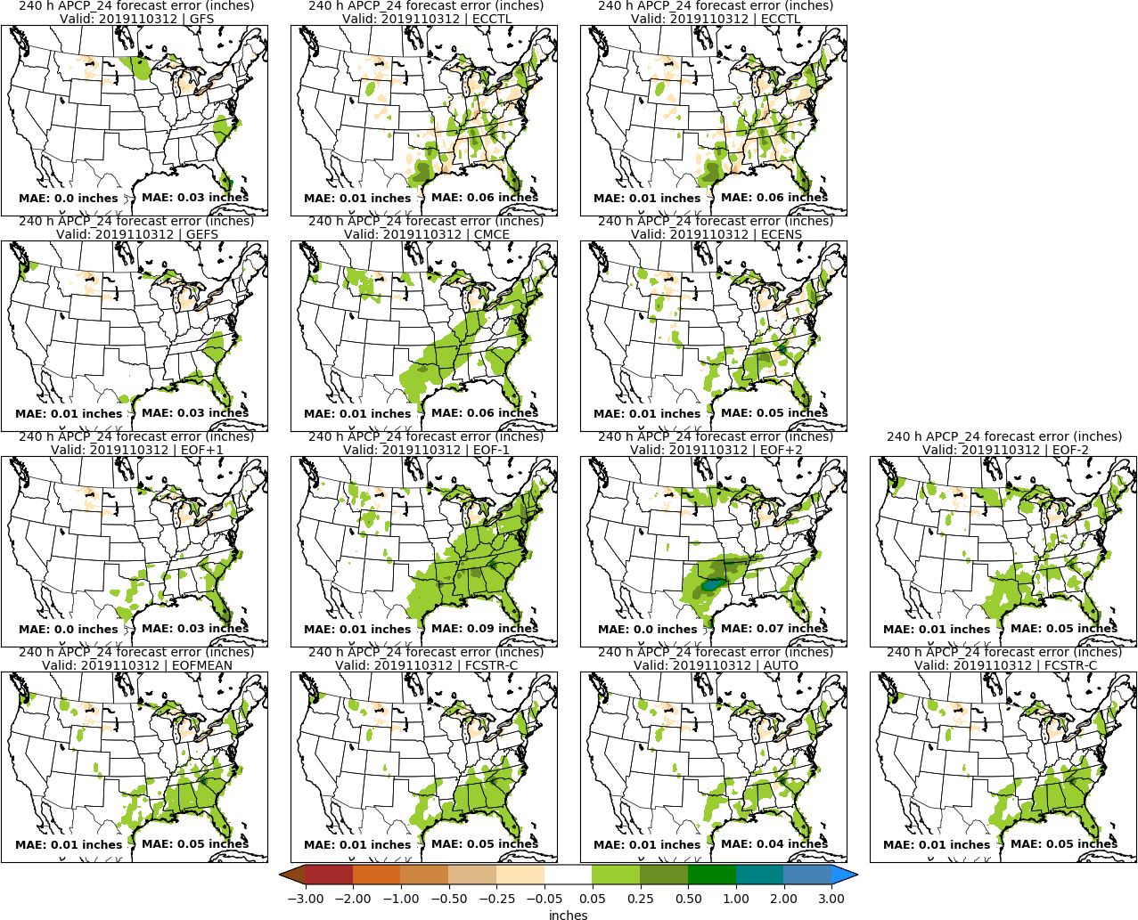
MISSING
ECCTL
Day 10: APCP
STAGE 4

Slide 41
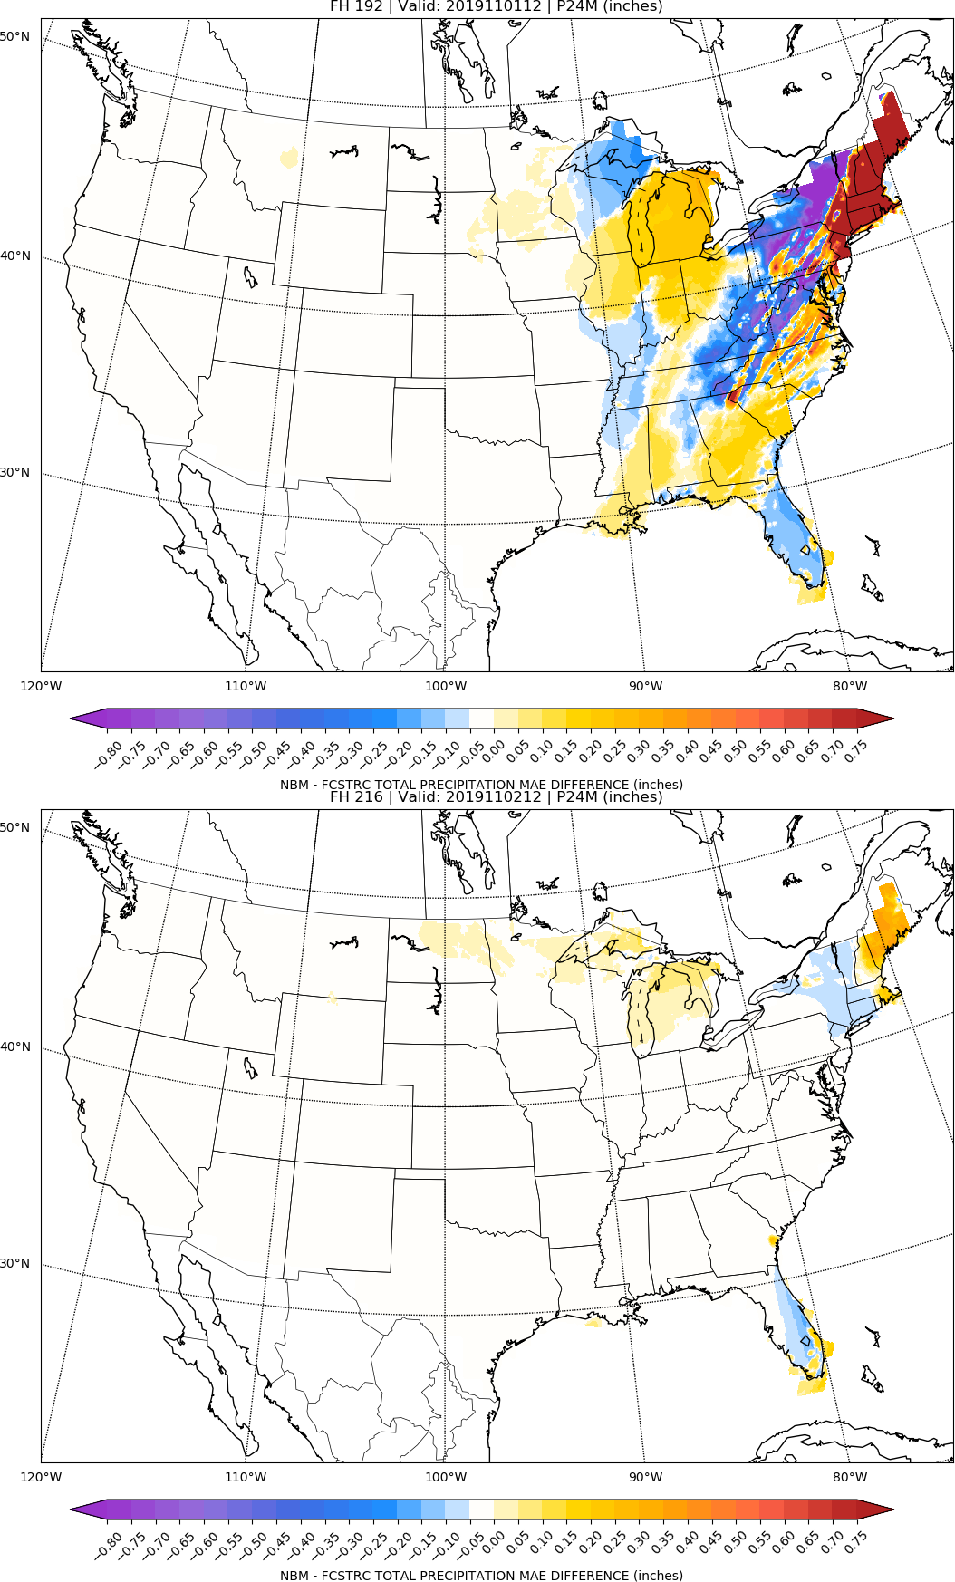
NBM vs FCSTR-C
Blend Comparison
Day 8
MAE_{NBM} – MAE_{FCSTRC} } > 0 is FCSTRC
improvement
over NBM
Day 9
FCSTRC Worse
FCSTRC Better

Slide 42
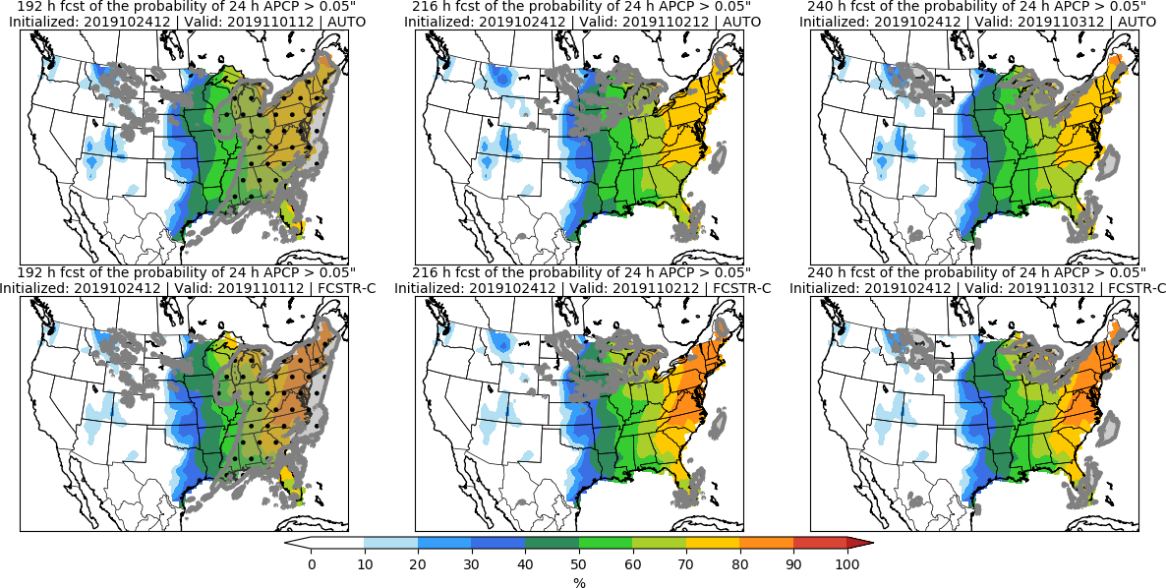
Day 8 Day 9 Day 10

Slide 43
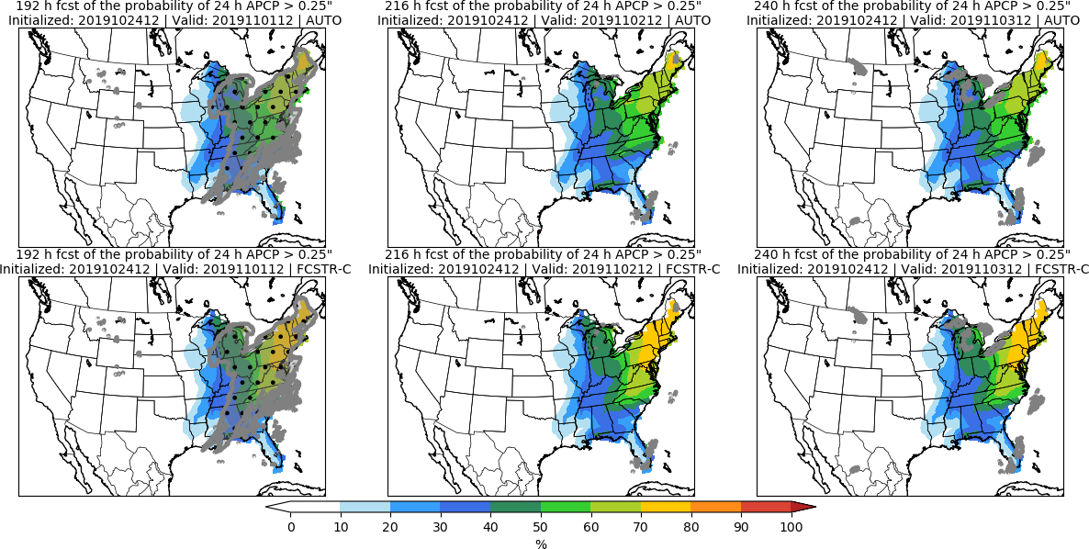
Day 8 Day 9 Day 10

Slide 44
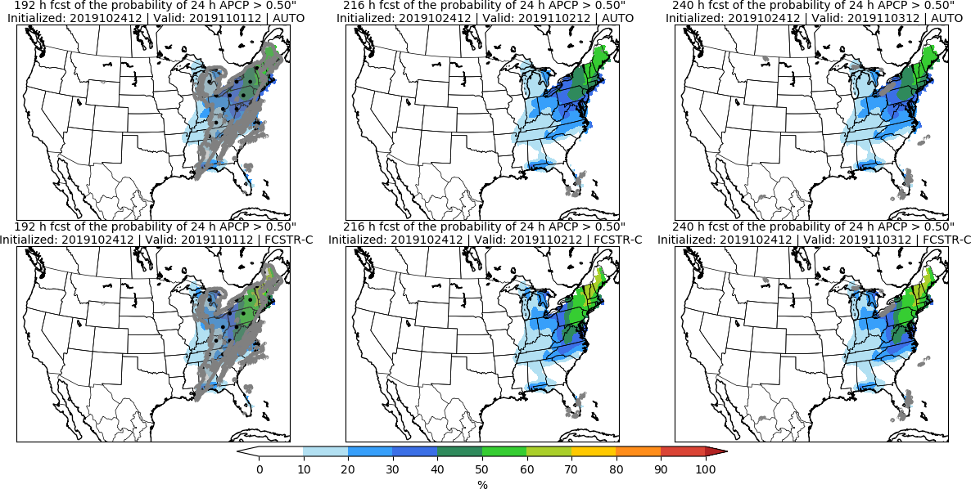
Day 8 Day 9 Day 10

Slide 45
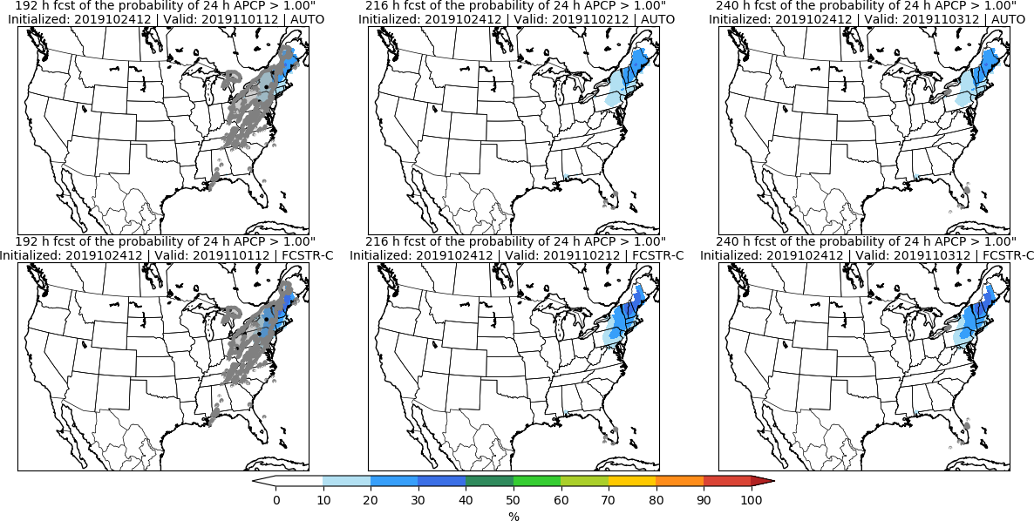
Day 8 Day 9 Day 10

Slide 46
Day 8–10 Hazards

Slide 47
No Hazards

Slide 48
Day 3–7 Hazards

Slide 49
No Hazards

