Slide 1
Extended Range Forecast Experiment Verification
CONUS forecasts created 10 October

Slide 2
500 mb Geopotential Height | 500Z

Slide 3
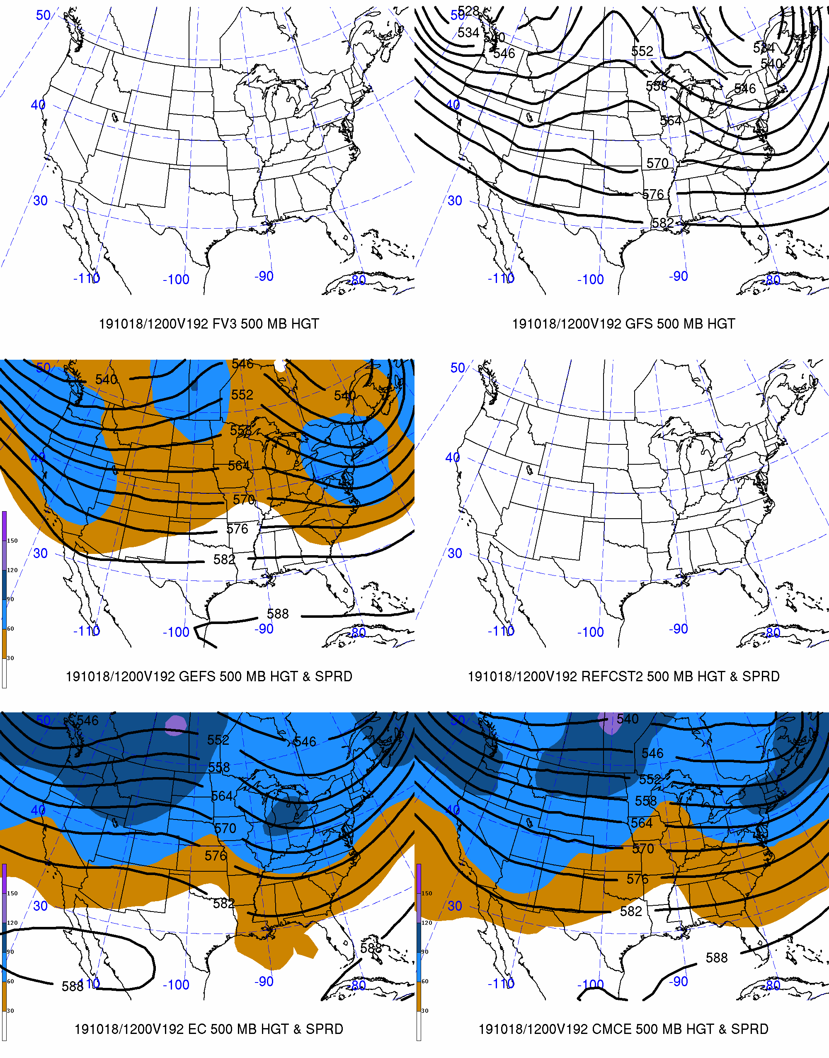
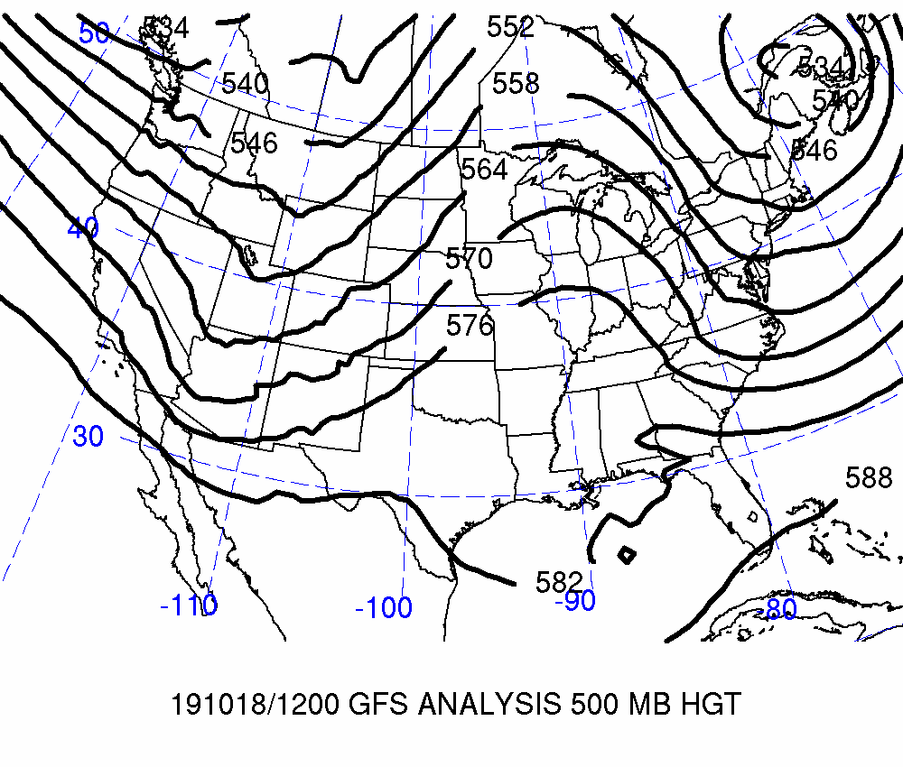
Day 8: Valid 2019-10-18 12Z
FCSTR Blend Weights (%)
TMAX / TMIN / QPF
FV3: 0% / 0% / 0%
GFS: 0% / 0% / 0%
GEFS: 0% / 0% / 0%
REFCST2: 0% / 0% / 0%
EC CTRL: 0% / 0% / 0%
ECENS: 0% / 0% / 0%
CMCE: 0% / 0% / 0%

Slide 4
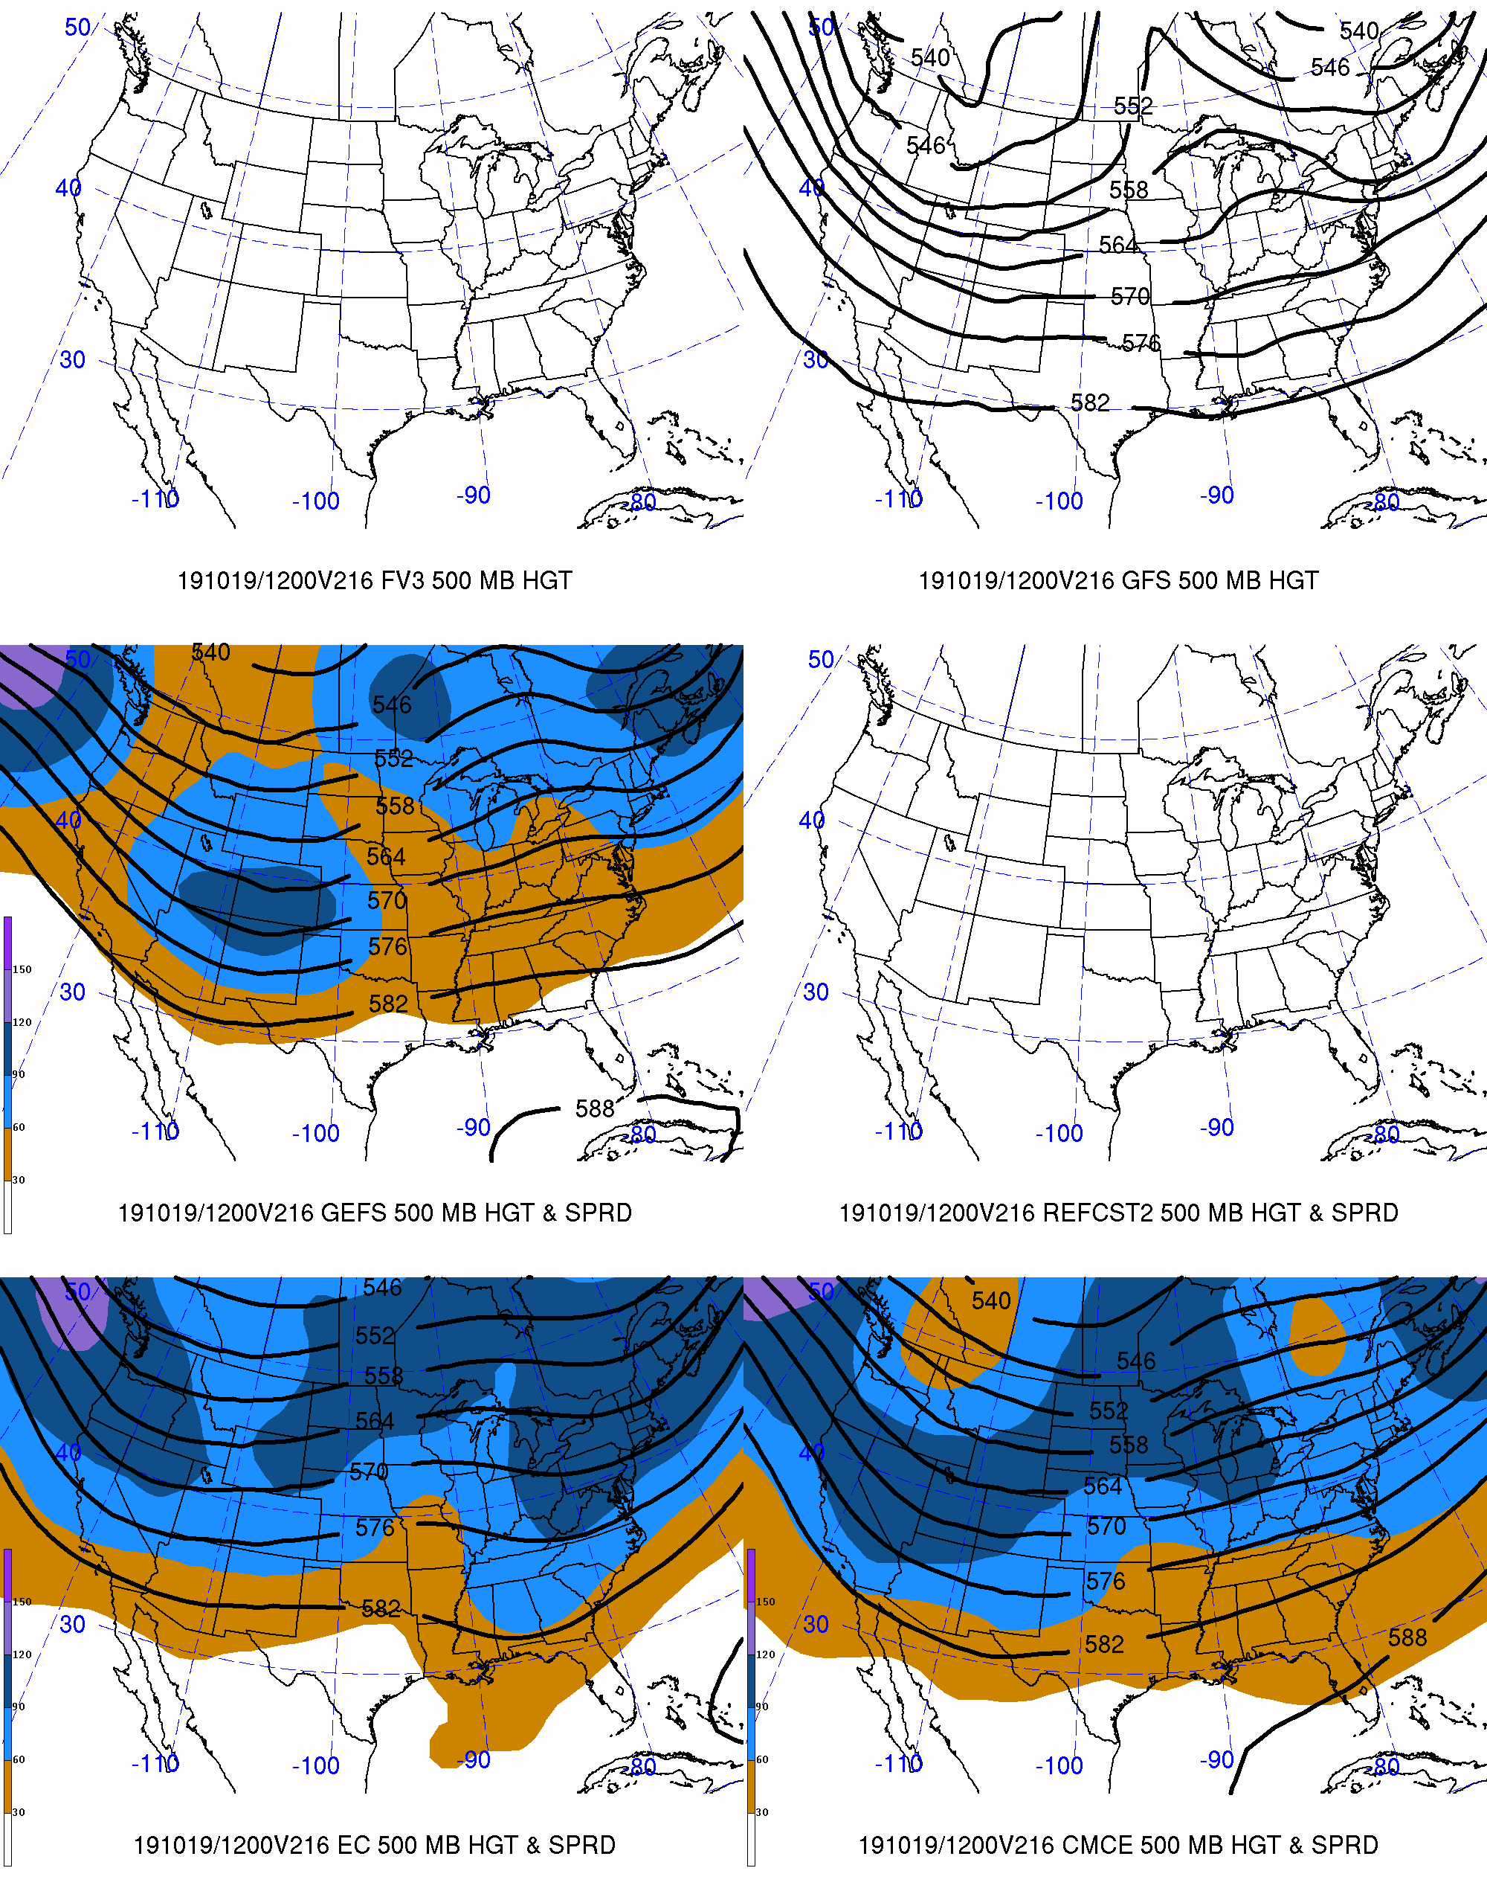
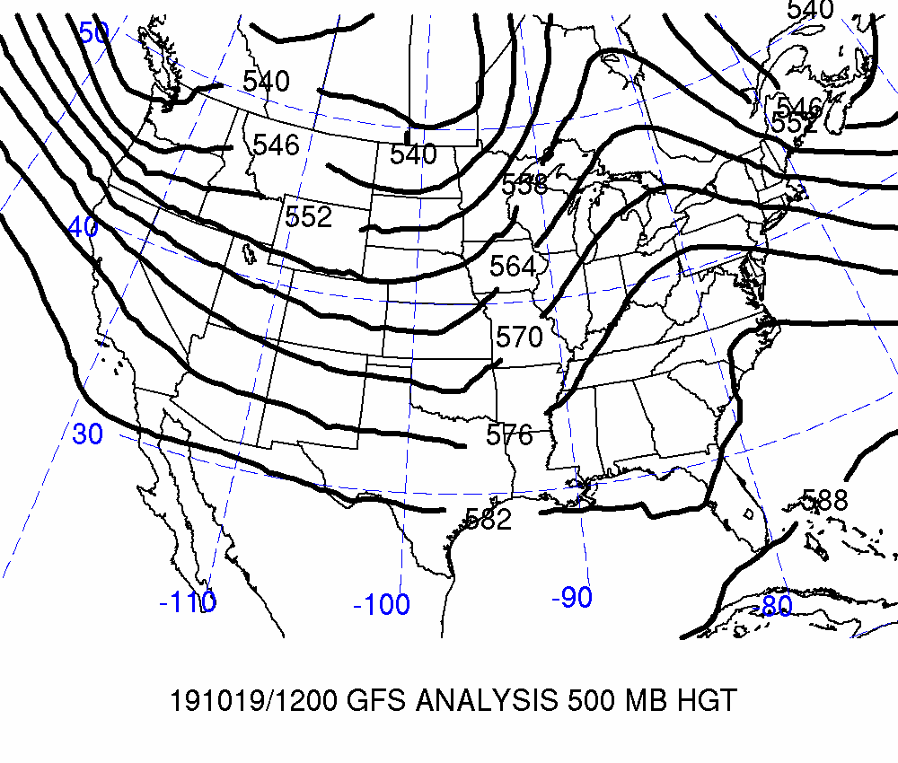
Day 9: Valid 2019-10-19 12Z
FCSTR Blend Weights (%)
TMAX / TMIN / QPF
FV3: 0% / 0% / 0%
GFS: 0% / 0% / 0%
GEFS: 0% / 0% / 0%
REFCST2: 0% / 0% / 0%
EC CTRL: 0% / 0% /0%
ECENS: 0% / 0% / 0%
CMCE: 0% / 0% / 0%

Slide 5
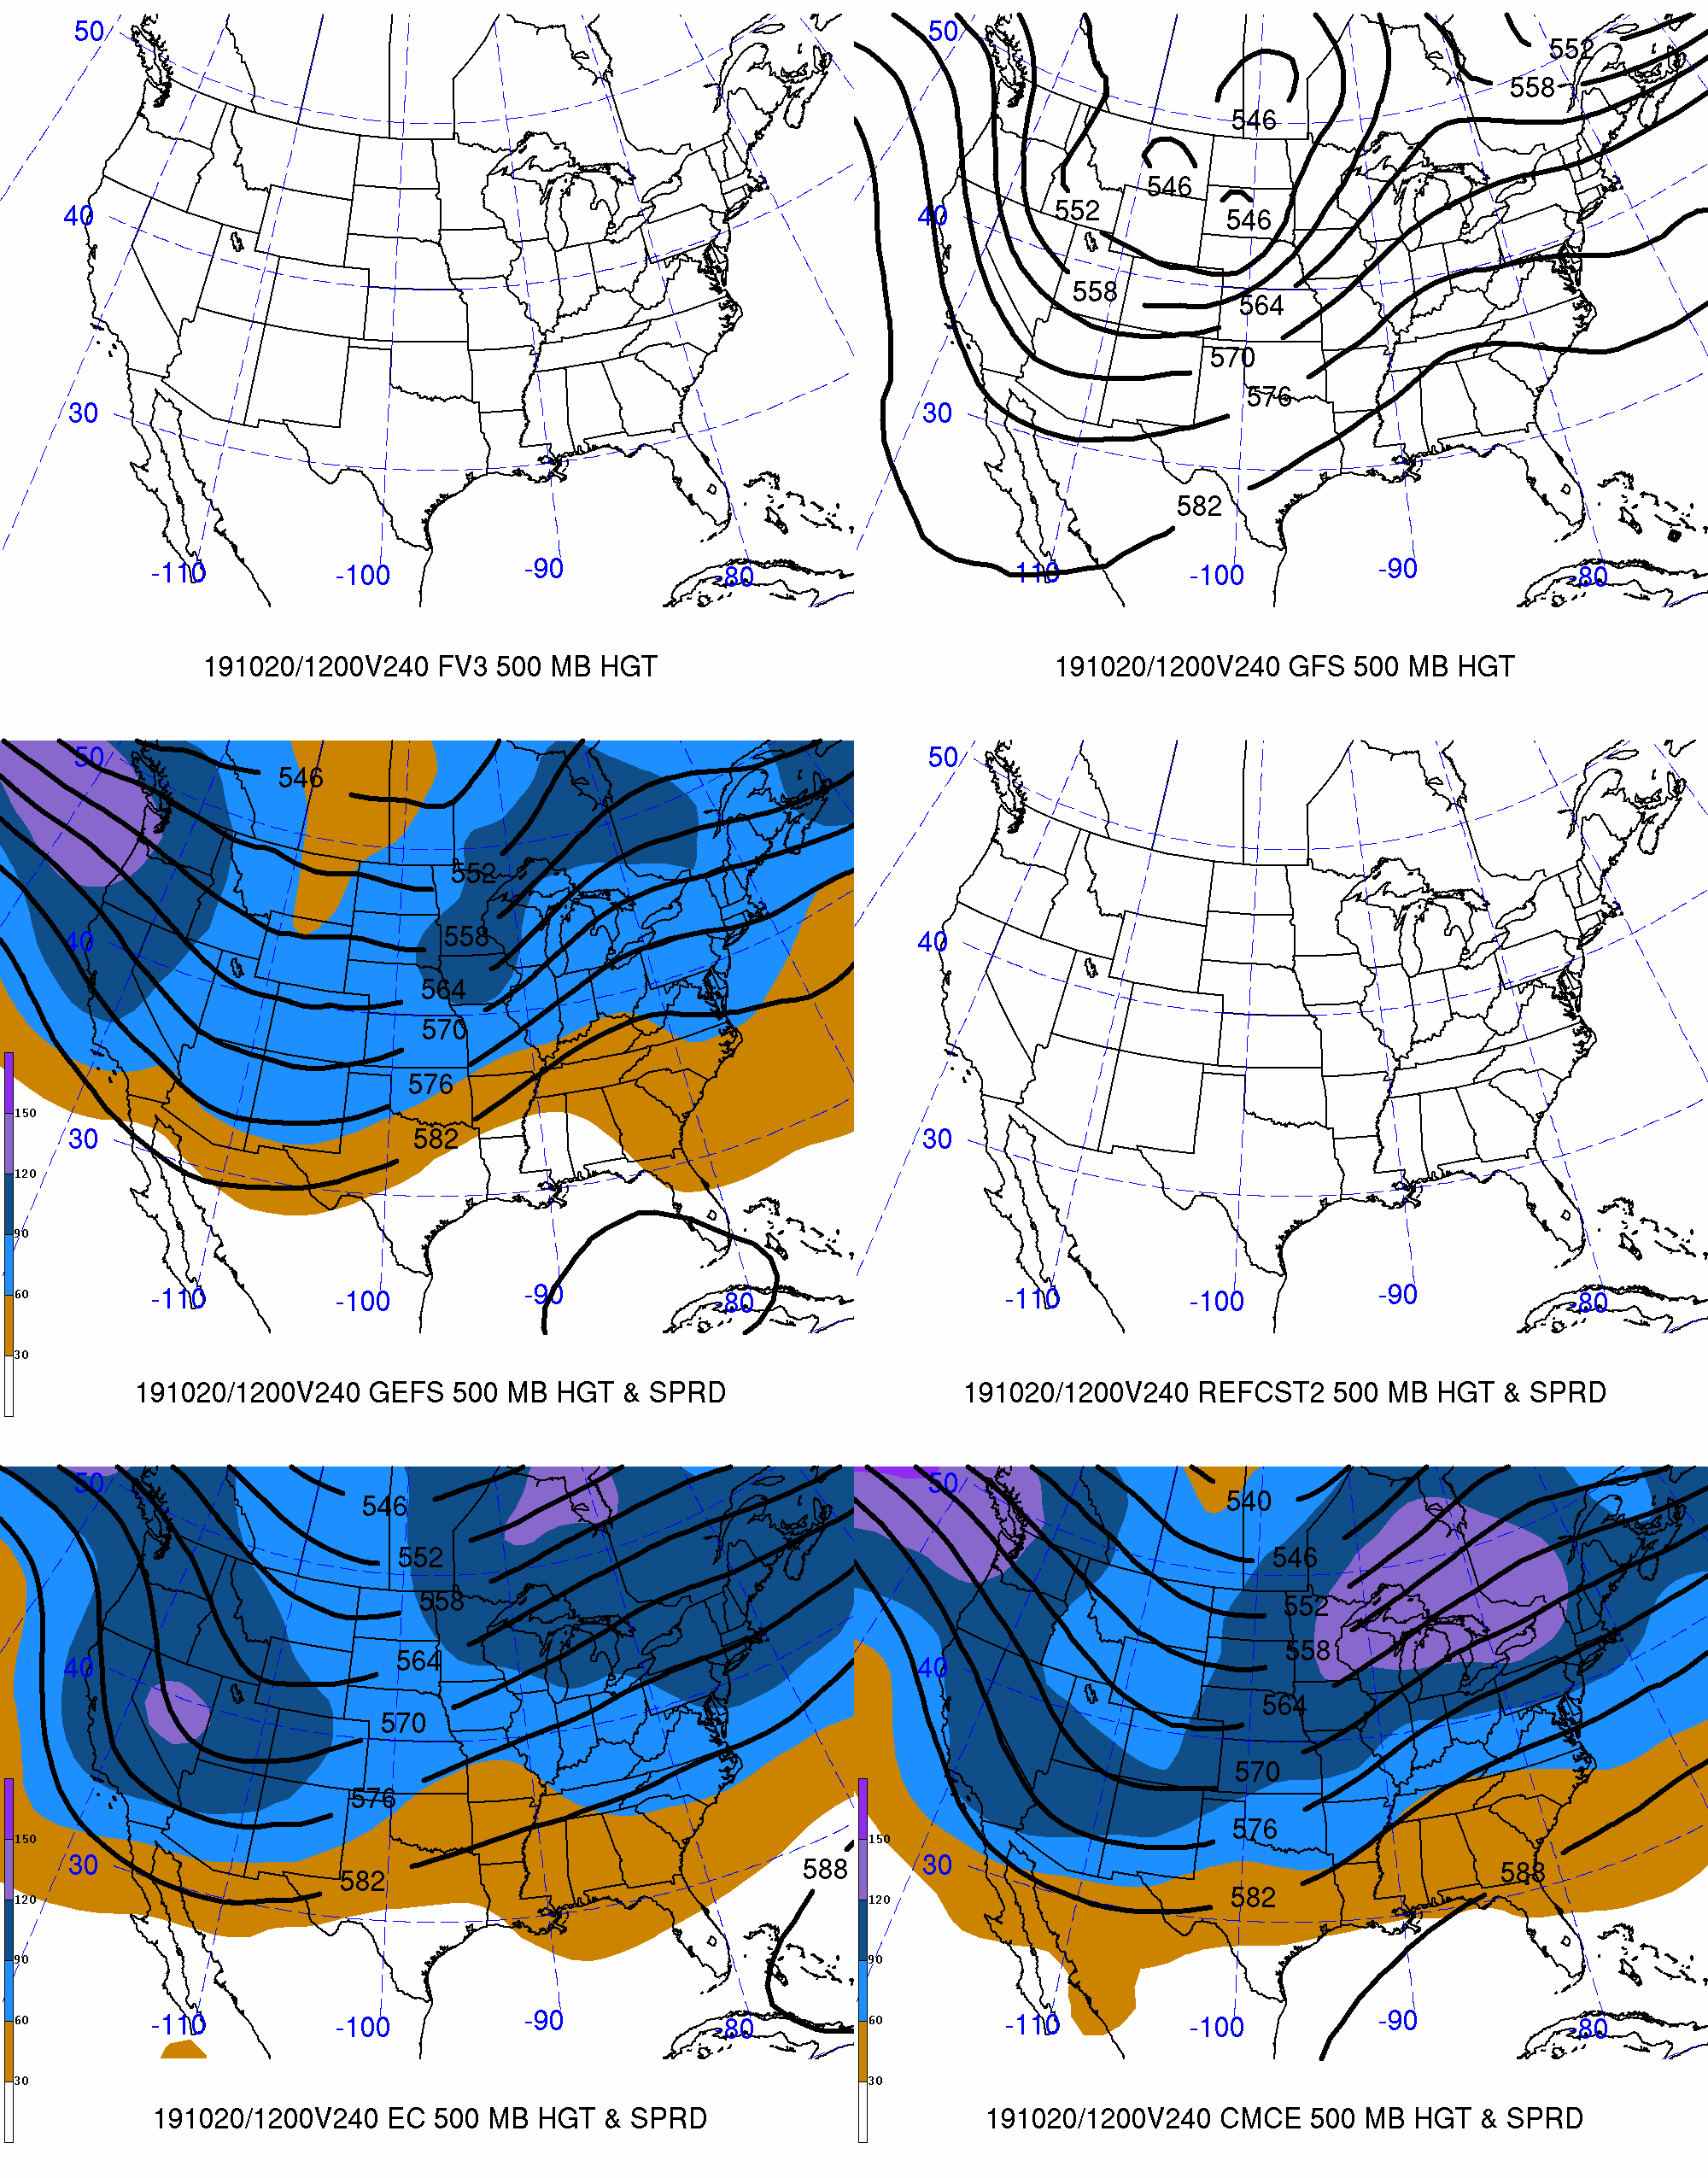
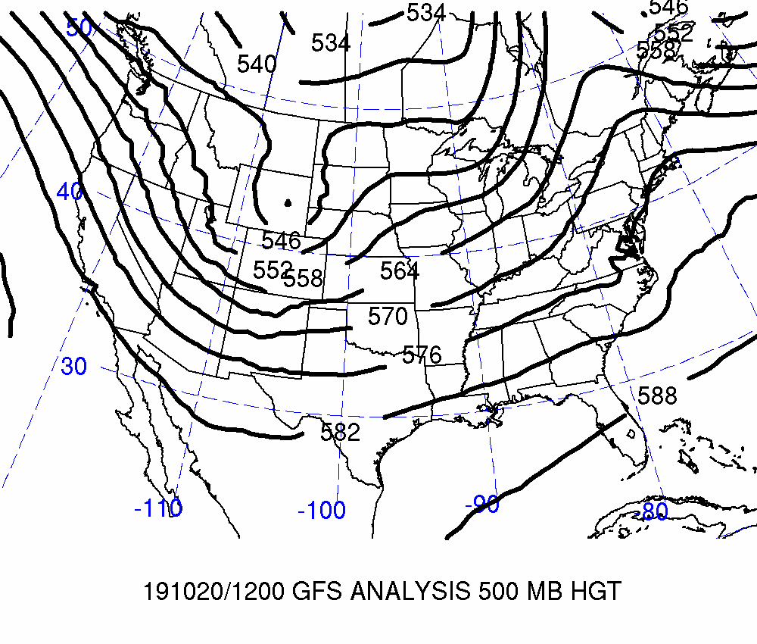
Day 10: Valid 2019-10-20 12Z
FCSTR Blend Weights (%)
TMAX / TMIN / QPF
FV3: 0% / 0% / 0%
GFS: 0% / 0% / 0%
GEFS: 0% / 0% / 0%
REFCST2: 0% / 0% / 0%
EC CTRL: 0% / 0% / 0%
ECENS: 0% / 0% / 0%
CMCE: 0% / 0% / 0%

Slide 6
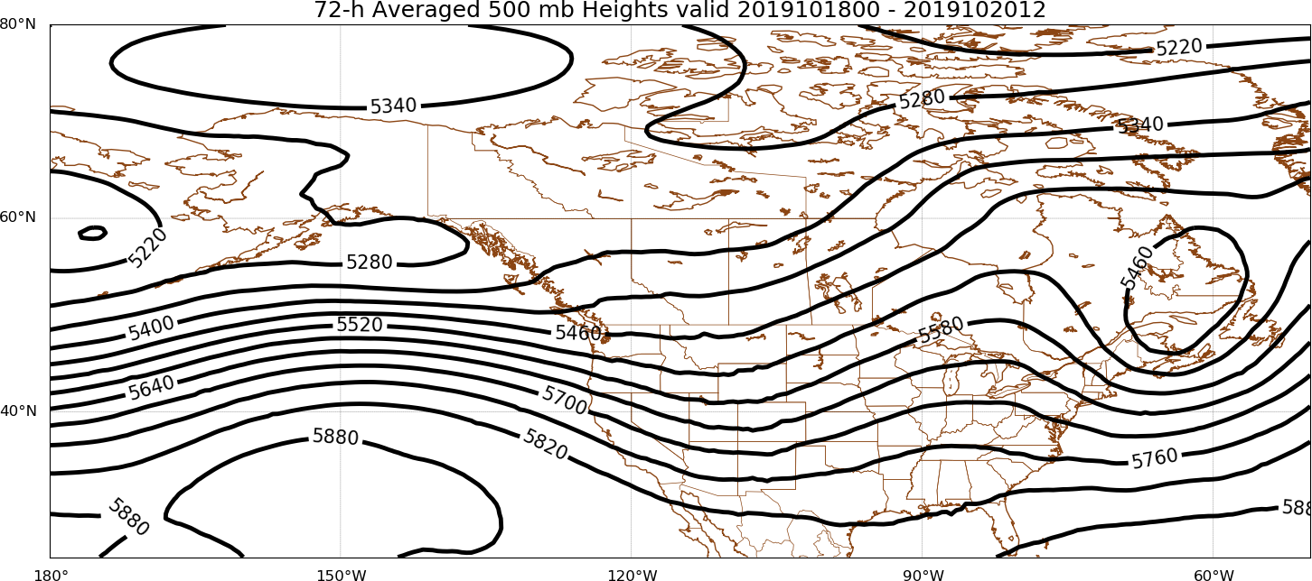
Days 8–10
FCSTR Blend Weights (%): TMAX / TMIN / QPF
EOF1P: 0% / 0% / 0%
EOF1N: 0% / 0% / 0%
EOFMN: 80% / 80% / 80%
GFS Analysis
EOF2P: 20% / 20% / 20%
EOF2N: 0% / 0% / 0%

Slide 7
Maximum Temperature | TMAX

Slide 8
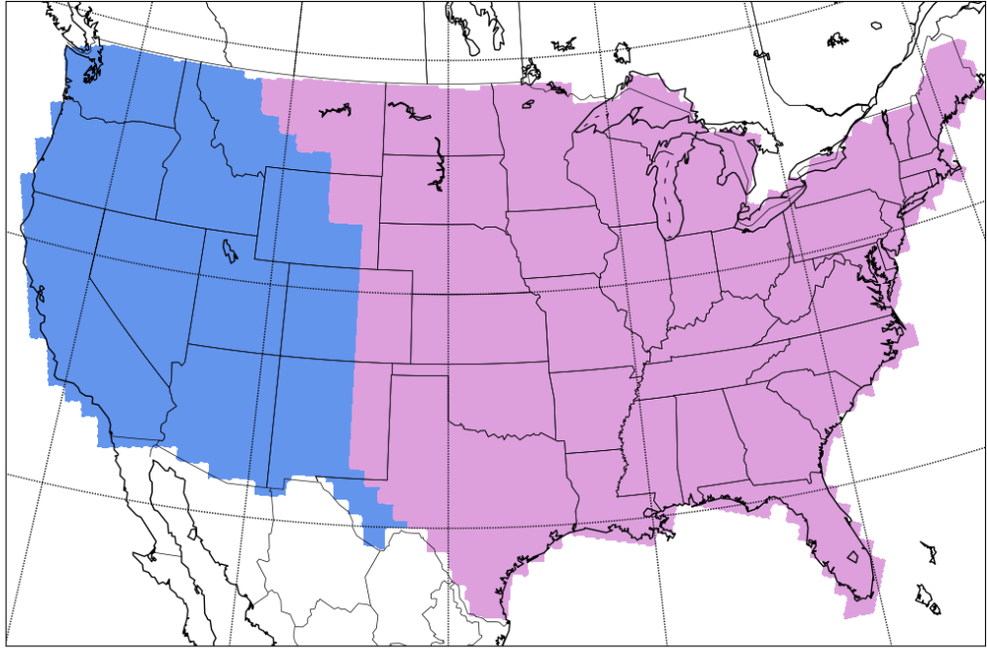
Separation of Western & Eastern CONUS
West
East
West
East

Slide 9
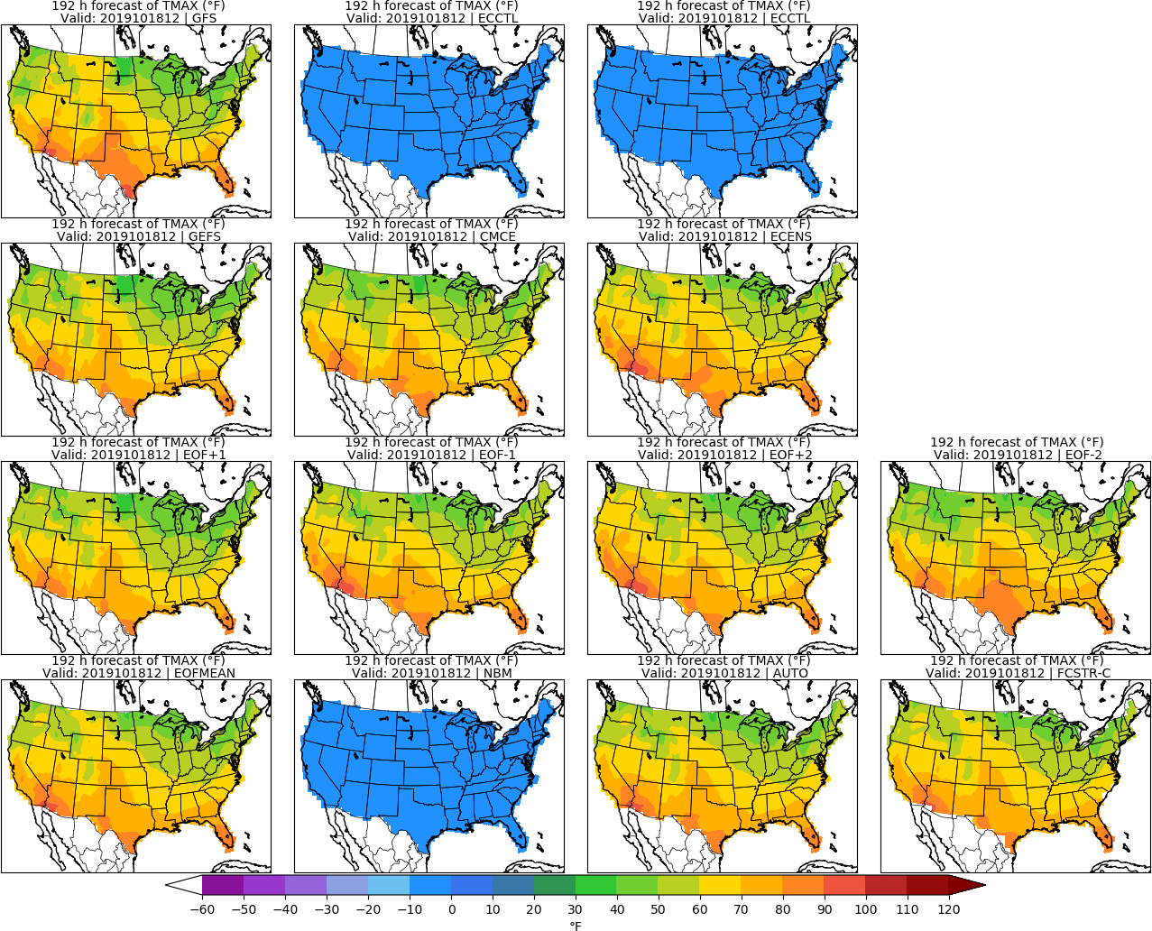
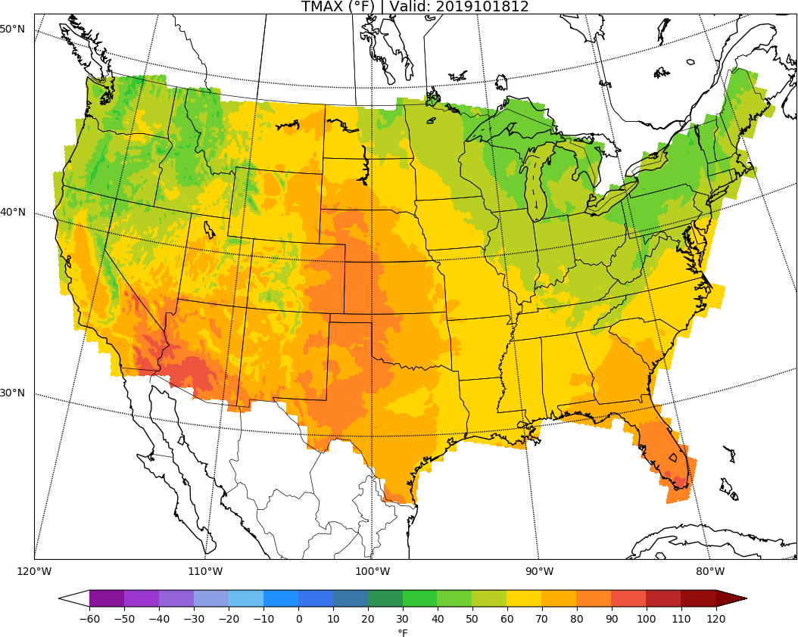
MISSING
ECCTL
Day 8: TMAX
URMA

Slide 10
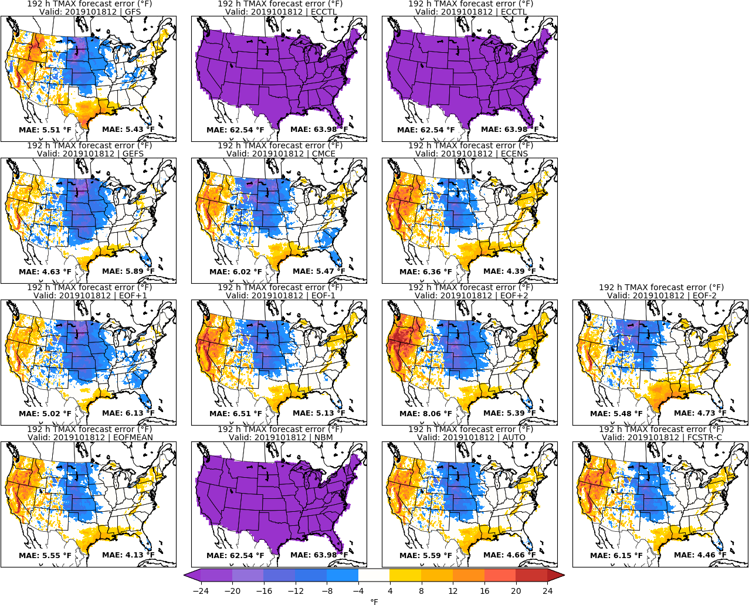
MISSING
ECCTL
Day 8: TMAX
URMA

Slide 11
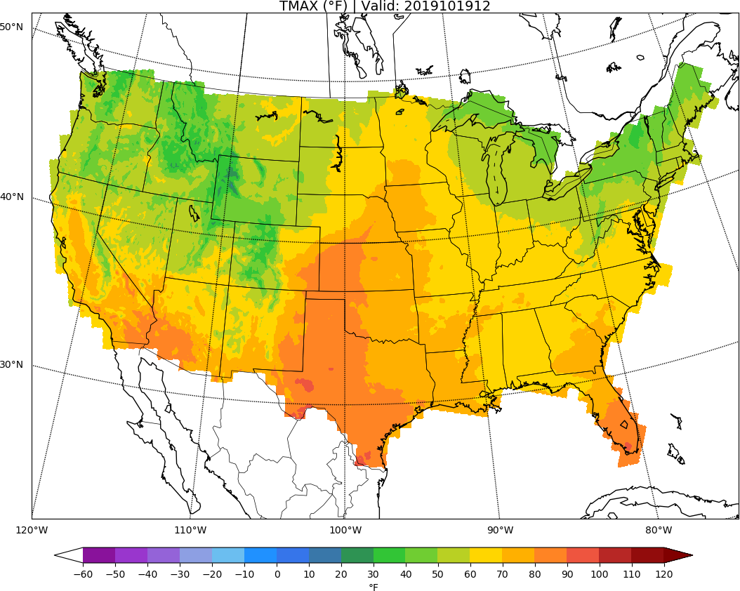
MISSING
ECCTL
Day 9: TMAX
URMA

Slide 12
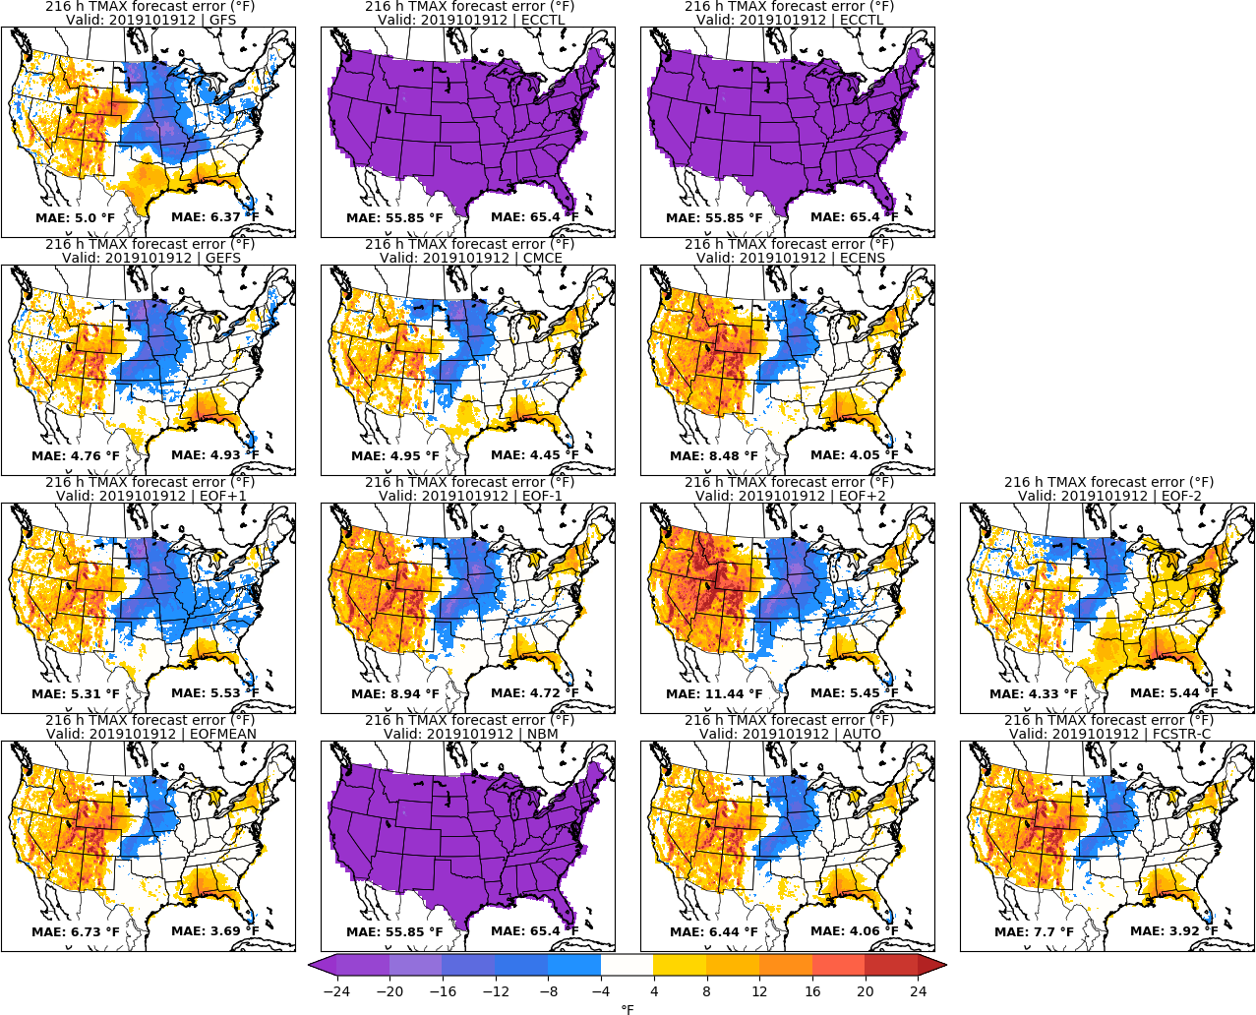
MISSING
ECCTL
Day 9: TMAX
URMA

Slide 13
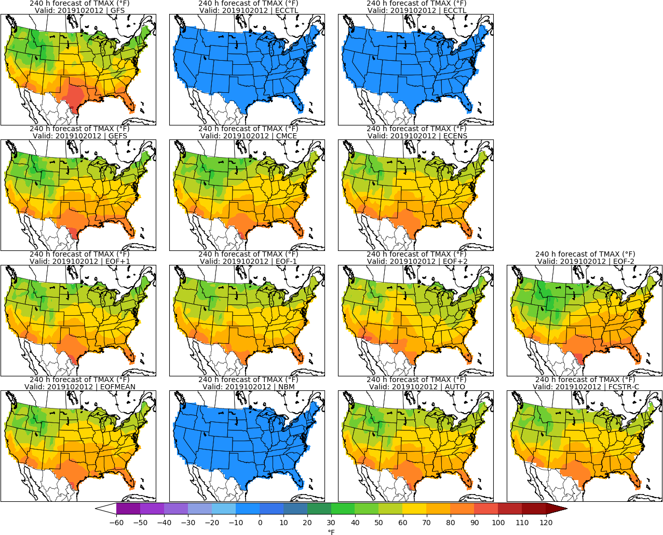
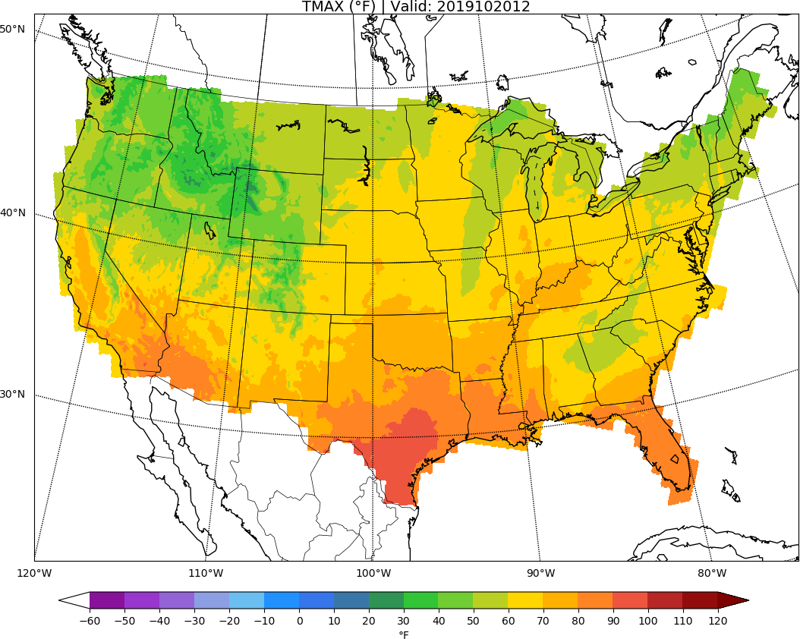
MISSING
ECCTL
Day 10: TMAX
URMA

Slide 14
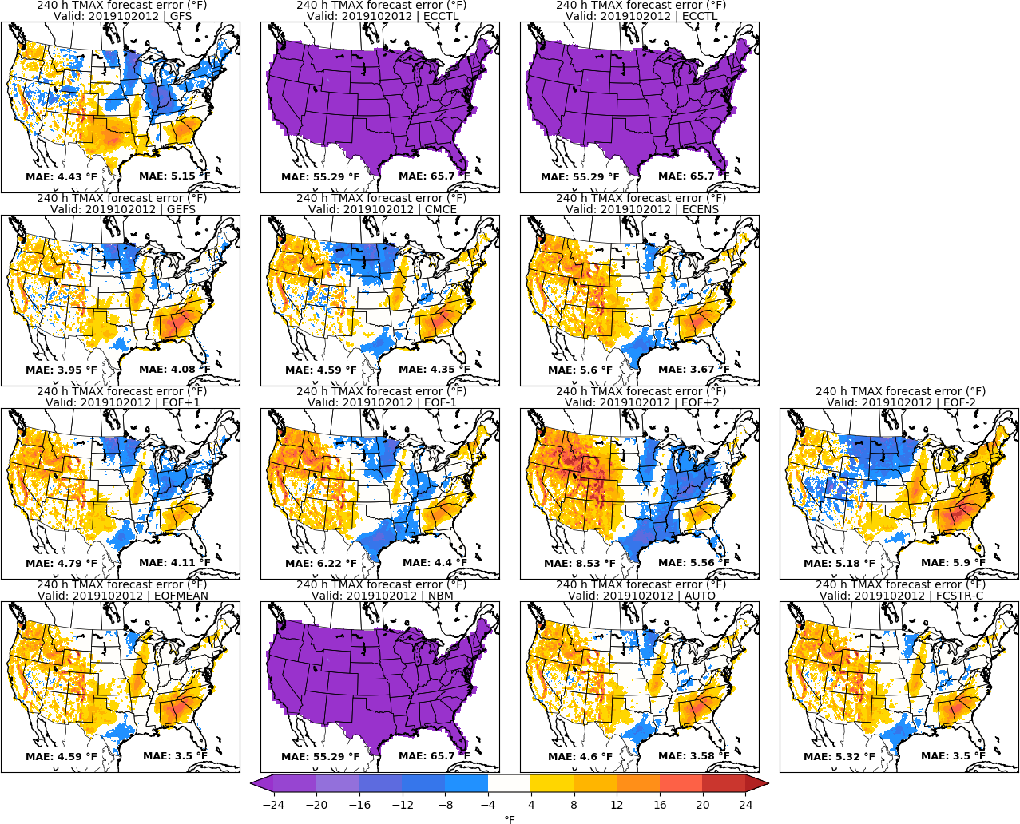
MISSING
ECCTL
Day 10: TMAX
URMA

Slide 15
Minimum Temperature | TMIN

Slide 16
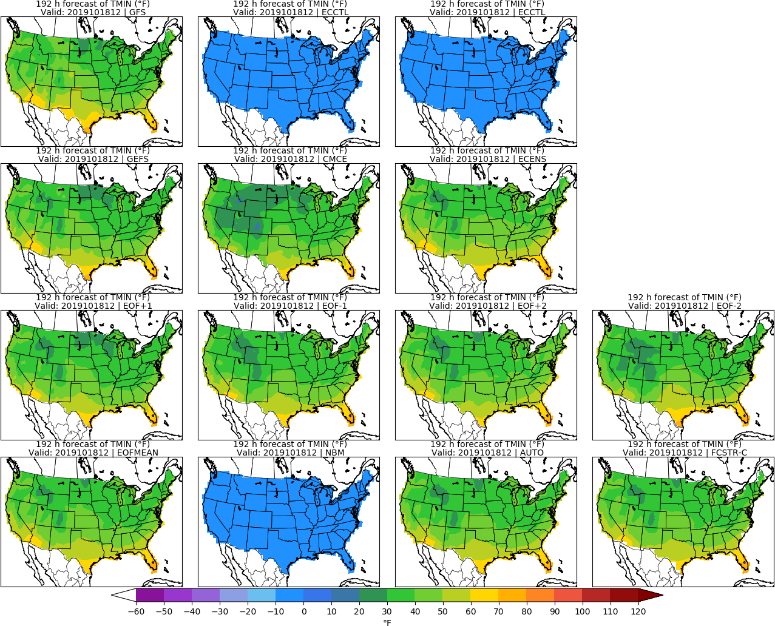
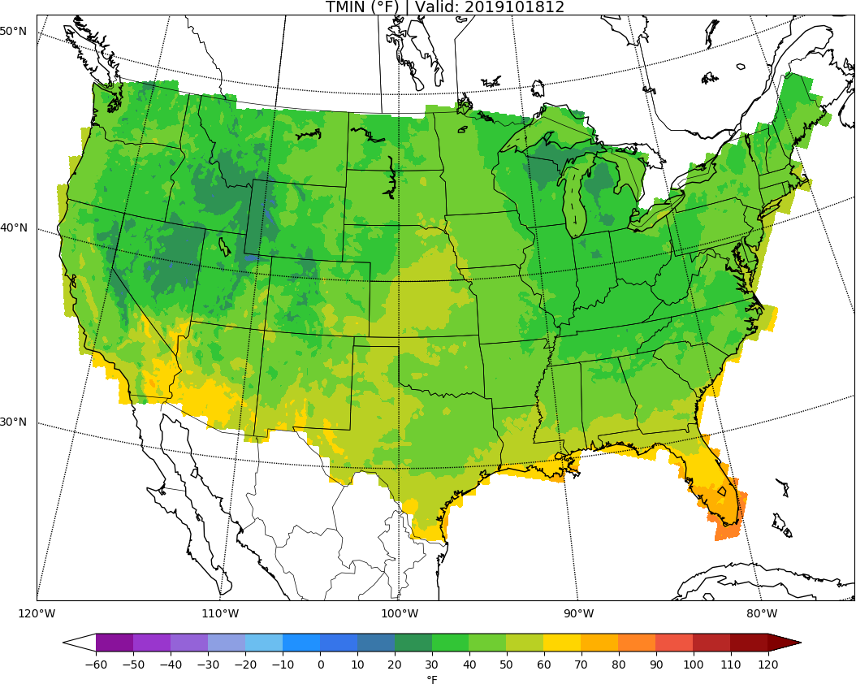
MISSING
ECCTL
Day 8: TMIN
URMA

Slide 17
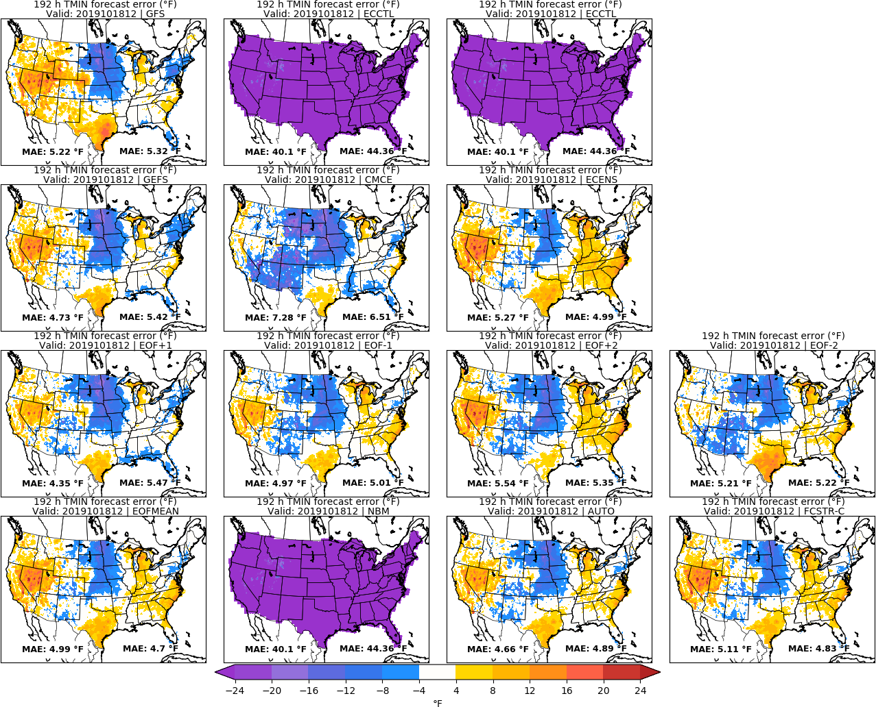
MISSING
ECCTL
Day 8: TMIN
URMA

Slide 18
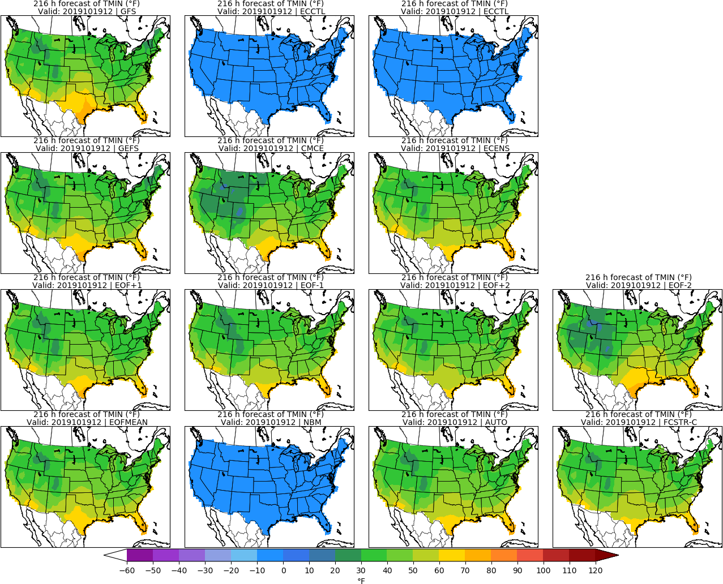
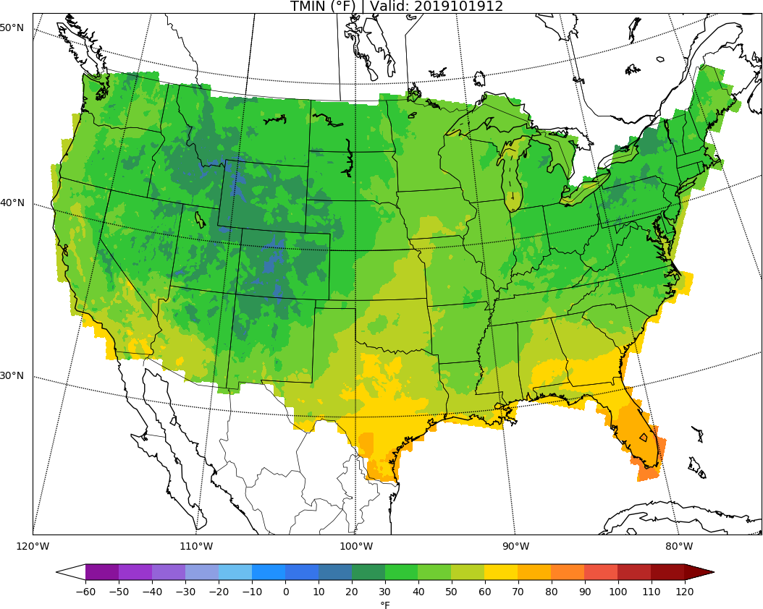
MISSING
ECCTL
Day 9: TMIN
URMA

Slide 19
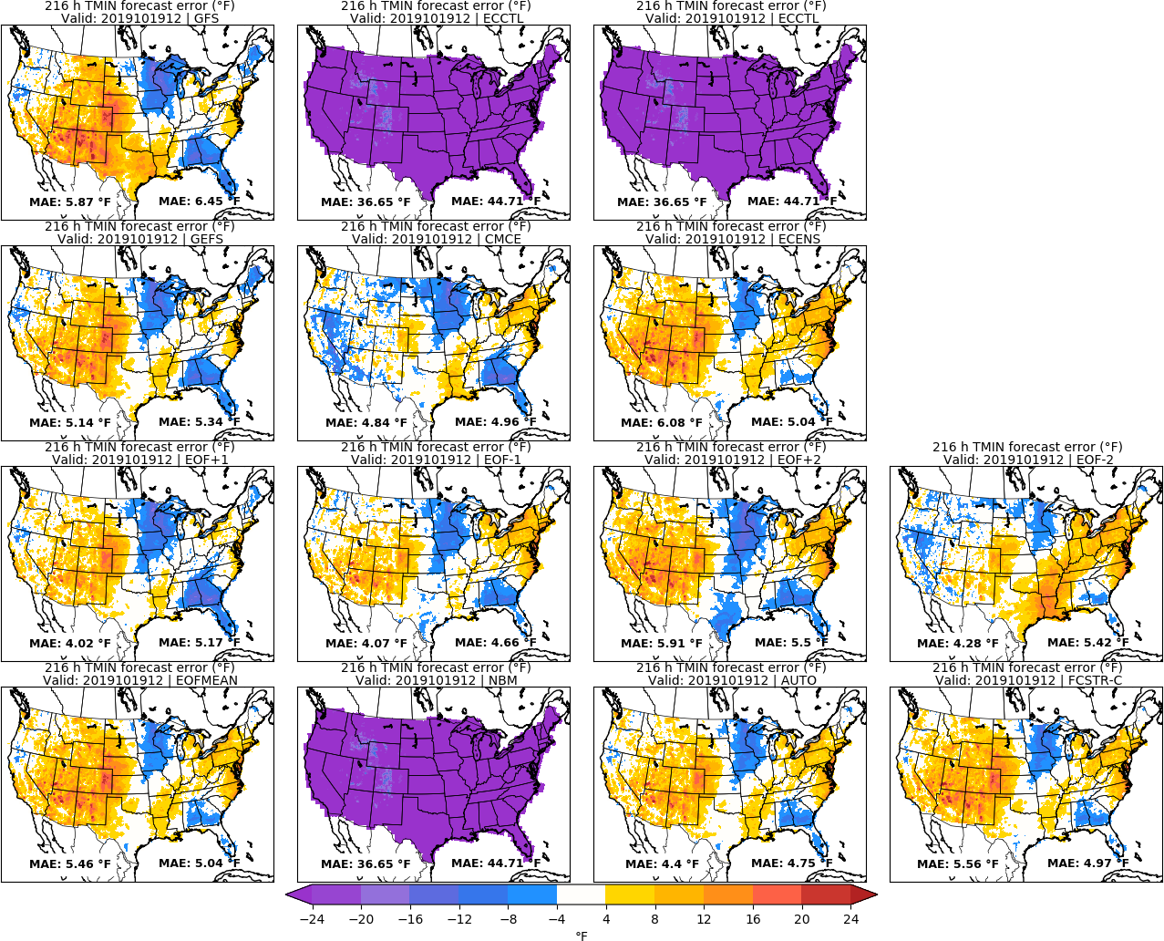
MISSING
ECCTL
Day 9: TMIN
URMA

Slide 20
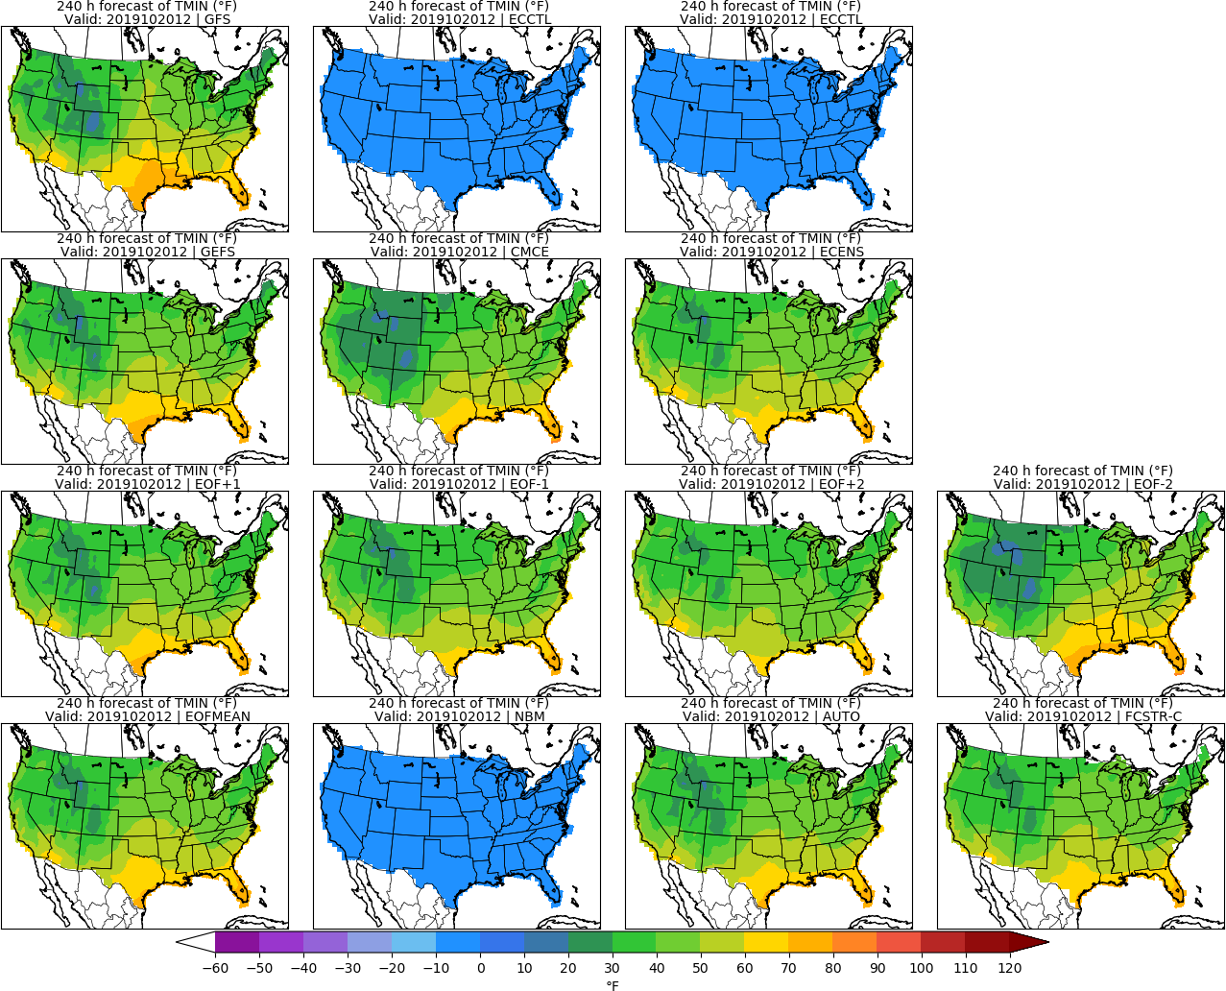
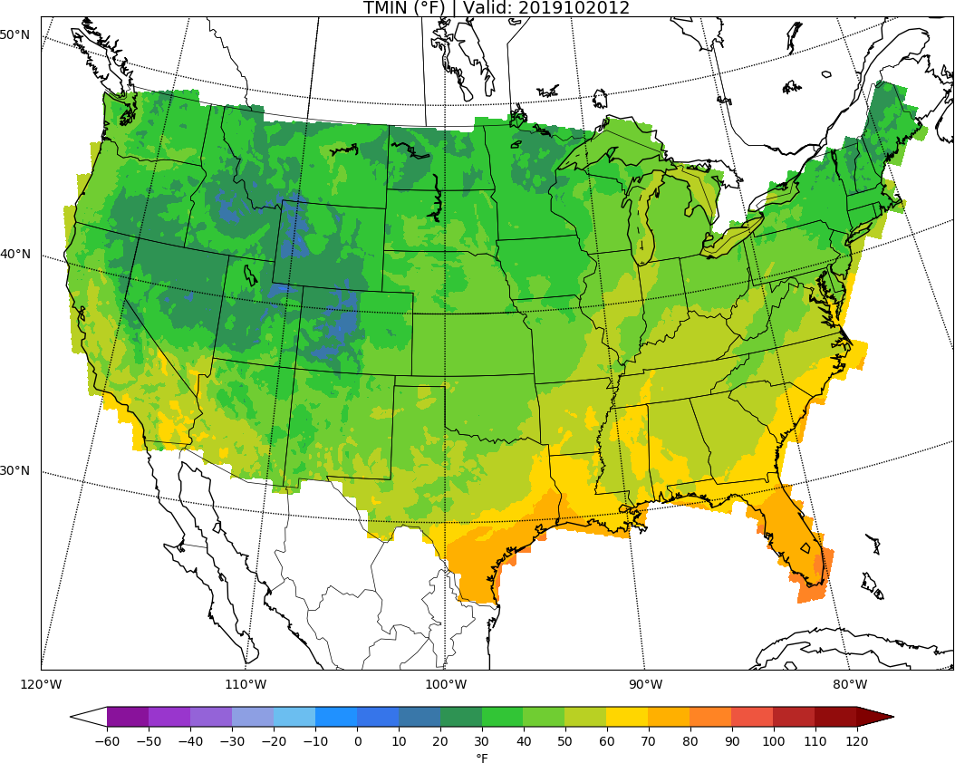
MISSING
ECCTL
Day 10: TMIN
URMA

Slide 21
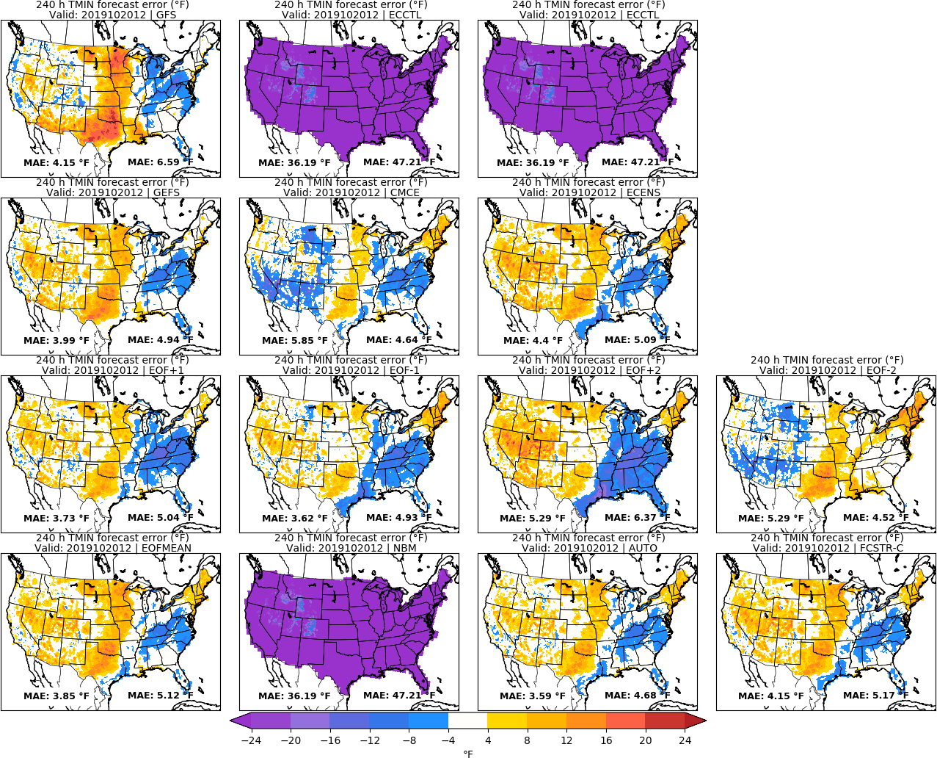
MISSING
ECCTL
Day 10: TMIN
URMA

Slide 22
Accumulated Precipitation | APCP

Slide 23
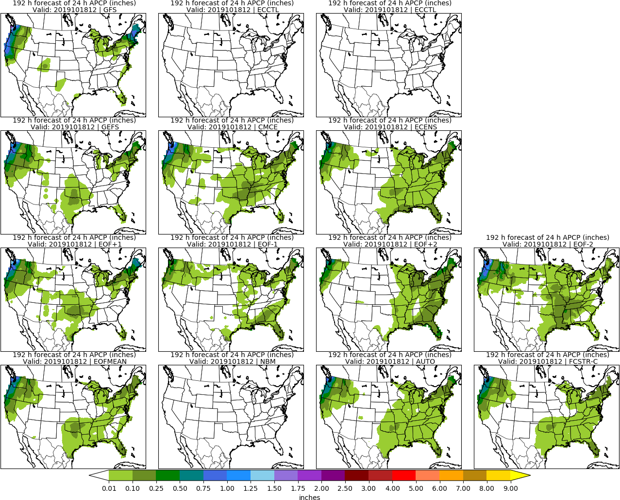
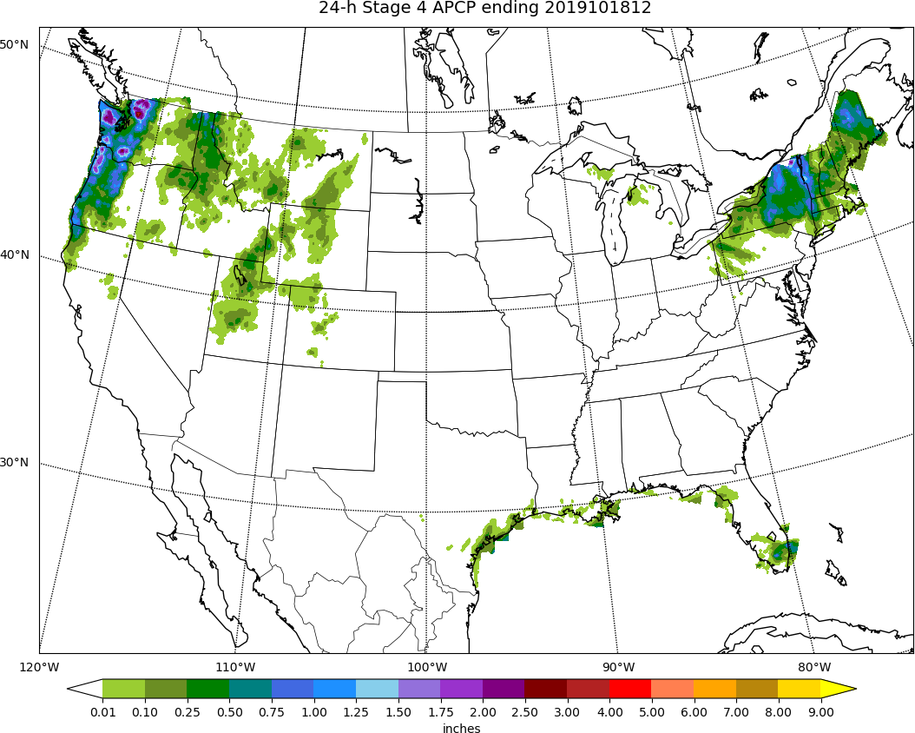
MISSING
ECCTL
Day 8: APCP
STAGE 4

Slide 24
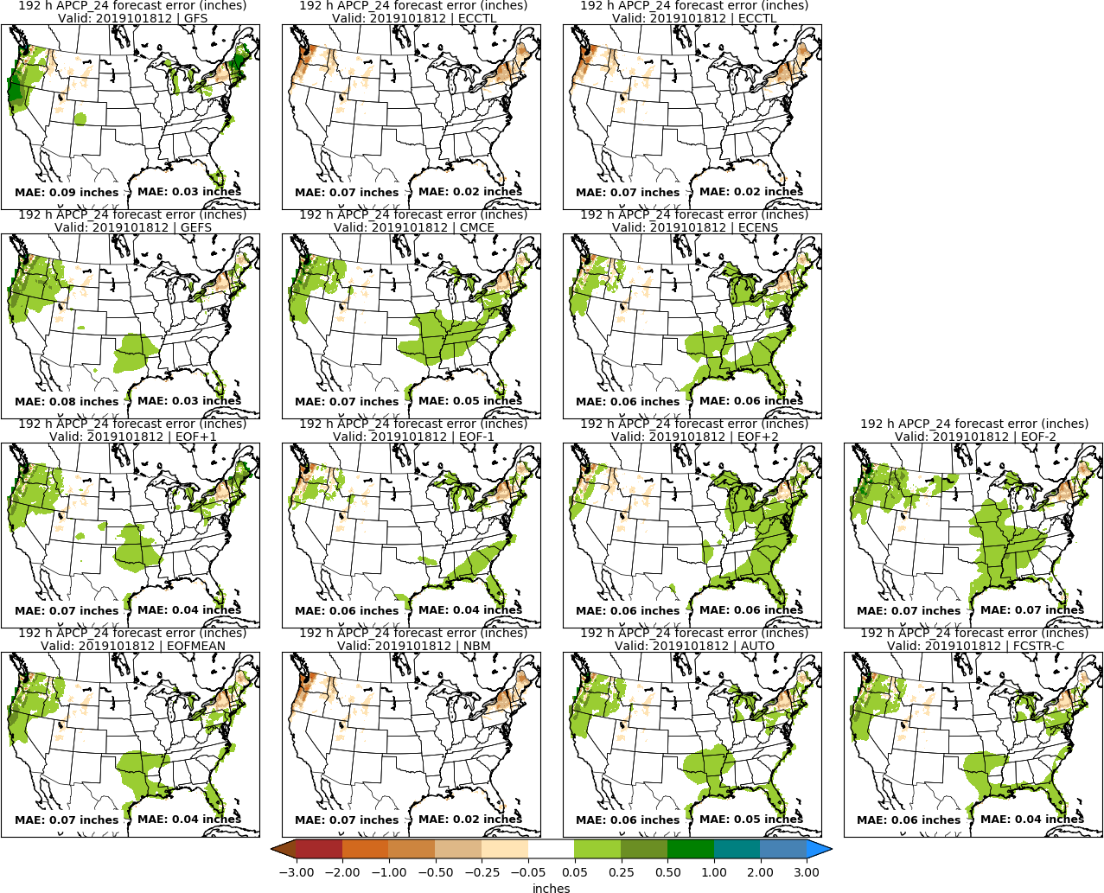
MISSING
ECCTL
Day 8: APCP
STAGE 4

Slide 25
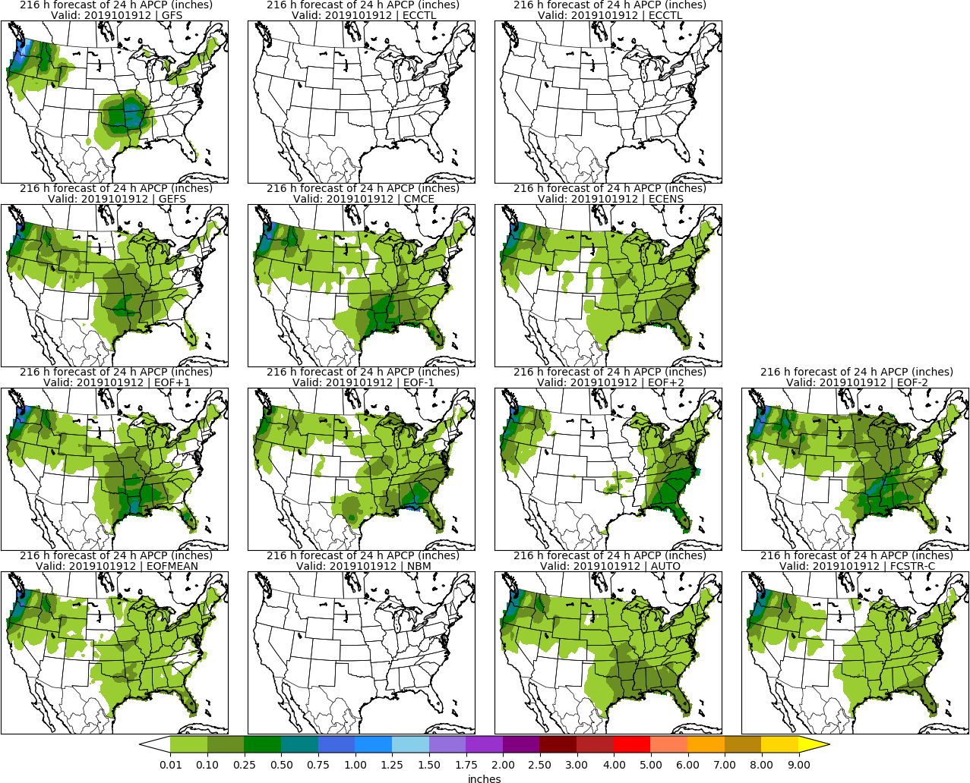
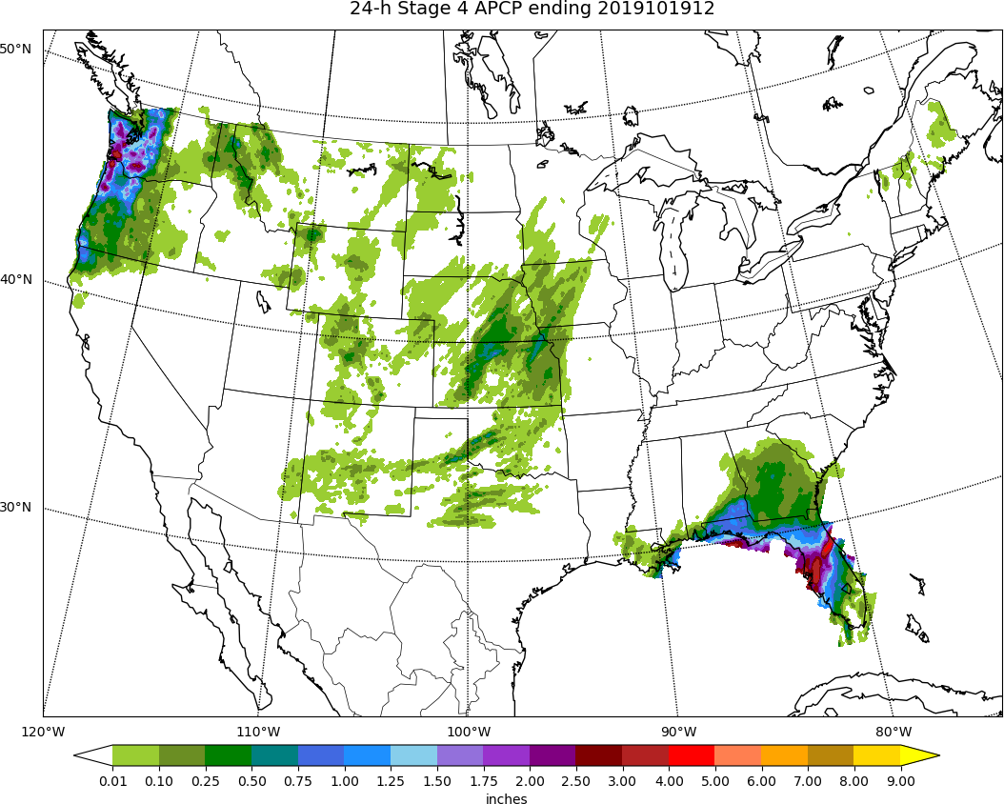
MISSING
ECCTL
Day 9: APCP
STAGE 4

Slide 26
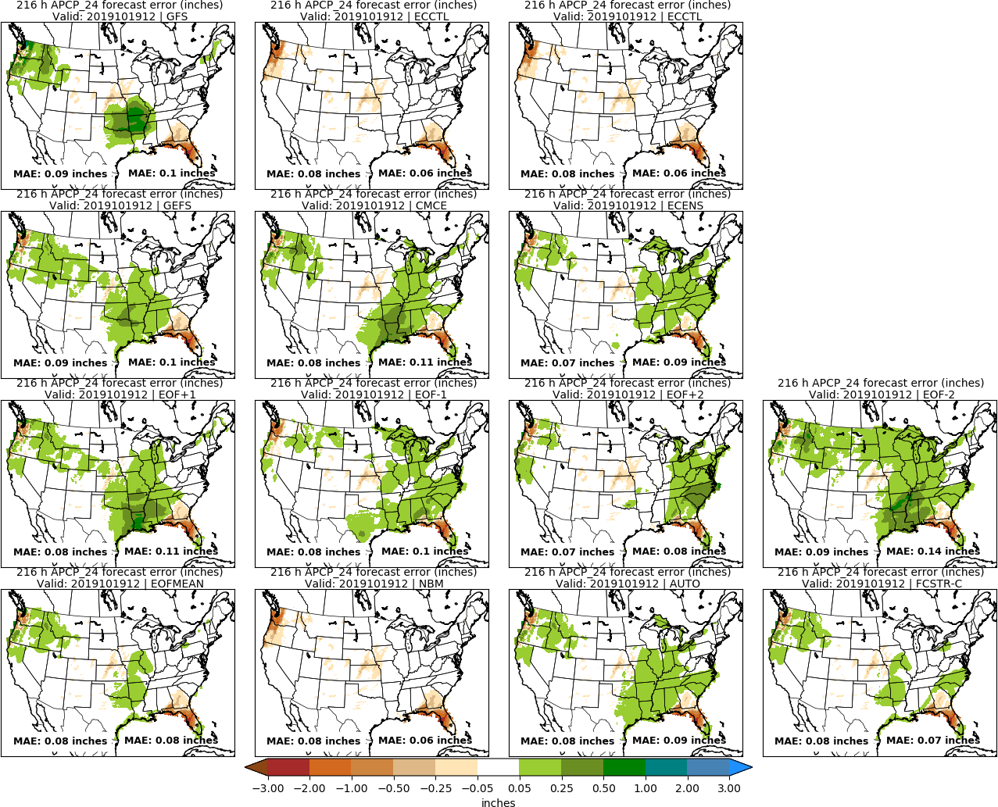
MISSING
ECCTL
Day 9: APCP
STAGE 4

Slide 27
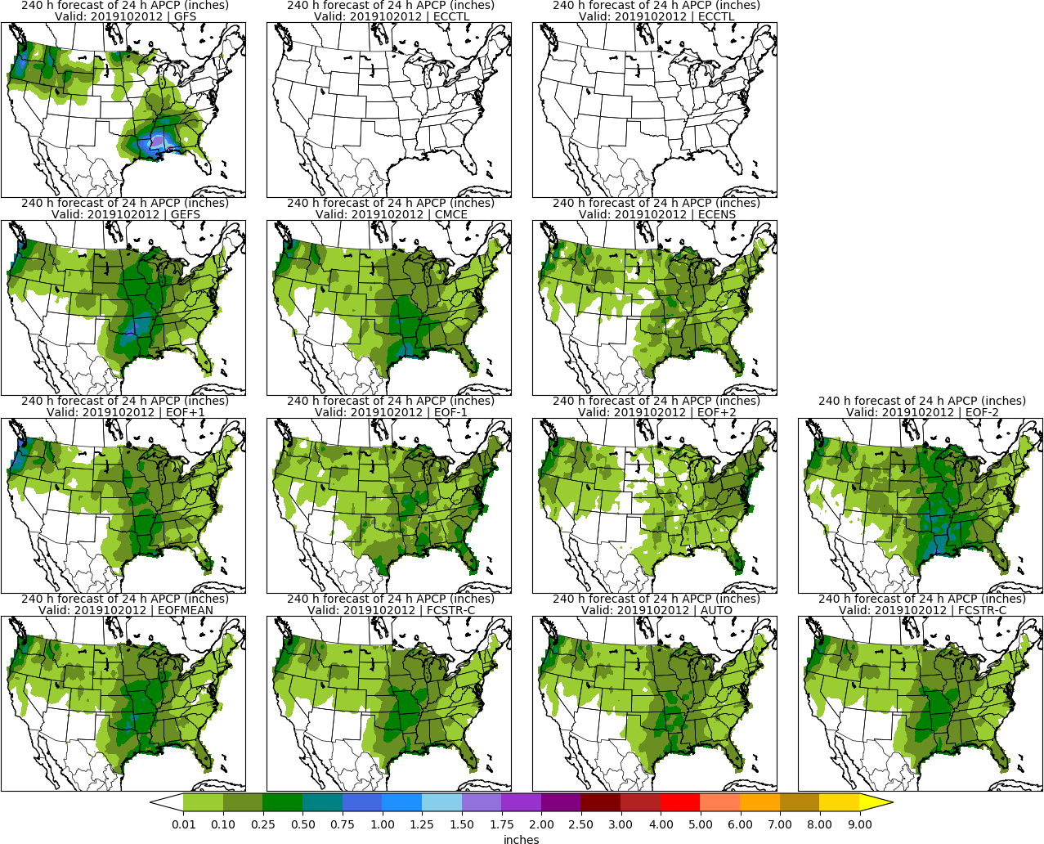
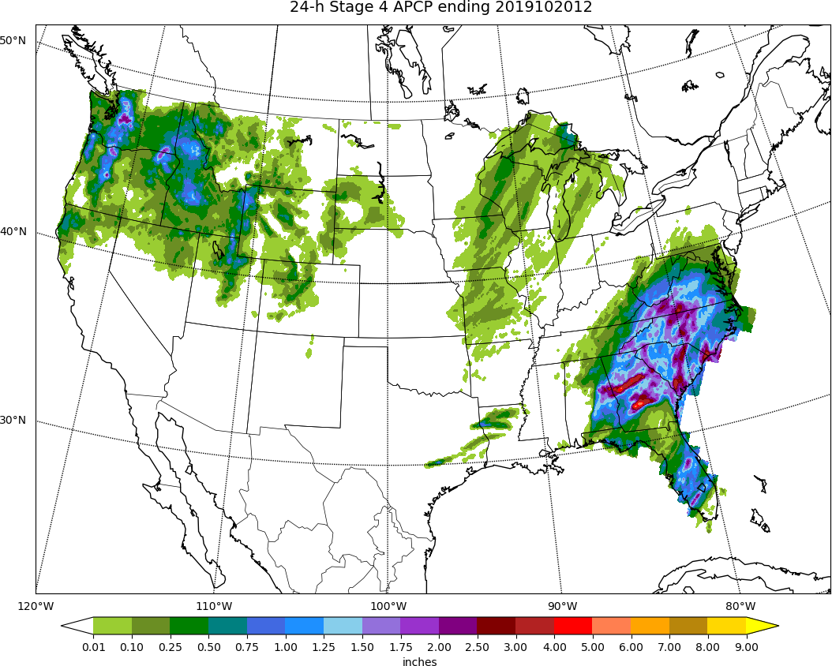
MISSING
ECCTL
Day 10: APCP
STAGE 4

Slide 28
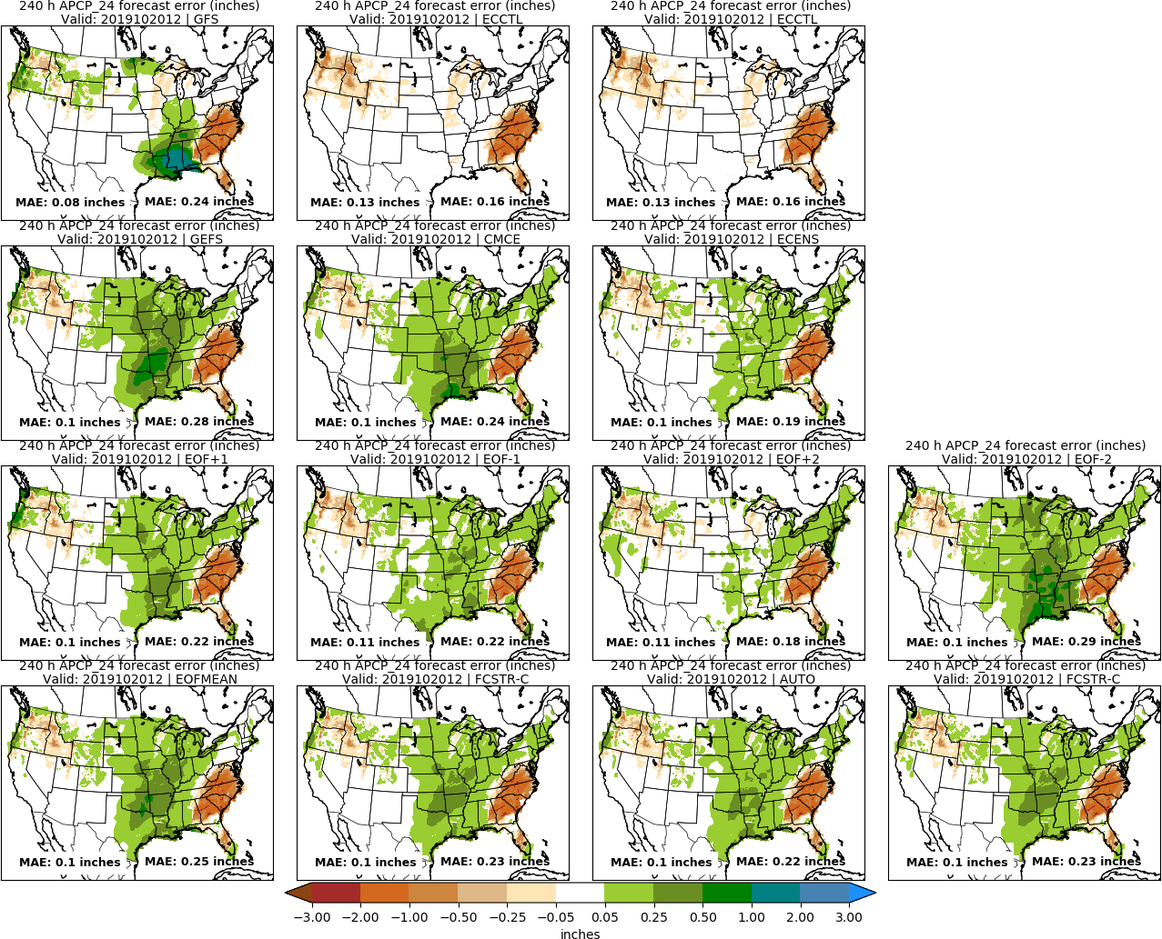
MISSING
ECCTL
Day 10: APCP
STAGE 4

Slide 29
Day 8–10 Hazards

Slide 30
No Hazards

Slide 31
Day 3–7 Hazards

Slide 32
No Hazards

