Slide 1
Extended Range Forecast Experiment Verification
CONUS forecasts created 12 September

Slide 2
500 mb Geopotential Height | 500Z

Slide 3
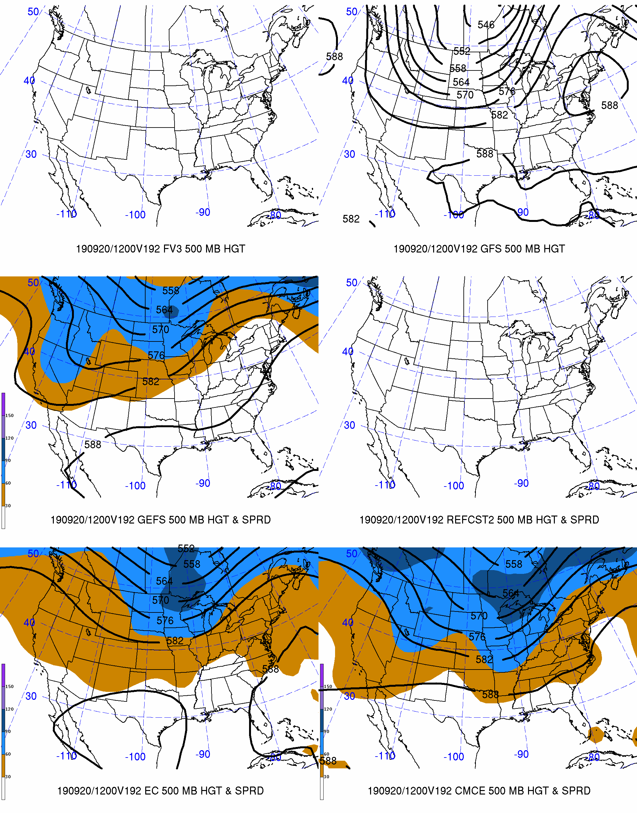
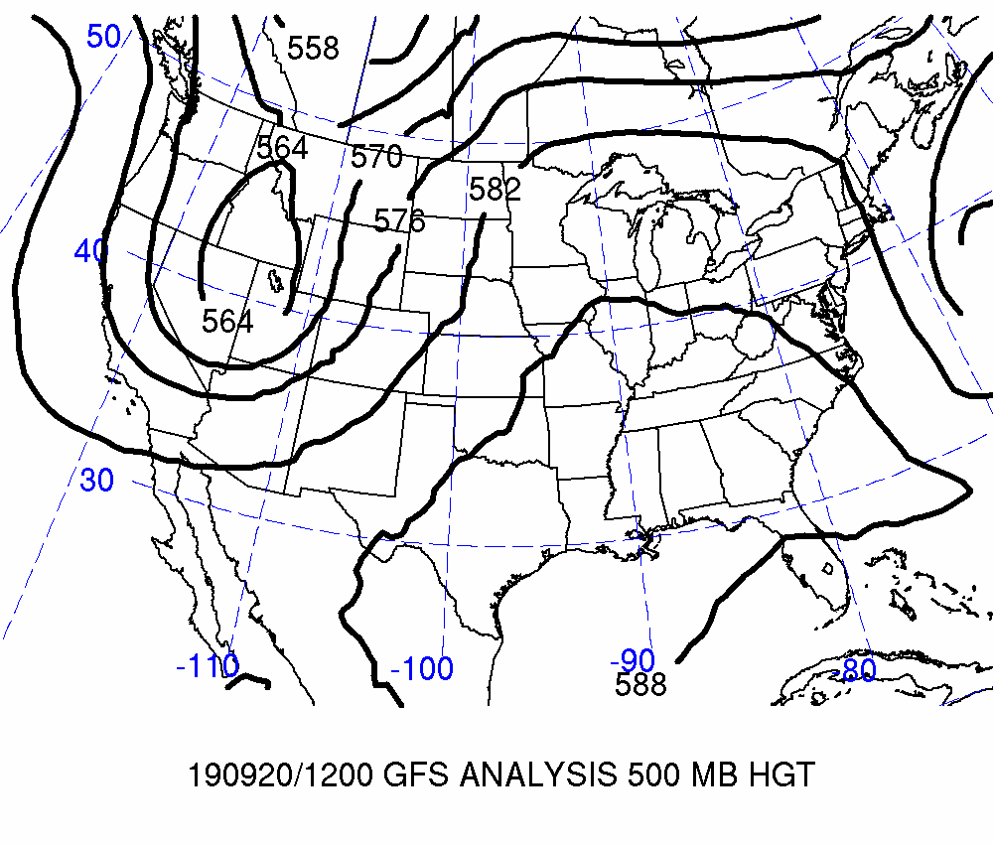
Day 8: Valid 2019-09-20 12Z
FCSTR Blend Weights (%)
TMAX / TMIN / QPF
FV3: 0% / 0% / 0%
GFS: 0% / 0% / 0%
GEFS: 0% / 0% / 0%
REFCST2: 0% / 0% / 0%
EC CTRL: 0% / 0% / 0%
ECENS: 0% / 0% / 0%
CMCE: 0% / 0% / 0%

Slide 4
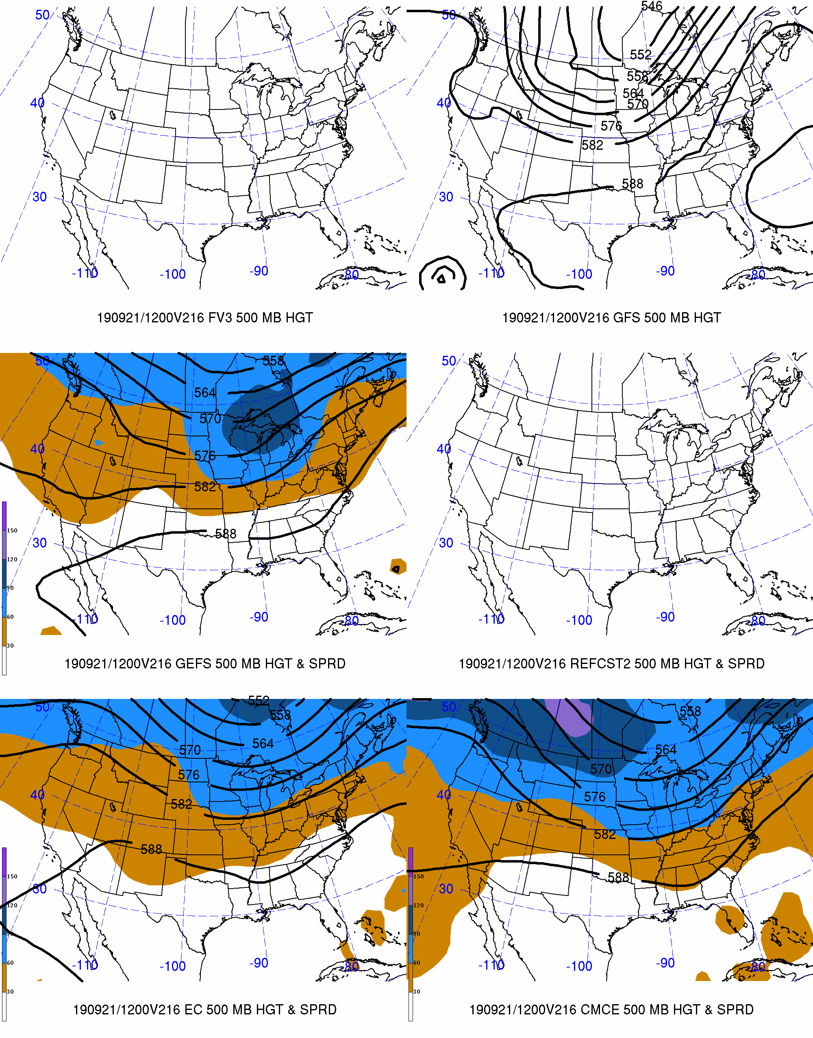
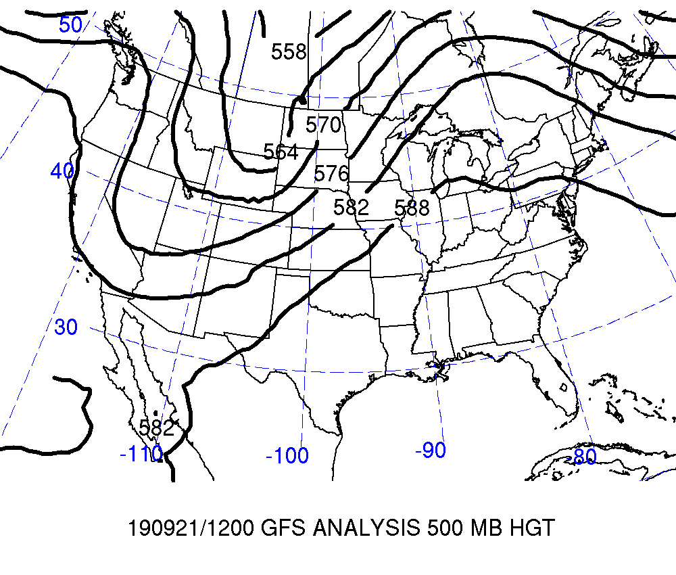
Day 9: Valid 2019-09-21 12Z
FCSTR Blend Weights (%)
TMAX / TMIN / QPF
FV3: 0% / 0% / 0%
GFS: 0% / 0% / 0%
GEFS: 0% / 0% / 0%
REFCST2: 0% / 0% / 0%
EC CTRL: 0% / 0% /0%
ECENS: 0% / 0% / 0%
CMCE: 0% / 0% / 0%

Slide 5
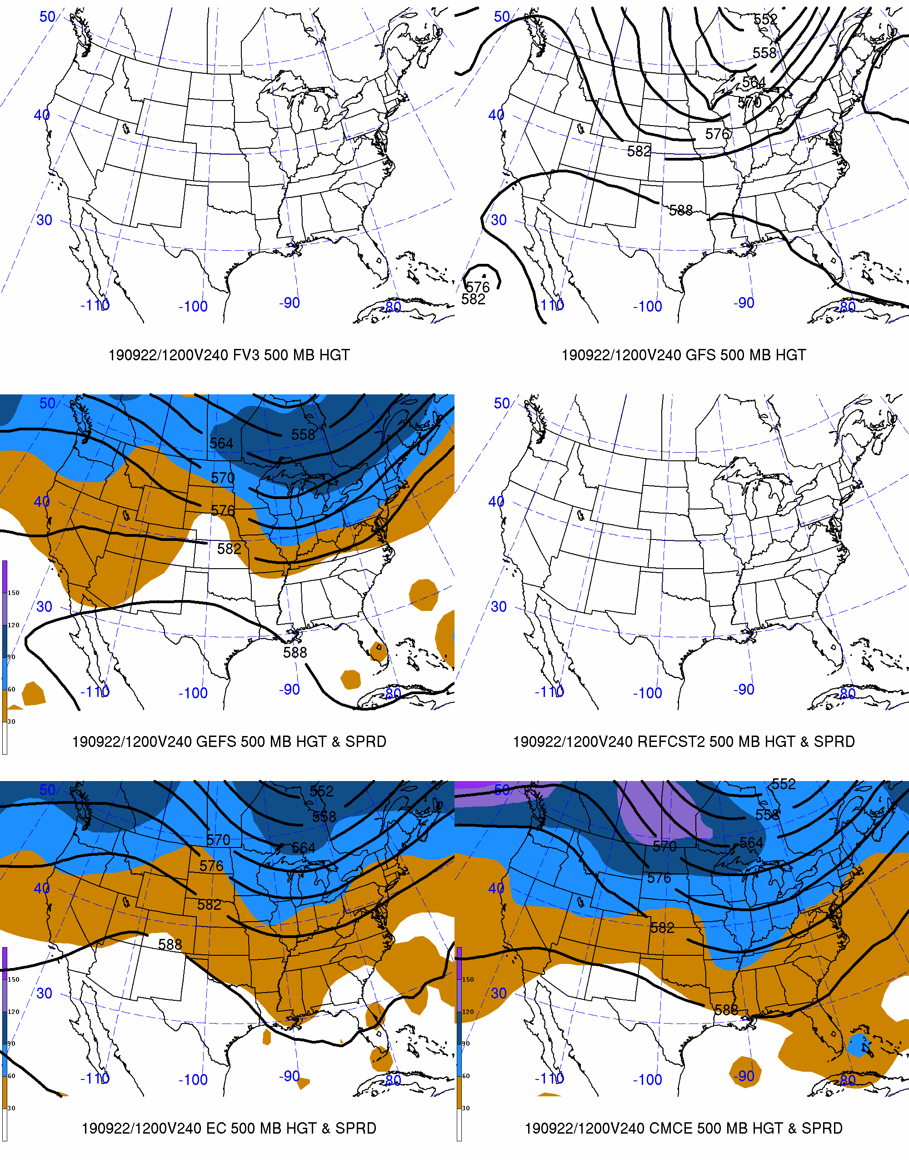
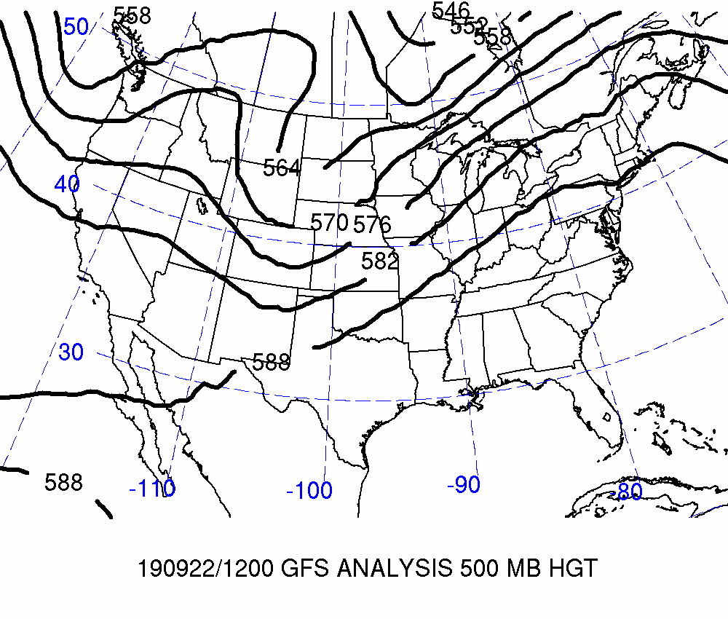
Day 10: Valid 2019-09-22 12Z
FCSTR Blend Weights (%)
TMAX / TMIN / QPF
FV3: 0% / 0% / 0%
GFS: 0% / 0% / 0%
GEFS: 0% / 0% / 0%
REFCST2: 0% / 0% / 0%
EC CTRL: 0% / 0% / 0%
ECENS: 0% / 0% / 0%
CMCE: 0% / 0% / 0%

Slide 6
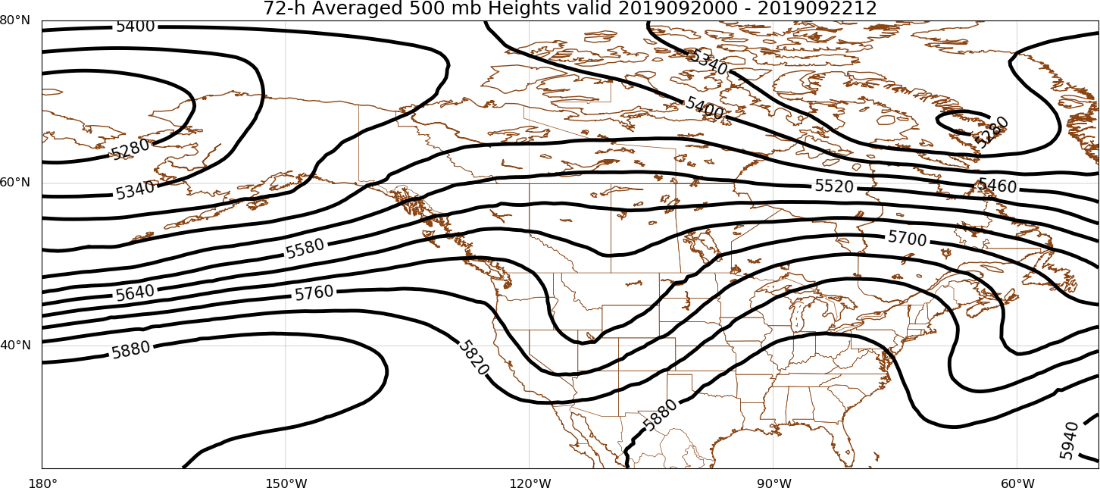
Days 8–10
FCSTR Blend Weights (%): TMAX / TMIN / QPF
EOF1P: 0% / 0% / 0%
EOF1N: 0% / 0% / 0%
EOFMN: 40% / 40% / 80%
GFS Analysis
EOF2P: 60% / 60% / 20%
EOF2N: 0% / 0% / 0%

Slide 7
Maximum Temperature | TMAX

Slide 8
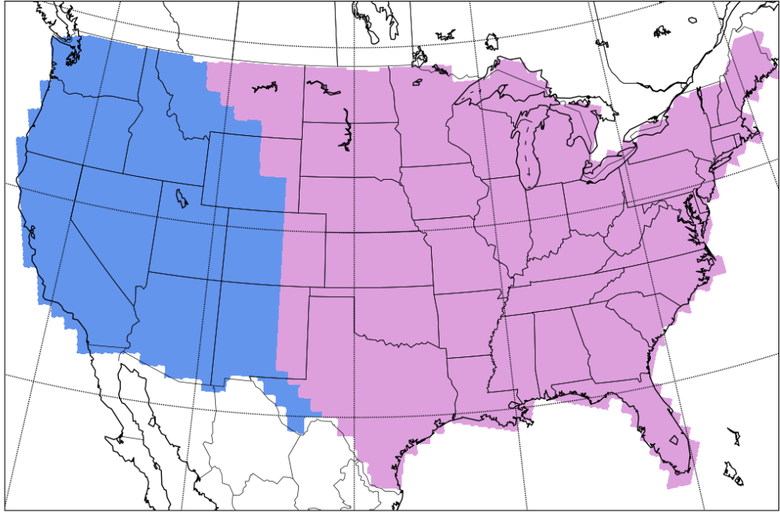
Separation of Western & Eastern CONUS
West
East
West
East

Slide 9
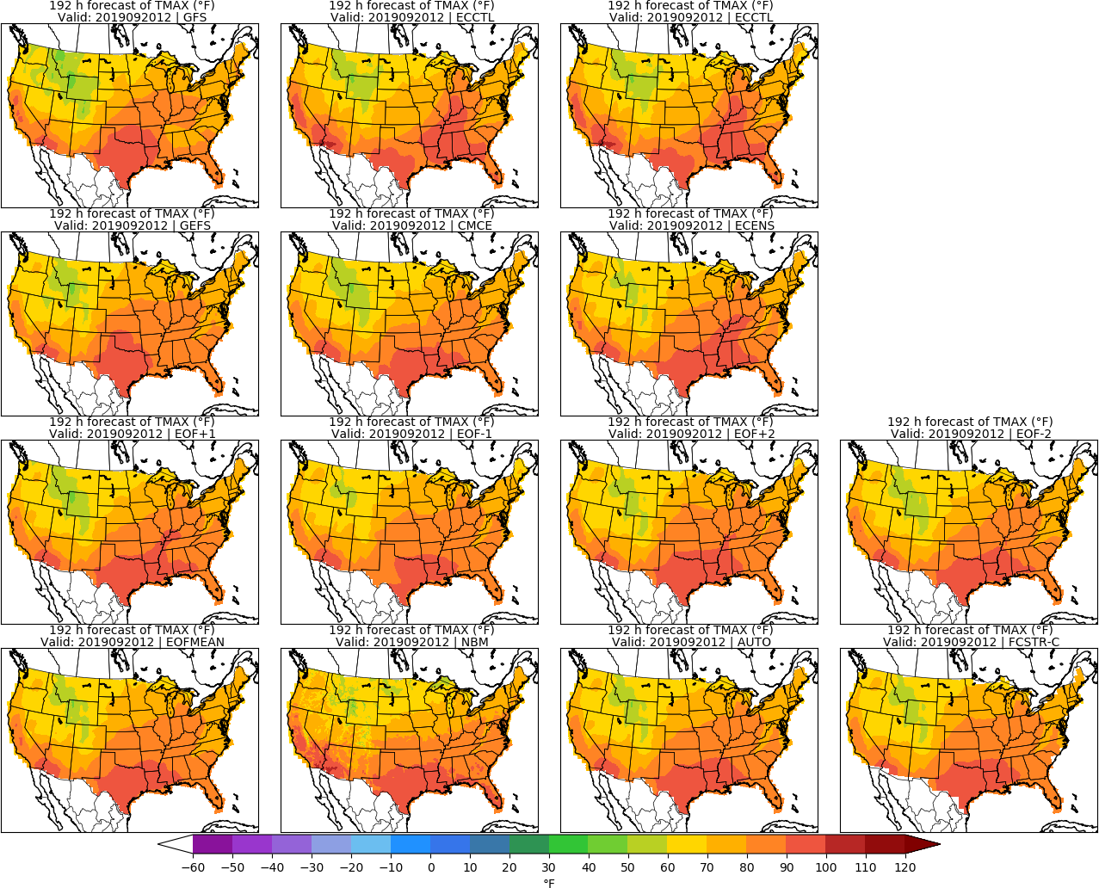
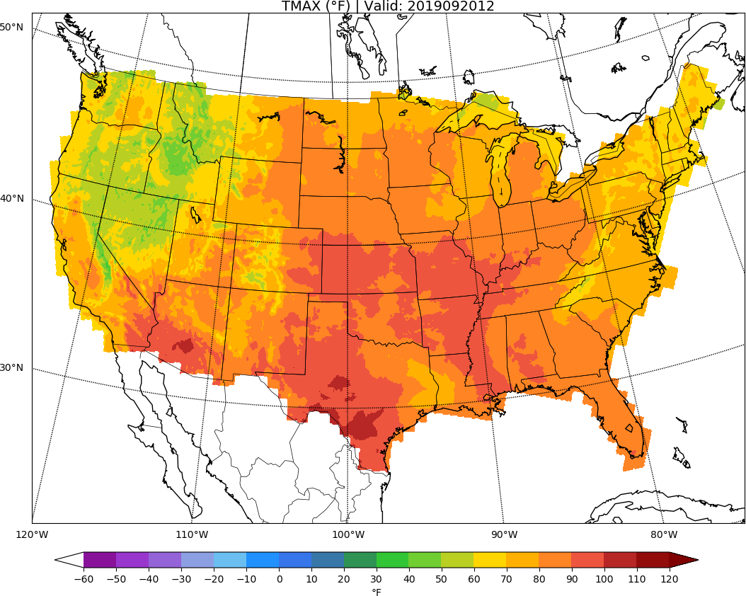
MISSING
ECCTL
Day 8: TMAX
URMA

Slide 10
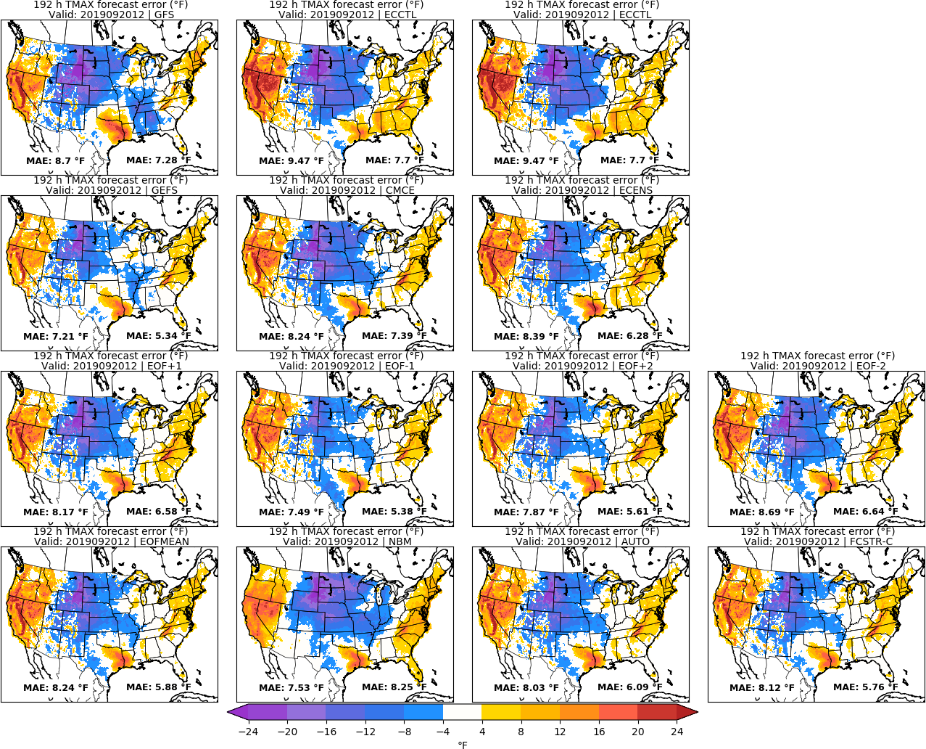
MISSING
ECCTL
Day 8: TMAX
URMA

Slide 11
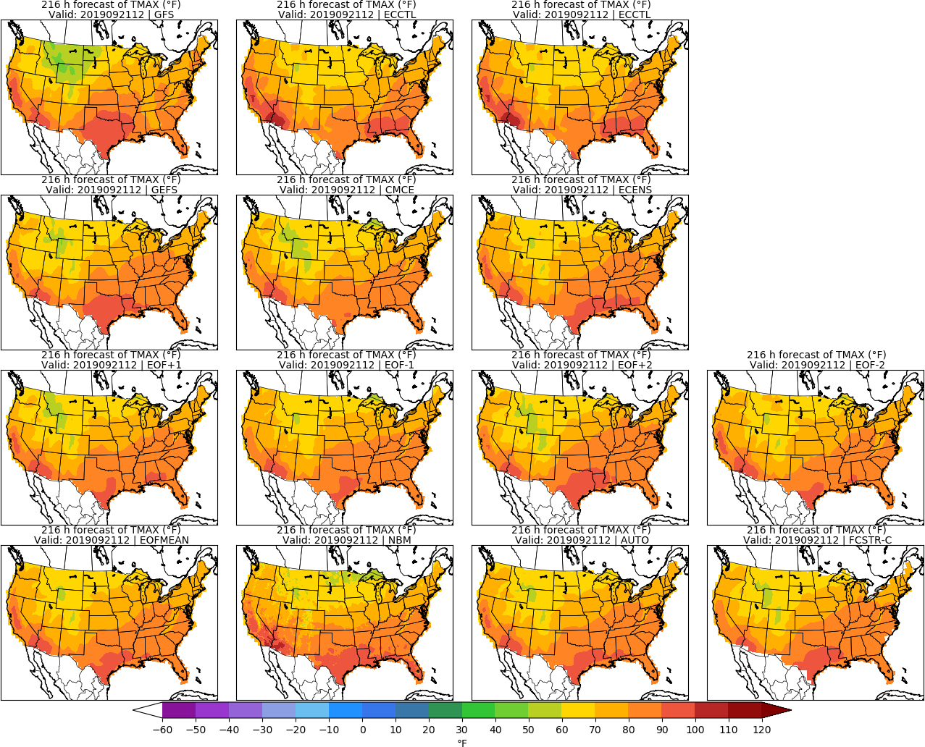
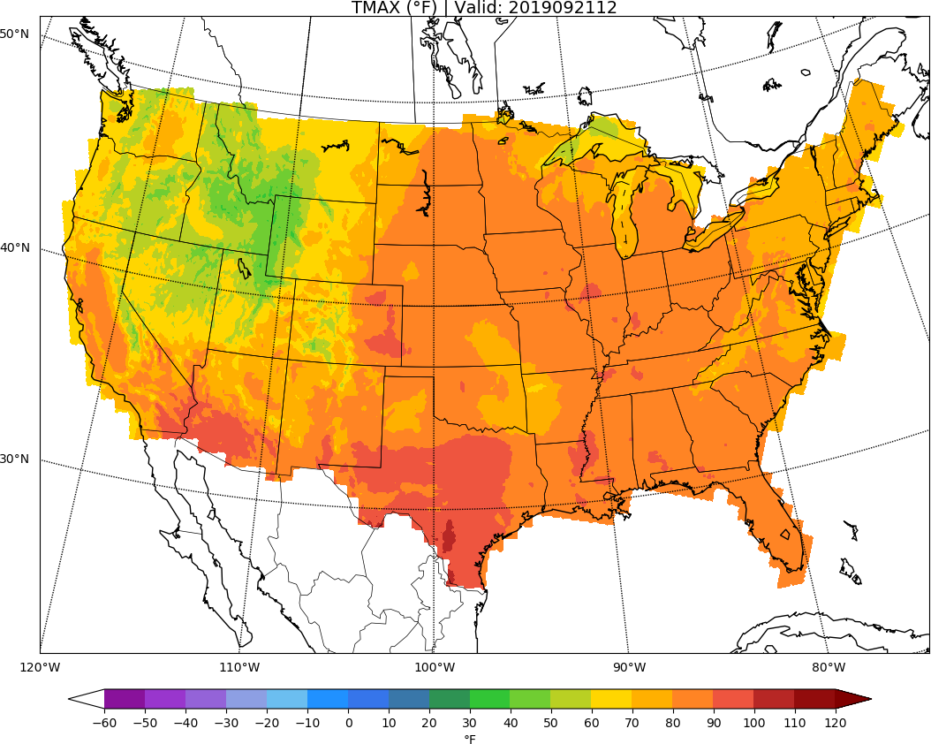
MISSING
ECCTL
Day 9: TMAX
URMA

Slide 12
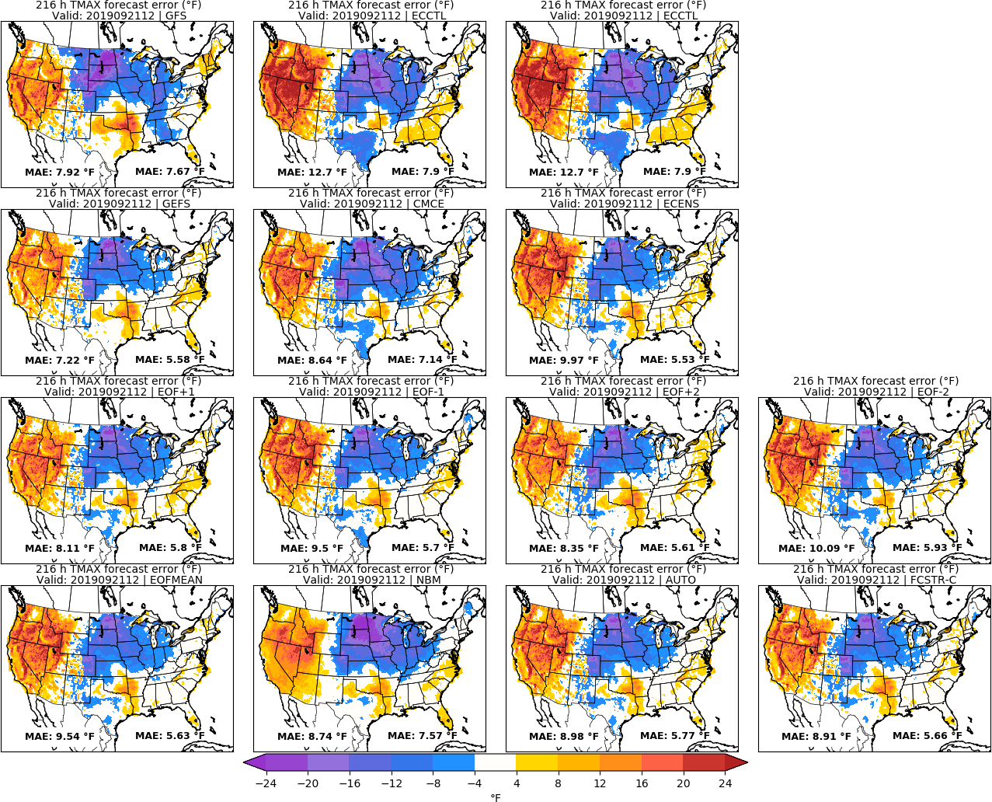
MISSING
ECCTL
Day 9: TMAX
URMA

Slide 13
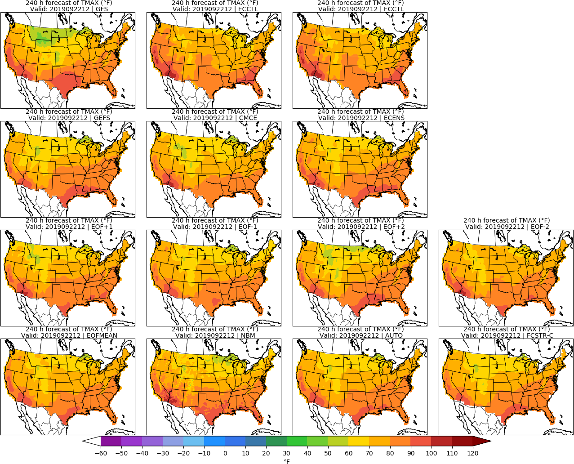
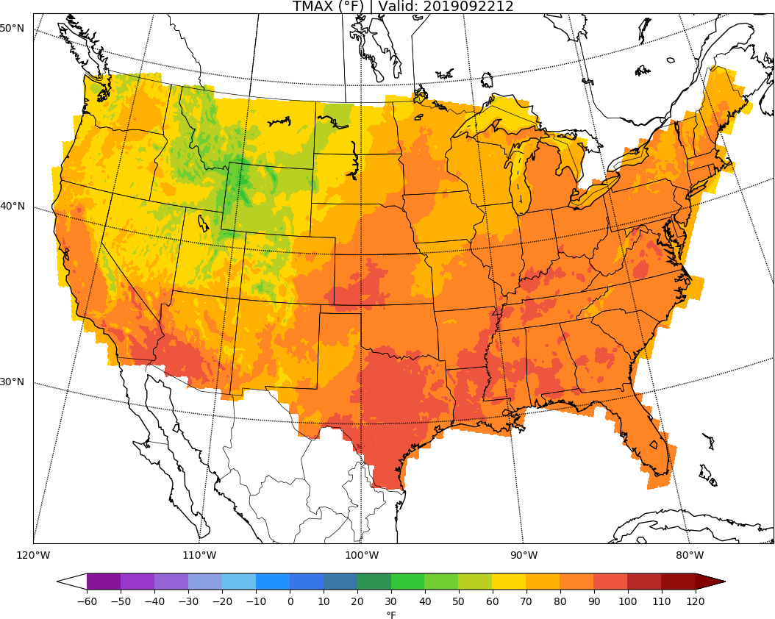
MISSING
ECCTL
Day 10: TMAX
URMA

Slide 14
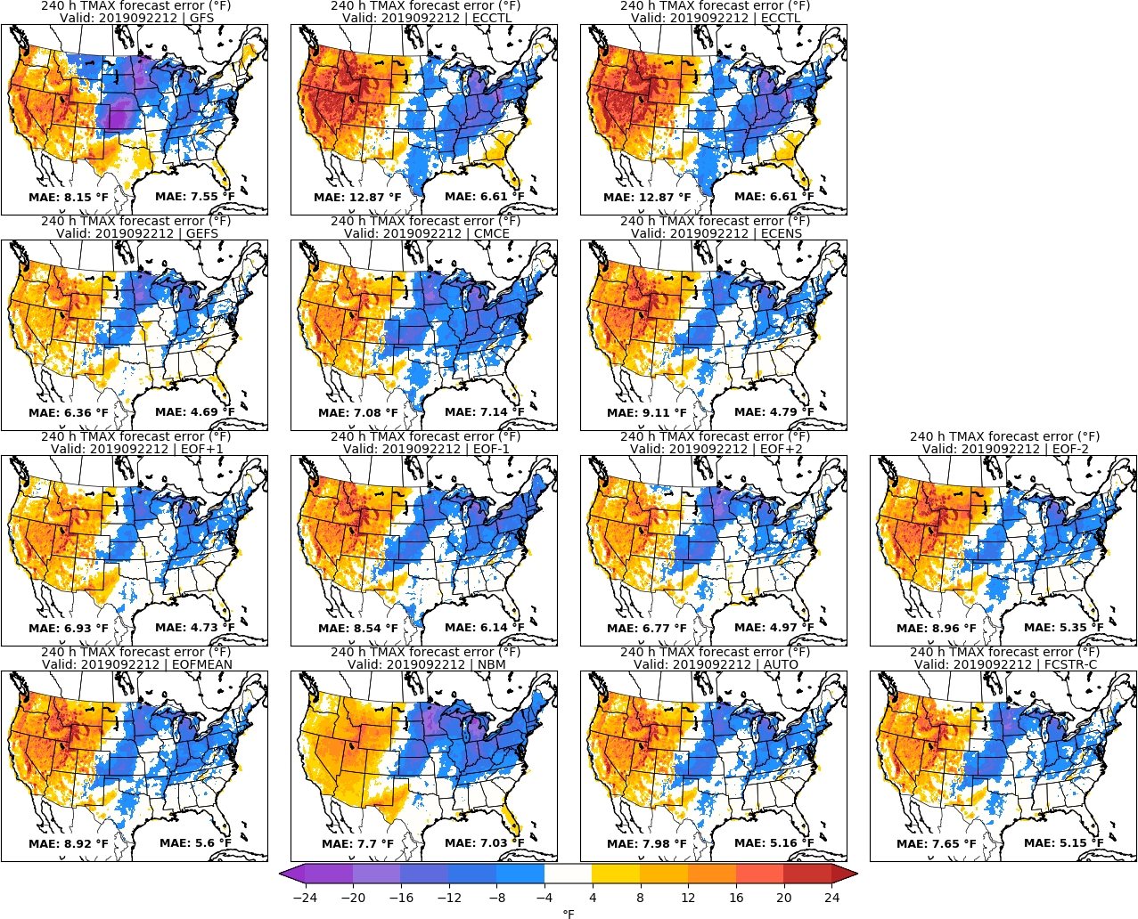
MISSING
ECCTL
Day 10: TMAX
URMA

Slide 15
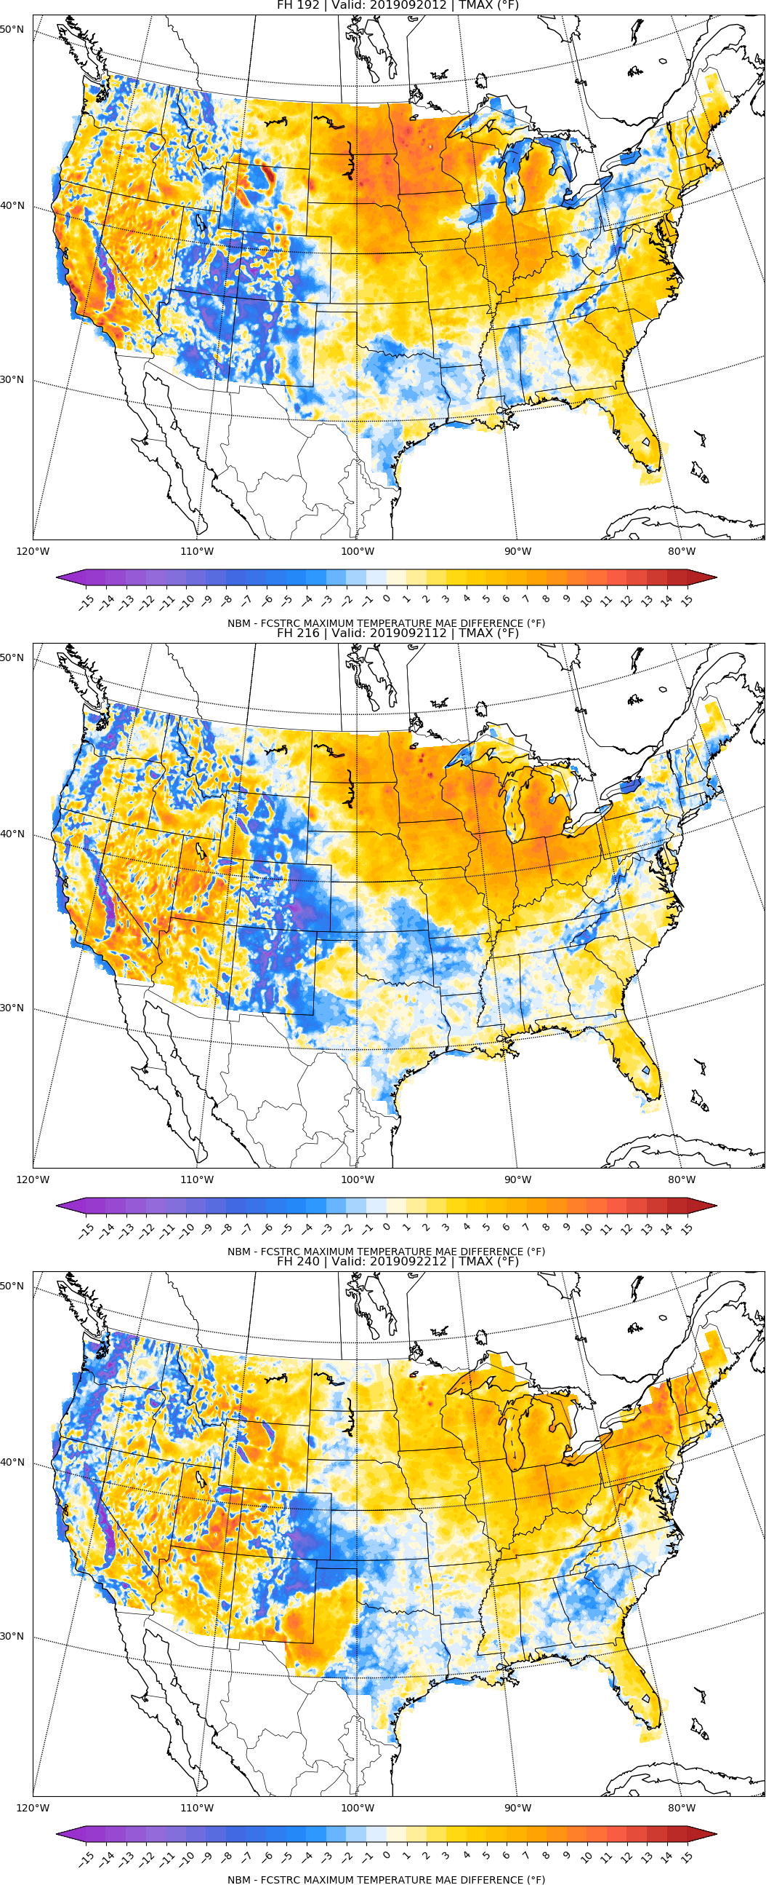
NBM vs FCSTR-C
Blend Comparison
Day 8
MAE_{NBM} – MAE_{FCSTRC} } > 0 is FCSTRC
improvement
over NBM
Day 9
FCSTRC Worse
FCSTRC Better
Day 10

Slide 16
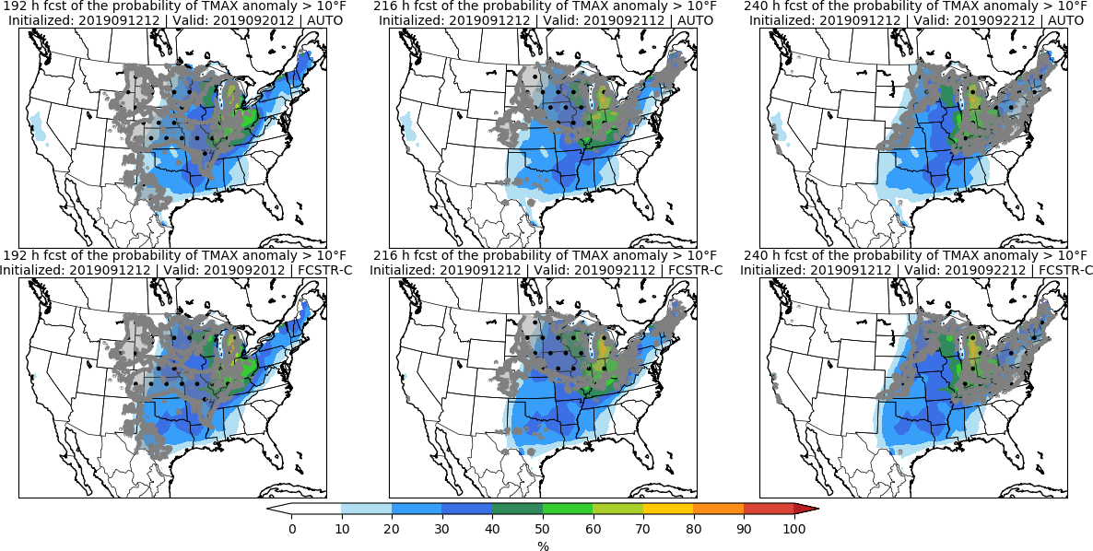
Day 8 Day 9 Day 10

Slide 17
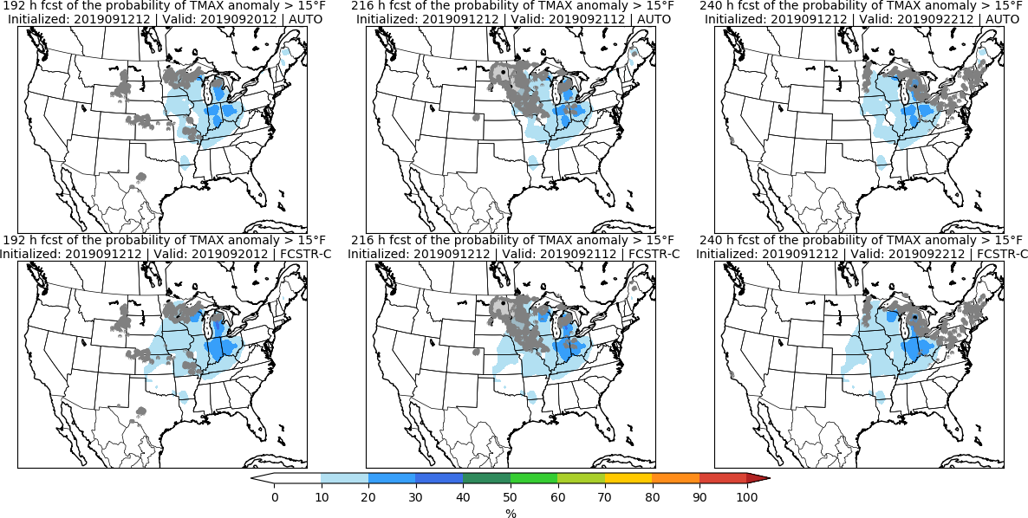
Day 8 Day 9 Day 10

Slide 18
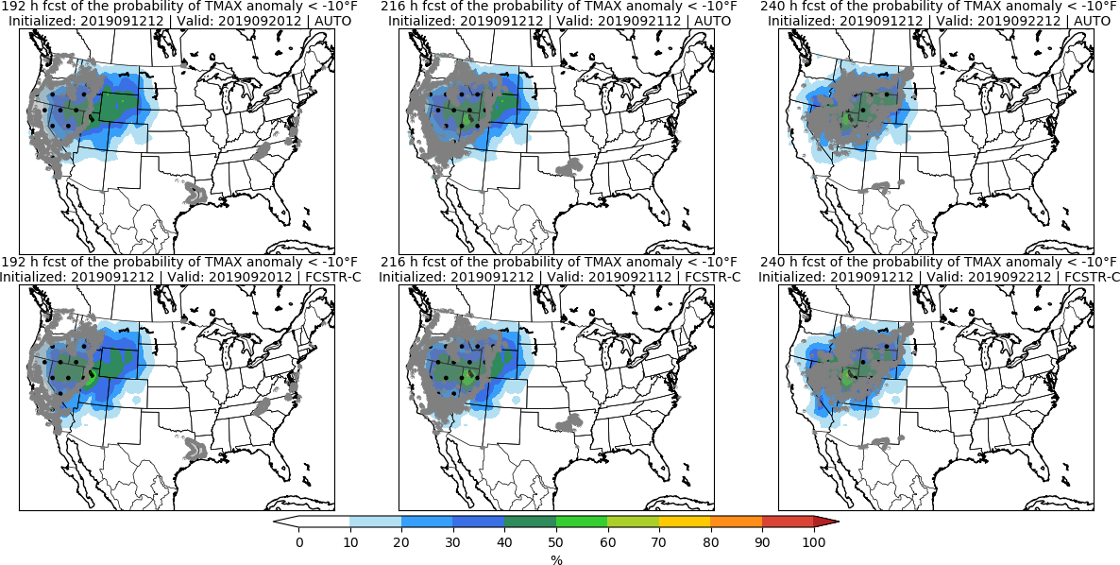
Day 8 Day 9 Day 10

Slide 19
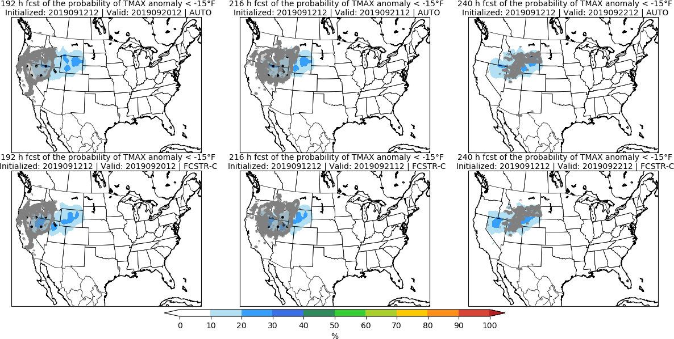
Day 8 Day 9 Day 10

Slide 20
Minimum Temperature | TMIN

Slide 21
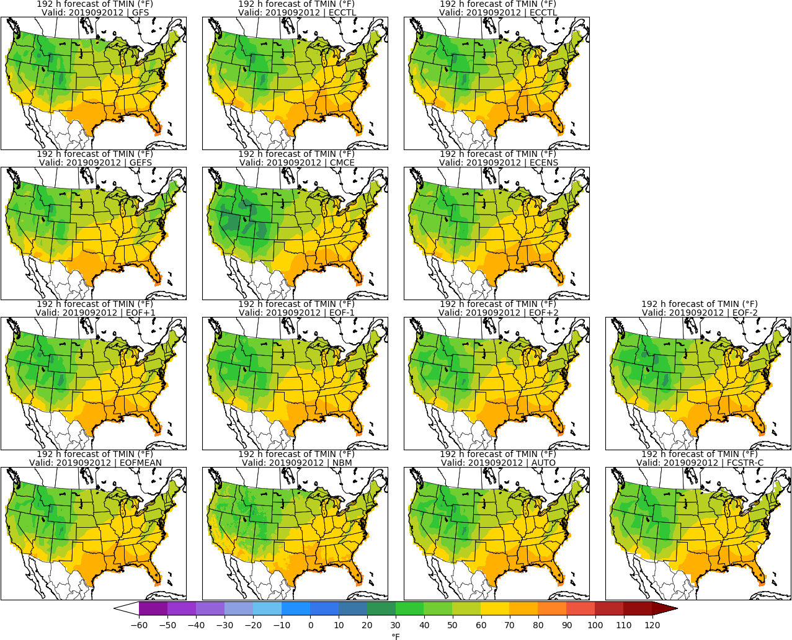
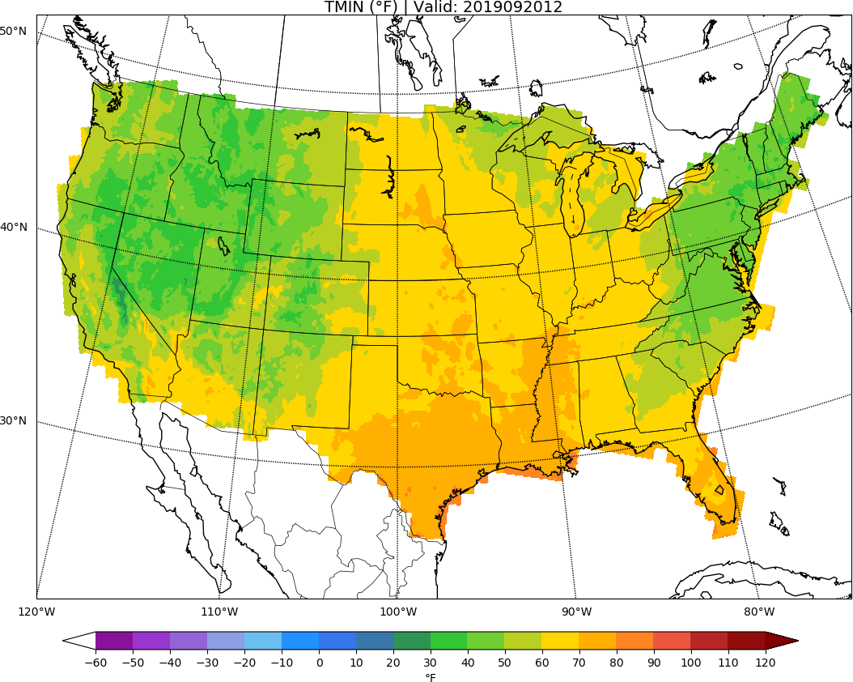
MISSING
ECCTL
Day 8: TMIN
URMA

Slide 22
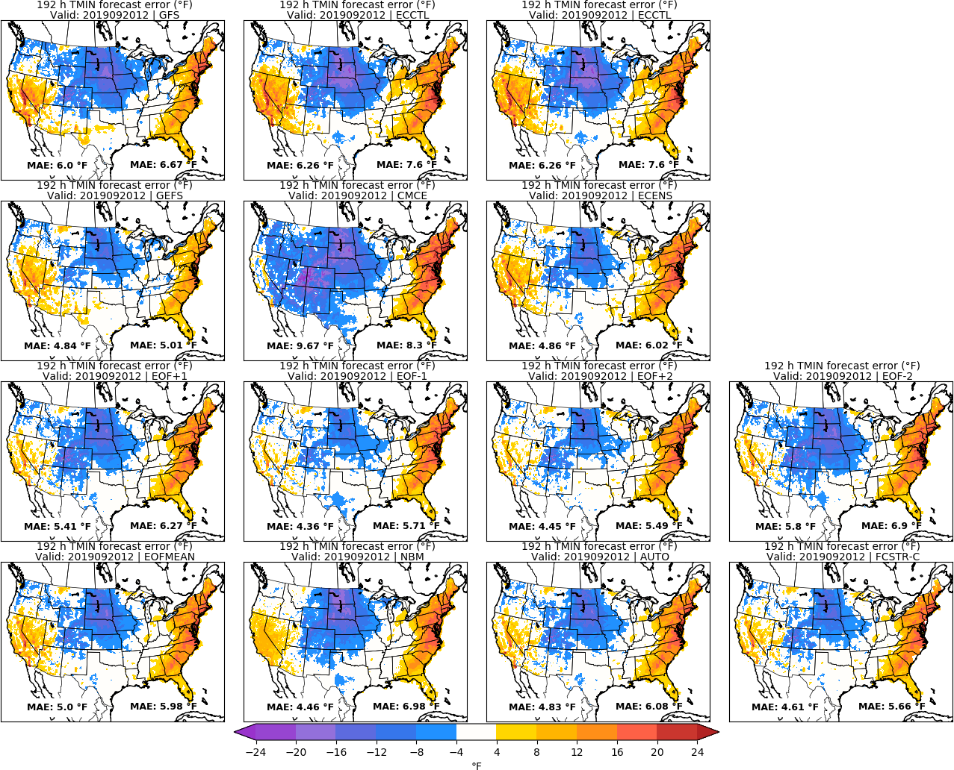
MISSING
ECCTL
Day 8: TMIN
URMA

Slide 23
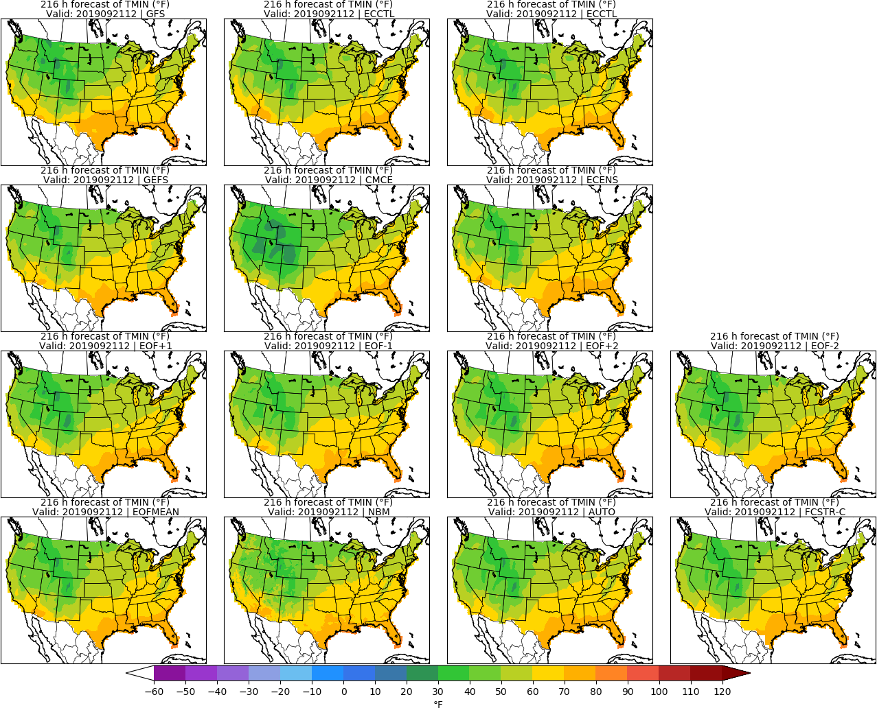
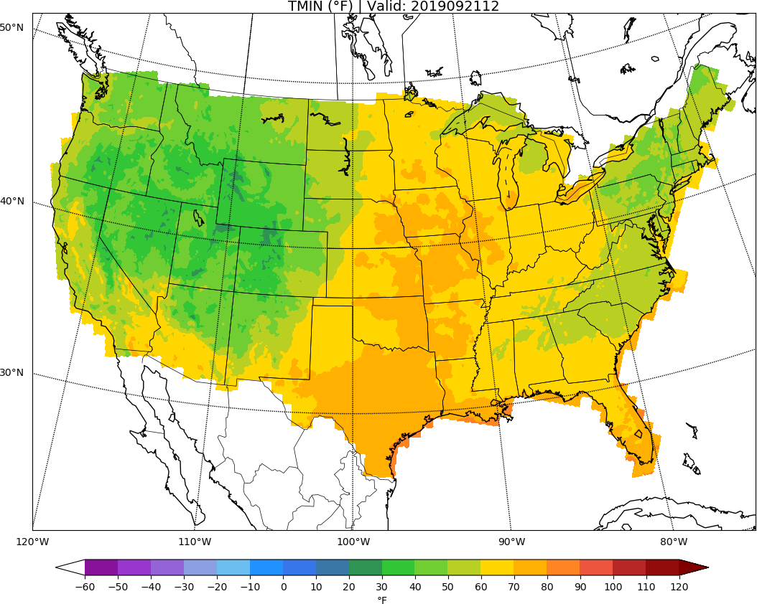
MISSING
ECCTL
Day 9: TMIN
URMA

Slide 24
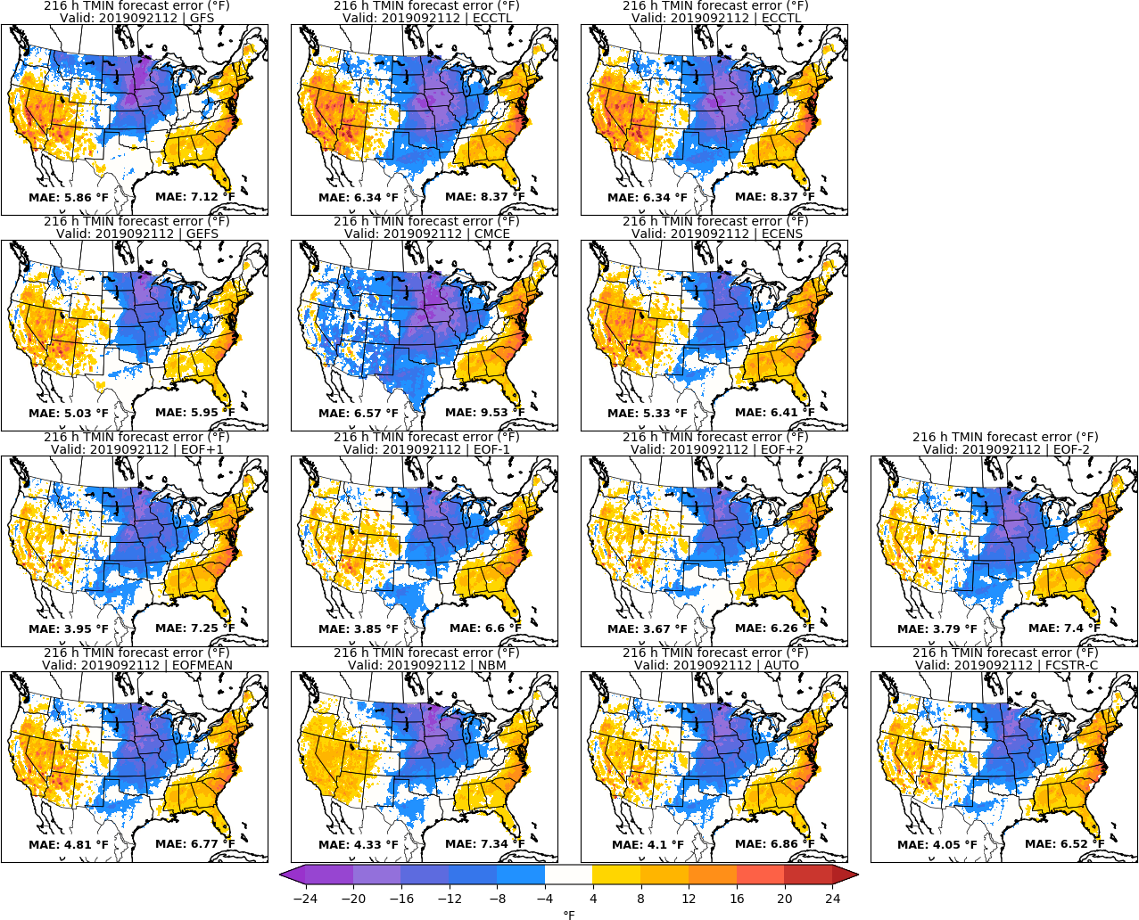
MISSING
ECCTL
Day 9: TMIN
URMA

Slide 25
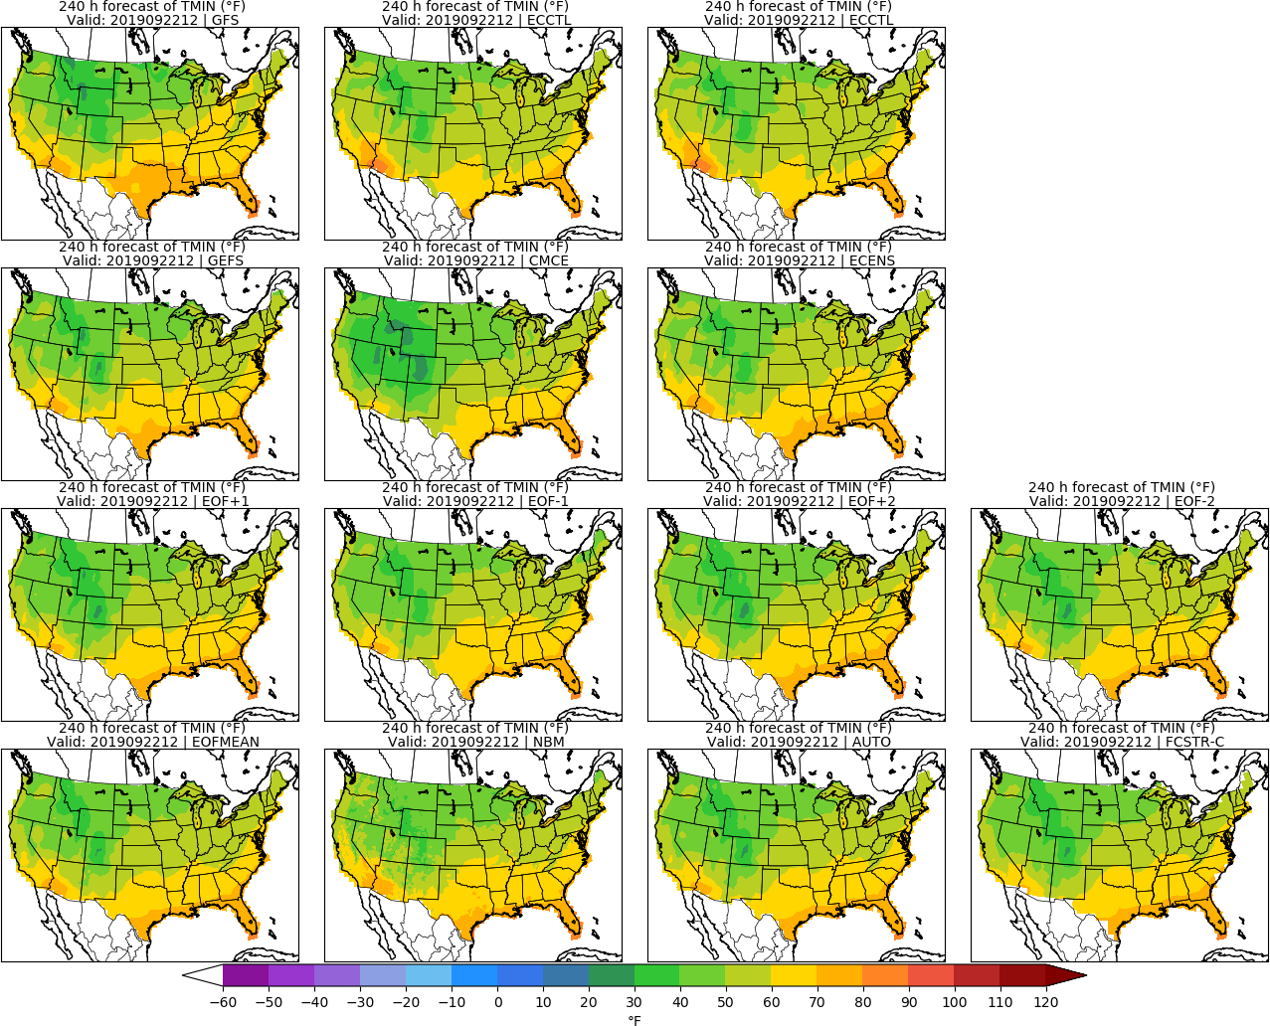
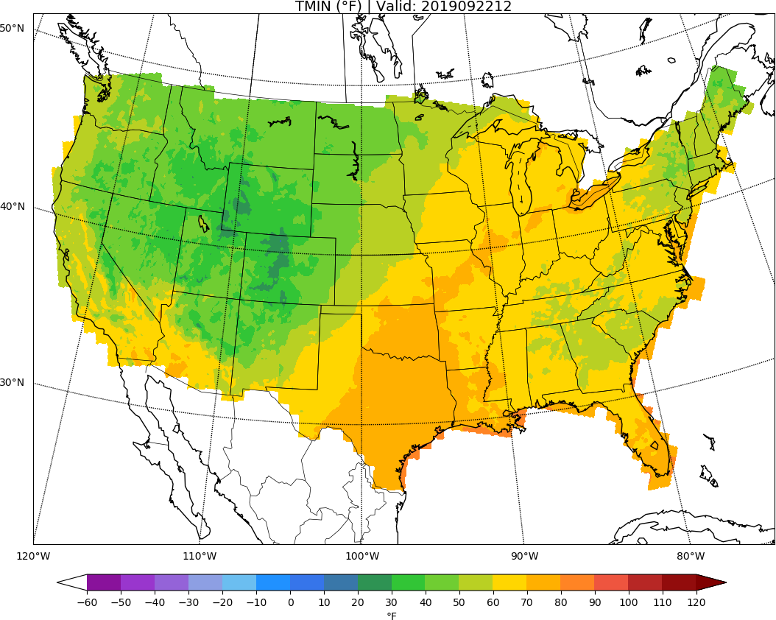
MISSING
ECCTL
Day 10: TMIN
URMA

Slide 26
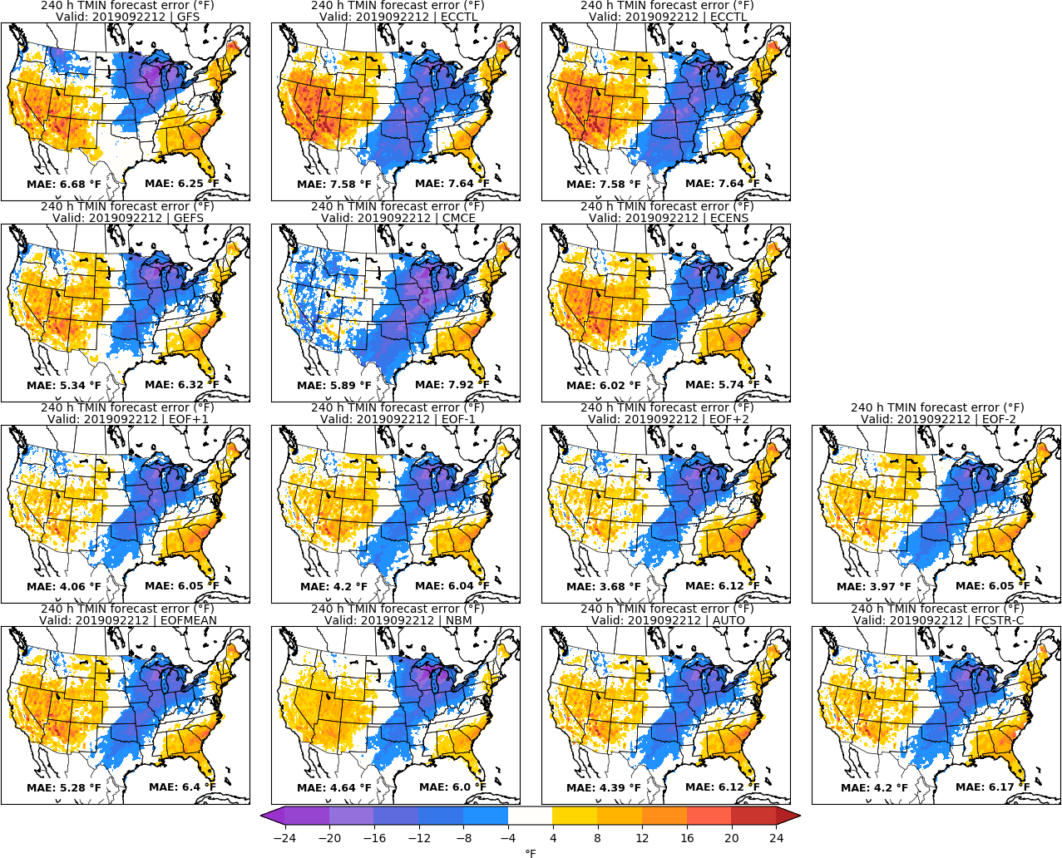
MISSING
ECCTL
Day 10: TMIN
URMA

Slide 27
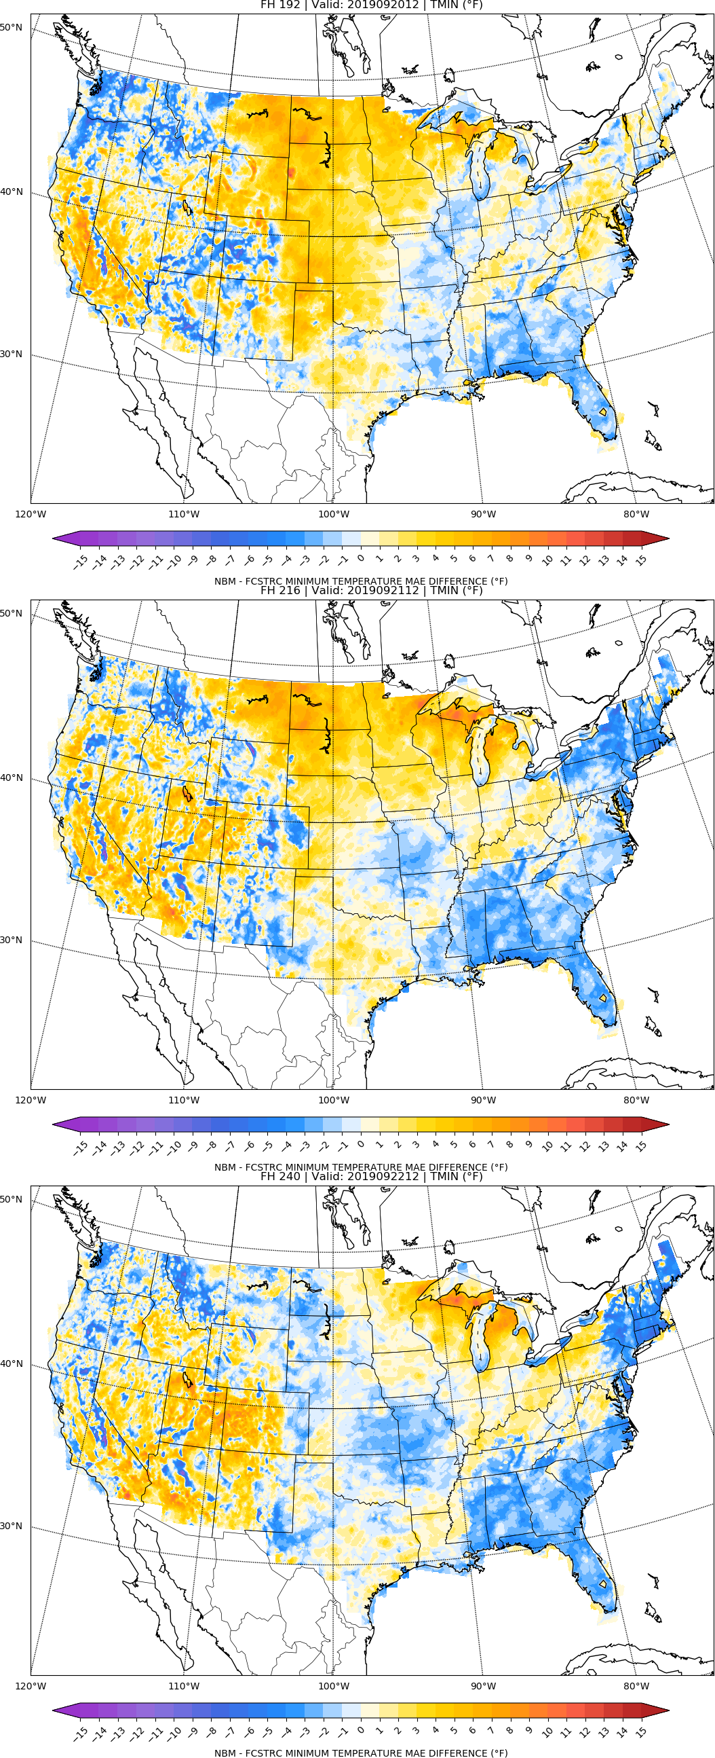
NBM vs FCSTR-C
Blend Comparison
Day 8
MAE_{NBM} – MAE_{FCSTRC} } > 0 is FCSTRC
improvement
over NBM
Day 9
FCSTRC Worse
FCSTRC Better
Day 10

Slide 28
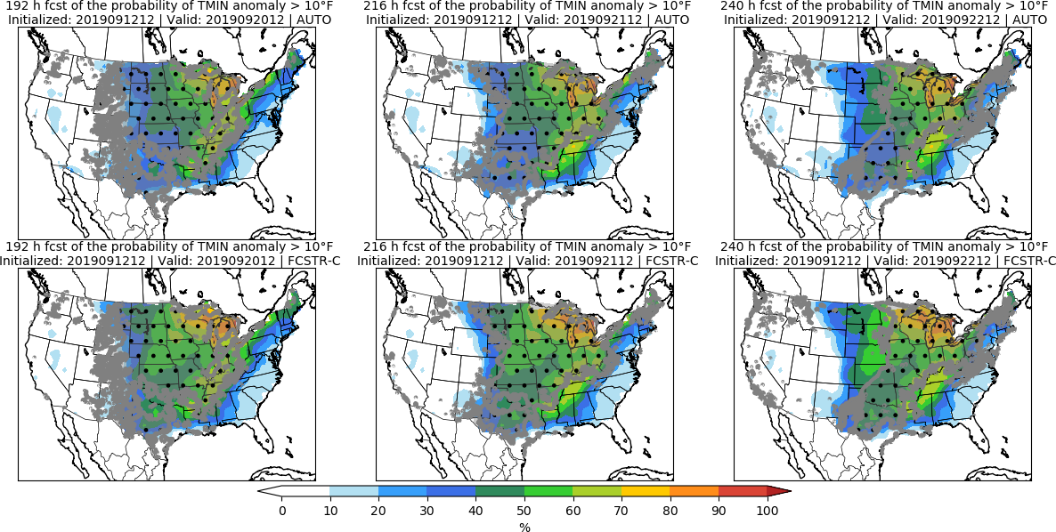
Day 8 Day 9 Day 10

Slide 29
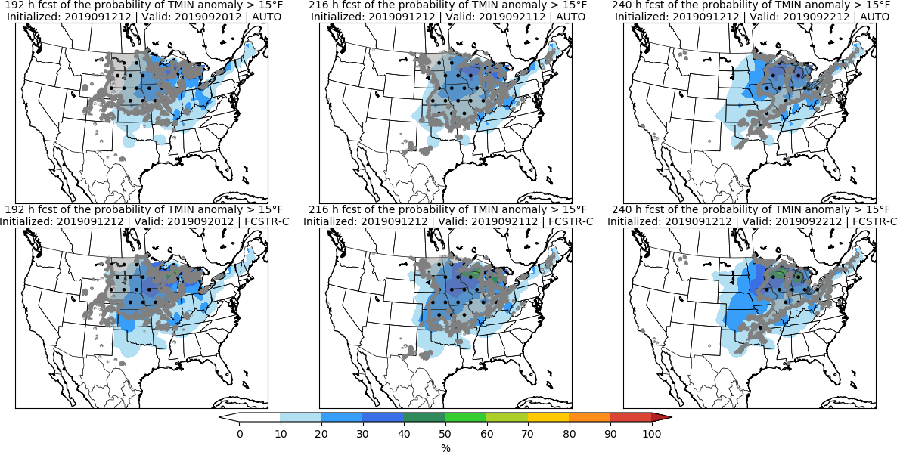
Day 8 Day 9 Day 10

Slide 30
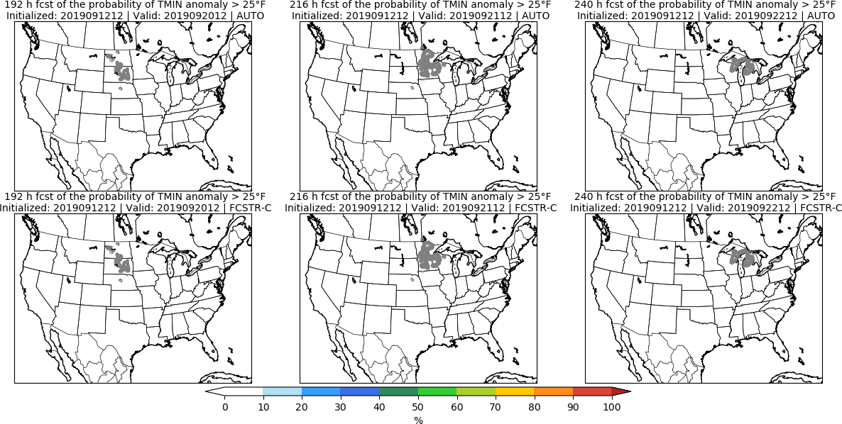
Day 8 Day 9 Day 10

Slide 31
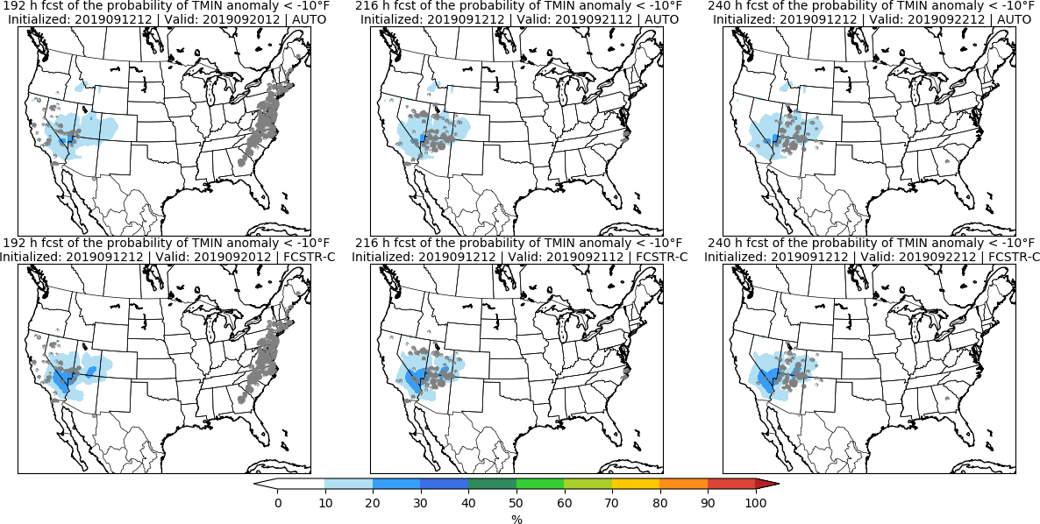
Day 8 Day 9 Day 10

Slide 32
Accumulated Precipitation | APCP

Slide 33
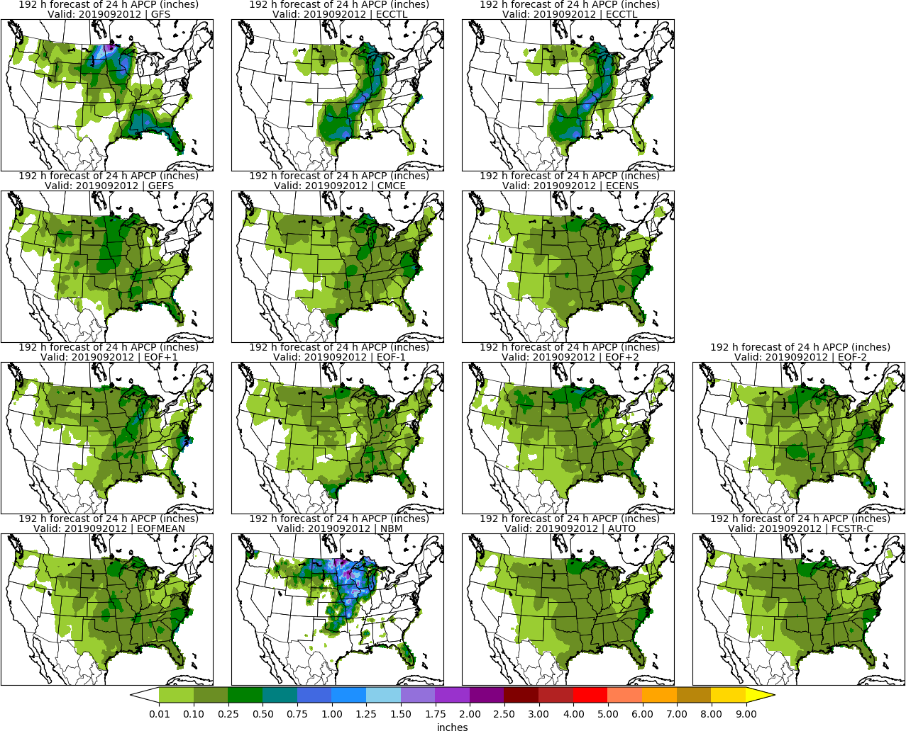
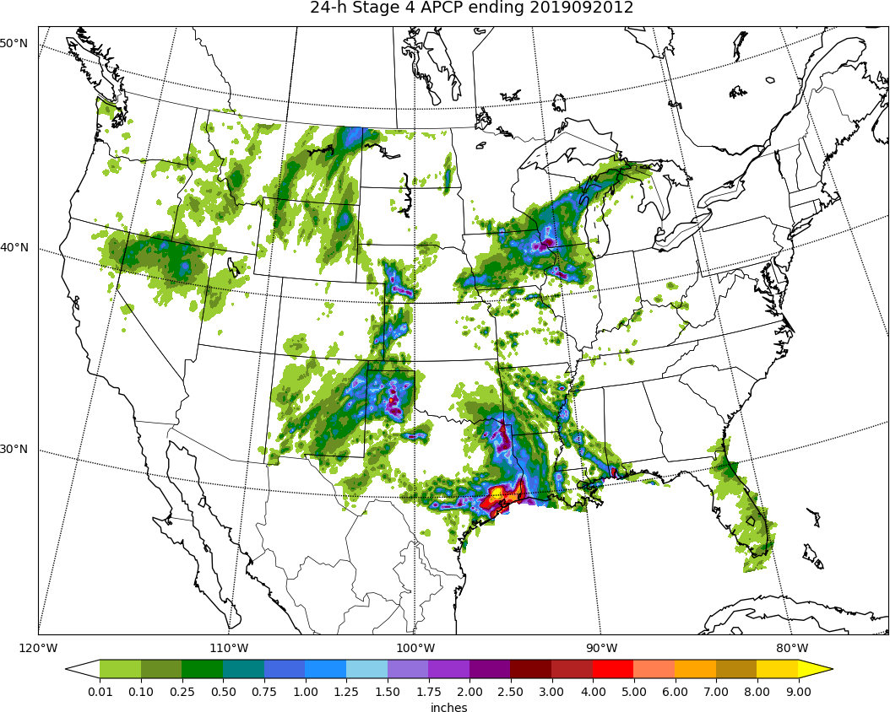
MISSING
ECCTL
Day 8: APCP
STAGE 4

Slide 34
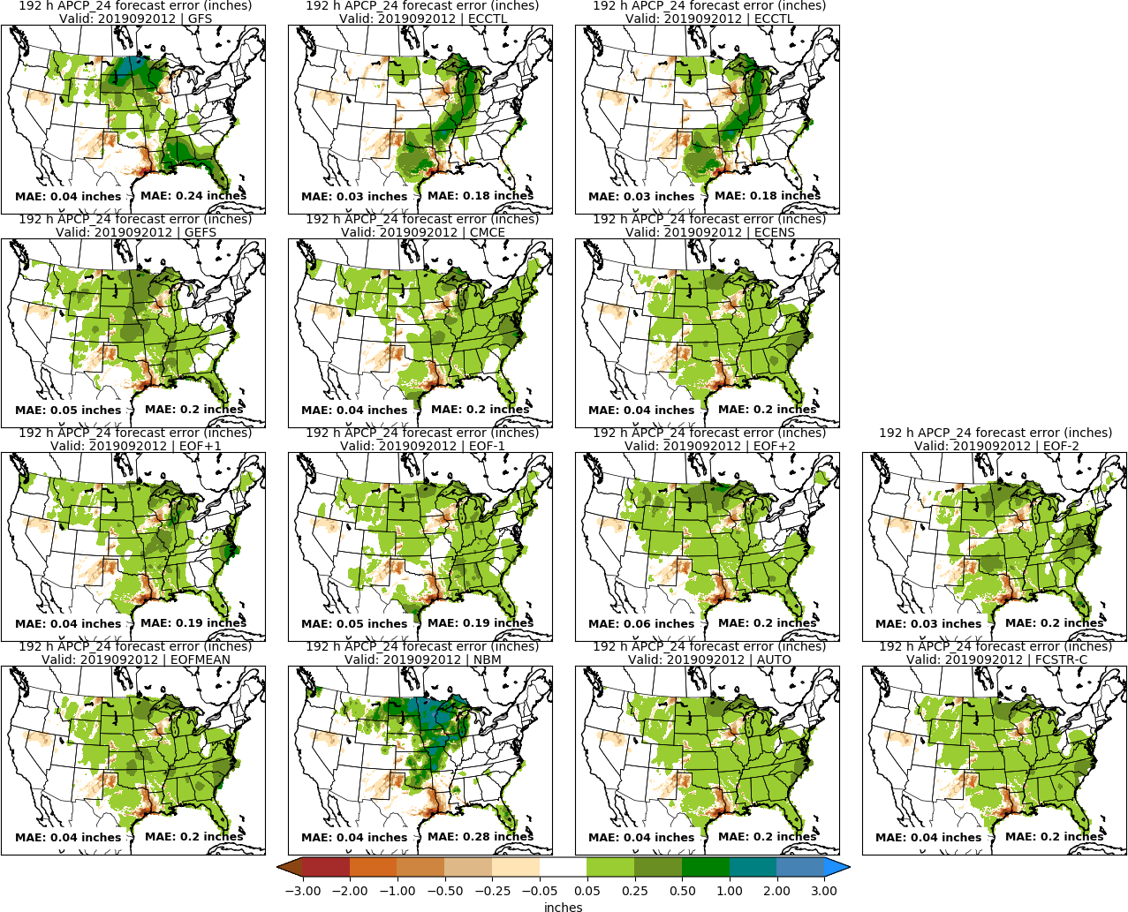
MISSING
ECCTL
Day 8: APCP
STAGE 4

Slide 35
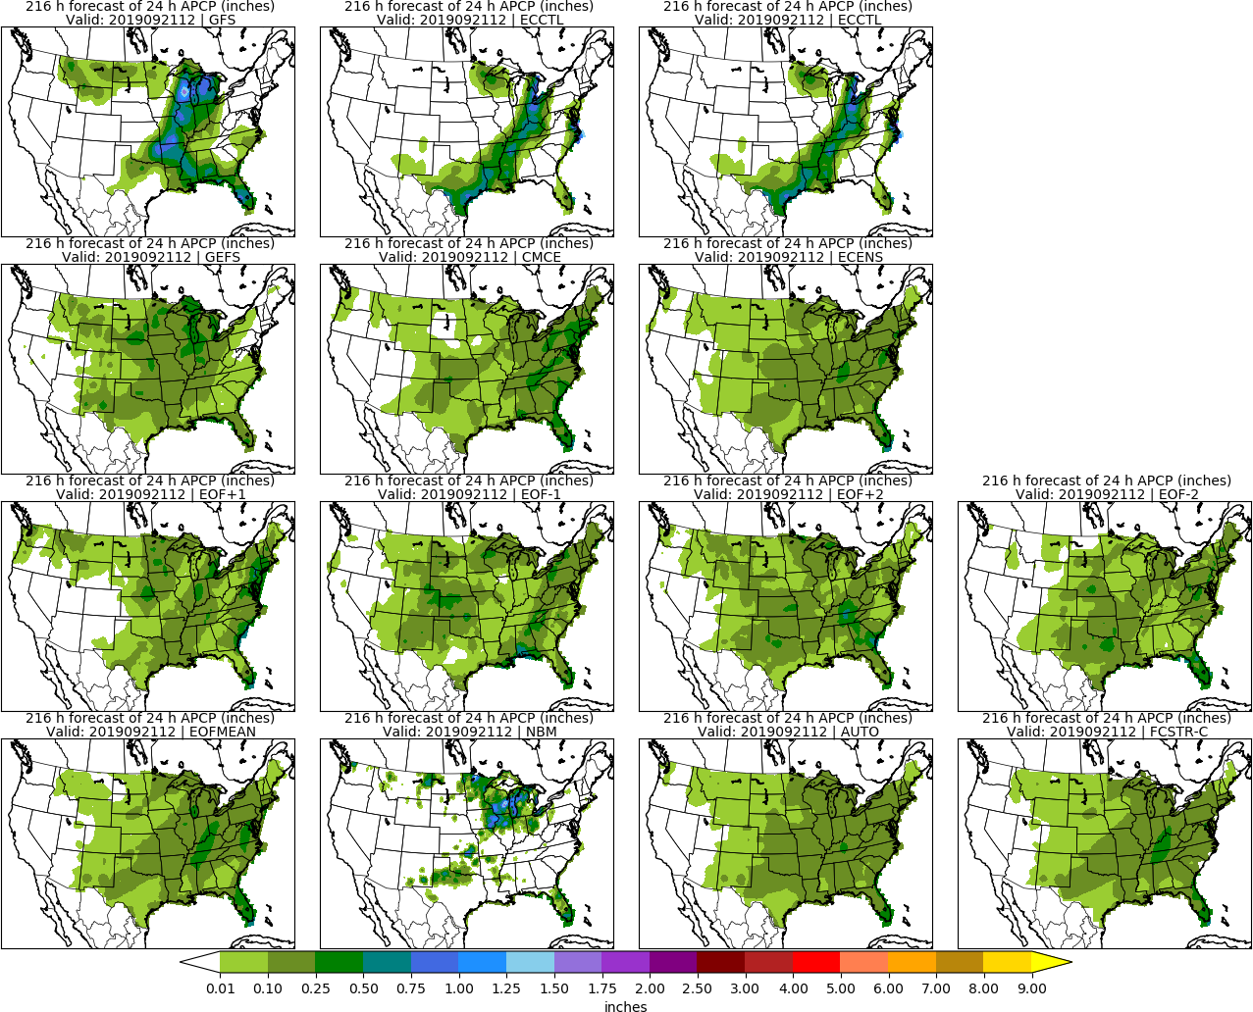
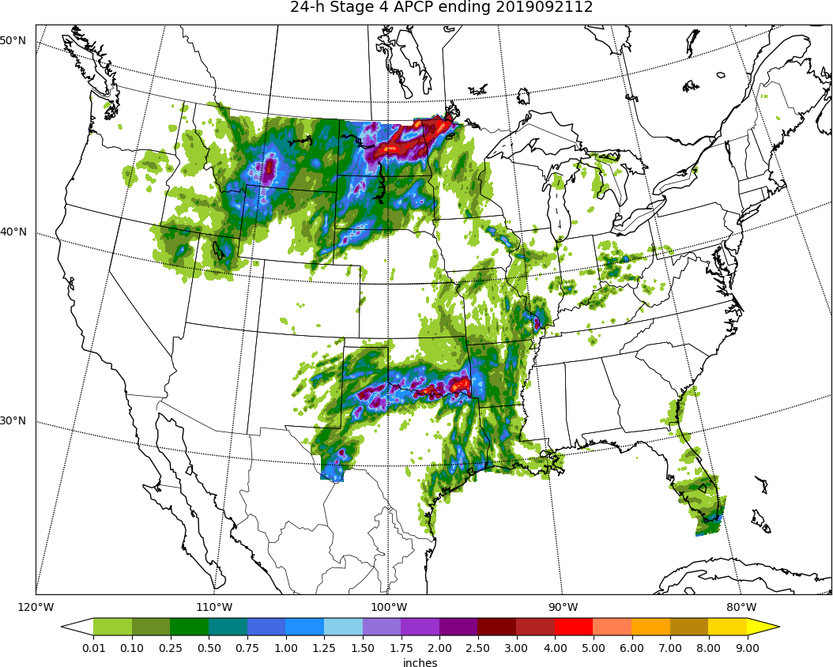
MISSING
ECCTL
Day 9: APCP
STAGE 4

Slide 36
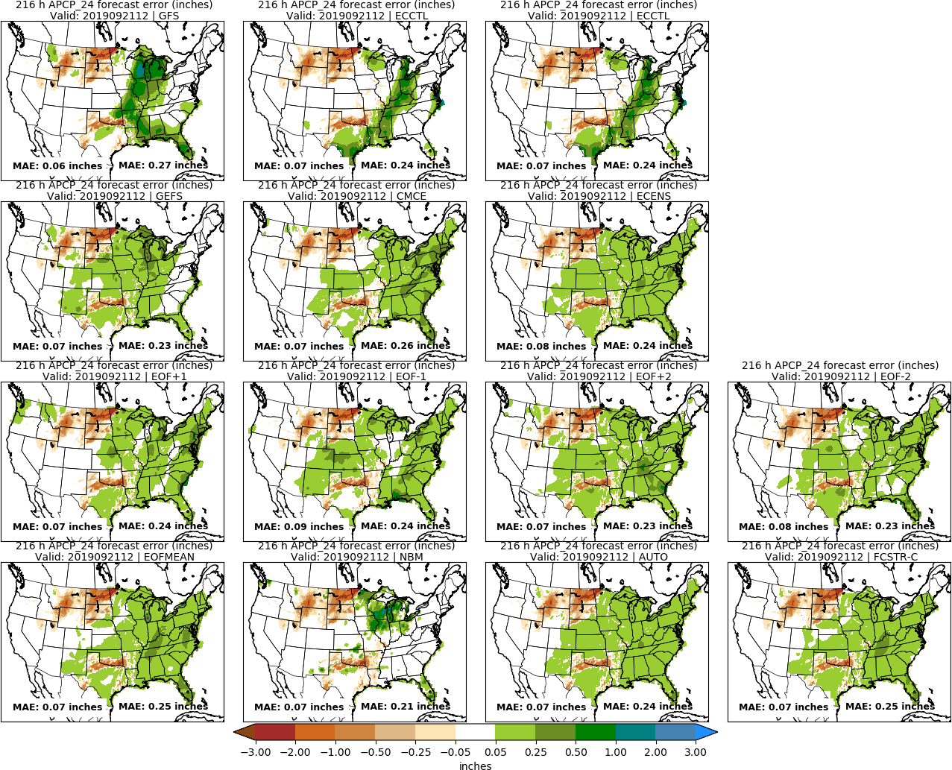
MISSING
ECCTL
Day 9: APCP
STAGE 4

Slide 37
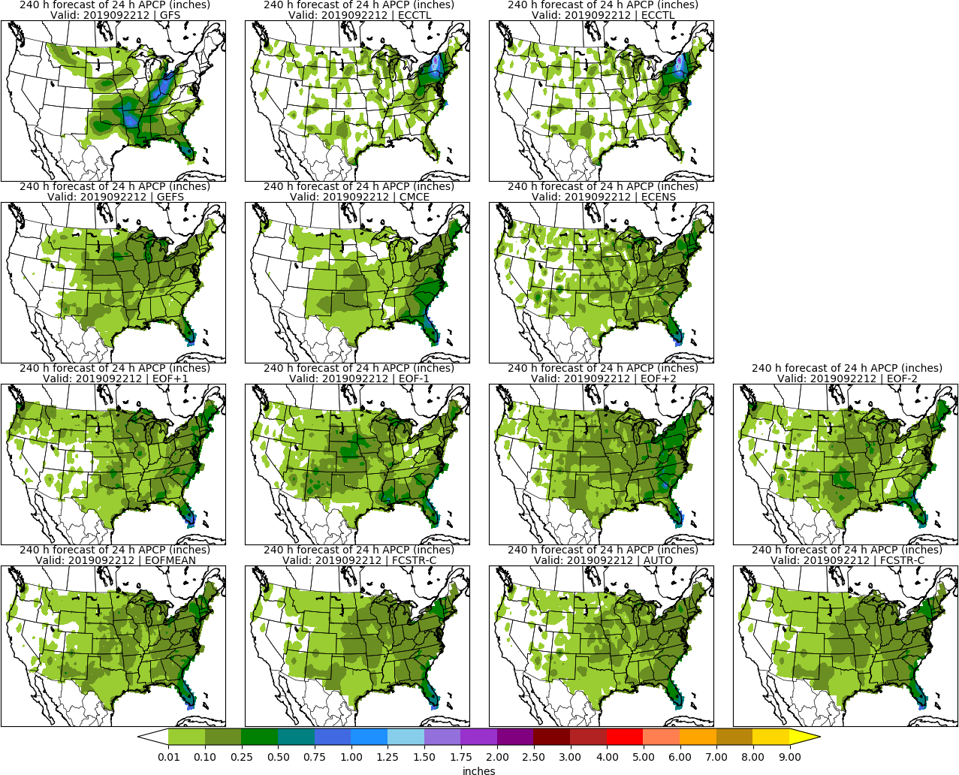
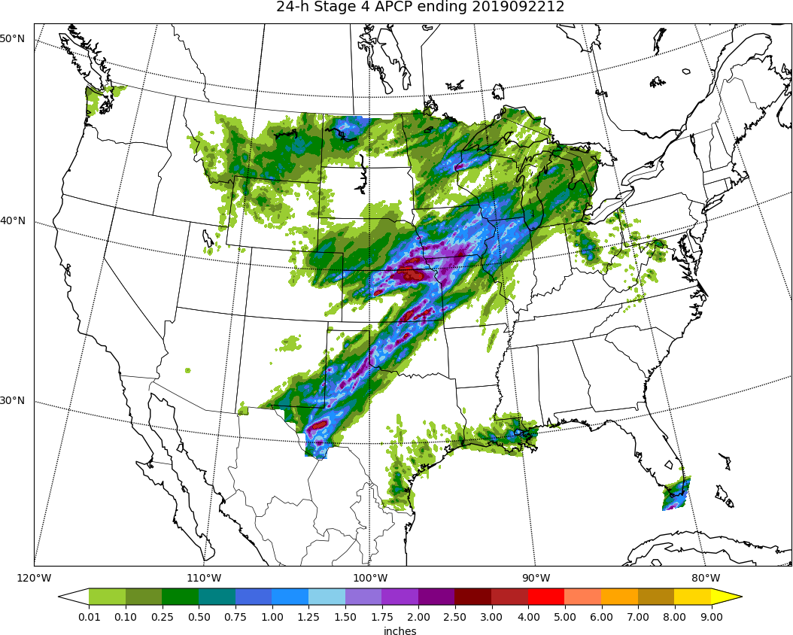
MISSING
ECCTL
Day 10: APCP
STAGE 4

Slide 38
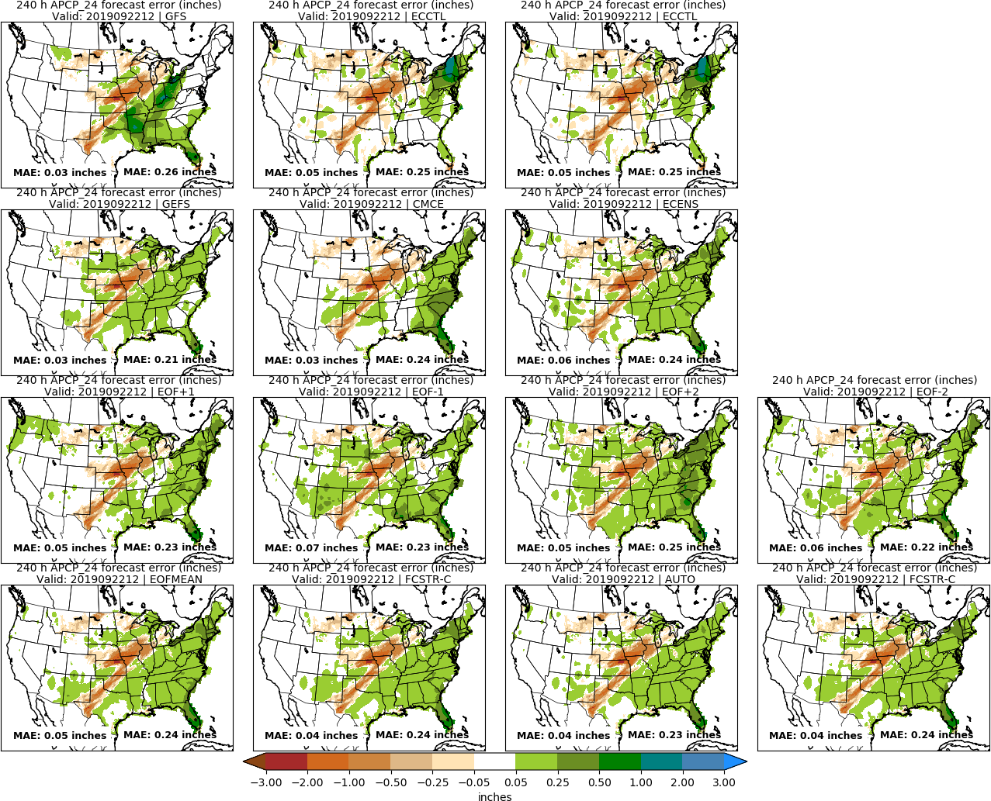
MISSING
ECCTL
Day 10: APCP
STAGE 4

Slide 39
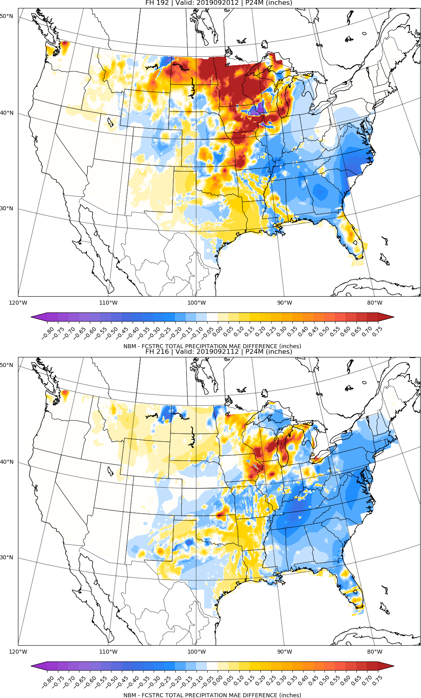
NBM vs FCSTR-C
Blend Comparison
Day 8
MAE_{NBM} – MAE_{FCSTRC} } > 0 is FCSTRC
improvement
over NBM
Day 9
FCSTRC Worse
FCSTRC Better

Slide 40
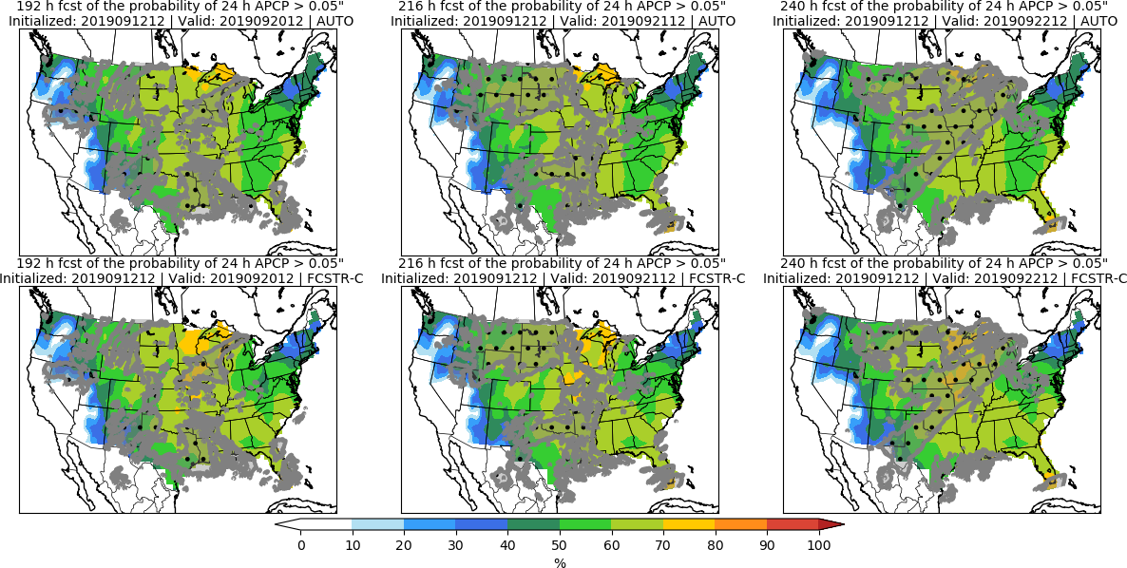
Day 8 Day 9 Day 10

Slide 41
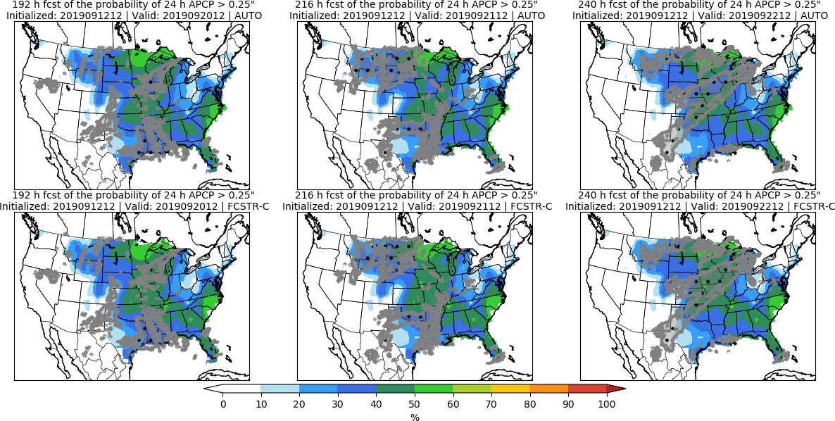
Day 8 Day 9 Day 10

Slide 42
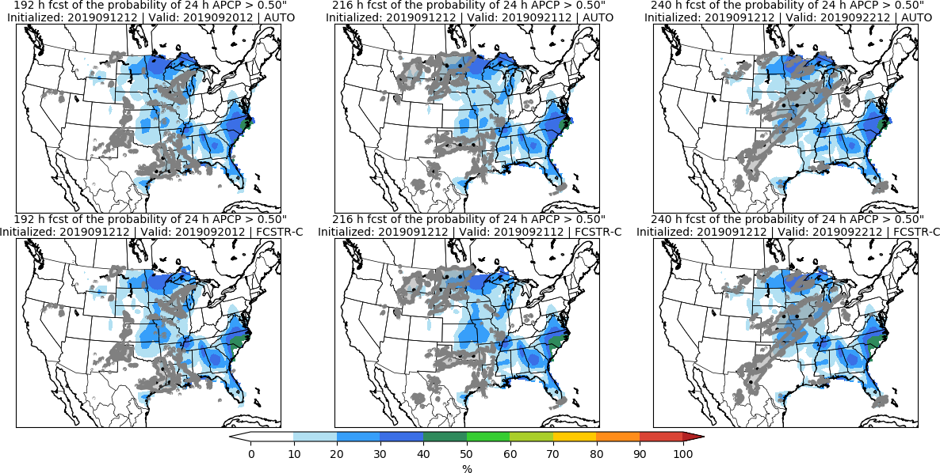
Day 8 Day 9 Day 10

Slide 43
Day 8–10 Hazards

Slide 44
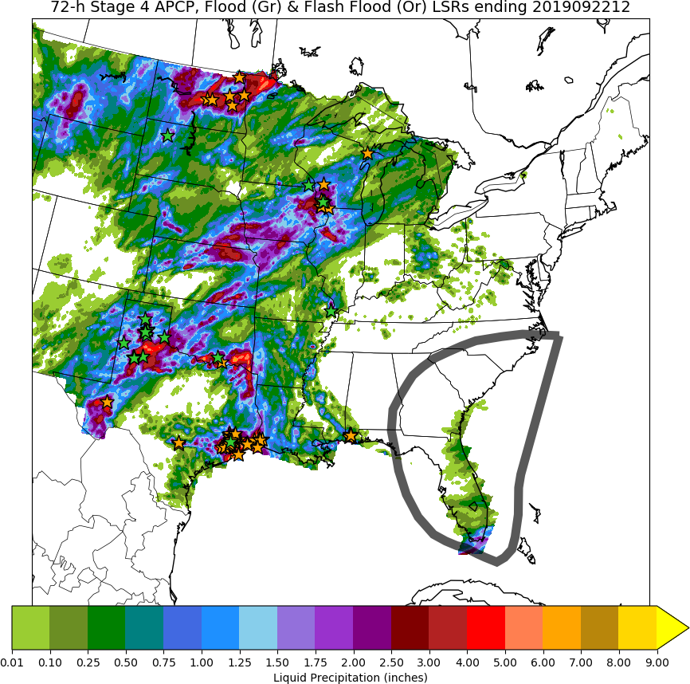
Heavy Rainfall and Potential Tropical Cyclone Conditions

Slide 45
Day 3–7 Hazards

Slide 46
Potential for 2” of Rain in 24 hours on Days 3, 4, and 5

