Slide 1
Extended Range Forecast Experiment Verification
CONUS forecasts created 2 May

Slide 2
500 mb Geopotential Height | 500Z

Slide 3
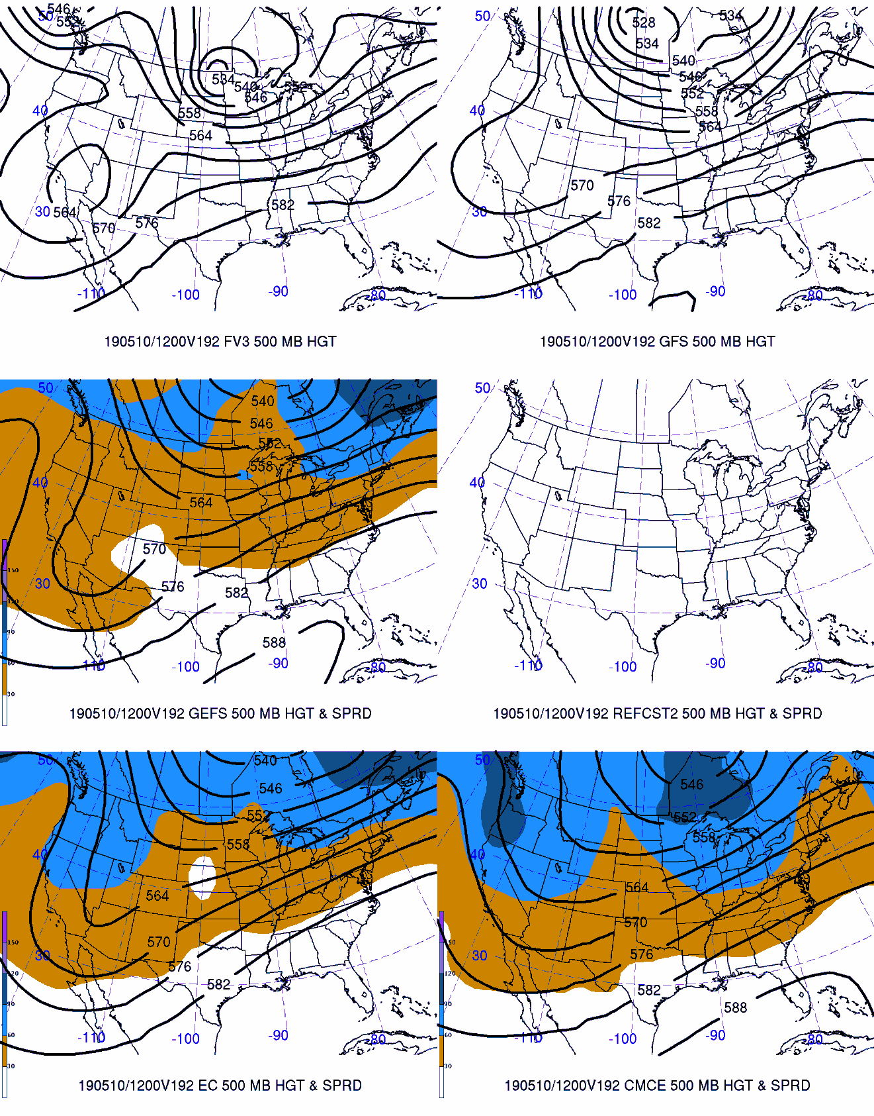
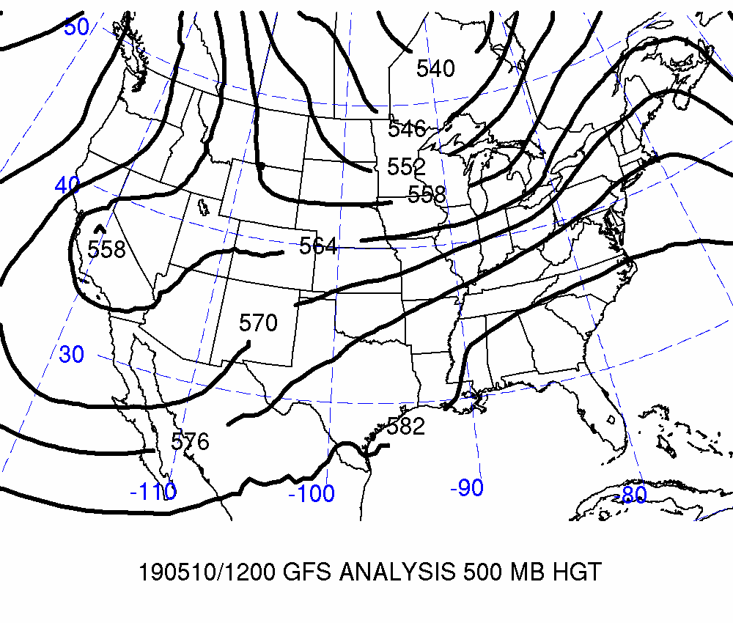
Day 8: Valid 2019-05-10 12Z
FCSTR Blend Weights (%)
TMAX / TMIN / QPF
FV3: 0% / 0% / 0%
GFS: 5% / 0% / 0%
GEFS: 0% / 0% / 0%
REFCST2: 0% / 0% / 0%
EC CTRL: 10% / 10% / 20%
ECENS: 0% / 0% / 0%
CMCE: 0% / 0% / 0%

Slide 4
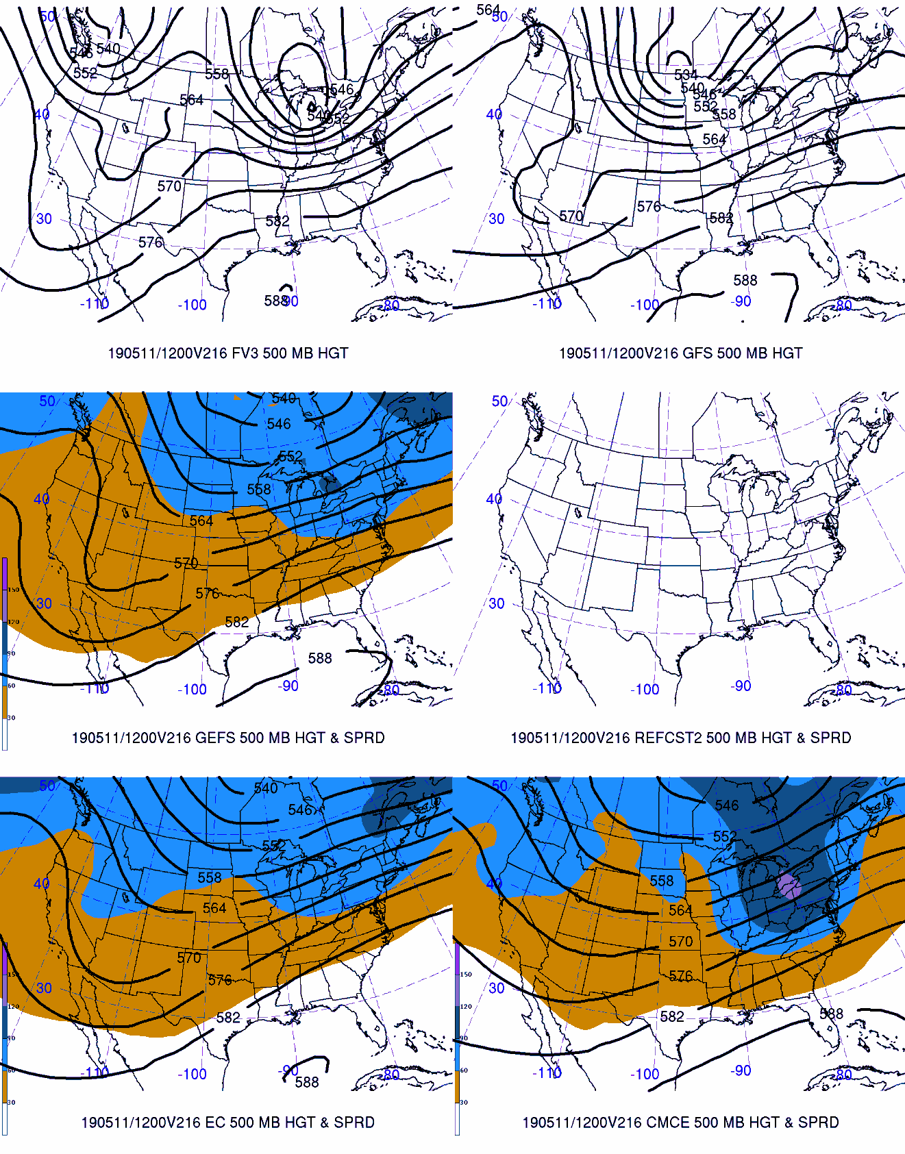
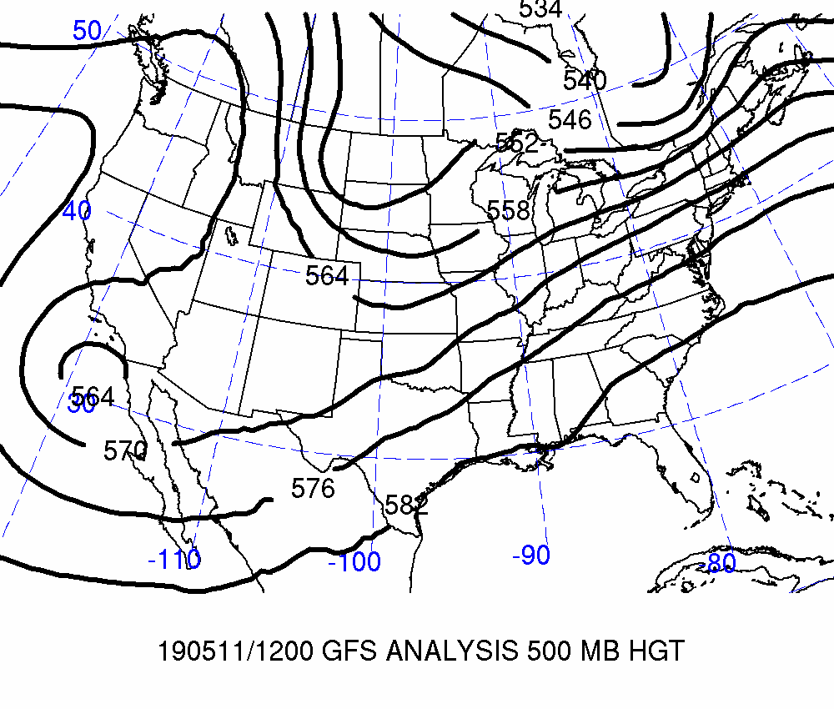
Day 9: Valid 2019-05-11 12Z
FCSTR Blend Weights (%)
TMAX / TMIN / QPF
FV3: 0% / 0% / 0%
GFS: 5% / 0% / 0%
GEFS: 0% / 0% / 0%
REFCST2: 0% / 0% / 0%
EC CTRL: 10% / 10% / 20%
ECENS: 0% / 0% / 0%
CMCE: 0% / 0% / 0%

Slide 5
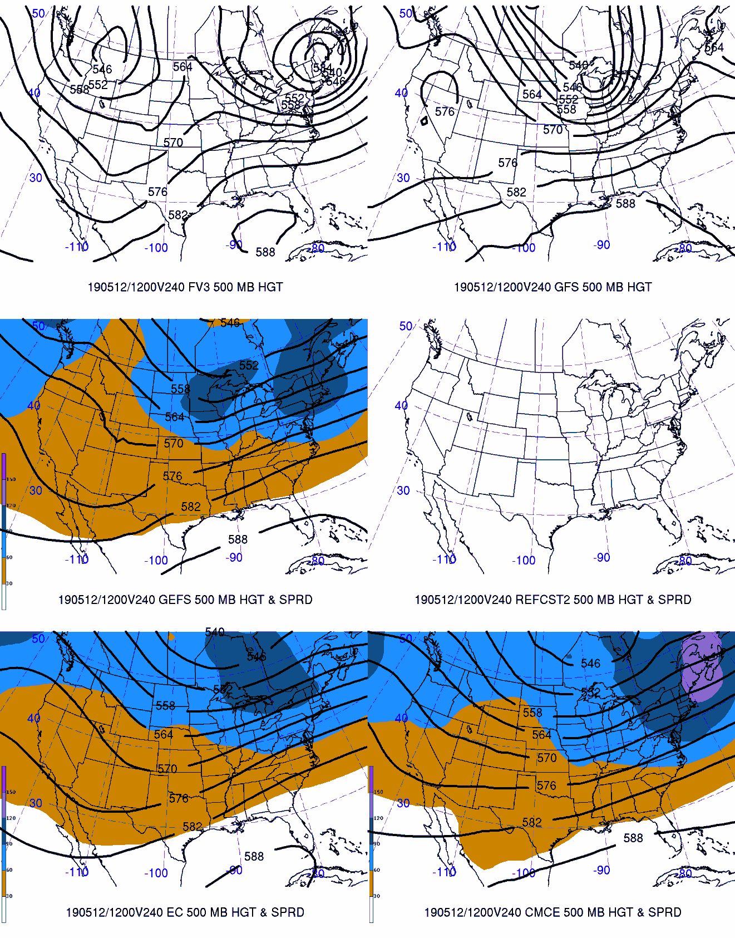
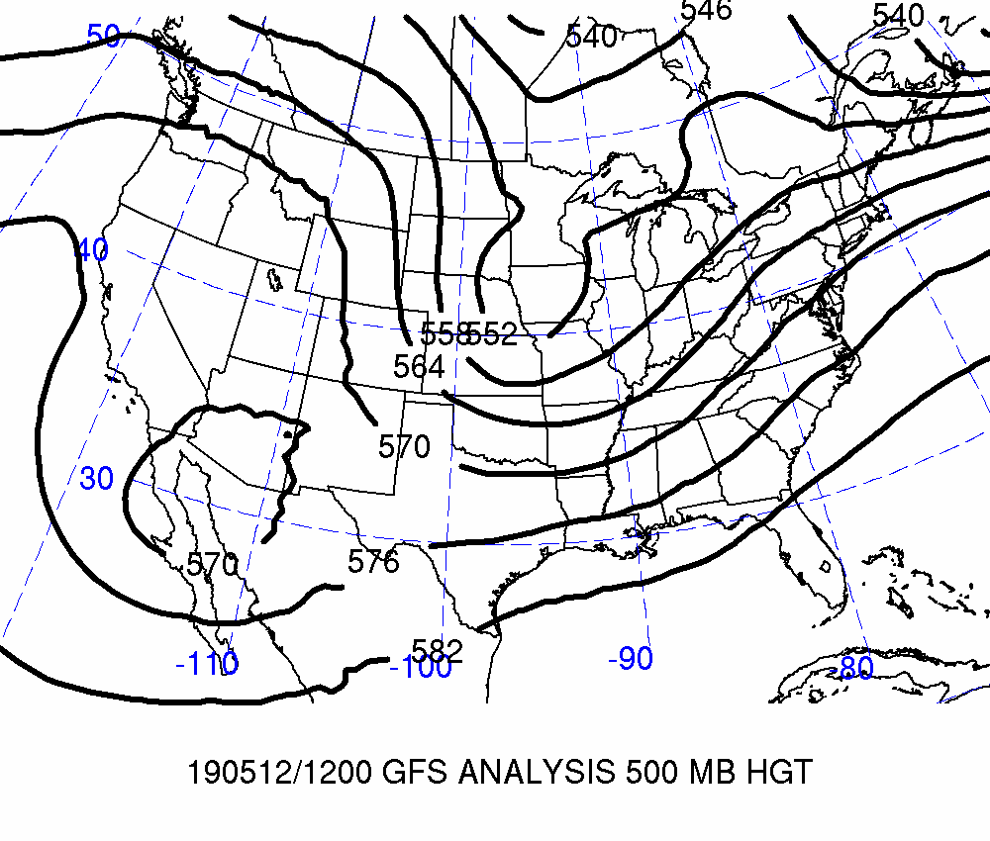
Day 10: Valid 2019-05-12 12Z
FCSTR Blend Weights (%)
TMAX / TMIN / QPF
FV3: 0% / 0% / 0%
GFS: 5% / 0% / 0%
GEFS: 0% / 0% / 0%
REFCST2: 0% / 0% / 0%
EC CTRL: 10% / 10% / 20%
ECENS: 0% / 0% / 0%
CMCE: 0% / 0% / 0%

Slide 6
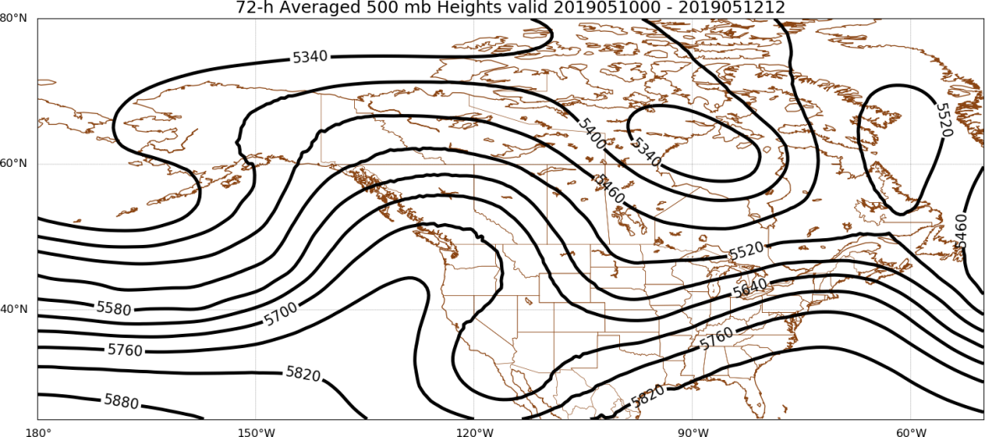
Days 8–10
FCSTR Blend Weights (%): TMAX / TMIN / QPF
EOF1P: 0% / 0% / 0%
EOF1N: 0% / 0% / 0%
EOFMN: 85% / 90% / 80%
GFS Analysis
EOF2P: 0% / 0% / 0%
EOF2N: 0% / 0% / 0%

Slide 7
Maximum Temperature | TMAX

Slide 8
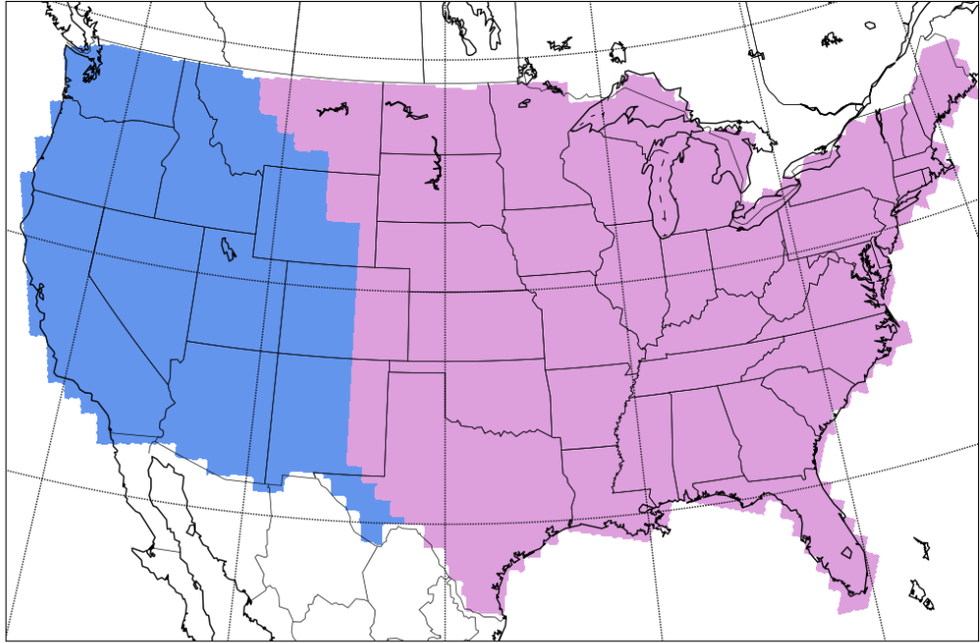
Separation of Western & Eastern CONUS
West
East
West
East

Slide 9
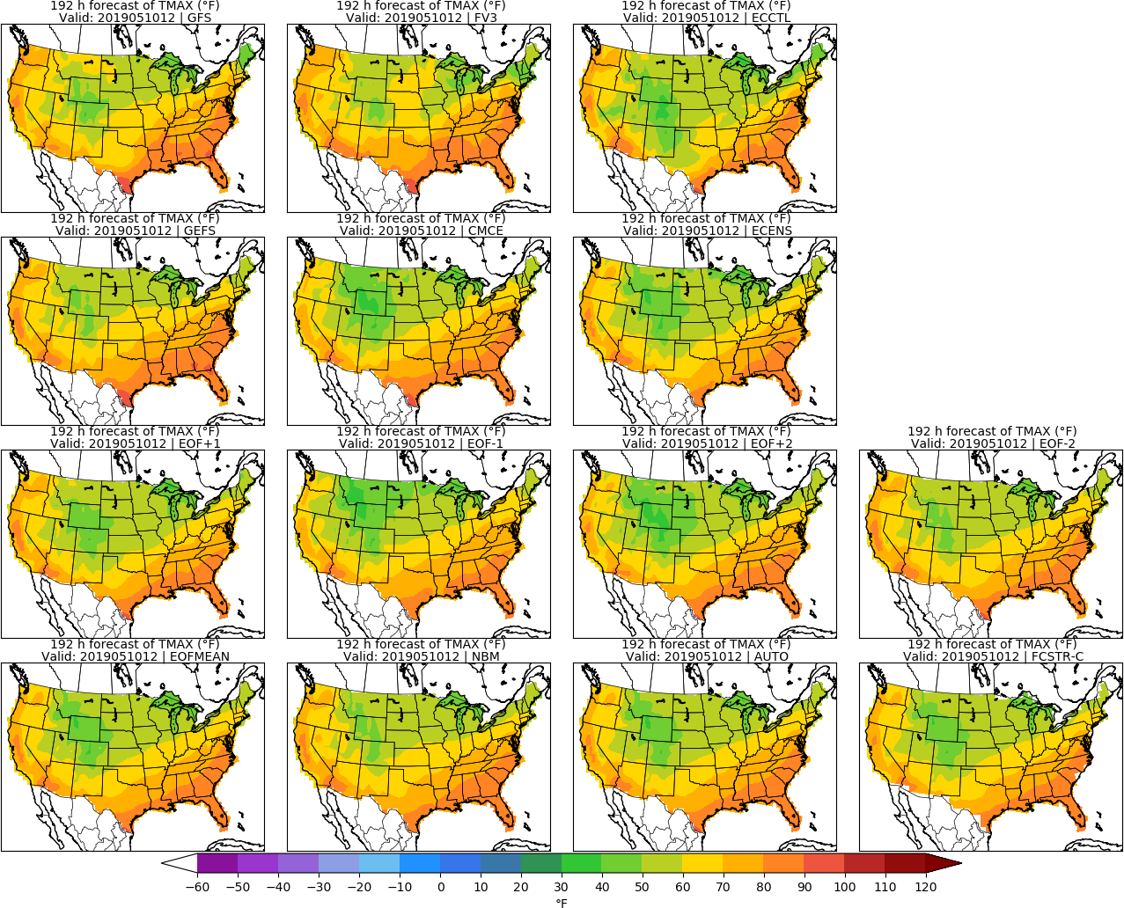
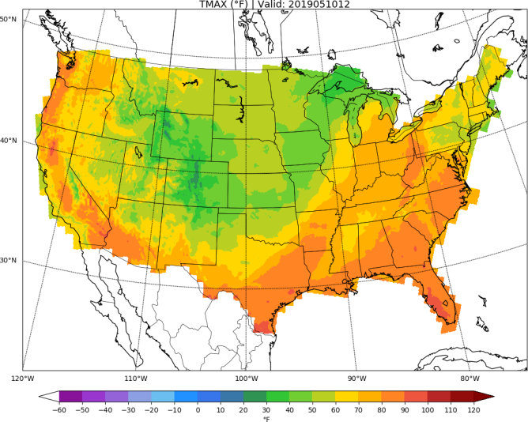
Day 8: TMAX
URMA

Slide 10
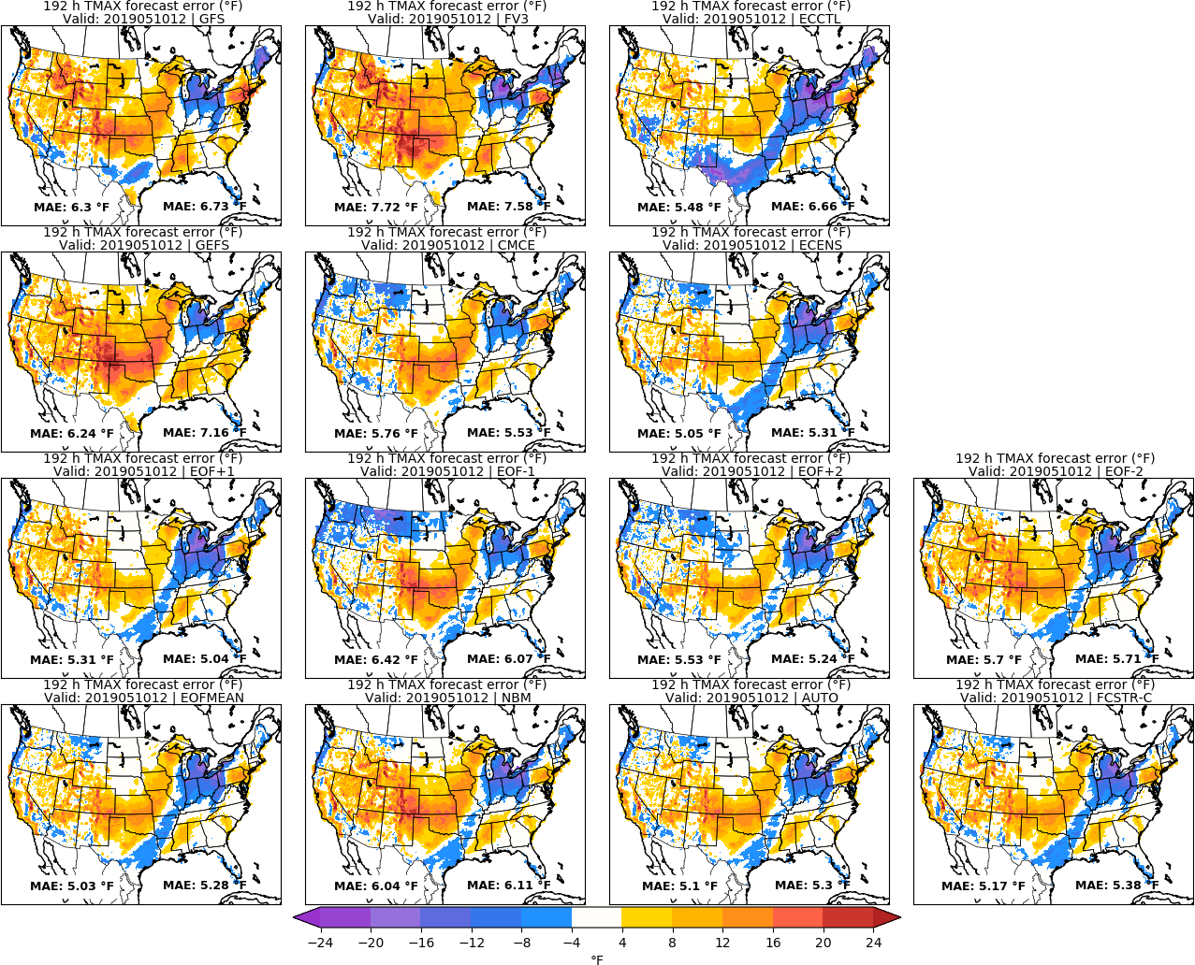
Day 8: TMAX
URMA

Slide 11
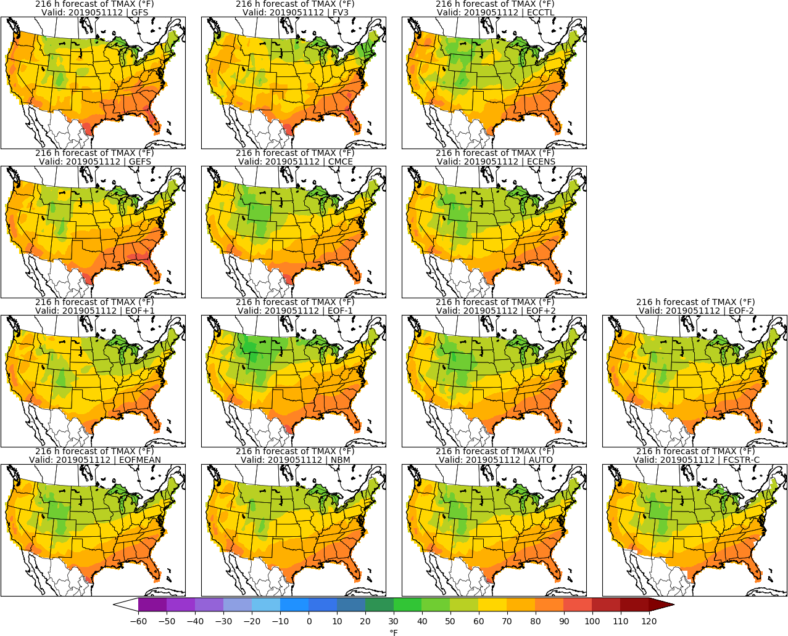
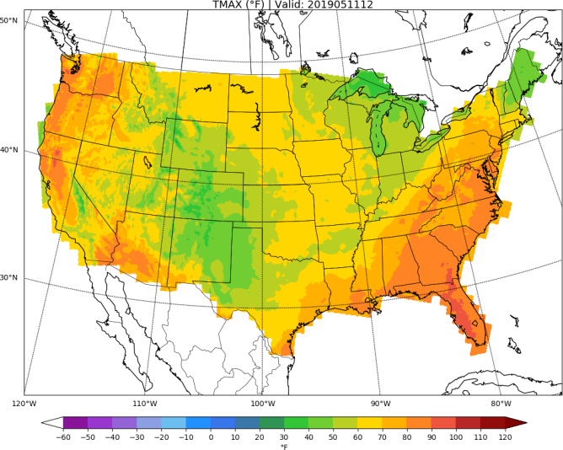
Day 9: TMAX
URMA

Slide 12
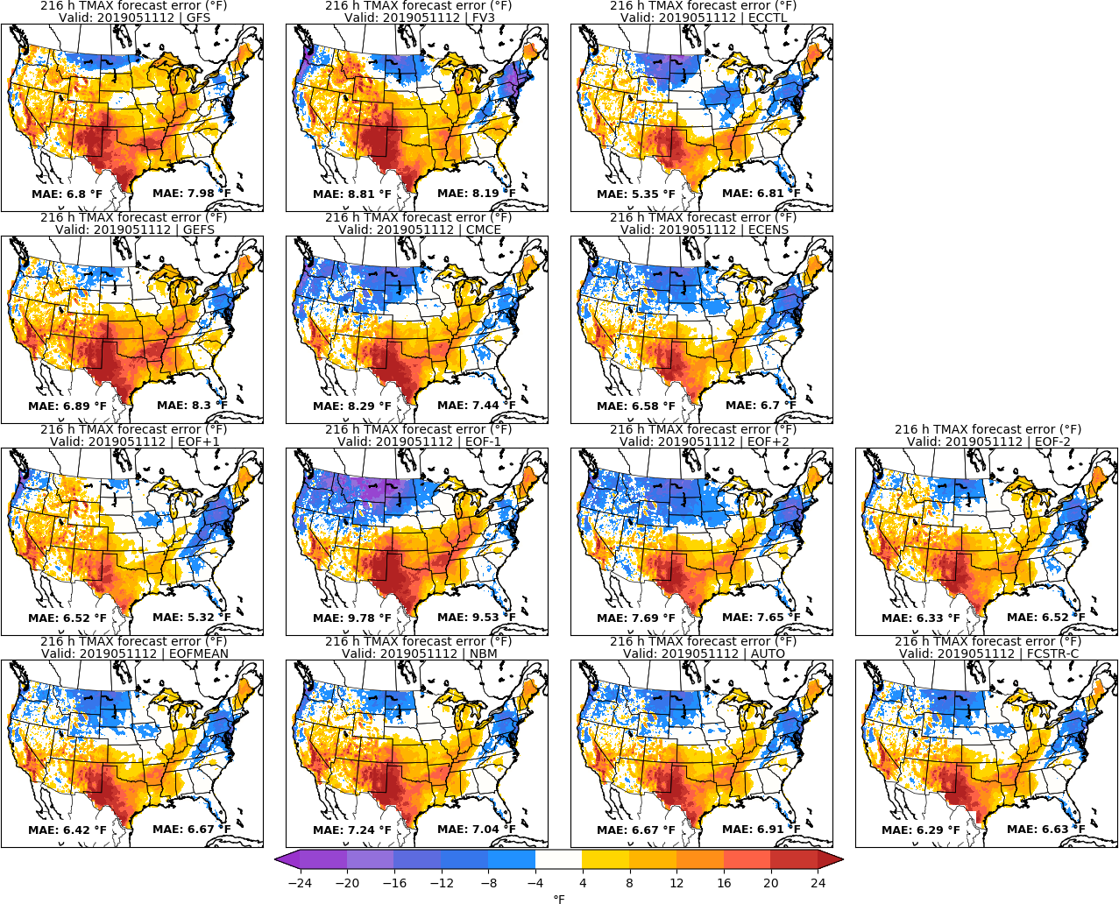
Day 9: TMAX
URMA

Slide 13
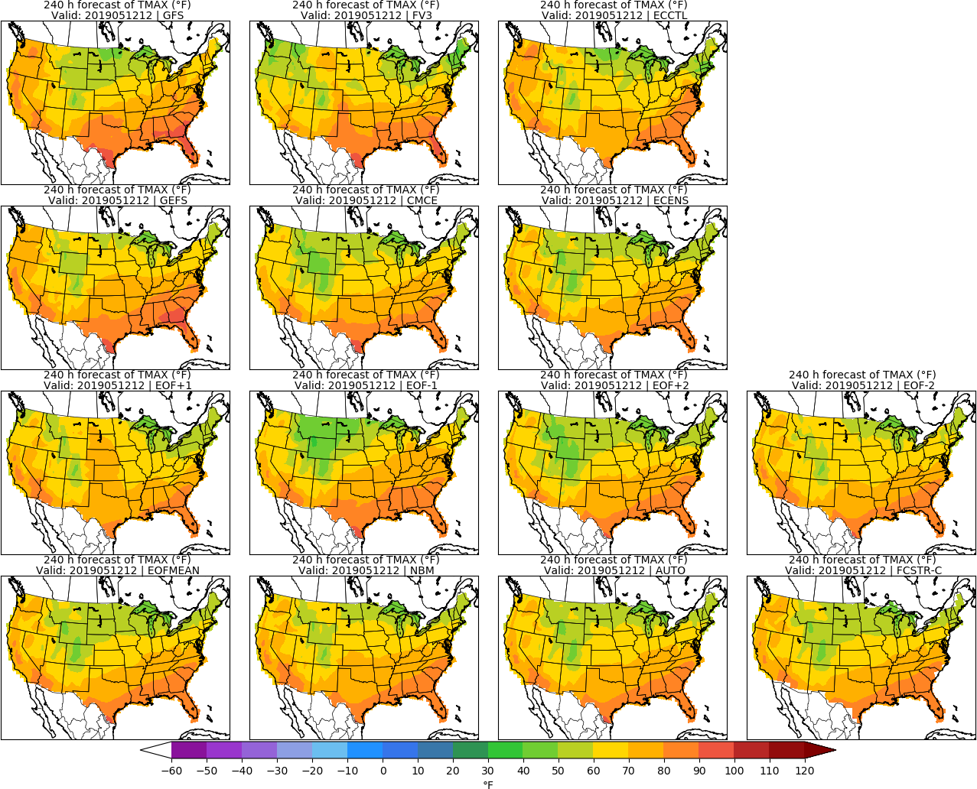
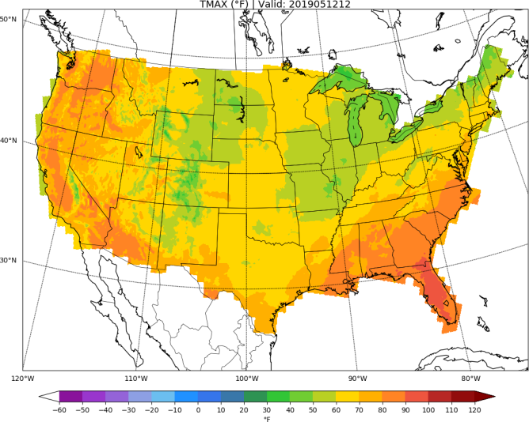
Day 10: TMAX
URMA

Slide 14
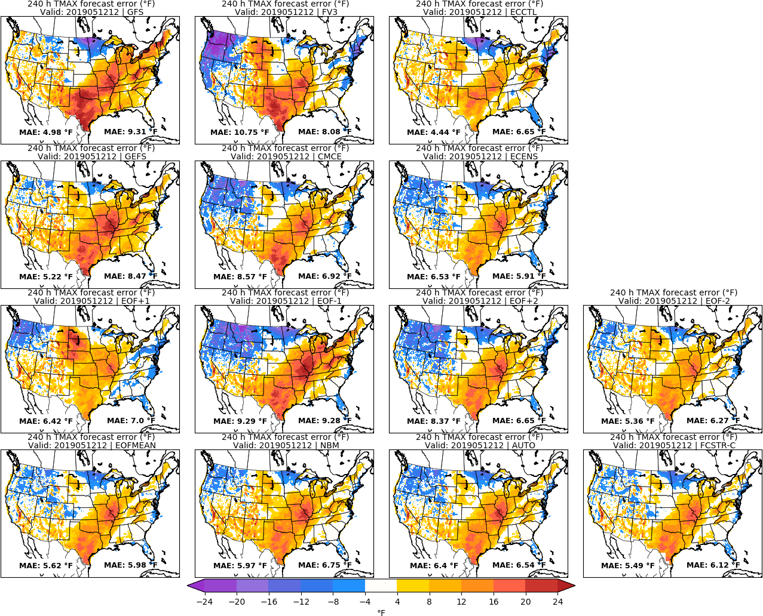
Day 10: TMAX
URMA

Slide 15
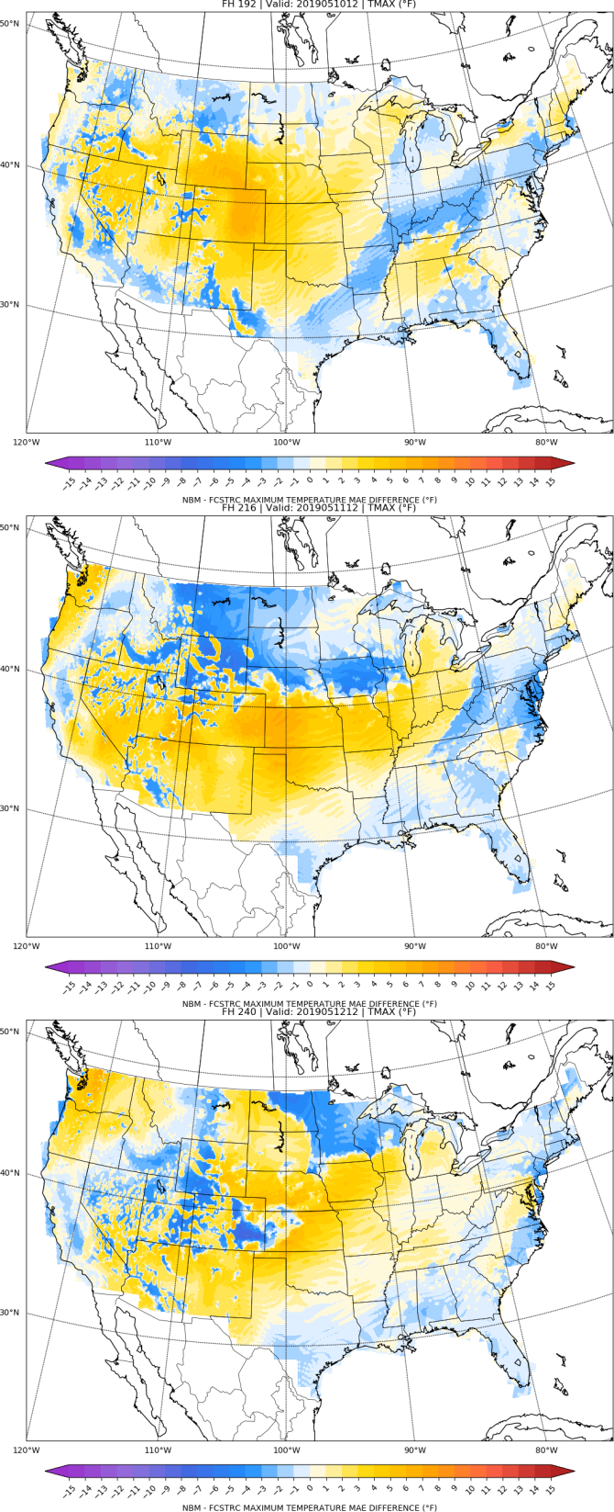
NBM vs FCSTR-C
Blend Comparison
Day 8
MAE_{NBM} – MAE_{FCSTRC} } > 0 is FCSTRC
improvement
over NBM
Day 9
FCSTRC Worse
FCSTRC Better
Day 10

Slide 16
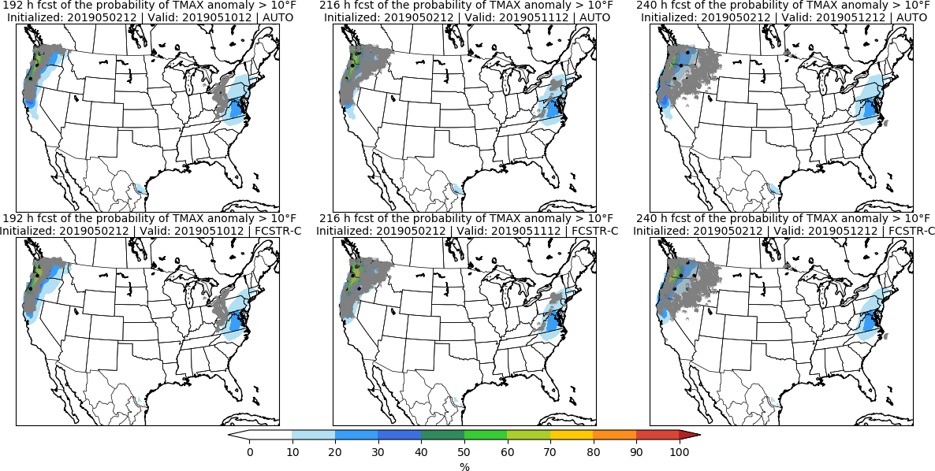
Day 8 Day 9 Day 10

Slide 17
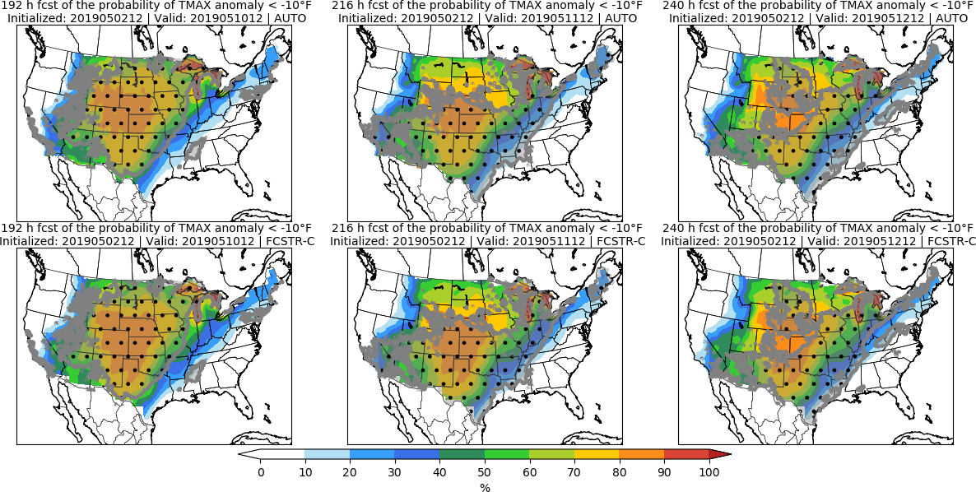
Day 8 Day 9 Day 10

Slide 18
Minimum Temperature | TMIN

Slide 19
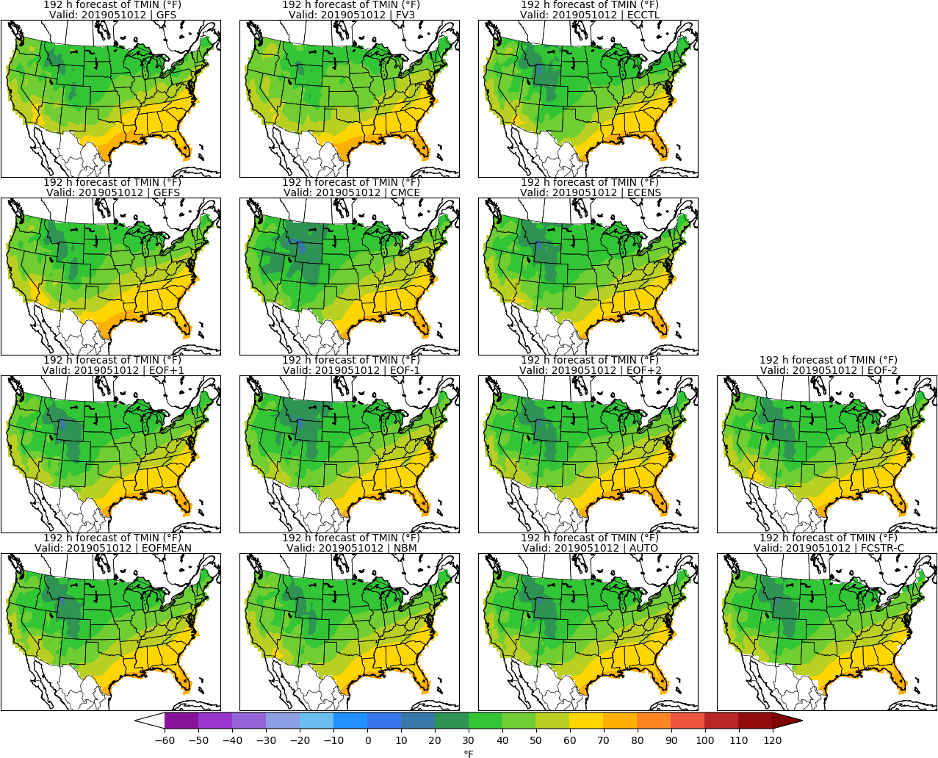
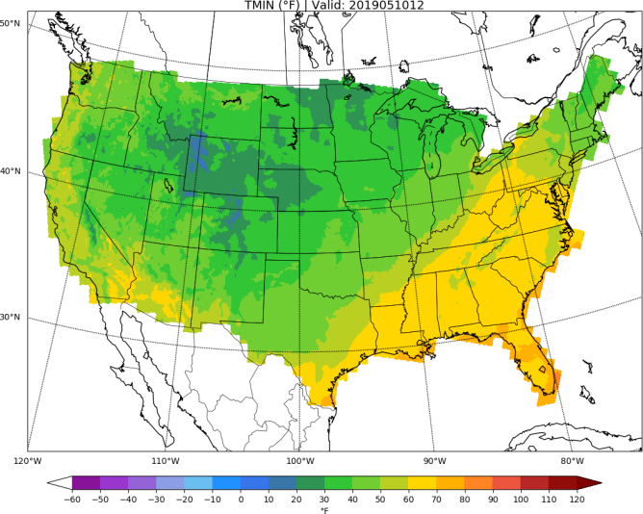
Day 8: TMIN
URMA

Slide 20
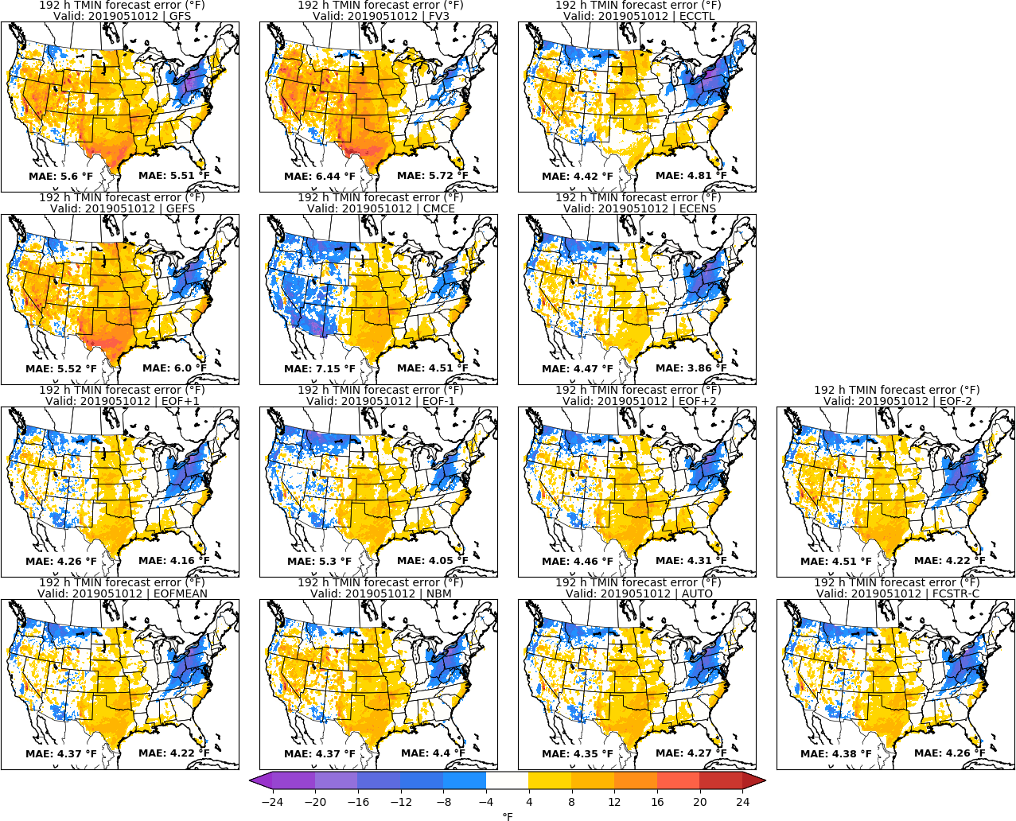
Day 8: TMIN
URMA

Slide 21
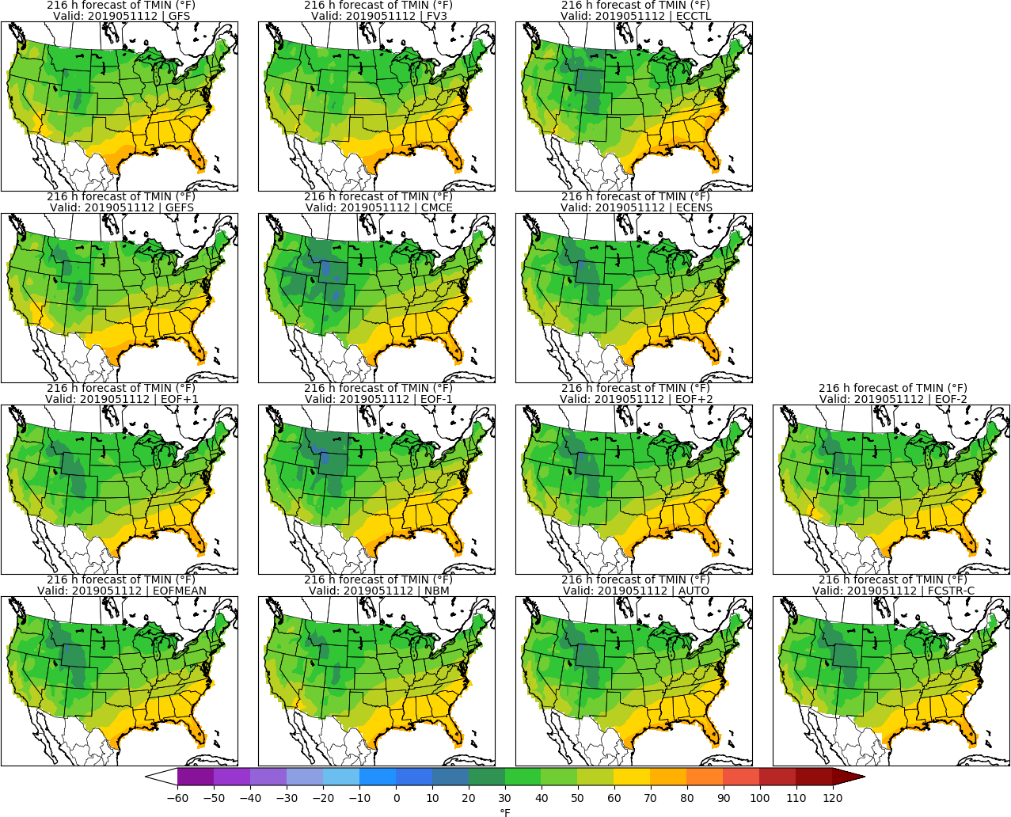
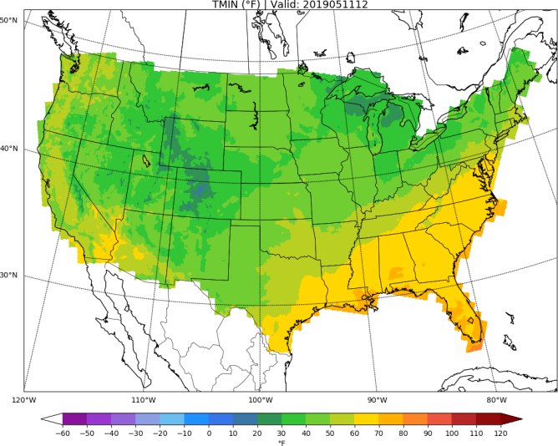
Day 9: TMIN
URMA

Slide 22
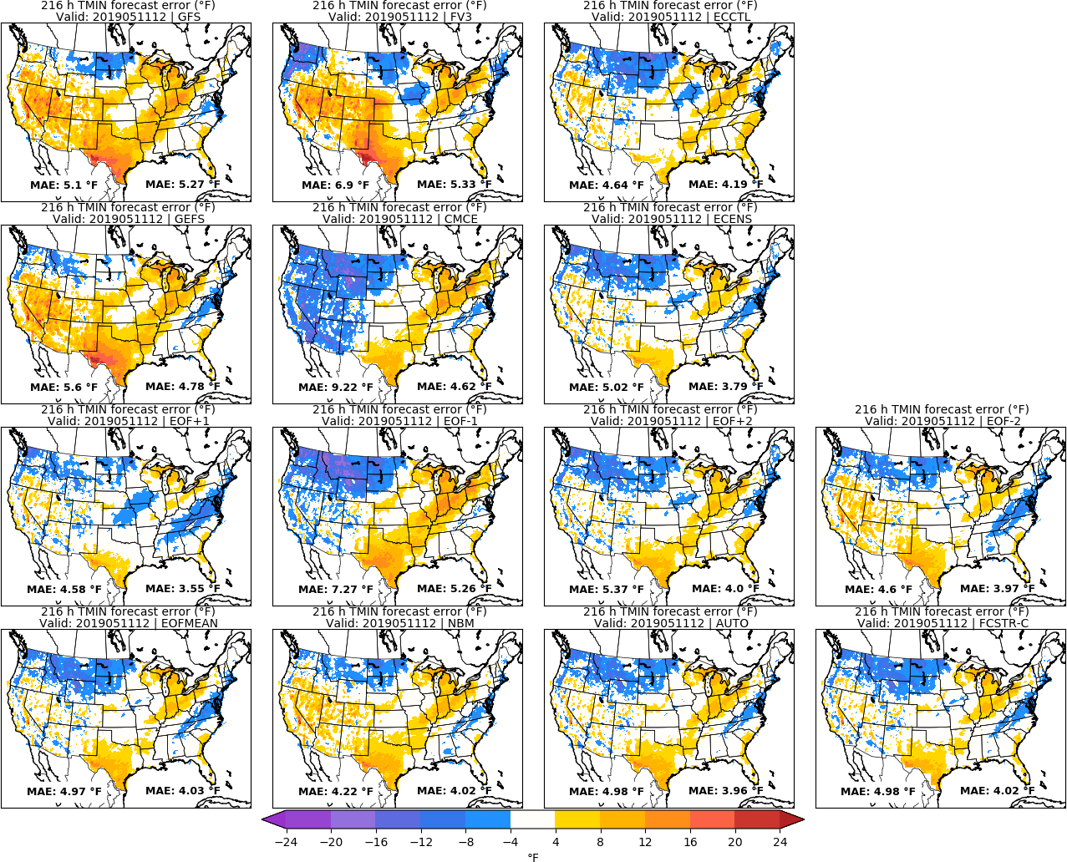
Day 9: TMIN
URMA

Slide 23
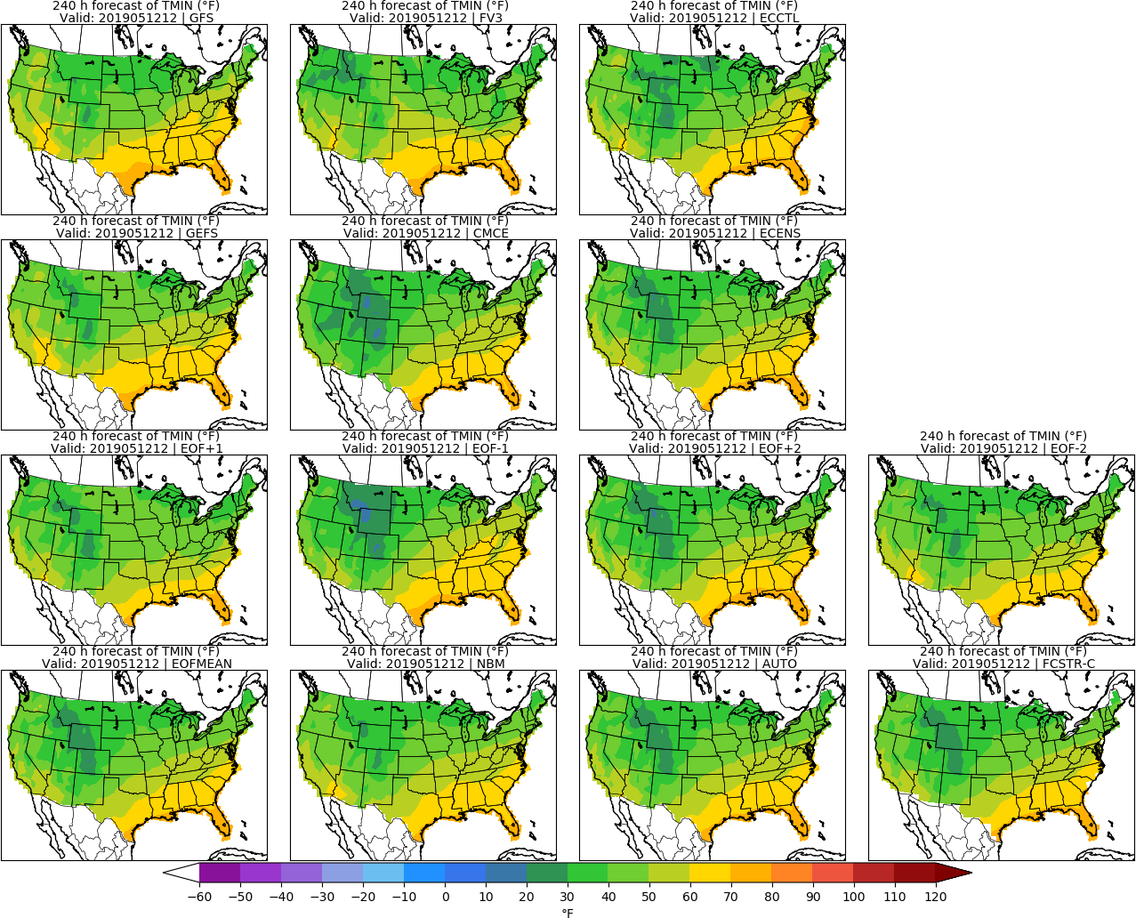
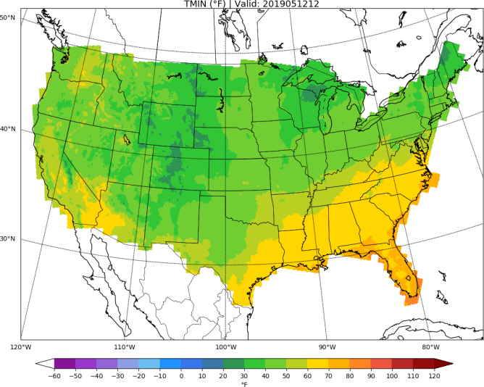
Day 10: TMIN
URMA

Slide 24
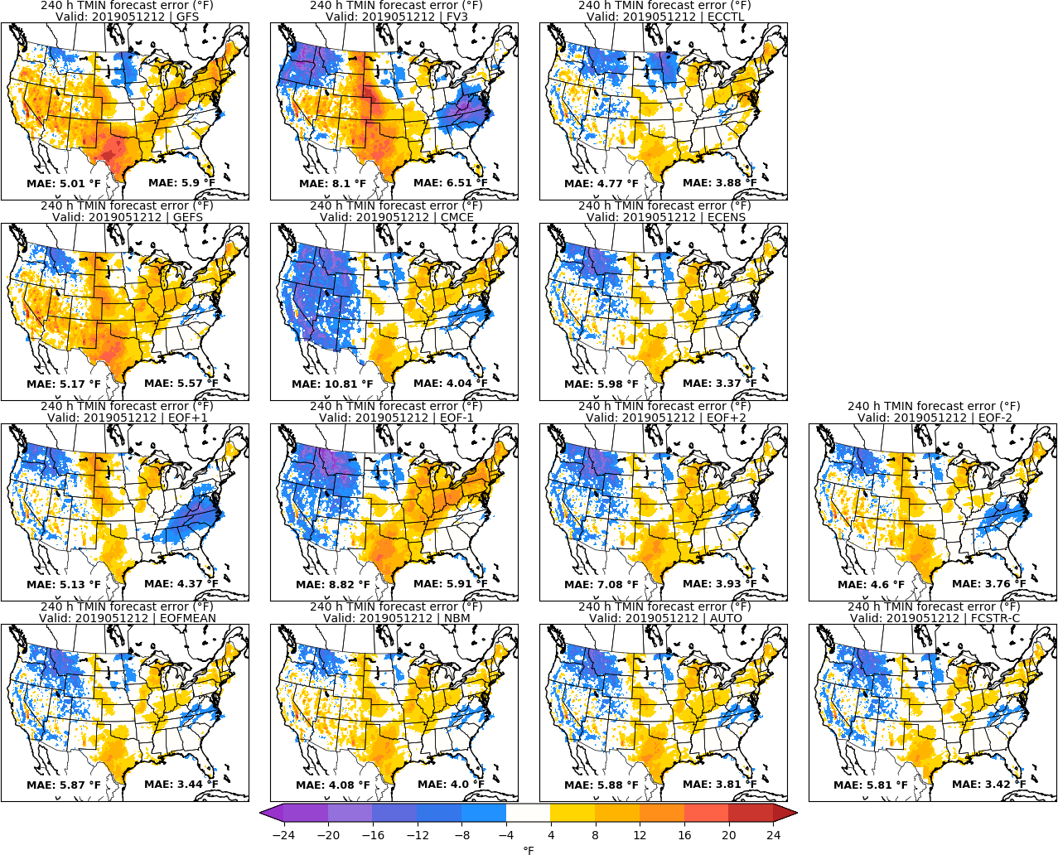
Day 10: TMIN
URMA

Slide 25
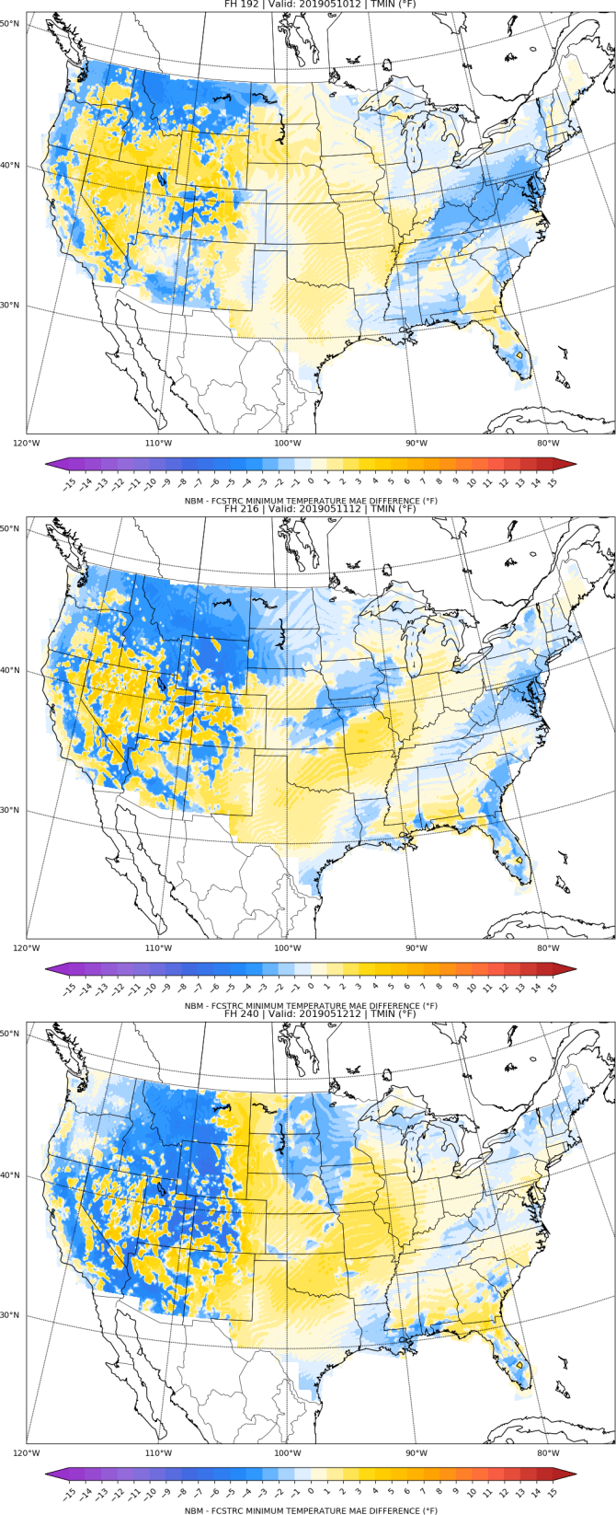
NBM vs FCSTR-C
Blend Comparison
Day 8
MAE_{NBM} – MAE_{FCSTRC} } > 0 is FCSTRC
improvement
over NBM
Day 9
FCSTRC Worse
FCSTRC Better
Day 10

Slide 26
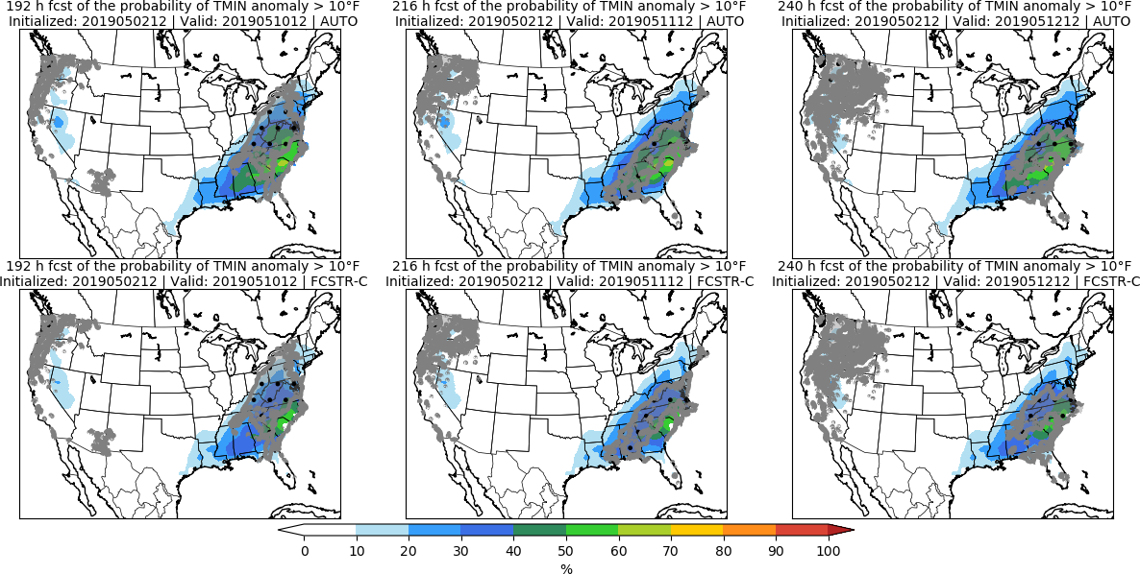
Day 8 Day 9 Day 10

Slide 27
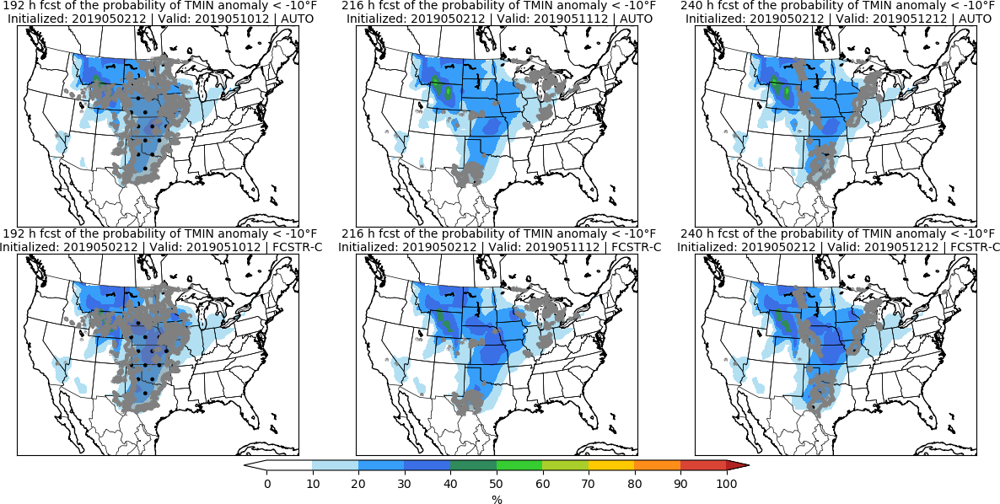
Day 8 Day 9 Day 10

Slide 28
Accumulated Precipitation | APCP

Slide 29
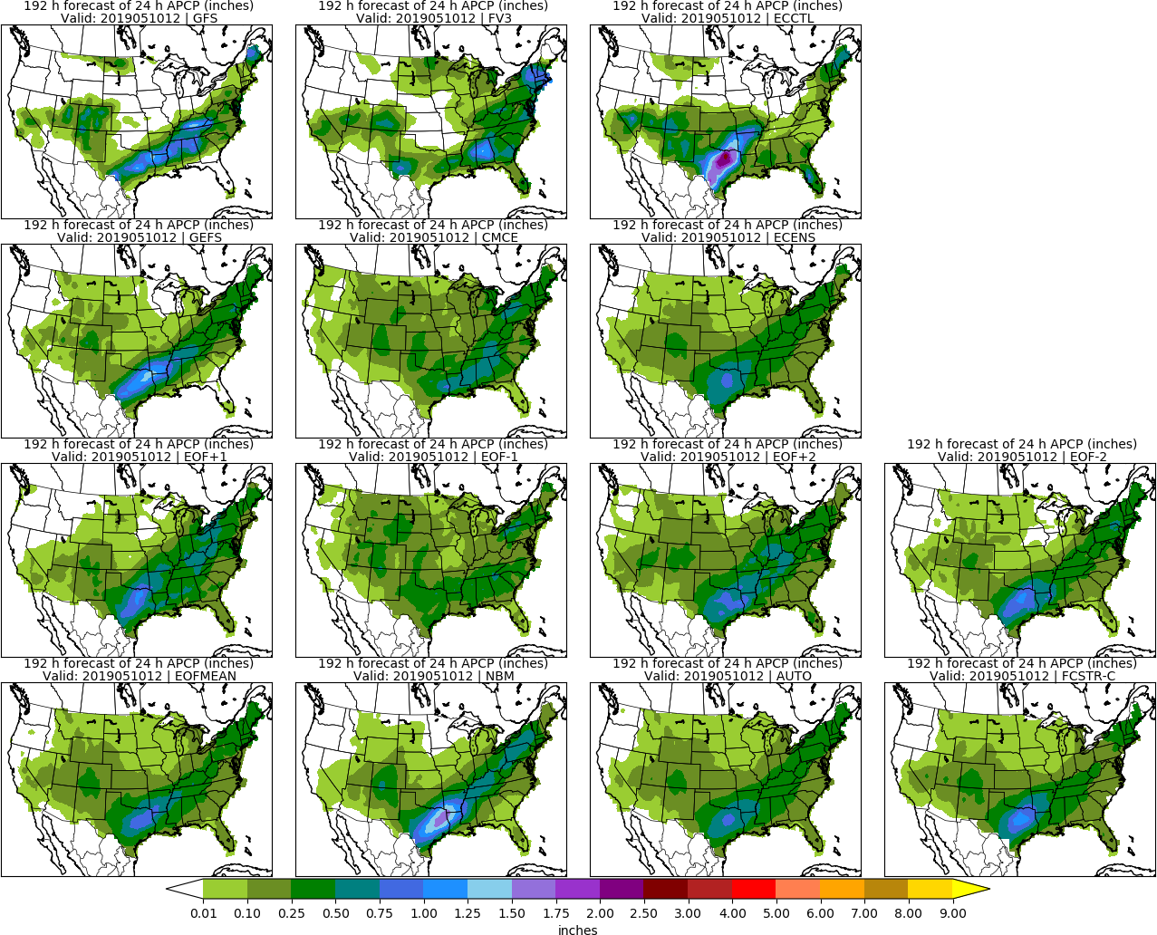
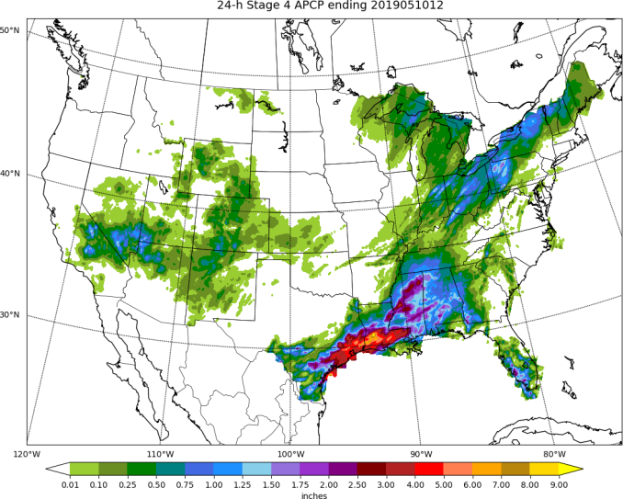
Day 8: APCP
STAGE 4

Slide 30
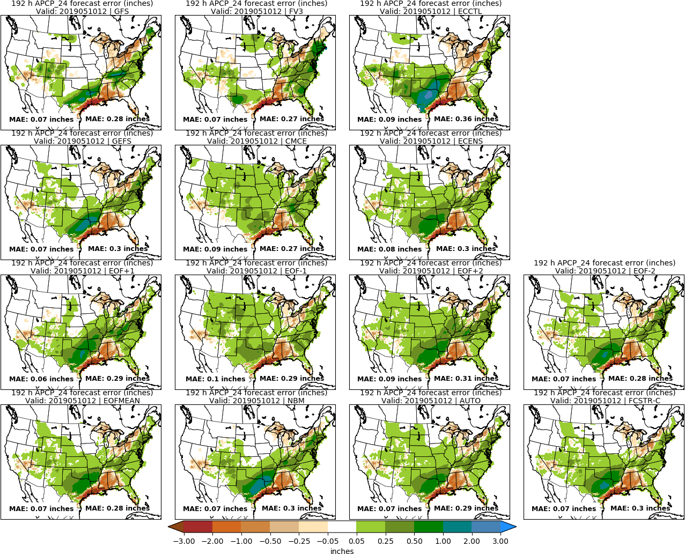
Day 8: APCP
STAGE 4

Slide 31
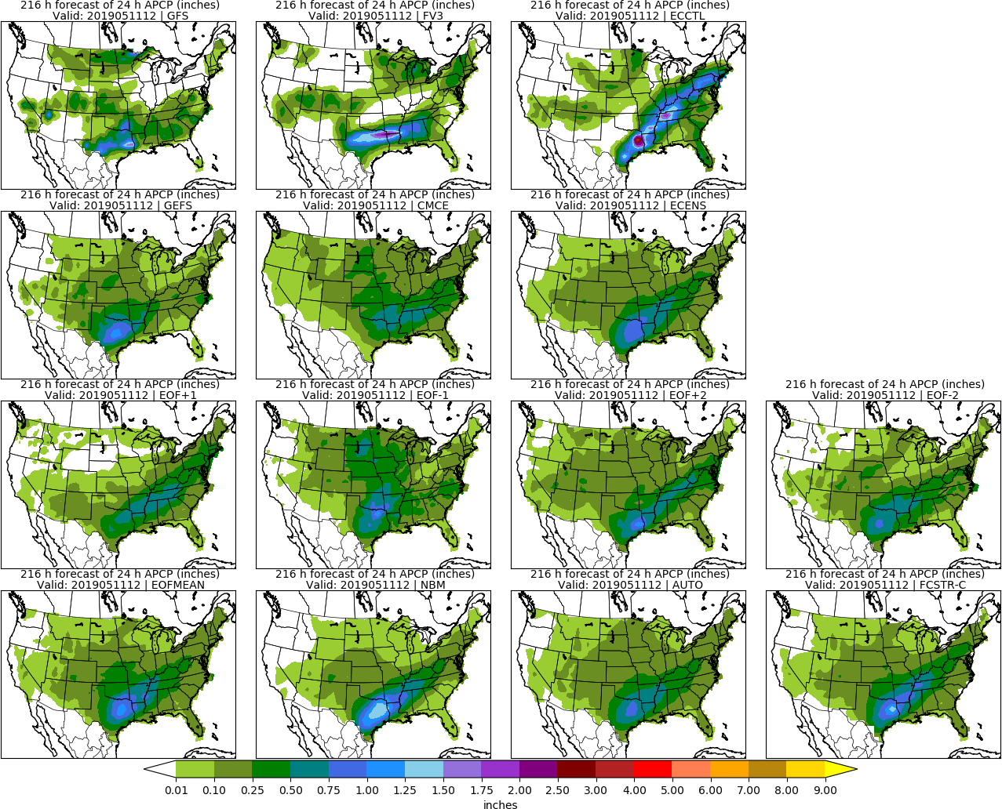
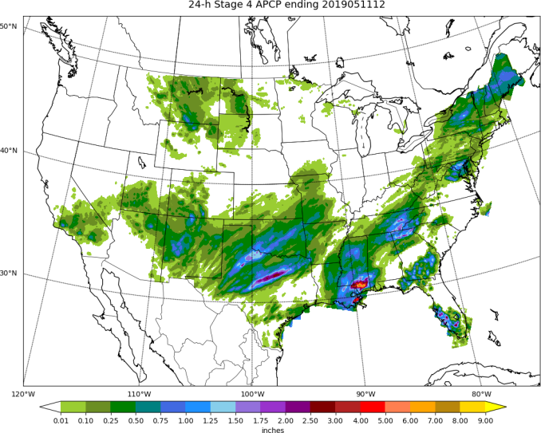
Day 9: APCP
STAGE 4

Slide 32
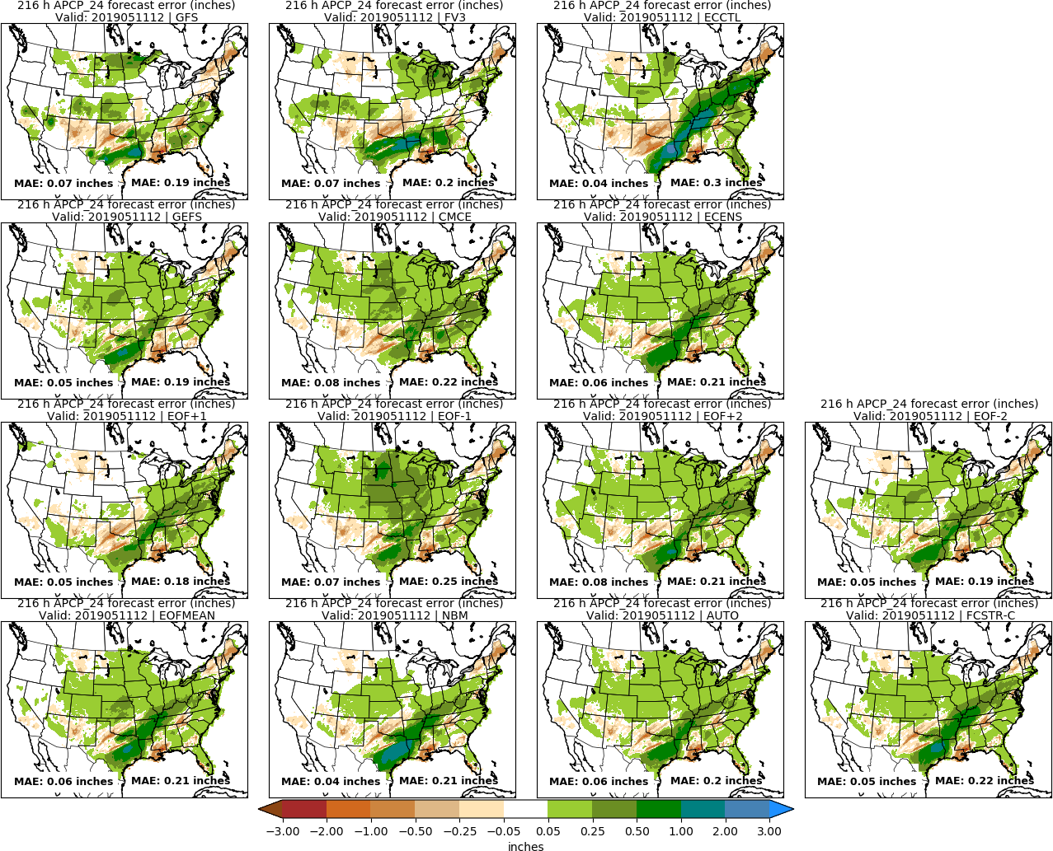
Day 9: APCP
STAGE 4

Slide 33
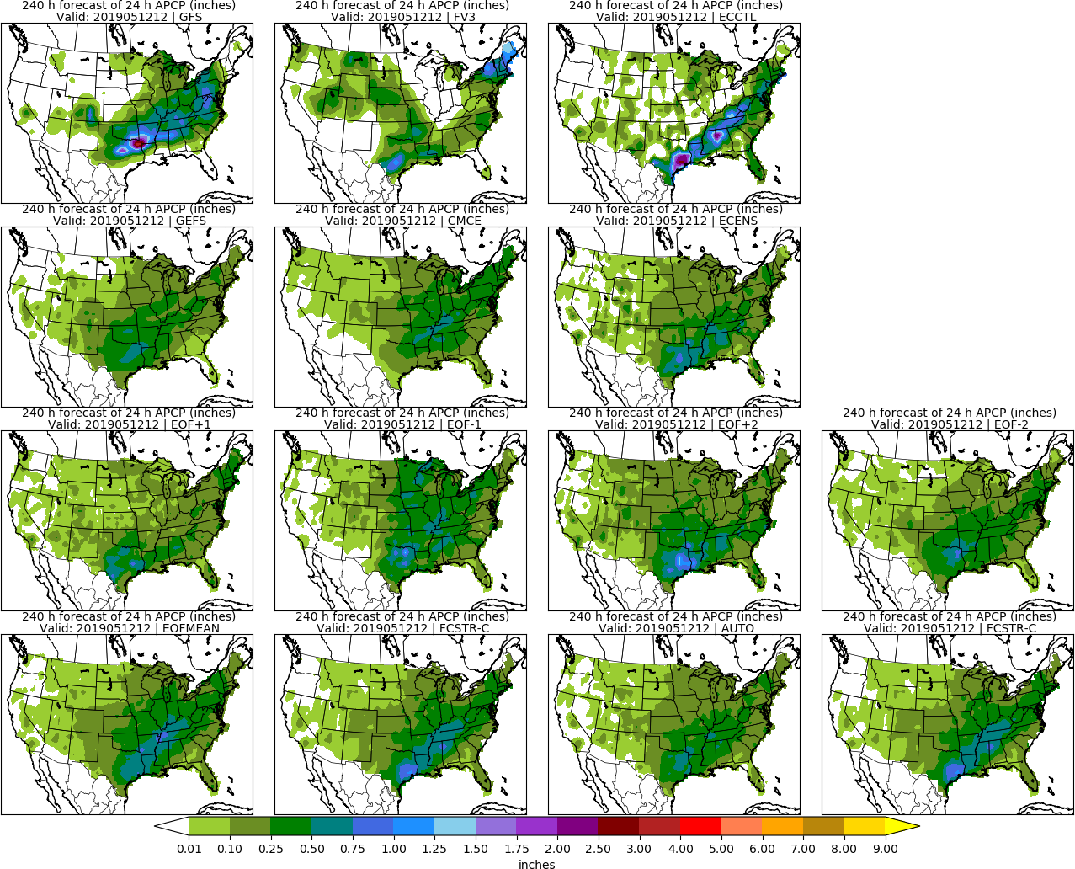
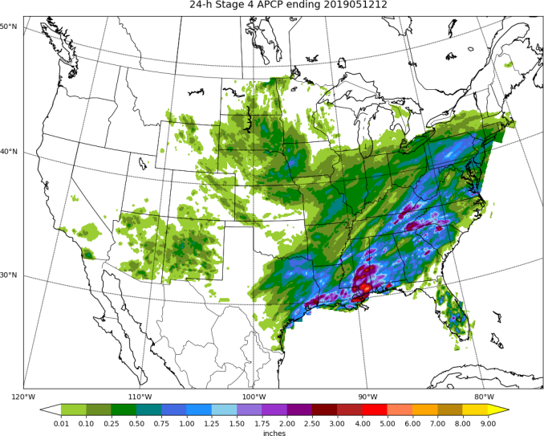
Day 10: APCP
STAGE 4

Slide 34
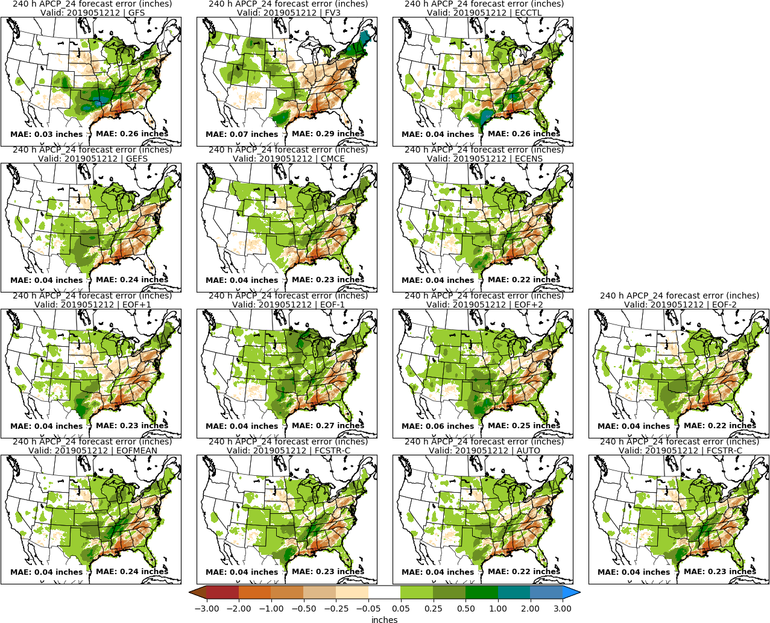
Day 10: APCP
STAGE 4

Slide 35
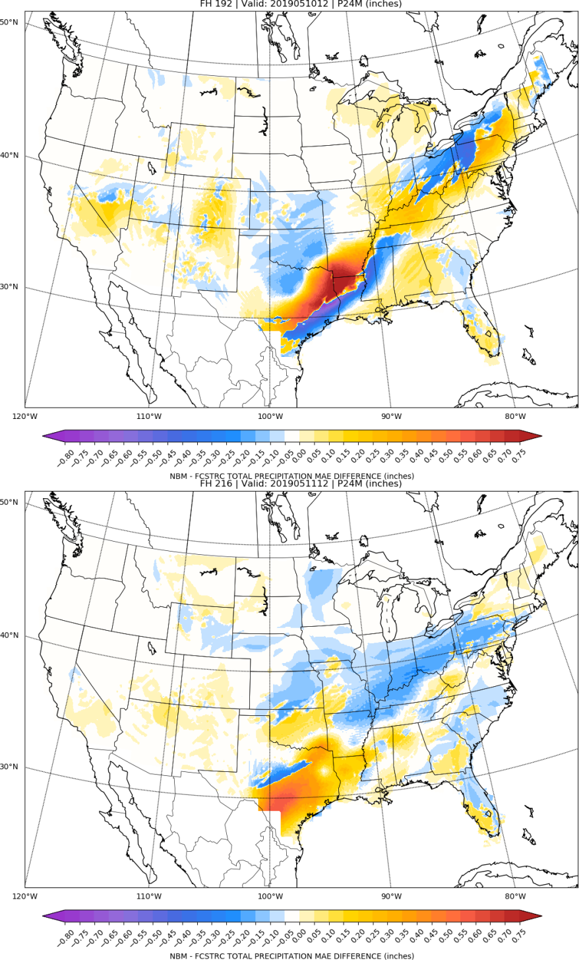
NBM vs FCSTR-C
Blend Comparison
Day 8
MAE_{NBM} – MAE_{FCSTRC} } > 0 is FCSTRC
improvement
over NBM
Day 9
FCSTRC Worse
FCSTRC Better

Slide 36
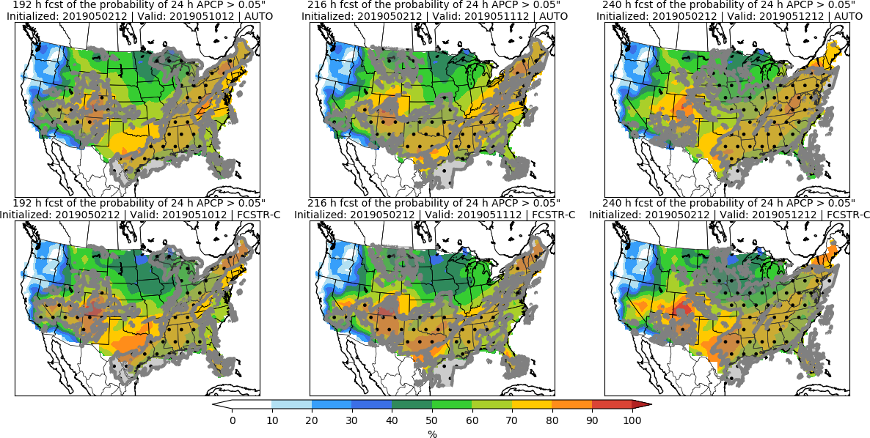
Day 8 Day 9 Day 10

Slide 37
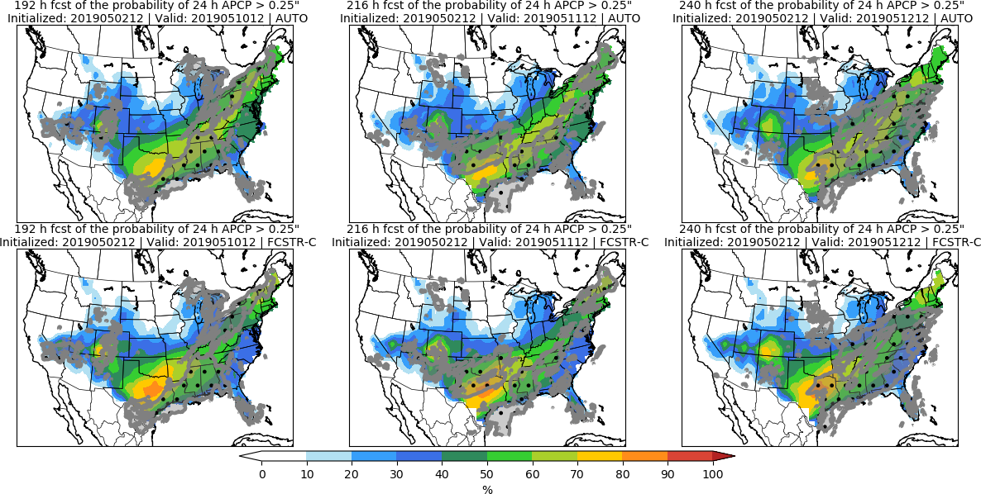
Day 8 Day 9 Day 10

Slide 38
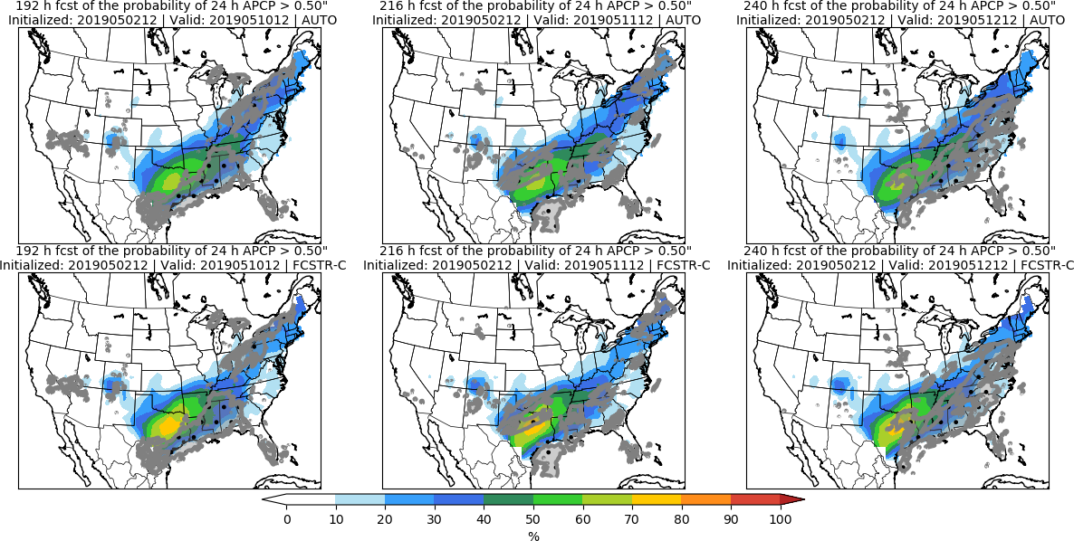
Day 8 Day 9 Day 10

Slide 39
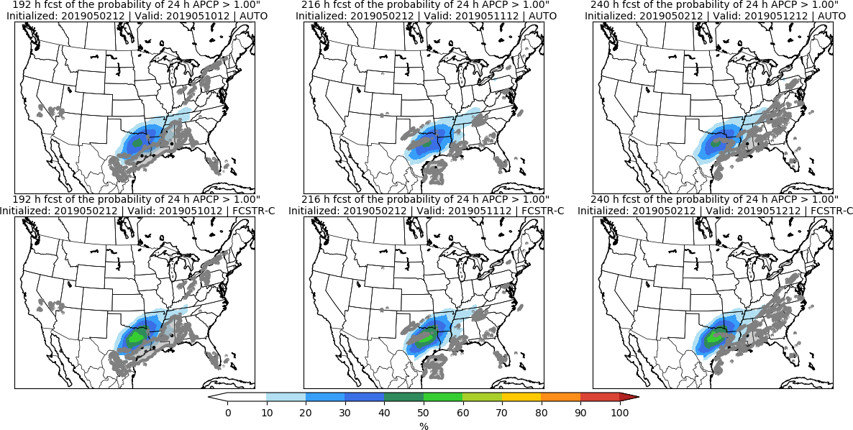
Day 8 Day 9 Day 10

Slide 40
Day 8–10 Hazards

Slide 41
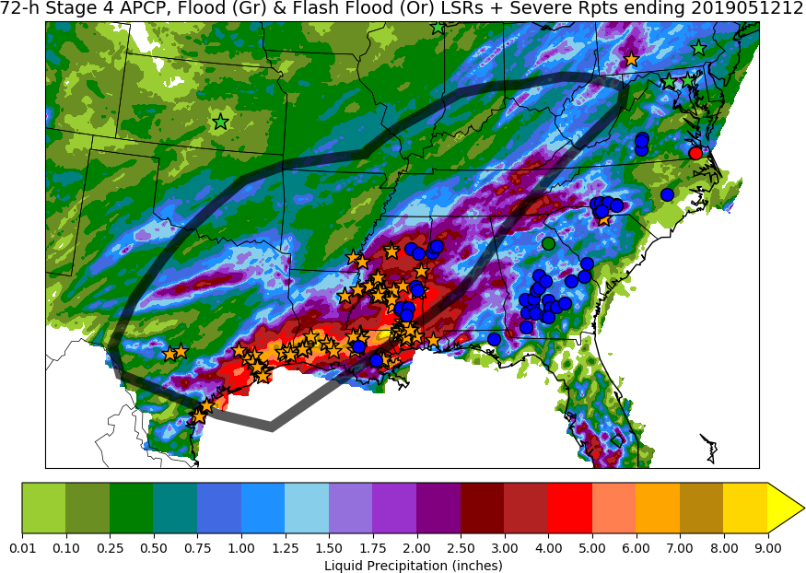
Day 8–10 Hazards: Day 8-10 Heavy Rain & Flooding & Possible Severe
LSRs
FLOOD
FLASH
FLOOD
SPC Reports
• TOR
• WIND
• HAIL

