Slide 1
Extended Range Forecast Experiment Verification
CONUS forecasts created 21 March

Slide 2
500 mb Geopotential Height | 500Z

Slide 3
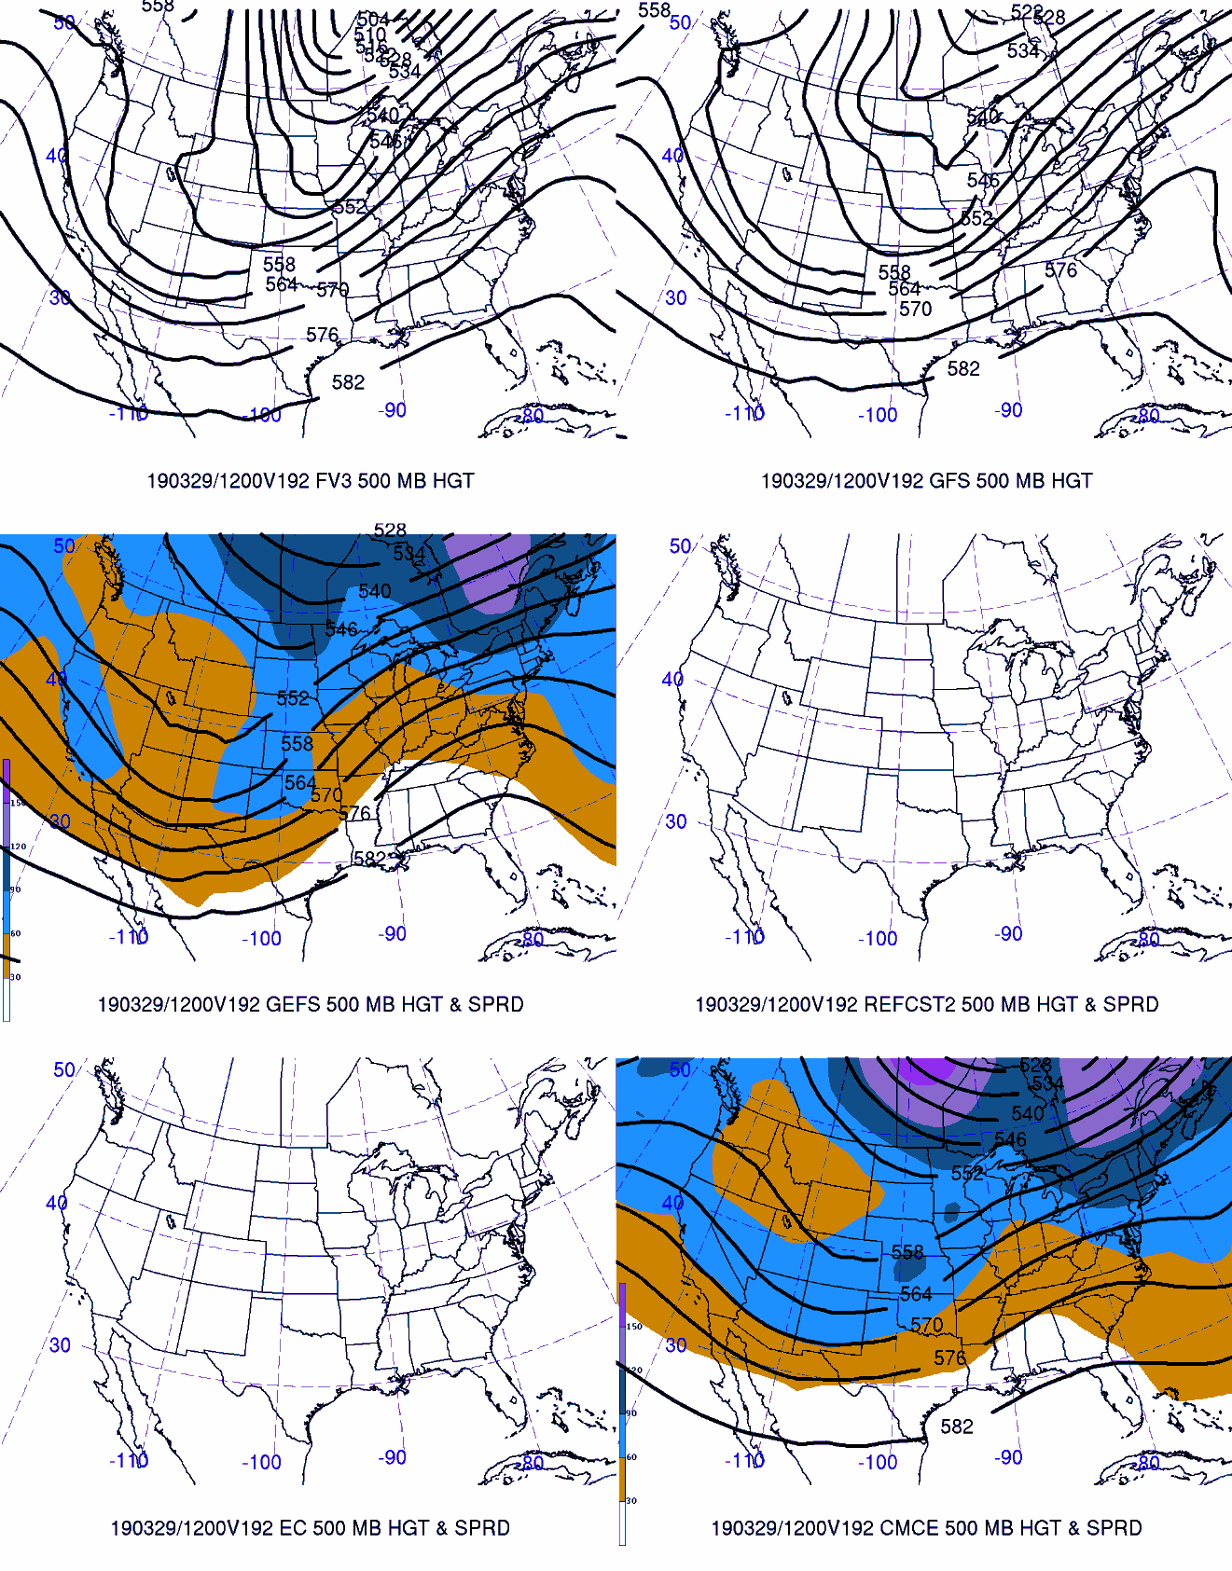
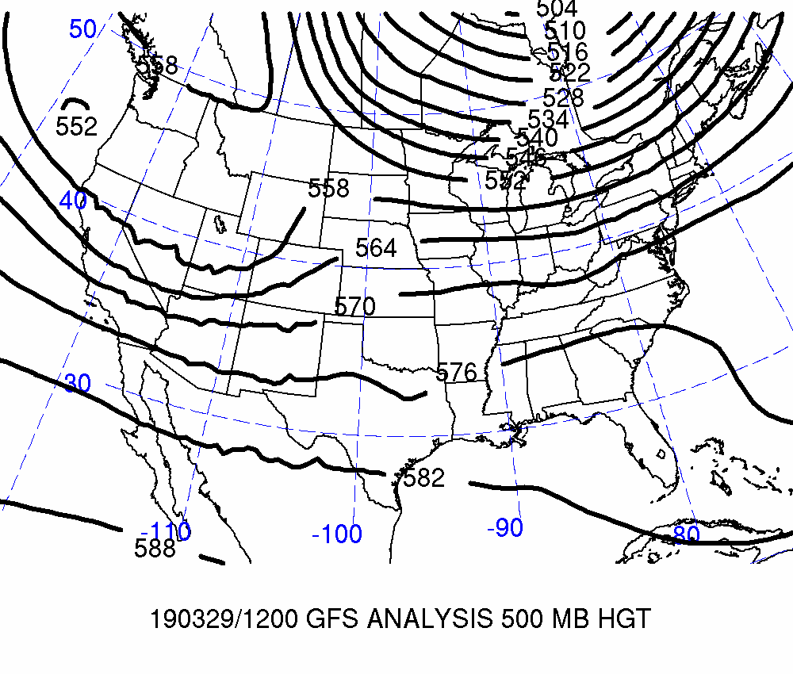
Day 8: Valid 2019-03-29 12Z
FCSTR Blend Weights (%)
TMAX / TMIN / QPF
FV3: 0% / 0% / 0%
GFS: 0% / 60% / 35%
GEFS: 0% / 0% / 0%
REFCST2: 0% / 0% / 0%
EC CTRL: 0% / 0% / 0%
ECENS: 0% / 0% / 0%
CMCE: 0% / 0% / 0%

Slide 4
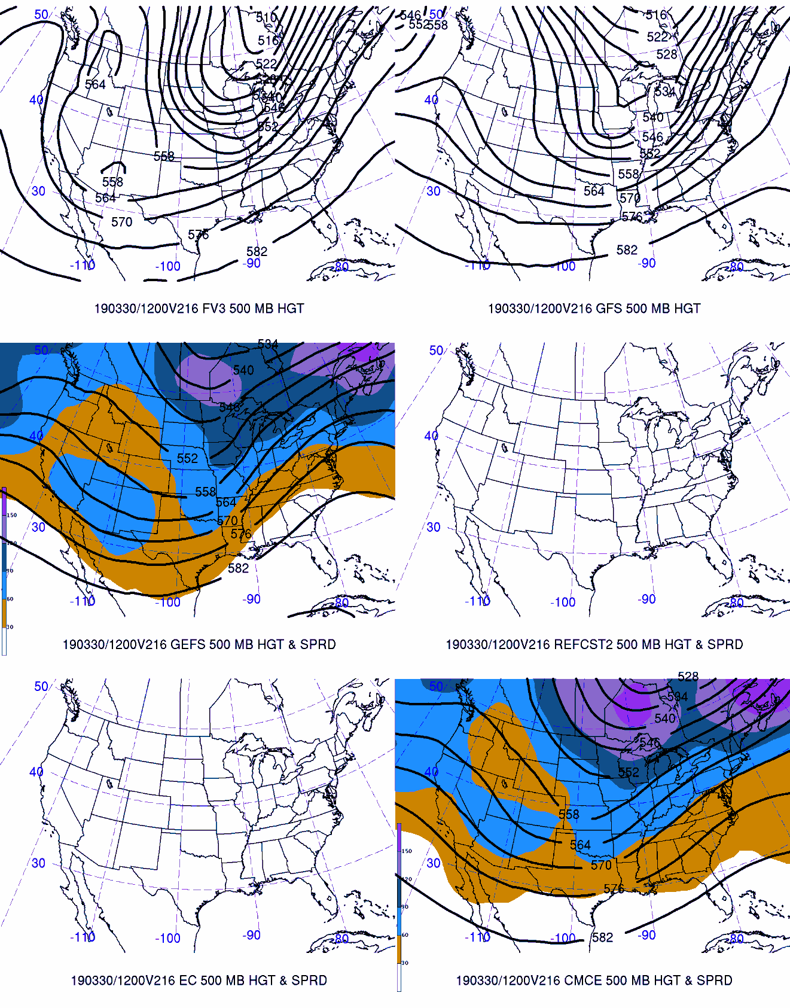
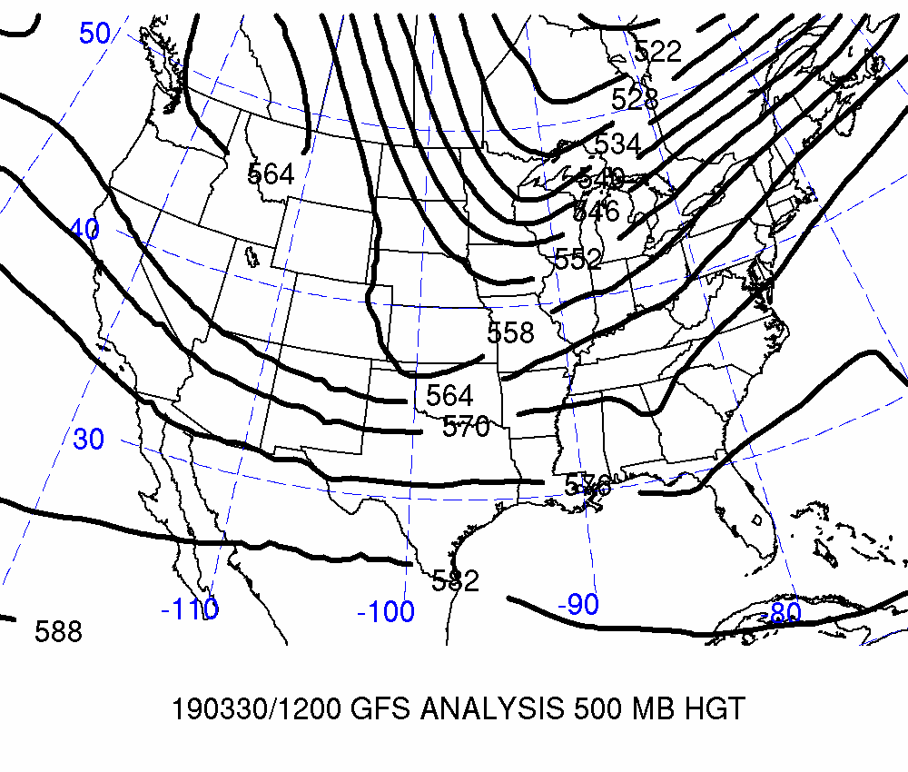
Day 9: Valid 2019-03-30 12Z
FCSTR Blend Weights (%)
TMAX / TMIN / QPF
FV3: 0% / 0% / 0%
GFS: 0% / 60% / 35%
GEFS: 0% / 0% / 0%
REFCST2: 0% / 0% / 0%
EC CTRL: 0% / 0% / 0%
ECENS: 0% / 0% / 0%
CMCE: 0% / 0% / 0%

Slide 5
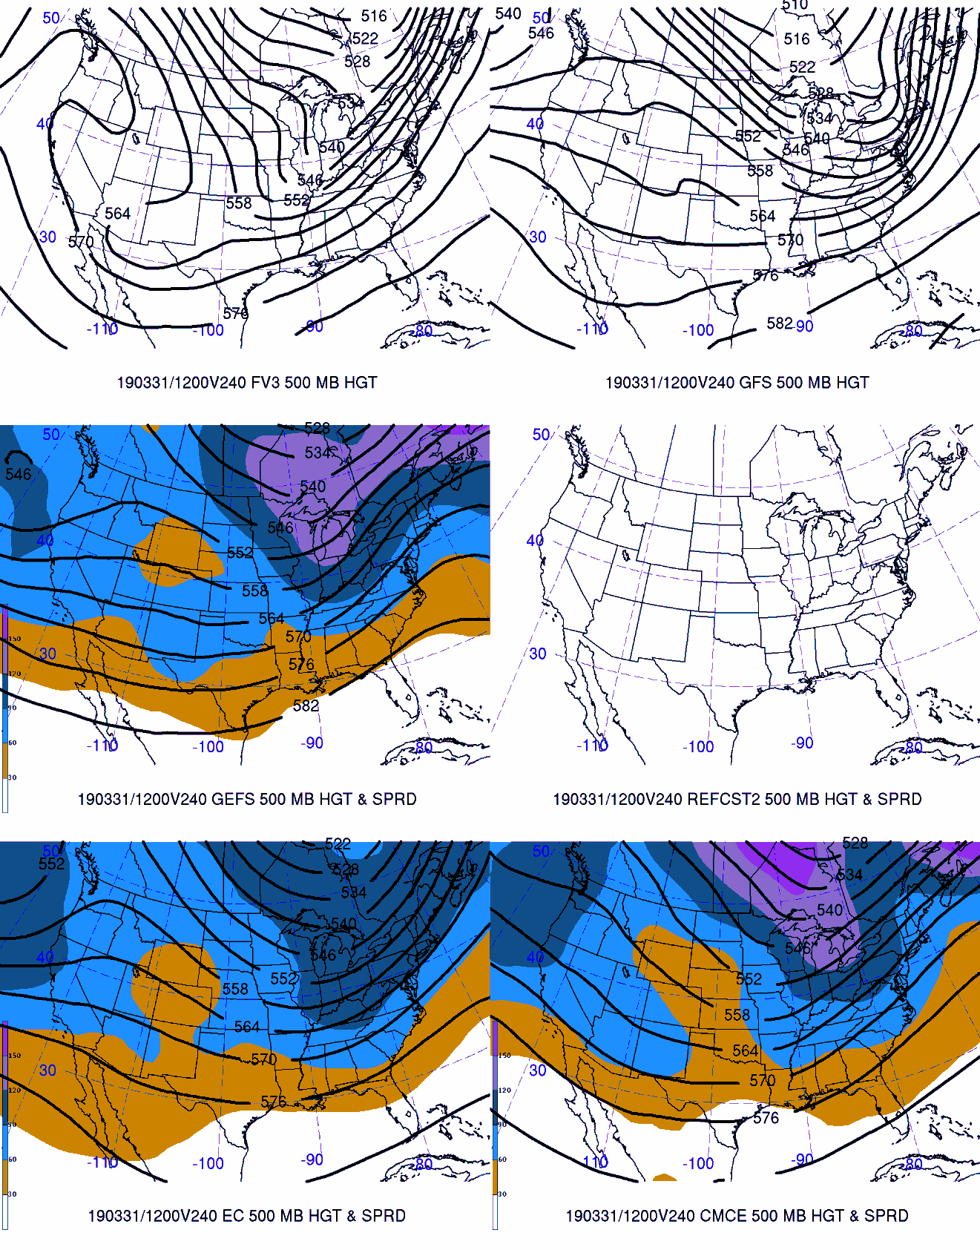
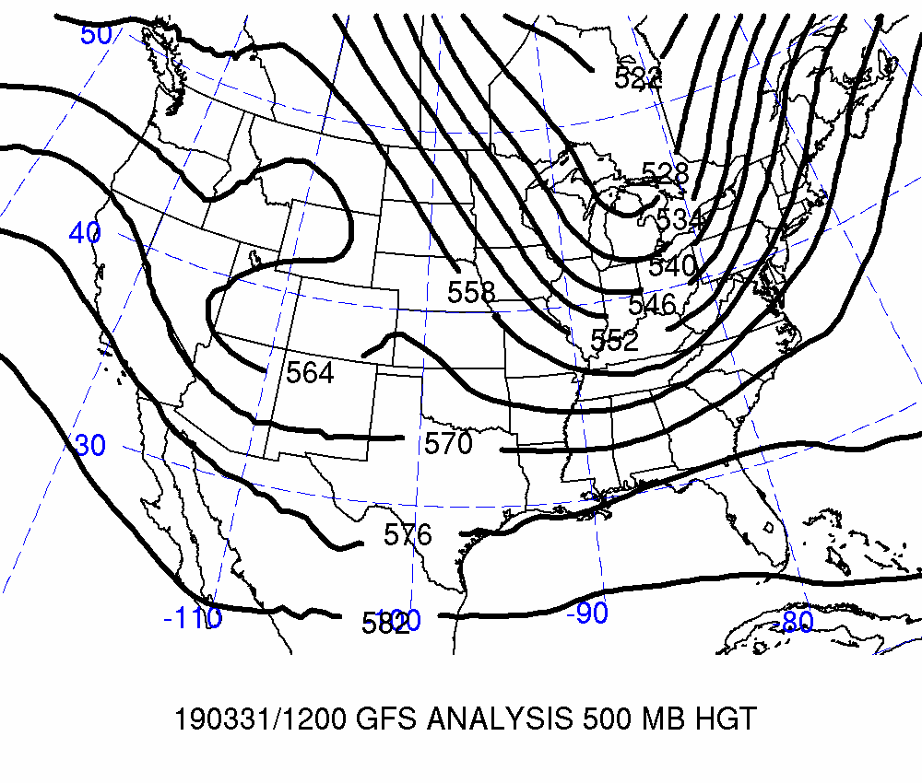
Day 10: Valid 2019-03-31 12Z
FCSTR Blend Weights (%)
TMAX / TMIN / QPF
FV3: 0% / 0% / 0%
GFS: 0% / 60% / 35%
GEFS: 0% / 0% / 0%
REFCST2: 0% / 0% / 0%
EC CTRL: 0% / 0% / 0%
ECENS: 0% / 0% / 0%
CMCE: 0% / 0% / 0%

Slide 6
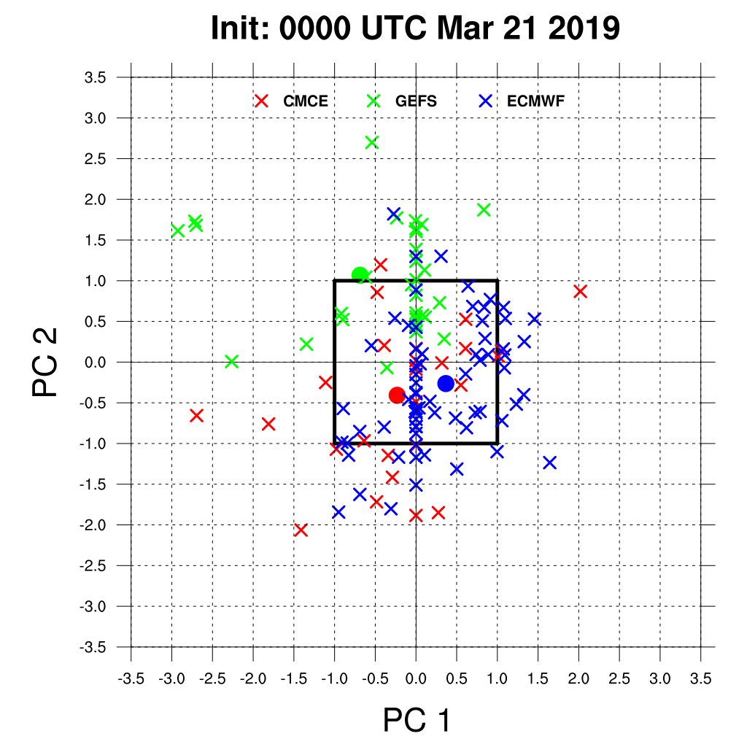
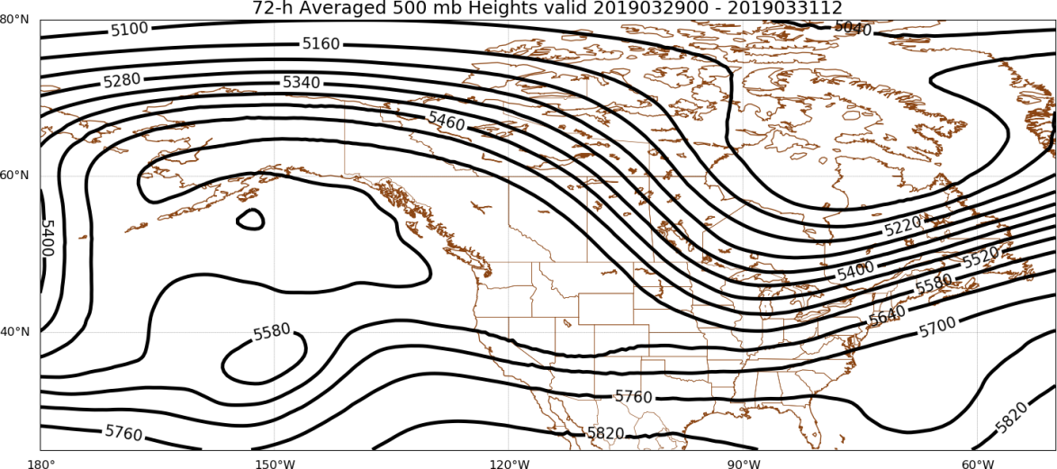
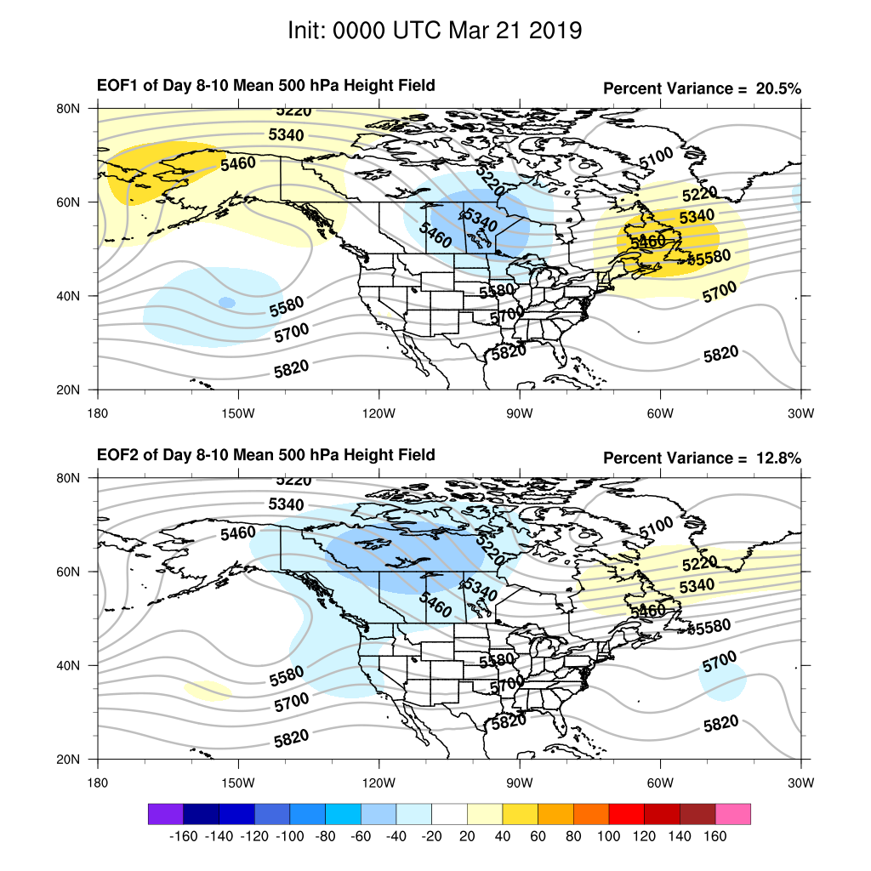
Days 8–10
FCSTR Blend Weights (%): TMAX / TMIN / QPF
EOF1P: 70% / 0% / 0%
EOF1N: 0% / 0% / 0%
EOFMN: 30% / 40% / 65%
GFS Analysis
EOF2P: 0% / 0% / 0%
EOF2N: 0% / 0% / 0%

Slide 7
Maximum Temperature | TMAX

Slide 8
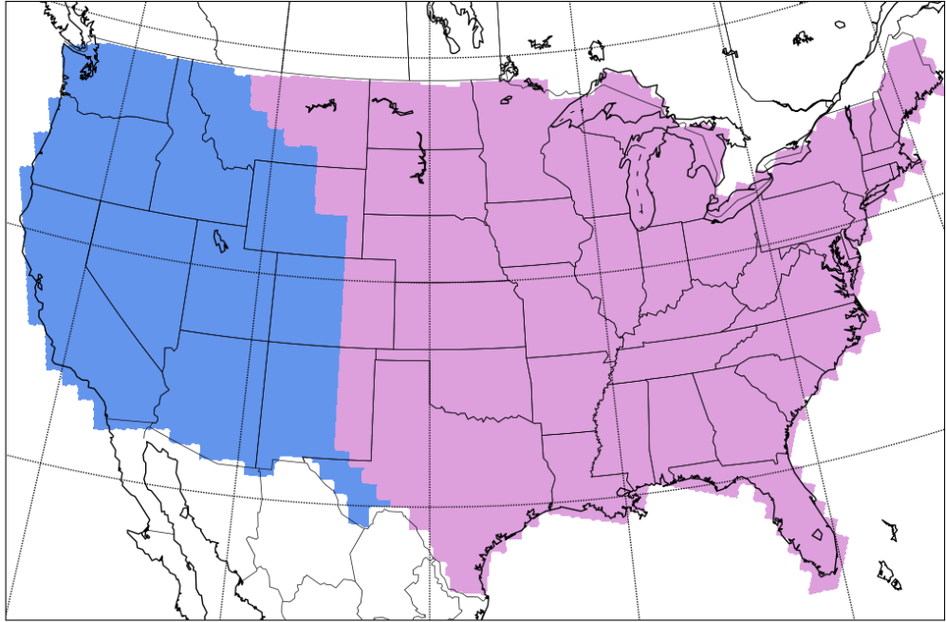
Separation of Western & Eastern CONUS
West
East
West
East

Slide 9
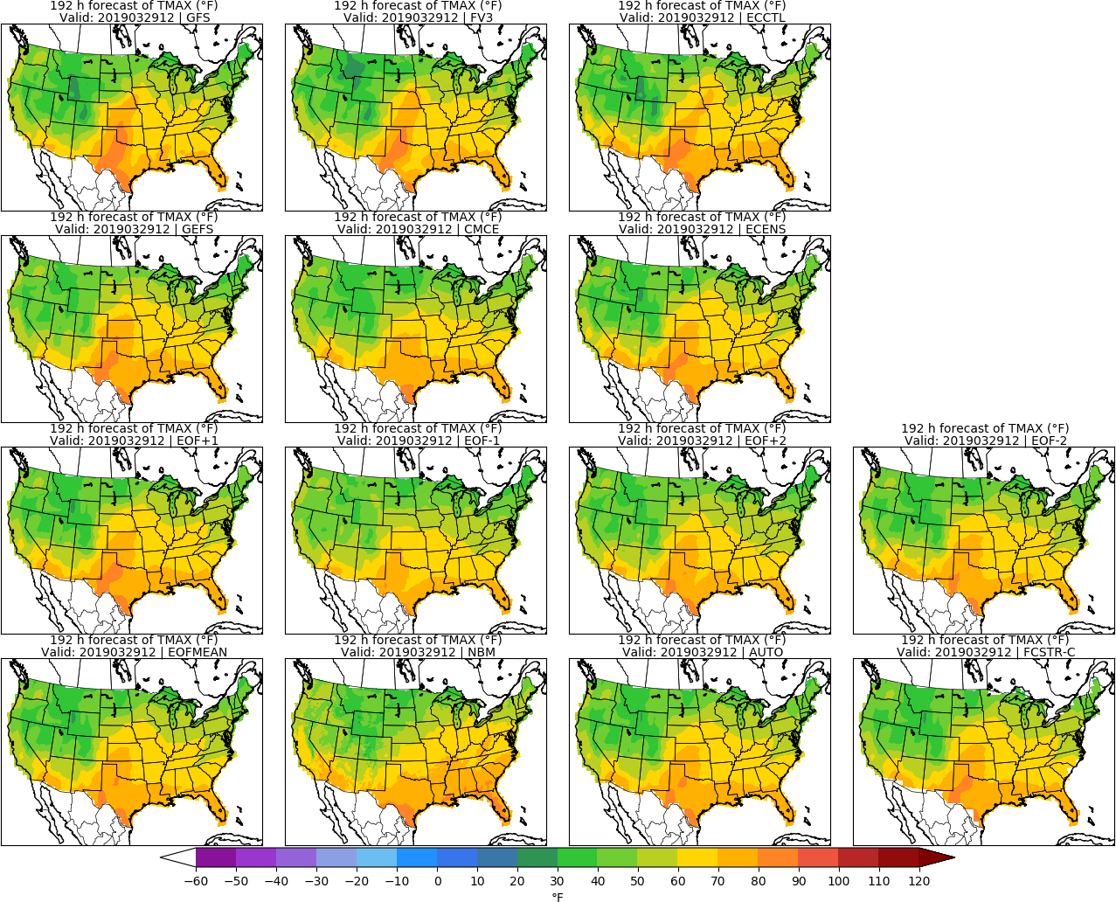
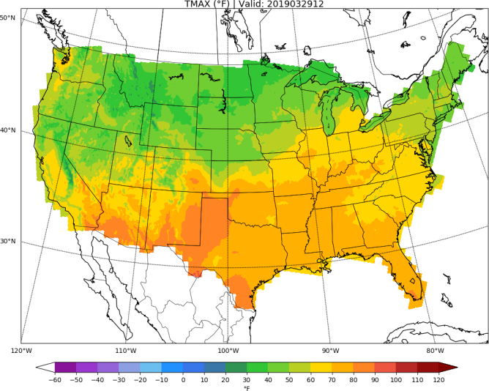
Day 8: TMAX
URMA

Slide 10
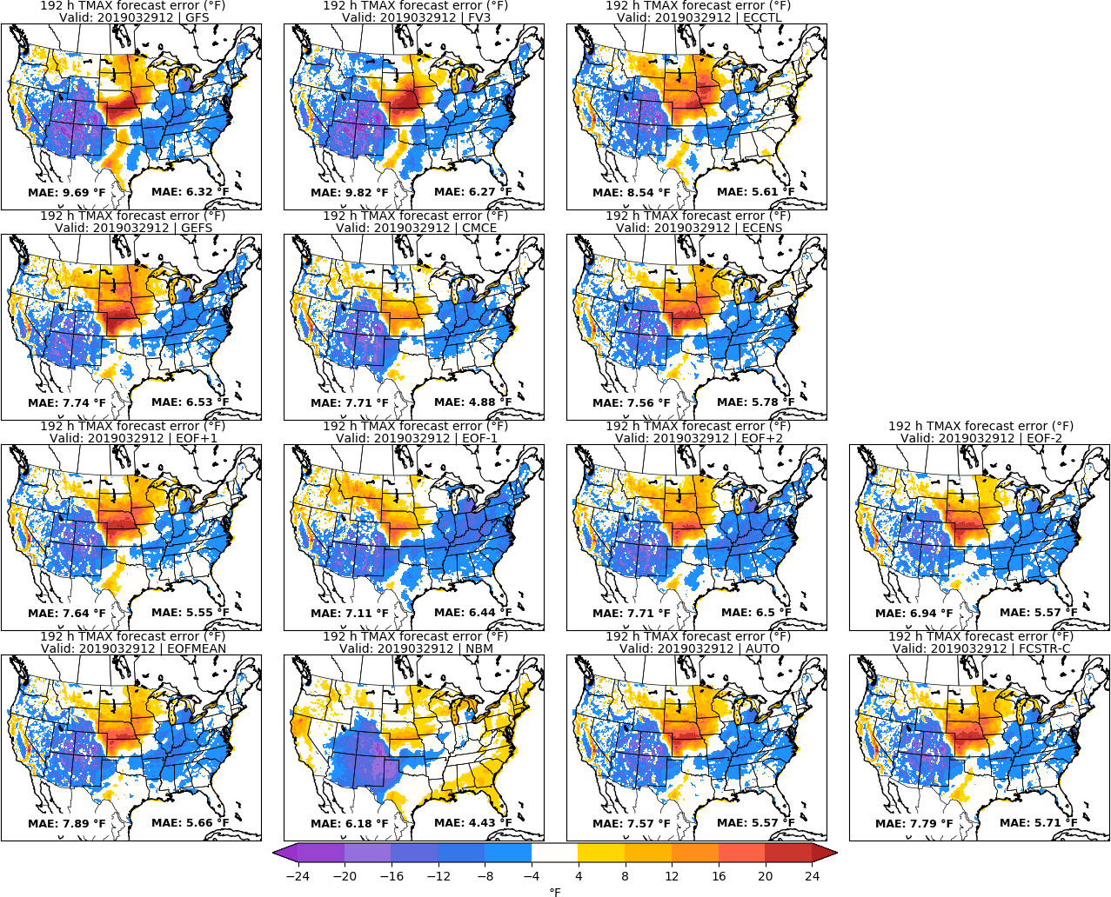
Day 8: TMAX
URMA

Slide 11
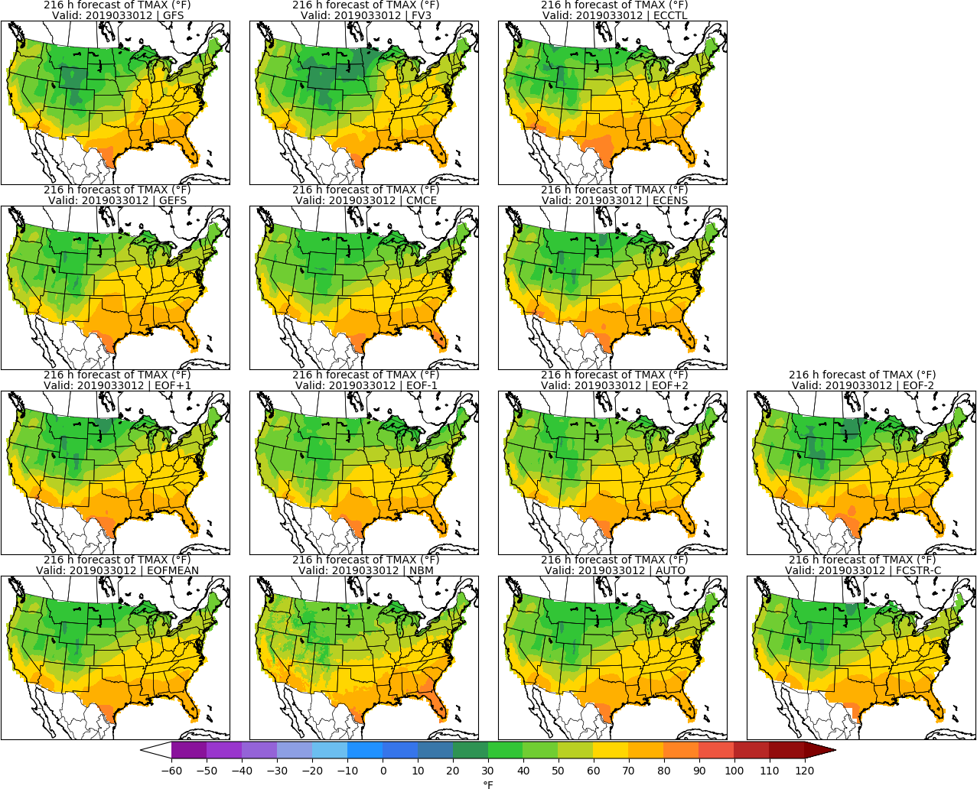
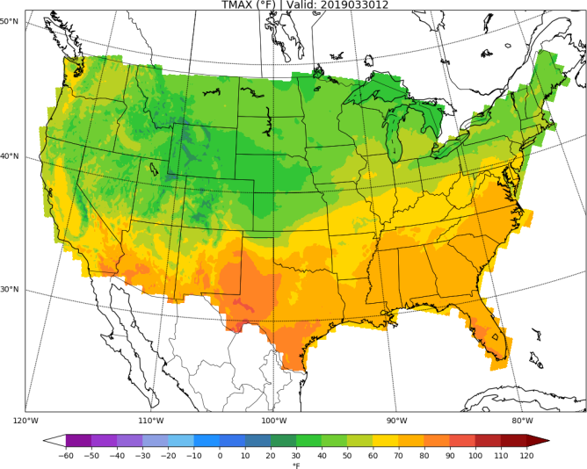
Day 9: TMAX
URMA

Slide 12
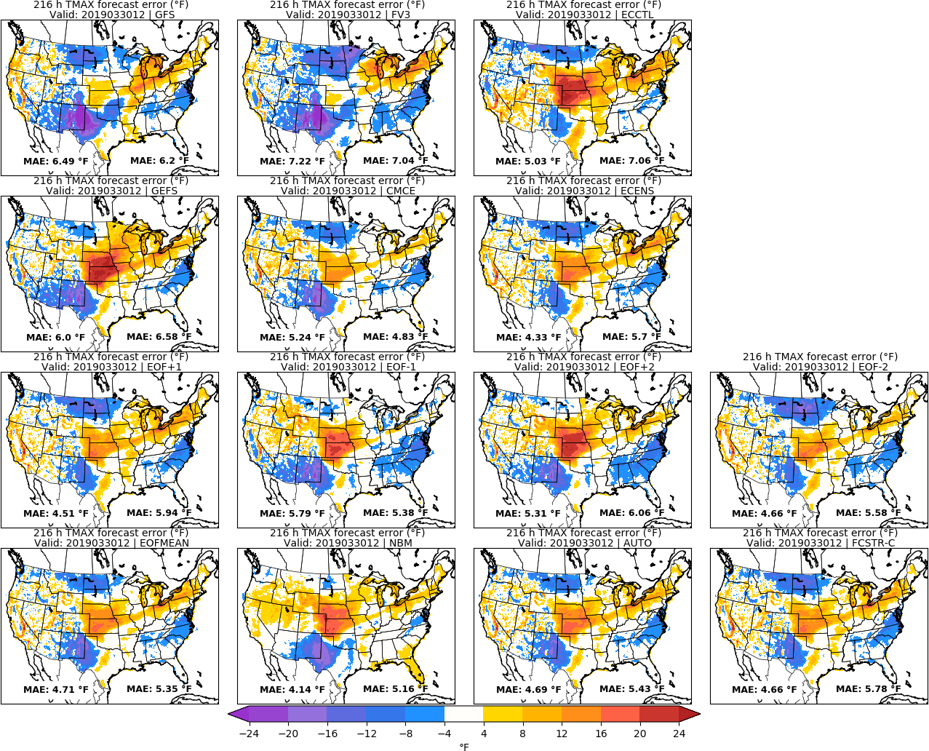
Day 9: TMAX
URMA

Slide 13
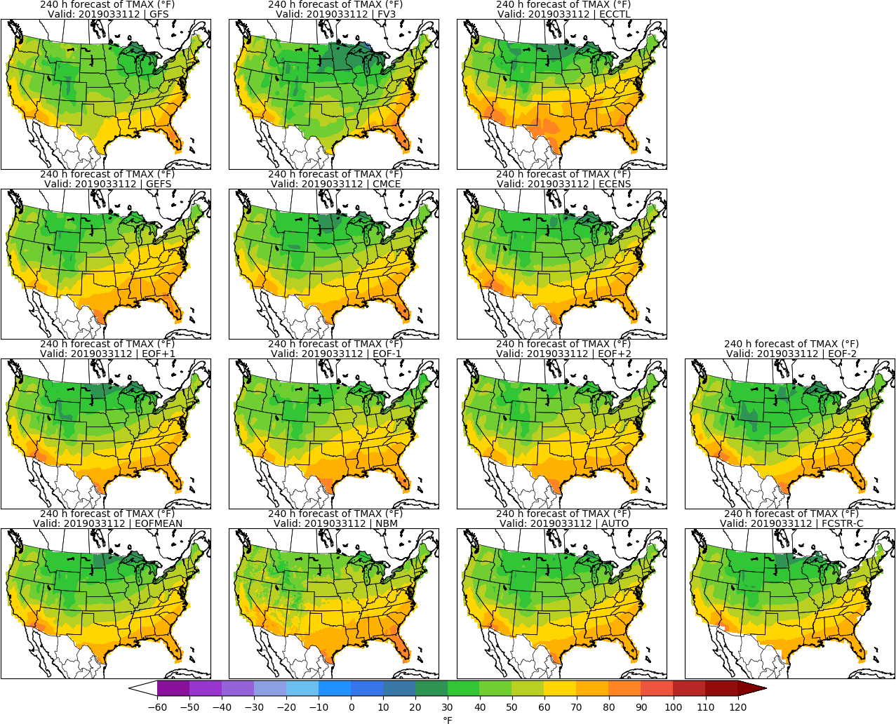
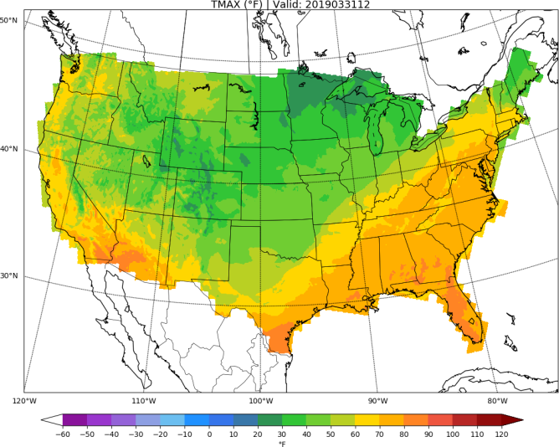
Day 10: TMAX
URMA

Slide 14
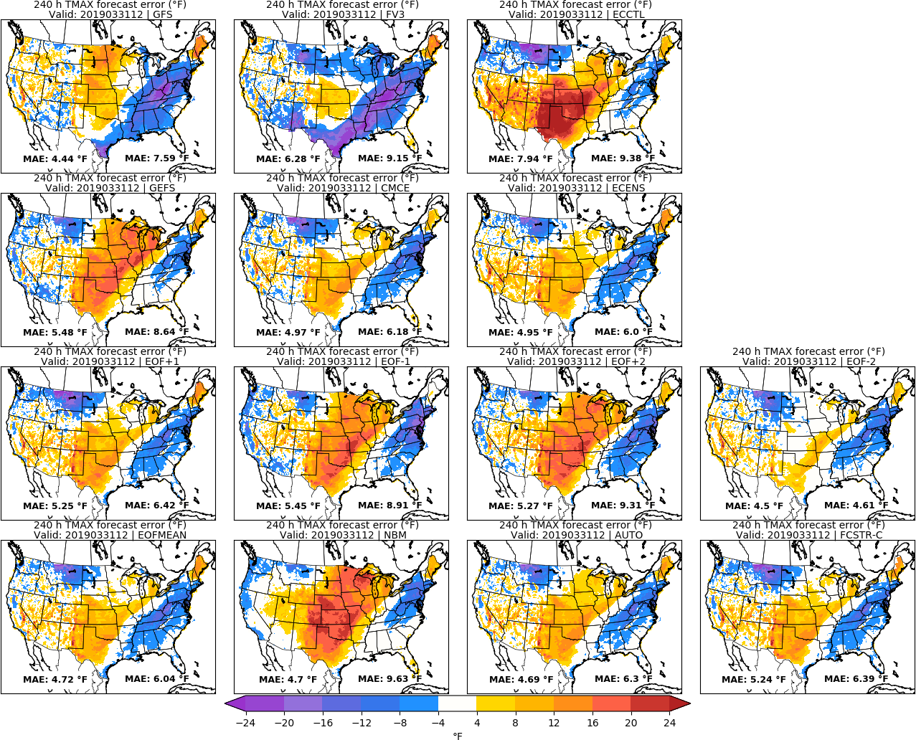
Day 10: TMAX
URMA

Slide 15
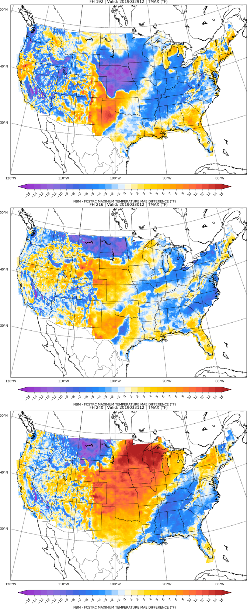
NBM vs FCSTR-C
Blend Comparison
Day 8
MAE_{NBM} – MAE_{FCSTRC} } > 0 is FCSTRC
improvement
over NBM
Day 9
FCSTRC Worse
FCSTRC Better
Day 10

Slide 16
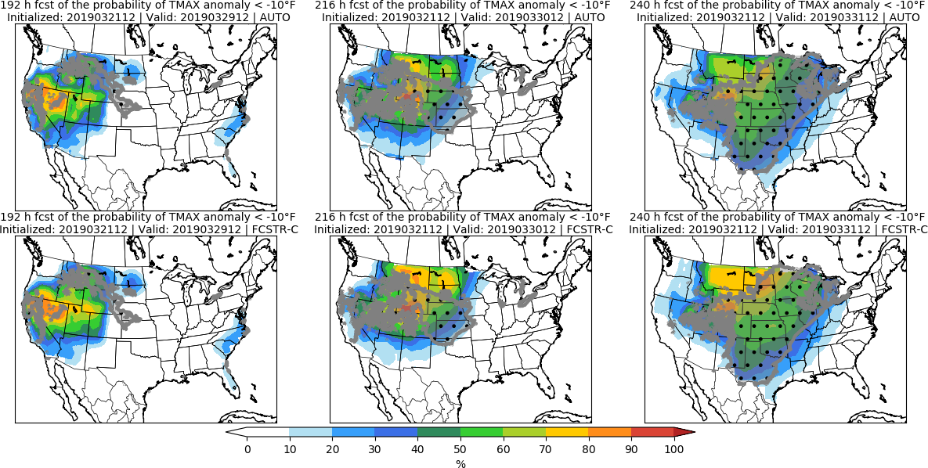
Day 8 Day 9 Day 10

Slide 17
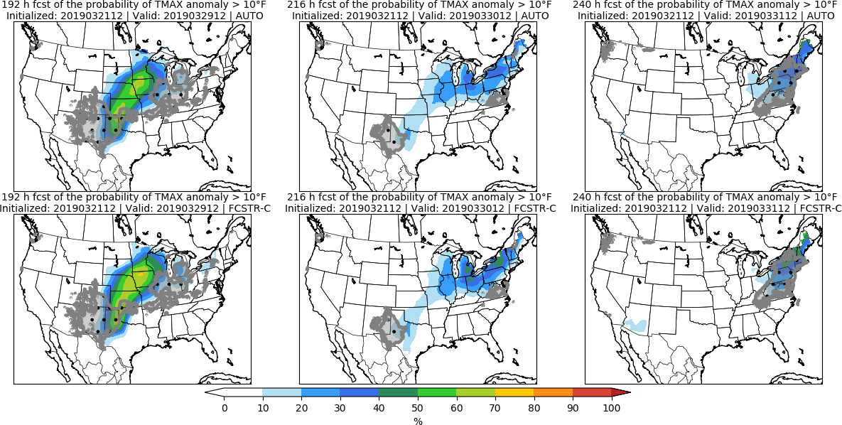
Day 8 Day 9 Day 10

Slide 18
Minimum Temperature | TMIN

Slide 19
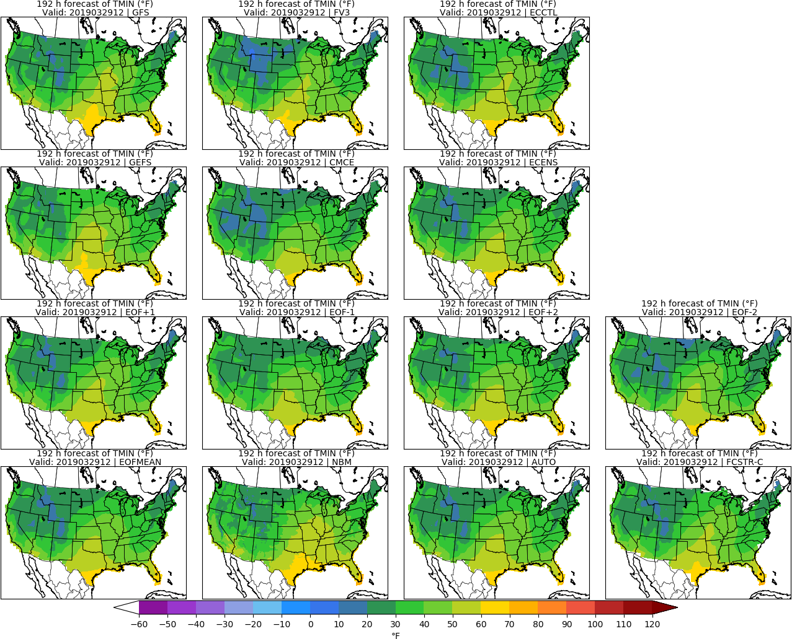
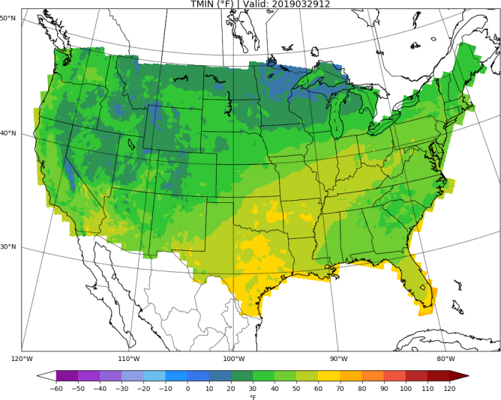
Day 8: TMIN
URMA

Slide 20
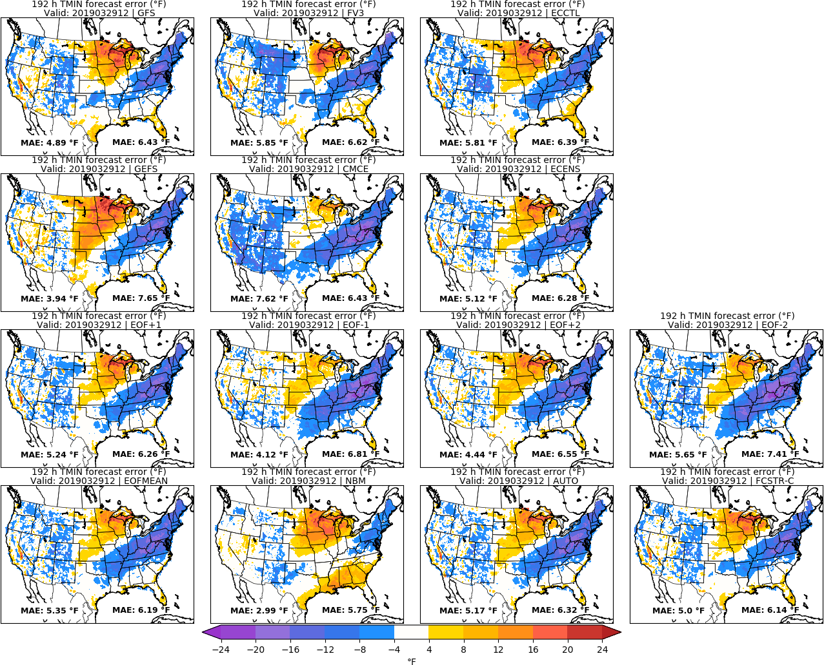
Day 8: TMIN
URMA

Slide 21
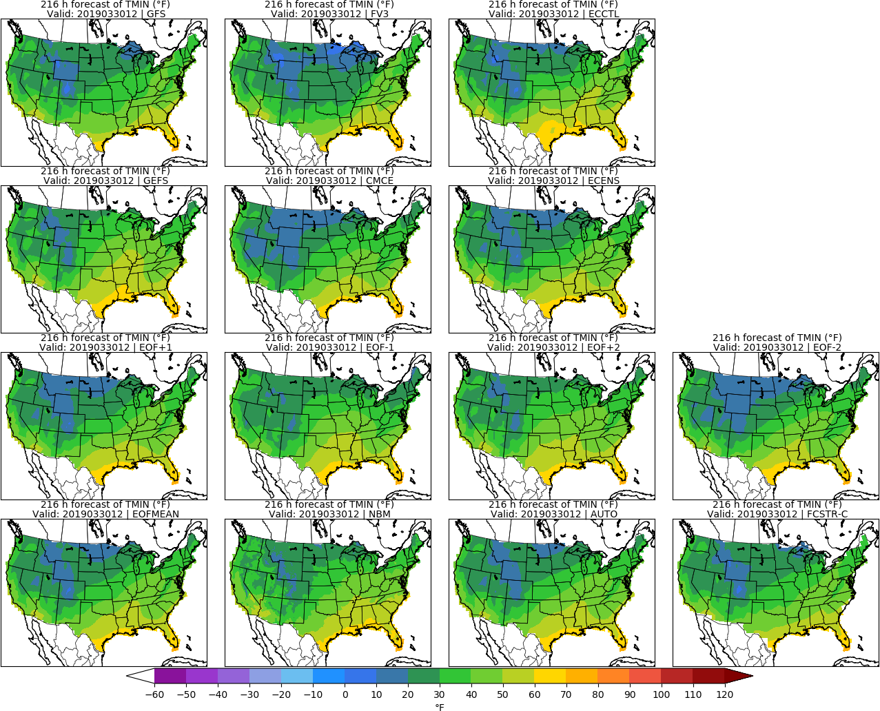
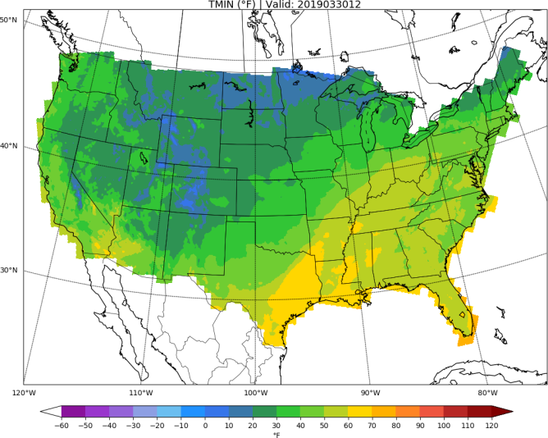
Day 9: TMIN
URMA

Slide 22
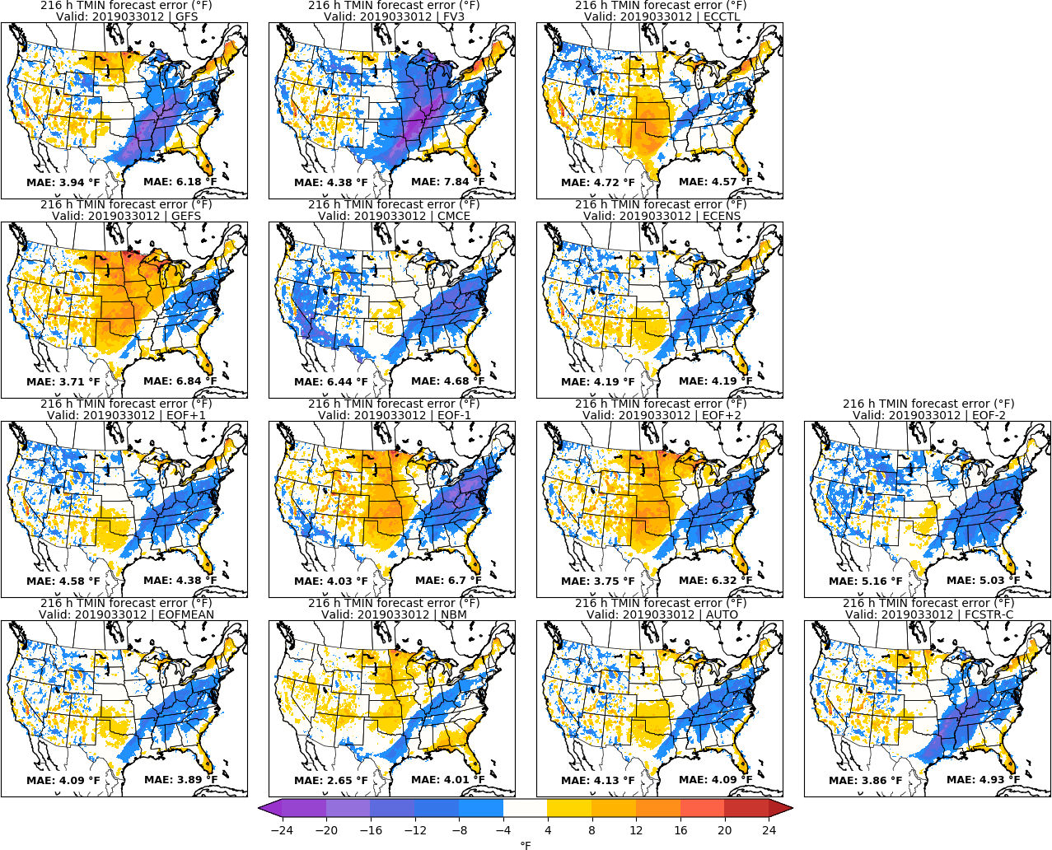
Day 9: TMIN
URMA

Slide 23
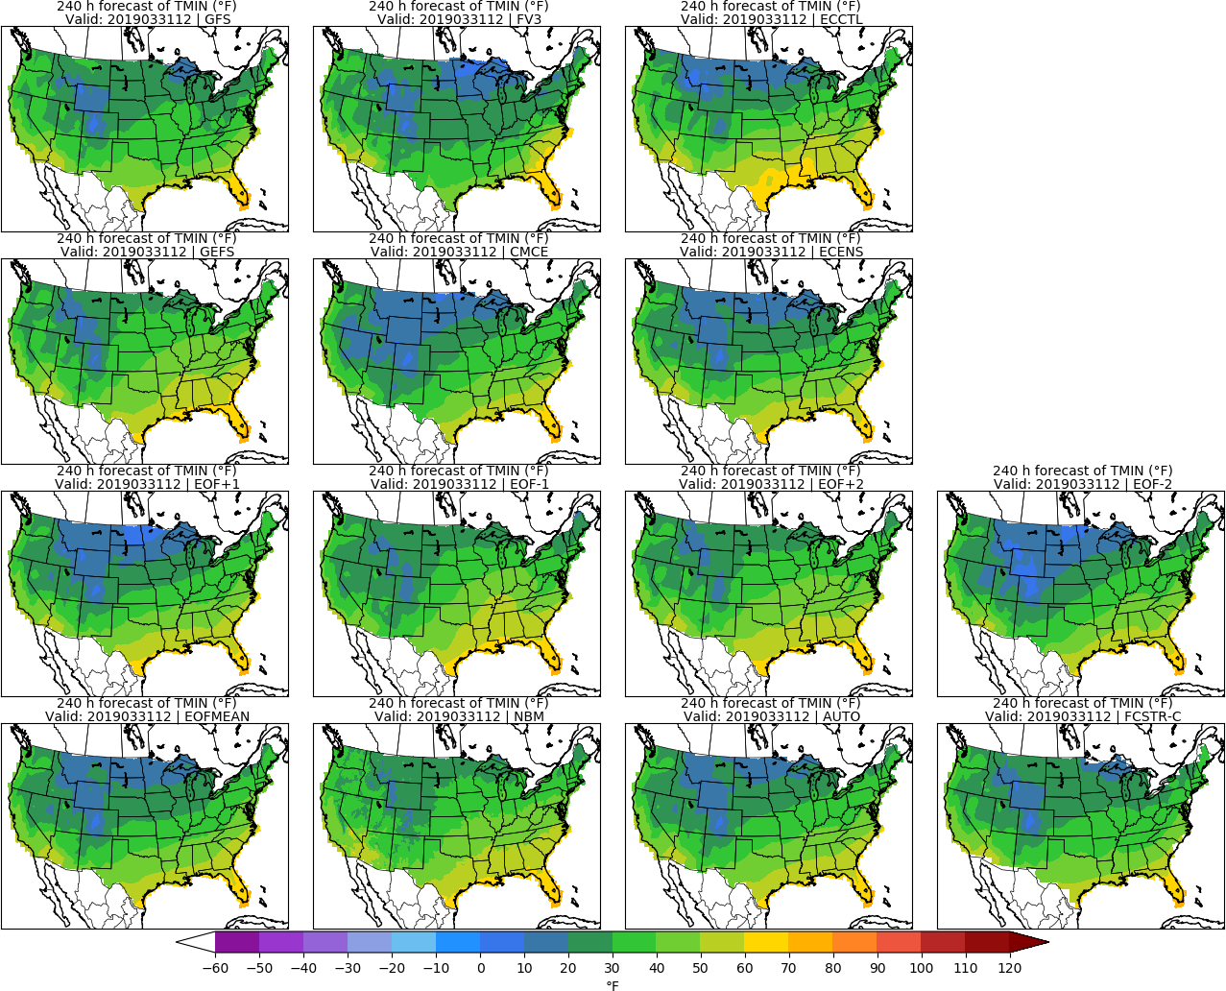
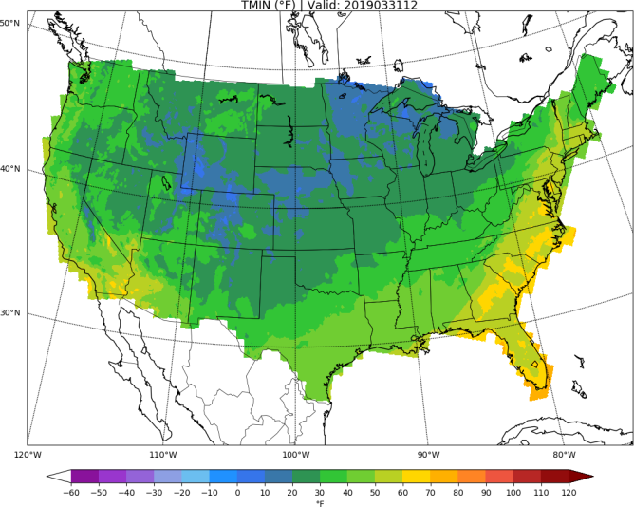
Day 10: TMIN
URMA

Slide 24
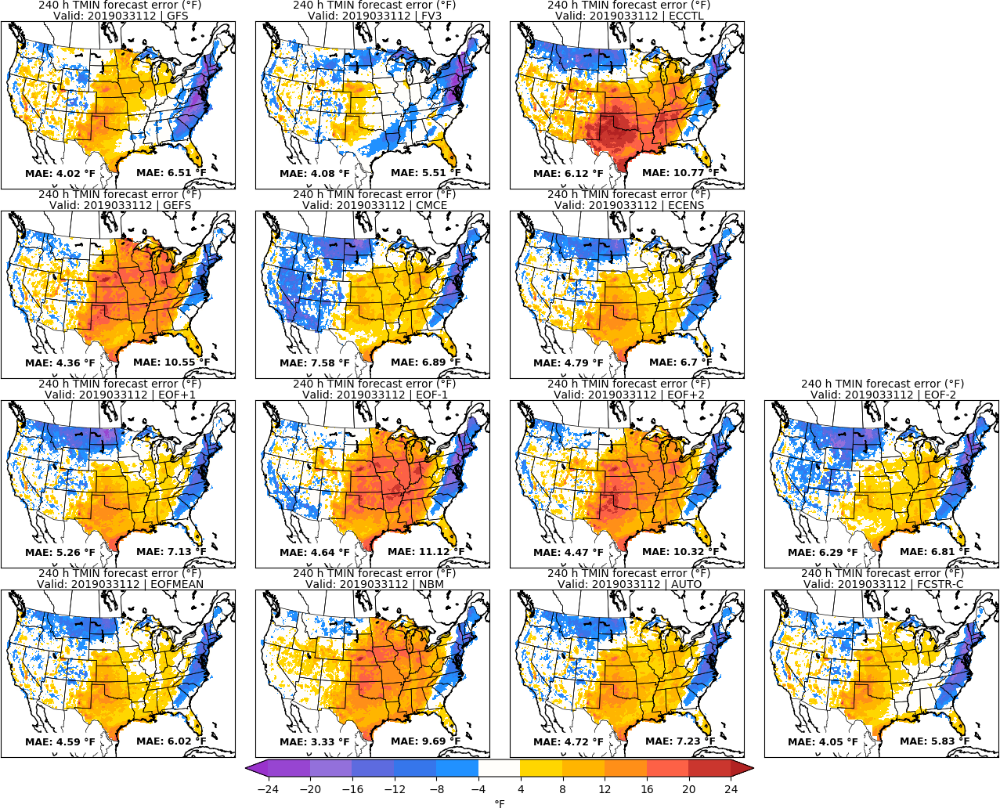
Day 10: TMIN
URMA

Slide 25
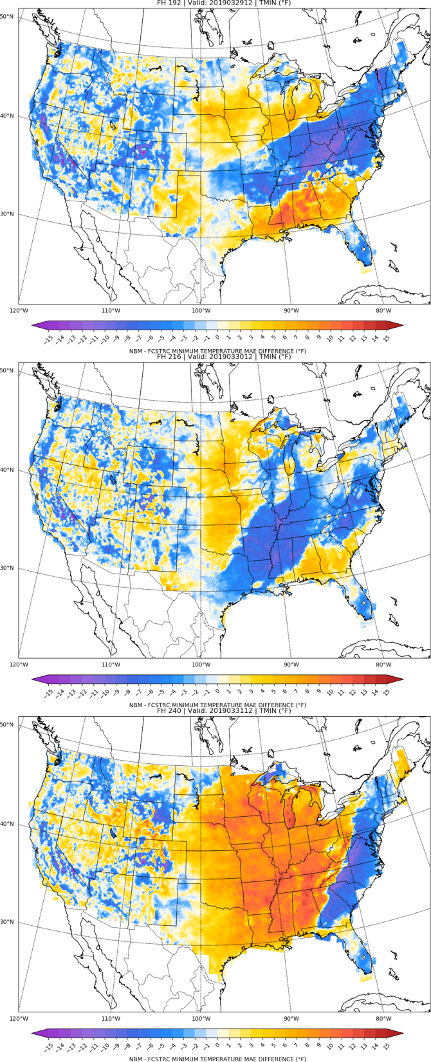
NBM vs FCSTR-C
Blend Comparison
Day 8
MAE_{NBM} – MAE_{FCSTRC} } > 0 is FCSTRC
improvement
over NBM
Day 9
FCSTRC Worse
FCSTRC Better
Day 10

Slide 26
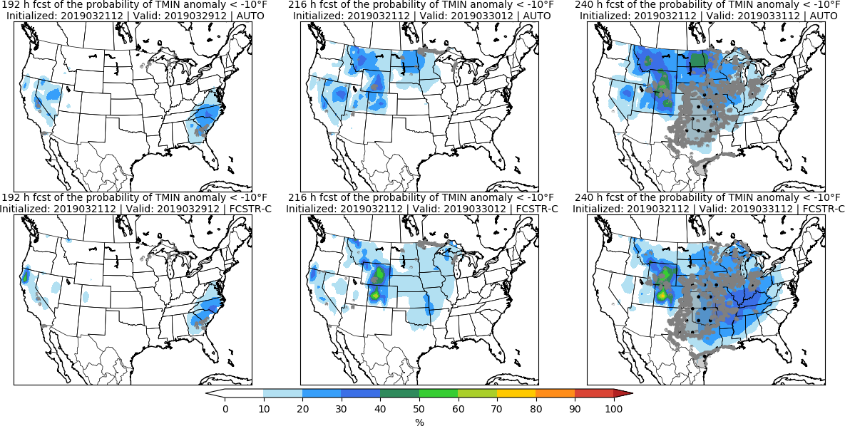
Day 8 Day 9 Day 10

Slide 27
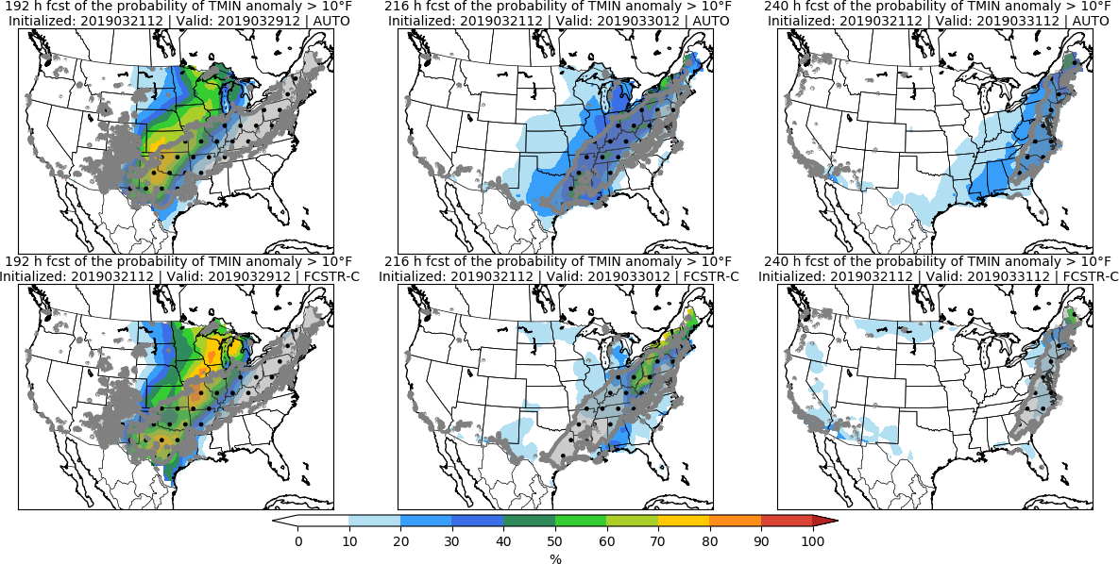
Day 8 Day 9 Day 10

Slide 28
Accumulated Precipitation | APCP

Slide 29
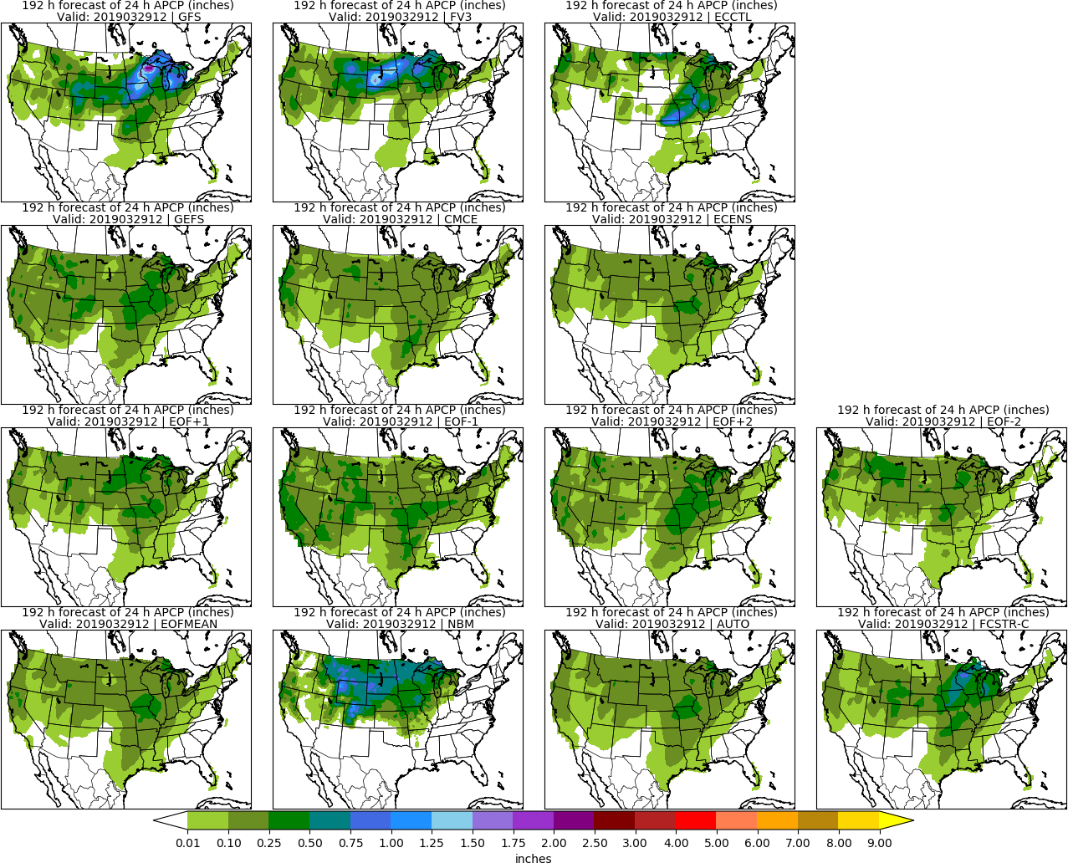
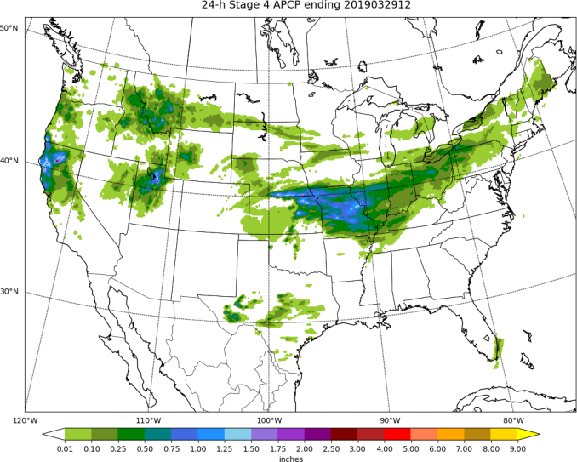
Day 8: APCP
STAGE 4

Slide 30
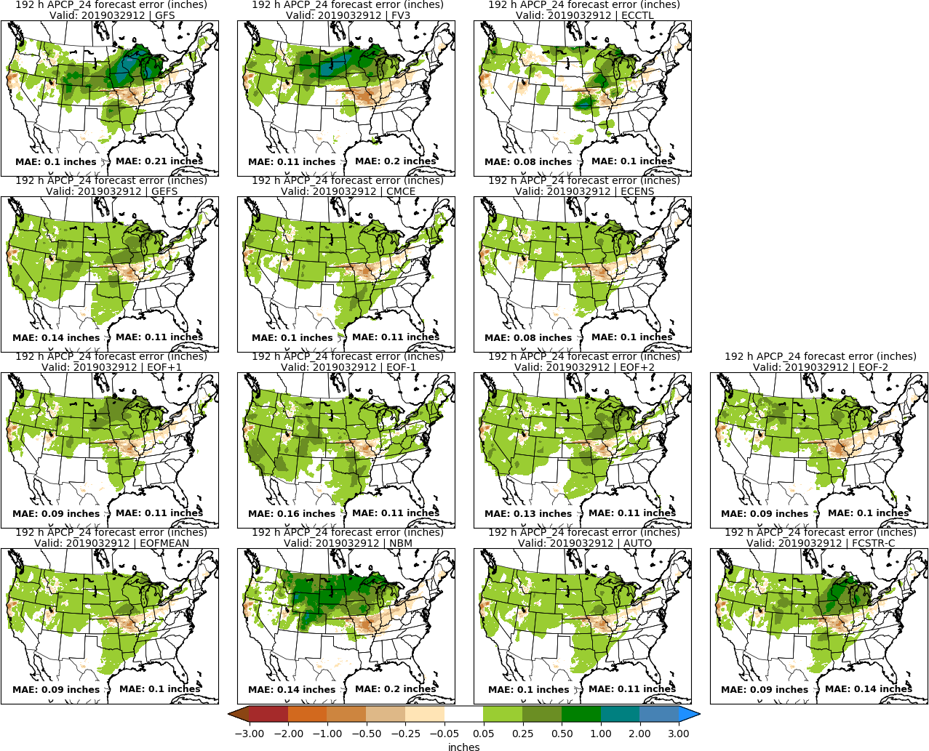
Day 8: APCP
STAGE 4

Slide 31
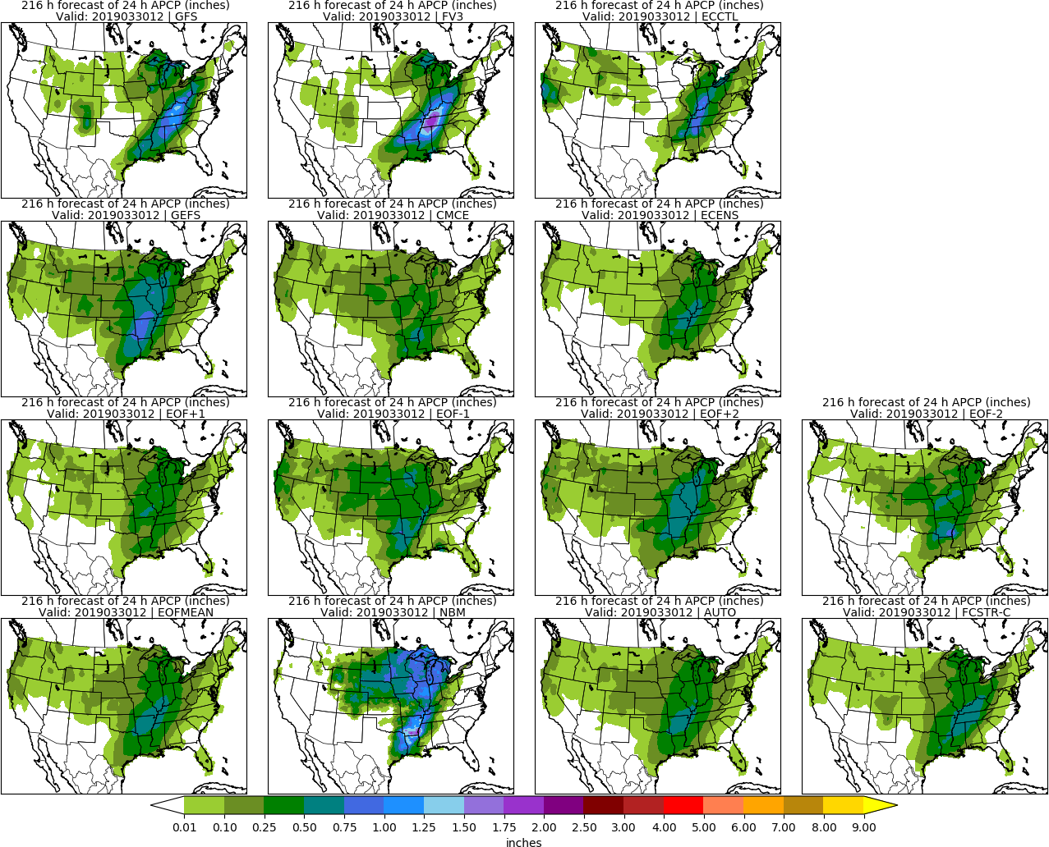
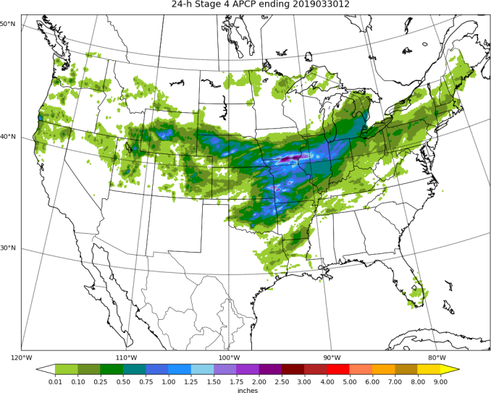
Day 9: APCP
STAGE 4

Slide 32
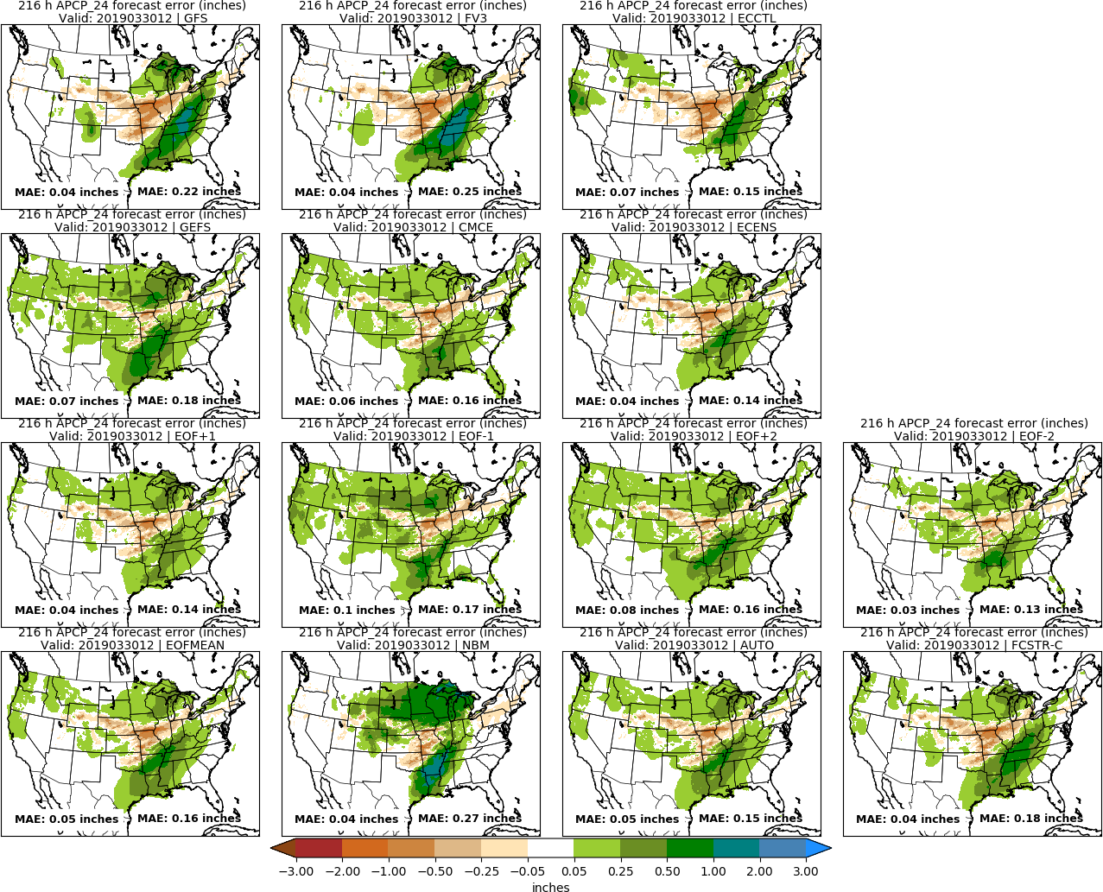
Day 9: APCP
STAGE 4

Slide 33
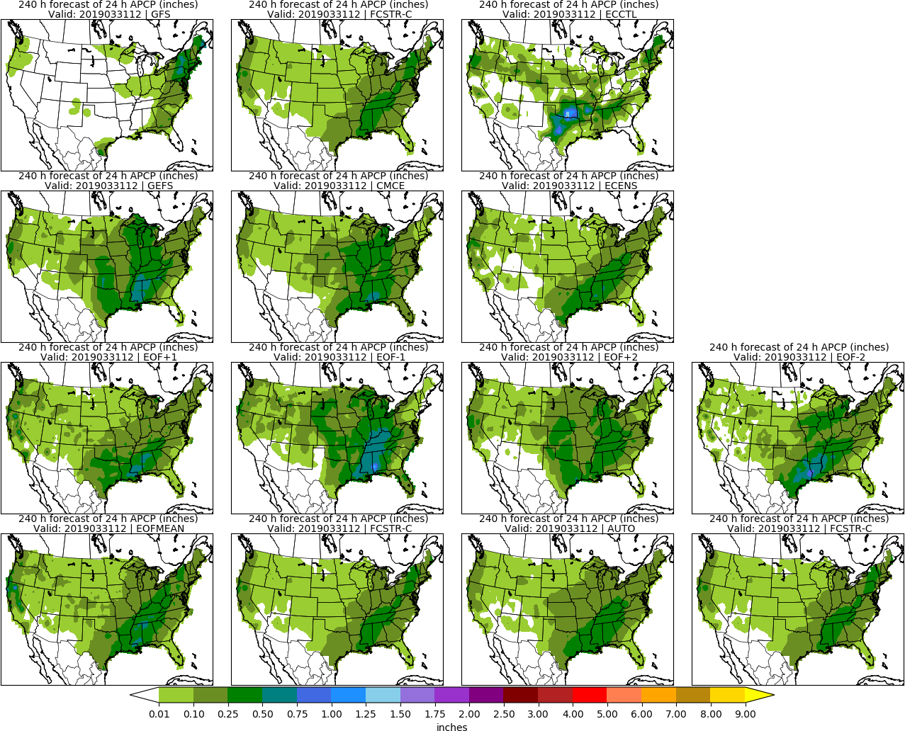
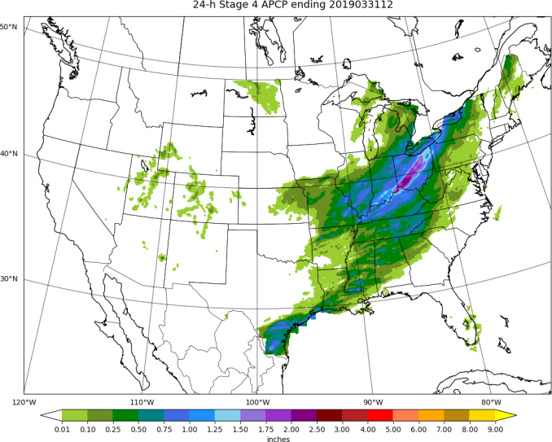
Day 10: APCP
STAGE 4

Slide 34
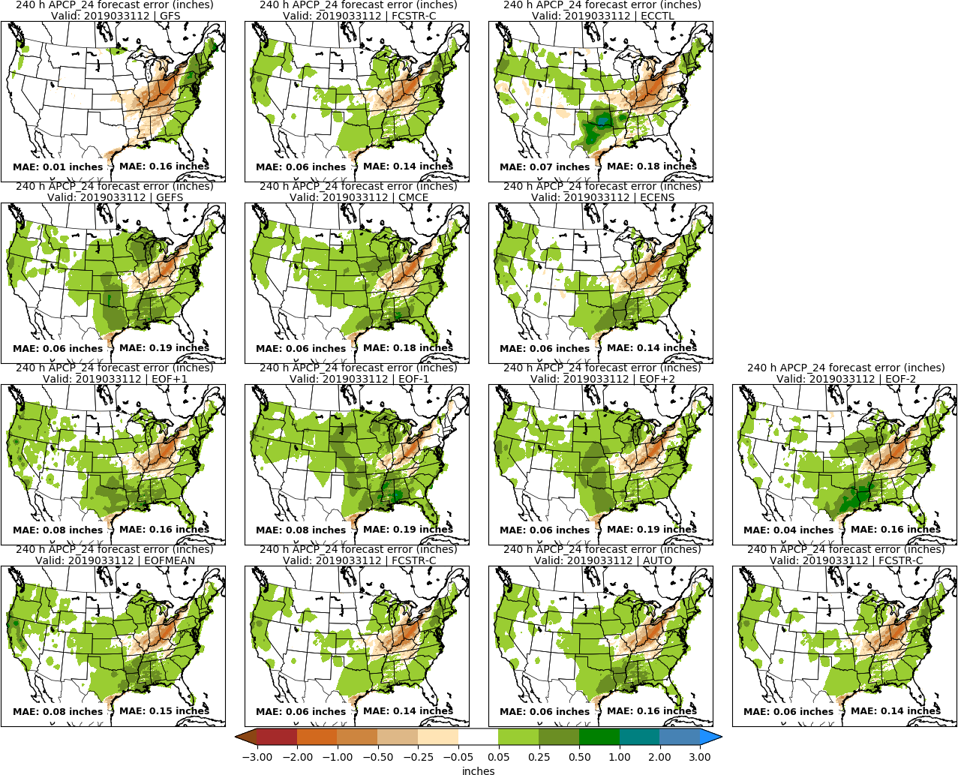
Day 10: APCP
STAGE 4

Slide 35
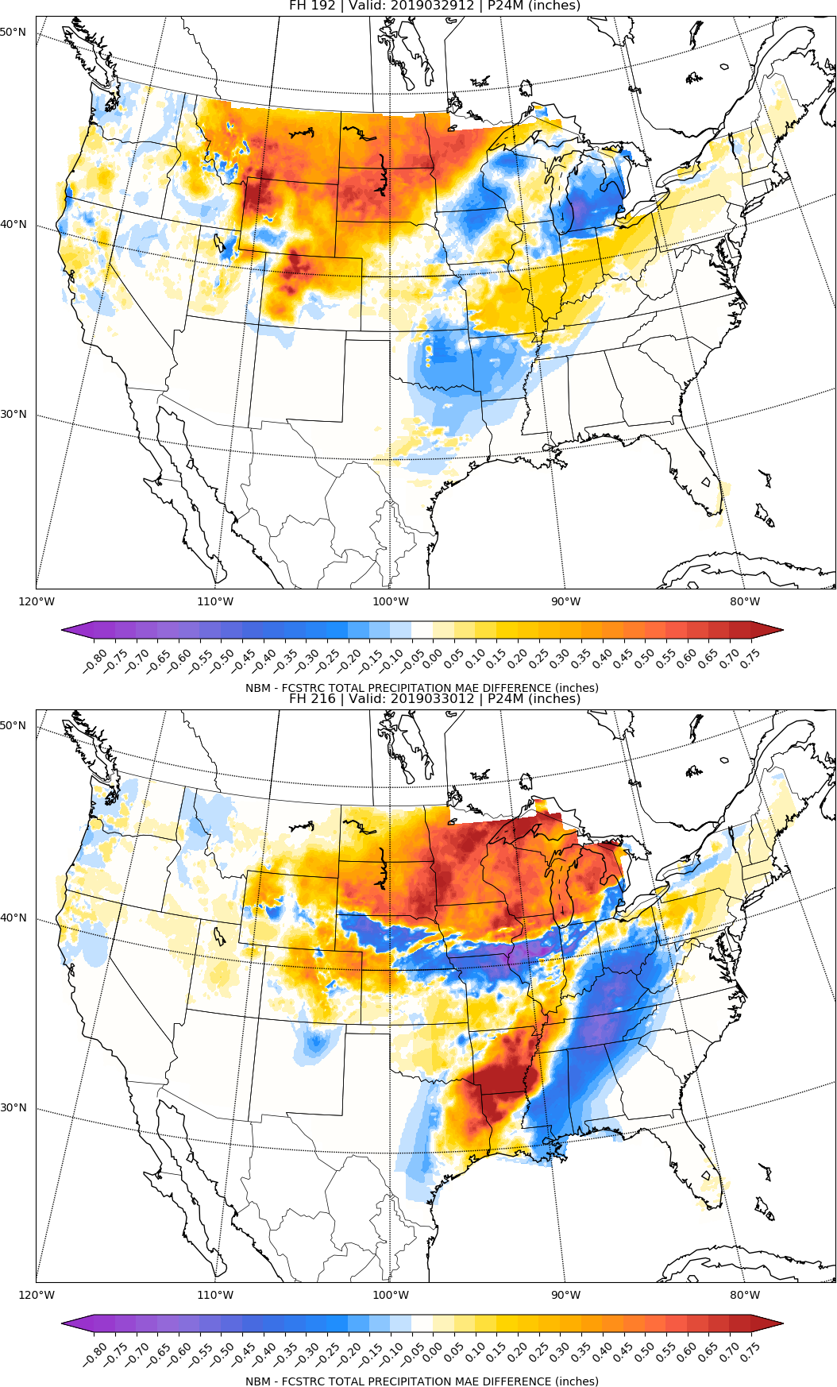
NBM vs FCSTR-C
Blend Comparison
Day 8
MAE_{NBM} – MAE_{FCSTRC} } > 0 is FCSTRC
improvement
over NBM
Day 9
FCSTRC Worse
FCSTRC Better

Slide 36
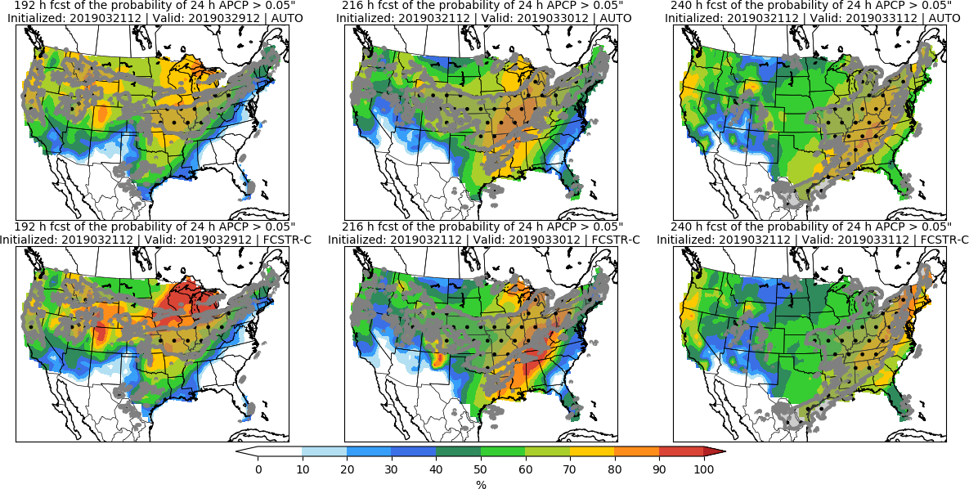
Day 8 Day 9 Day 10

Slide 37
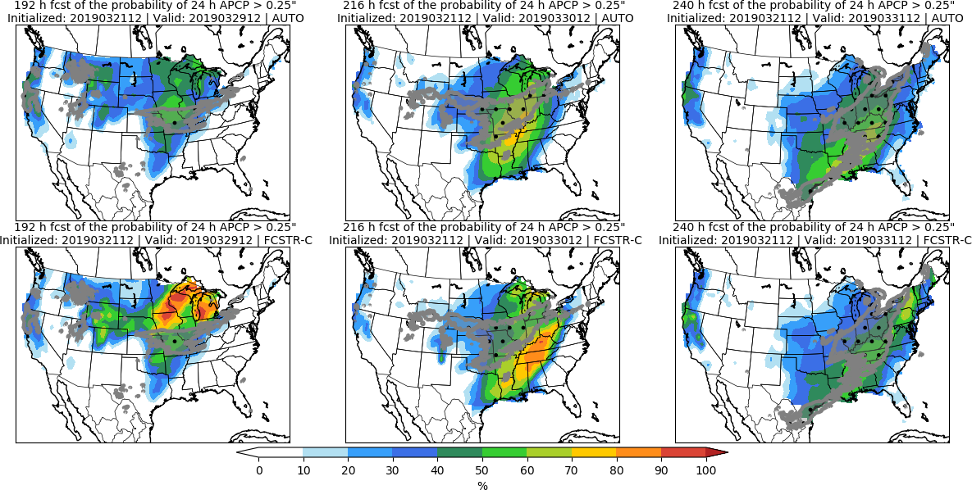
Day 8 Day 9 Day 10

Slide 38
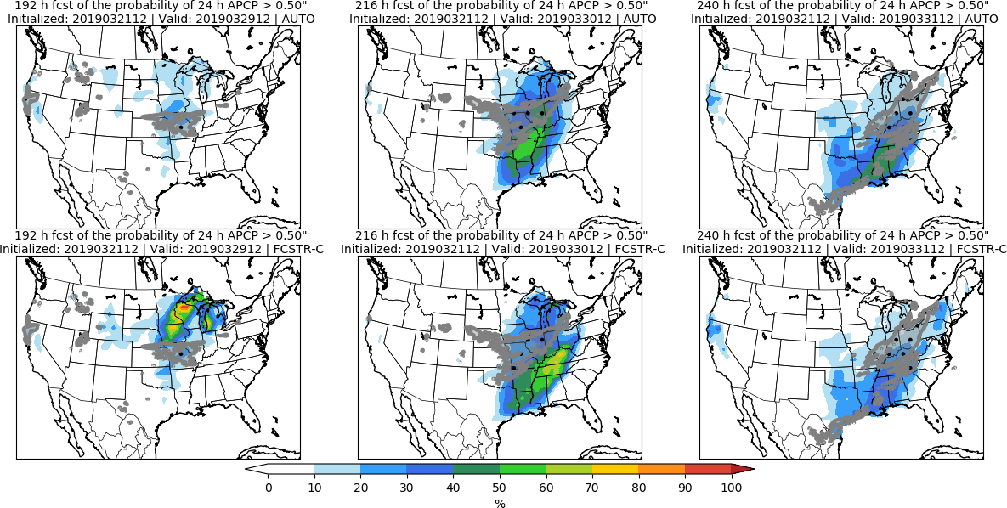
Day 8 Day 9 Day 10

Slide 39
Day 8–10 Hazards

Slide 40
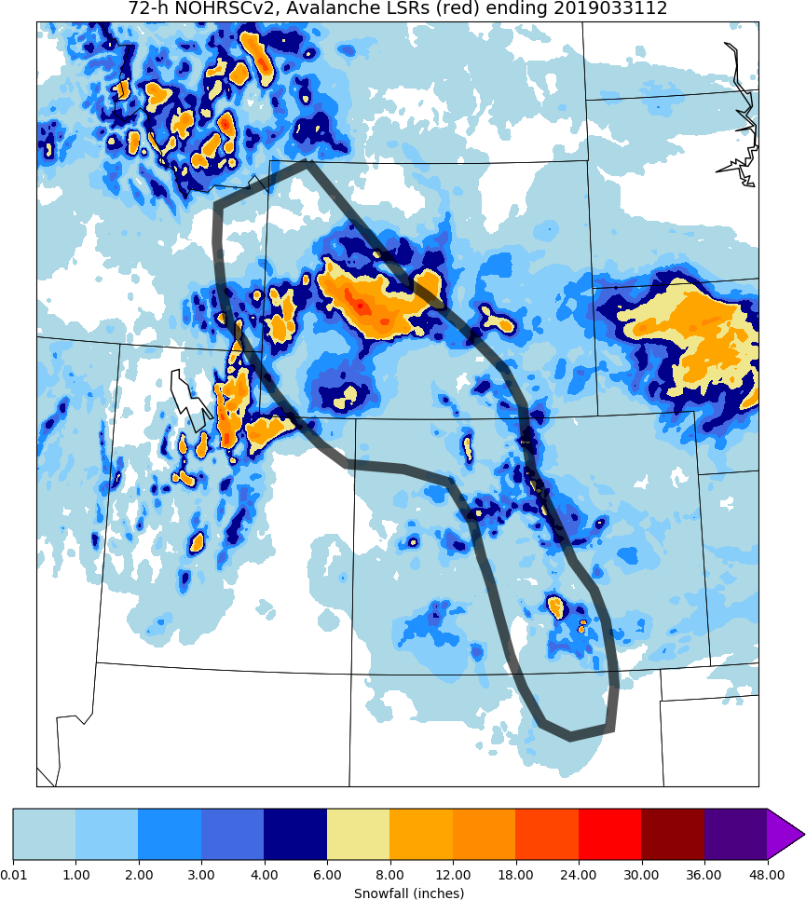
Day 8–10 Hazards: Hazard #1
LSRs
• Avalanche
Days 8-10
Chance for avalanches from heavy, wet snow

Slide 41
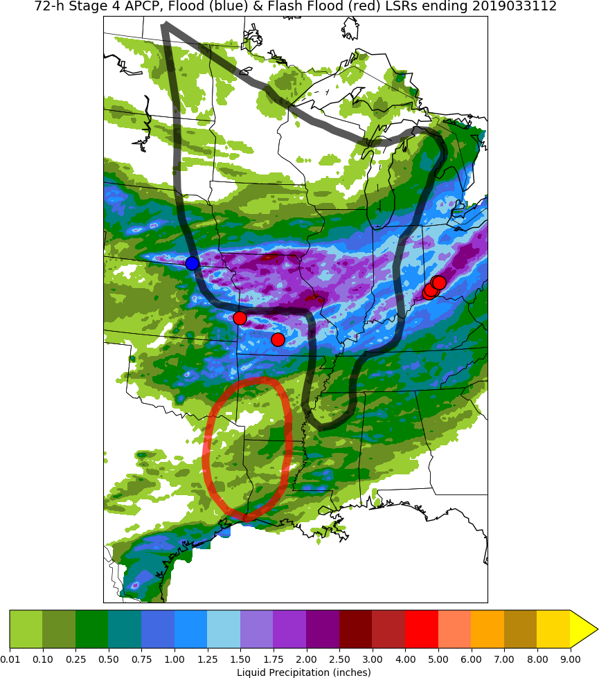
Day 8–10 Hazards: Hazard #2
LSRs
• FLOOD
• FLASH FLOOD
Days 8-10
Chance for flooding and flash flooding

Slide 42
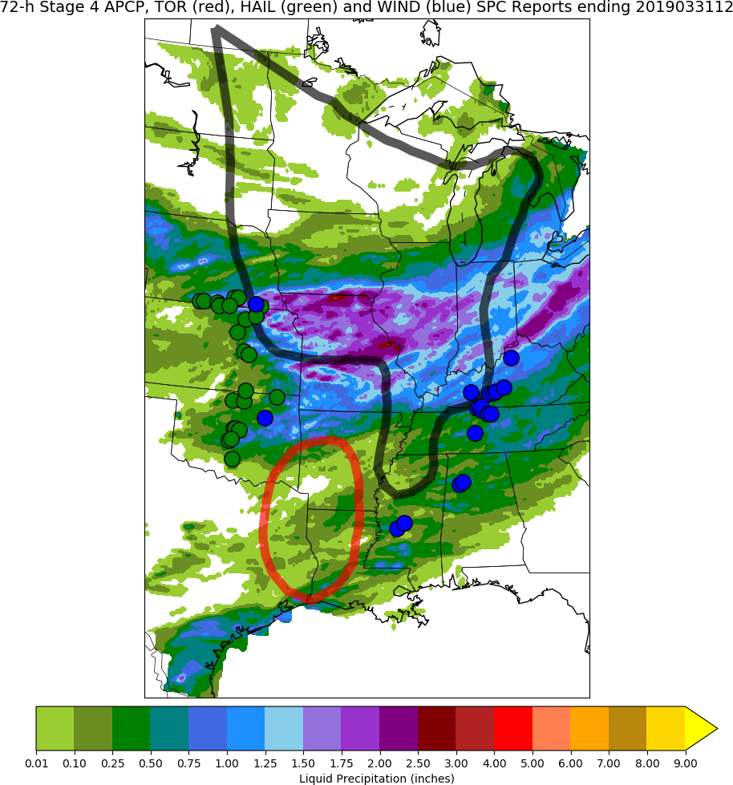
Day 8–10 Hazards: Hazard #3
SPC Reports
• TOR
• WIND
• HAIL
Day 8 (or 9 or 10)
Chance for isolated severe weather

